Slide 1
Whither Web Programming
Gilad Bracha
Google

Slide 2
Caveat
I am not speaking for Google here.

Slide 3
Web Platform Strengths
Ubiquity
Zero-install

Slide 4
Web Platform Strengths
Always Available
Notes:
Ubiquity put another way

Slide 5
Web Platform Strengths
Always Available
Always Up to Date
Notes:
Zero install

Slide 6
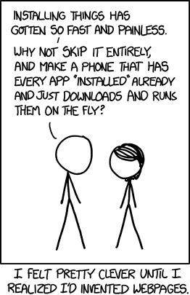
Ask xkcd:

Slide 7
Caveat Emptor
Always Available
- except when it’s not

Slide 8
Web Platform Weaknesses
Offline use
Network may be flakey, slow, costly or non-existent
Lacking a good mechanism for storing programs

Slide 9
Web Platform Weaknesses
Restricted choice of viable programming languages
Hard to implement alternative languages efficiently
Lacking necessary primitives
Lacking a good mechanism for storing programs (again!)
Notes:
No platform can remain monolingual for an extended period. We will see a repeat of what happened in Java-land: people grow tired of the limitations of the native language, and an explosion of alternatives grows on top.

Slide 10
God made the Integers, all the rest is man’s work
-- Leopold Kronecker
Notes:
What then, do you make of a programming language without integers? It lacks the divine spark?

Slide 11
Programming Language Issues
Integers
Stack Access
Weak References/Weak Arrays
Object Privacy
Concurrency

Slide 12
Let there be Hope
The web platform has another strength:
Openness

Slide 13
Let there be Hope
Openness leads to diversity
People are doing cool language work against the odds.

Slide 14
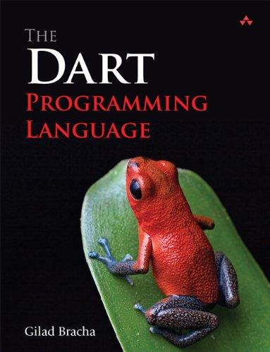
Notes:
Why is this book not out yet? Because the mirrors chapter isn’t ready, because mirrors are in flux, because reflection makes apps big, and the web is super sensitive to that because it has no model for storing applications

Slide 15
Try Dart
A playground for Dart programming, including a full Dart compiler running in the browser
Notes:
Start from scratch with the hello world example. Notice that the compiler takes seconds to complete.
Modify the greeting, notice that the output changes instantly. Replace "var" with "int", show type error. Change greeting some more to show it still runs.
Switch to "hello world (HTML)". Notice the compilation takes a while.

Slide 16
So, why is this book not out yet?
Notes:
Why is this book not out yet? Because the mirrors chapter isn’t ready, because mirrors are in flux, because reflection makes apps big, and the web is super sensitive to that because it has no model for storing applications

Slide 17
So, why is this book not out yet?
Because the reflection chapter isn’t ready
Notes:
Why is this book not out yet? Because the mirrors chapter isn’t ready, because mirrors are in flux, because reflection makes apps big, and the web is super sensitive to that because it has no model for storing applications

Slide 18
Why?
Notes:
Why is this book not out yet? Because the mirrors chapter isn’t ready, because mirrors are in flux, because reflection makes apps big, and the web is super sensitive to that because it has no model for storing applications

Slide 19
Why?
Because the reflection API is not stable
Notes:
Why is this book not out yet? Because the mirrors chapter isn’t ready, because mirrors are in flux, because reflection makes apps big, and the web is super sensitive to that because it has no model for storing applications

Slide 20
Why?
Notes:
Why is this book not out yet? Because the mirrors chapter isn’t ready, because mirrors are in flux, because reflection makes apps big, and the web is super sensitive to that because it has no model for storing applications

Slide 21
Why?
Because the reflection makes dart2js output larger
Notes:
Why is this book not out yet? Because the mirrors chapter isn’t ready, because mirrors are in flux, because reflection makes apps big, and the web is super sensitive to that because it has no model for storing applications

Slide 22
Why is that a problem?
Notes:
Why is this book not out yet? Because the mirrors chapter isn’t ready, because mirrors are in flux, because reflection makes apps big, and the web is super sensitive to that because it has no model for storing applications

Slide 23
Why is that a problem?
Because the web lacks a standard way of storing programs
Notes:
Why is this book not out yet? Because the mirrors chapter isn’t ready, because mirrors are in flux, because reflection makes apps big, and the web is super sensitive to that because it has no model for storing applications

Slide 24
Elm
A pure functional language for UI construction. Runs on the web, with a live environment.
import Mouse
import Graphics.Collage
redCircle x = collage 200 300 [filled red (circle (toFloat x))]
main = lift redCircle Mouse.x
Notes:
JS poor concurrency support has been an issue for Elm.
Use this program
import Mouse
import Graphics.Collage
makeCircle x = collage 200 300 [filled red (circle (toFloat x))]
main = lift makeCircle Mouse.x
then change to Mouse.y or some other

Slide 25
Elm
Could the web be nicer to Elm?
Concurrency
Tail recursion
Notes:
JS poor concurrency support has been an issue for Elm.
Use this program
import Mouse
import Graphics.Collage
makeCircle x = collage 200 300 [filled red (circle (toFloat x))]
main = lift makeCircle Mouse.x
then change to Mouse.y or some other

Slide 26
Lively
A live environment for the web
Notes:
Show clock. Get object inspector on clock and change seconds hand to move rapidly backward. Next, rotate object inspector (ctl-click at thin left edge). Disassemble inspector by moving and enlarging close button. Next, get inspector on inspector (ctl click at left top bar). Show code for confirm close. Make change to code in original inspector but don’t save, try and close (but don’t really close). Then change meta-inspector - show that change works. Finally close for real.

Slide 27
Leisure
A purely functional, lazy, dynamically typed homoiconic language with a live web-based literate programming environment
Notes:
Open up in slide mode. First slide says: ‘Leisure is a Presentation Manager’. Go to 2nd slide which is ‘Leisure Supports Several Themes’. Switch among themes. Notice how the themes change while we are running the slides. Go back to slide 1 and add a line to the header: ‘Where You Can Edit Slides Live’. Explain. Go to slide 3: ‘You Can Evaluate Code Live’ which has an evaluator for 3+4 and ‘Hello, World’. Show evaluation. Next show lazy evaluation (infinite lists, on slide 4). Then go to slide 5 and show code that modifies themes.

Slide 28
Newspeak
A live, modular, object-capability based platform for the networked age
Notes:
Minibrowser. Inspect presenter, go to class (ObjectPresenter) browse around - to the enclosing classes and back, and mutate captionBar: method changing captionColor to (Color r: 255 g: 0 b: 0) to show reflectivity. Next inspect presenter for the class browser. Ultimate goal - a platform that does it all for you - sync’s your program and state so offline is available by default.

Slide 29
Platform for the Networked Age?
The unmet goal: Code & data
Sync’ed by Available
the platform offline.
when online.
Notes:
Minibrowser. Inspect presenter, go to class (ObjectPresenter) browse around - to the enclosing classes and back, and mutate captionBar: method changing captionColor to (Color r: 255 g: 0 b: 0) to show reflectivity. Next inspect presenter for the class browser. Ultimate goal - a platform that does it all for you - sync’s your program and state so offline is available by default.

Slide 30
LIve Code Editing + Mixins
Changing a mixin at runtime means changing all classes that mix it in
Keep list of said classes in a weak array or weak map
JS weak maps are not enumerable :-(

Slide 31
Manipulating the Stack
Motivation:
IDE’s own debugger
First class control constructs
Serializing a thread
To be continued ...

Slide 32
Whither Web Programming?
Web apps should evolve to compete and surpass native apps
Web platform must support offline work, stored programs, many programming languages - or wither in the face of competition

Slide 33
Credits
TryDart: Peter Ahe & the Dart team
Elm: Evan Czaplicki
Lively Kernel: Dan Ingalls & Robert Krahn
Leisure: Bill Burdick
Newspeak: Ryan Macnak, Vassili Bykov &
others

Slide 34
Licensing and Attribution
This file is licensed under the Creative Commons Attribution ShareAlike 3.0 License. In short: you are free to share and make derivative works of the file under the conditions that you appropriately attribute it, and that you distribute it only under a license identical to this one. Official license.
Cartoon on slide 6: xkcd
Dart book copyright Addison-Wesley 2013
The Newspeak eye on slide 28 was designed by Victoria Bracha and used by permission

