Slide 1
Lessons Learned Scaling Gilt
QCon New York 2014
Michael Bryzek
CTO & Co-Founder Gilt
michael@gilt.com / @mbryzek
http://tech.gilt.com / @gilttech

Slide 2
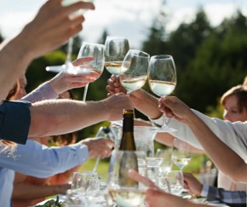
What is Gilt?
Founded in 2007
World’s best brands and products up to 60% off
New products launch at noon EST
Limited inventory – products constantly sell out
Over 1000 employees

Slide 3
Gilt Tech
~150 people
Strategy to attract great people and enable them to innovate
Lots of Small Teams
Micro services architecture
300+ services, ~1000 git repos
Busy days see > 100 production releases
> 10k requests / second
http://tech.gilt.com #gilttech

Slide 4
Culture
Innovate Faster
Even As You Grow

Slide 5
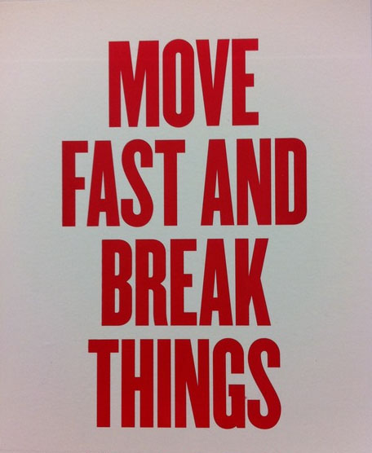

Slide 6
What that Actually Means
Move Fast
with
Minimal Risk

Slide 7
Defining Risk
Probability (event)
* Cost(event)
* Number of occurrences
There is a risk to doing nothing

Slide 8
Timing is critical
Startup
<5 Teams
10 Teams
Dunbar
Big

Slide 9
Startup
Risk
Product fails => Time to Market
Productivity
Tiny team; just works*
Startup
15 People
80 People
Dunbar
Big

Slide 10
15 People
Risk
Starting to slow down
Communication / coordination important
Productivity
Partition major systems
Startup
15 People
80 People
Dunbar
Big

Slide 11
80 People
Risk
Productivity down / Tech debt arrives
Mistakes costly
Productivity
micro-services
Startup
15 People
80 People
Dunbar
Big

Slide 12
Lots of Small Applications (LOSA)
Technology Strategy focused on:
Autonomy
Decentralization
Parallelism
Isolation

Slide 13
Teams and LOSA
Lots of Small Teams
4-10 people / team
Have all “ingredients” to succeed
Deliver across stack for most projects

Slide 14
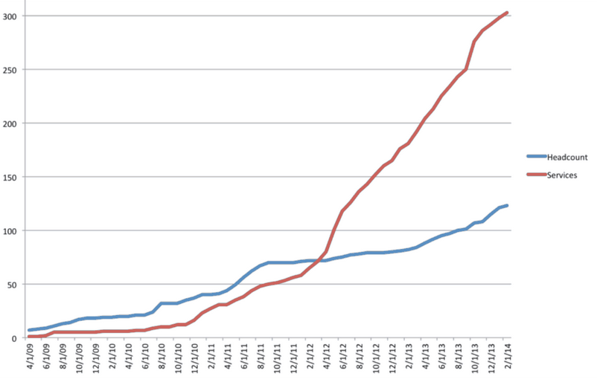
Startup to Dunbar

Slide 15
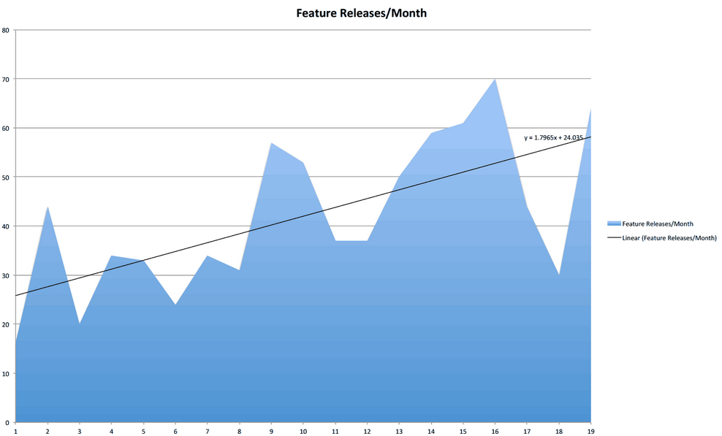
Startup to Dunbar

Slide 16
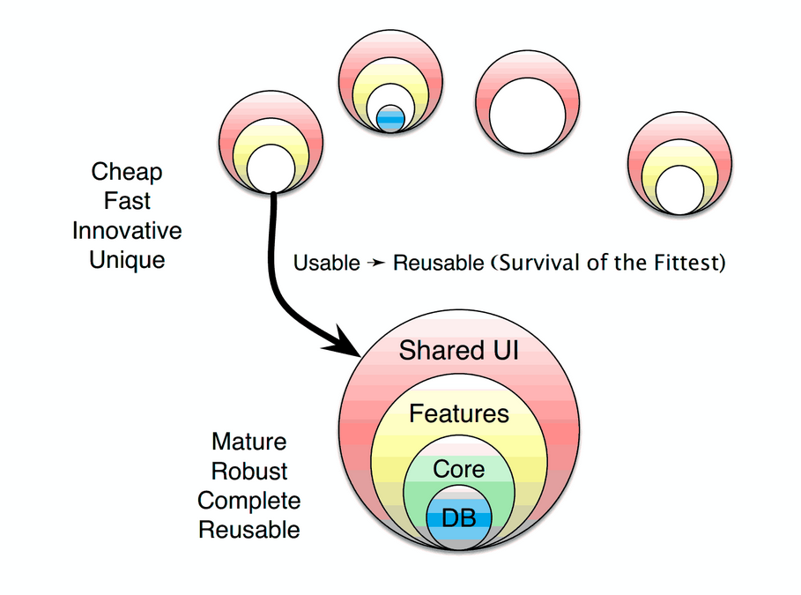
Theory of Service Evolution

Slide 17
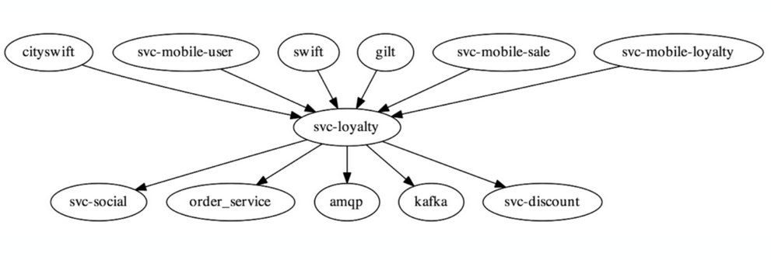
What a Satellite Looks Like
Team ownership end to end is critical

Slide 18
We believe innovation fuels growth.
Part of our strategy to accelerate innovation
Is to create truly autonomous teams
Supported by tooling and process
to relentlessly decrease risk of change

Slide 19
Modern Software Deployment
Constantly focused on risk reduction
Foundation of continuous delivery
Incremental rollout
Fast rollback
Testing in production, too
Metrics and alerting

Slide 20
Risk Reduction - Probability(event)
Testing
Manual or Automated
Prefer automated for long term
Not making changes
Peer review
Kaizen
Immutability
Ownership / Pride
Experience

Slide 21
Risk Reduction - Cost(event)
Small change sets
Verification in target environment
Incremental rollout
Automated rollout / rollback

Slide 22
Risk Reduction - NumOccurs(event)
Instant Rollback
Great Monitoring and Alerting

Slide 23
Continuous Delivery @ Gilt w/ Docker
ionblaster new api 1.2.3
ionblaster traffic api
1.2.2 90
1.2.3 10
Build docker container
Create new “stack” of infrastructure
Run container on each node in stack
Assign DNS to new stack
Manage traffic from old to new

Slide 24
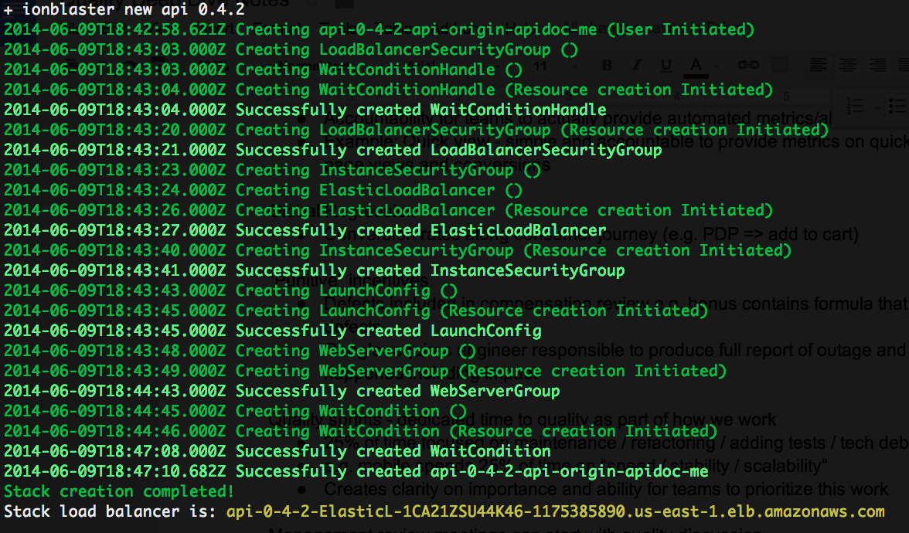
ionblaster new api 0.4.2

Slide 25
What do Smart and Autonomous People Want?
Authority to make project decisions
To build something that matters
To impact business
To develop a strong sense of well being
To work with great people (great = better than me)

Slide 26
Trust

Slide 27
Policies Matter
Each and every documented policy / approval is a source of friction and erodes trust
Let’s look at some common examples

Slide 28
Travel & Entertainment
Should be “Use your judgment. If unsure, ask in advance”
Probably is “You can spent up to $50 per diem”

Slide 29
Who can post to the company blog?
Should be “Anybody”
Probably is “Send a draft of your post to xxx for approval”

Slide 30
tech.gilt.com Policy
We have a public-facing Gilt Technology blog: http://tech.gilt.com
It is up to YOU to fill it up with the awesome stuff we're working on and doing here.
What you post there is auto syndicated to our gilttech twitter account, which you can post to directly. Password=*****
Things to Consider
It's often a good idea to ask for a peer review before posting to double check technical accuracy, grammar etc. We've also got a team of wordsmithers (see appendix) that have signed up to help you out.
If you've got content that you're not sure about e.g. talking about a feature that's not live or a subject that you're not sure is suitable, ask your manager.

Slide 31
Lessons from Gilt: Failure
Failure is a mandatory component of success
Prevent Recurrence
Reduce Emotion
Perfect Day
Anti Fragile

Slide 32
Lessons from Gilt: Stable Software
HTTP
DNS

Slide 33
Lessons from Gilt: Immutability
Infrastructure
Event Streams
Time Series Databases
Programming Languages

Slide 34
Lessons from Gilt: Interfaces Matter
HTTP + REST + JSON
Software as a Service
Open Source Model
http://www.apidoc.me

Slide 35
Tools and Process
Focus on
Creating a
Culture of Trust

Slide 36
Thank You
QCon New York 2014
Michael Bryzek
CTO & Co-Founder Gilt
michael@gilt.com / @mbryzek
http://tech.gilt.com / @gilttech

