Slide 1

Predictive Modeling
Claudia Perlich,
Chief Scientist
@claudia_perlich
Notes:
Claudia’s keynote
predict online conversions on a brand’s website
Claudia claimed
Makes predicting internet purchases look easy

Slide 2
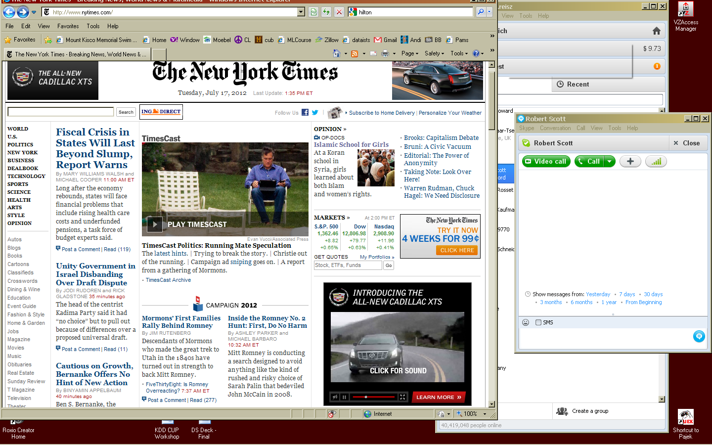
Targeted Online Display Advertising
Notes:
Robustness: we cannot do really badly ever
Scale: 2000 models per week

Slide 3
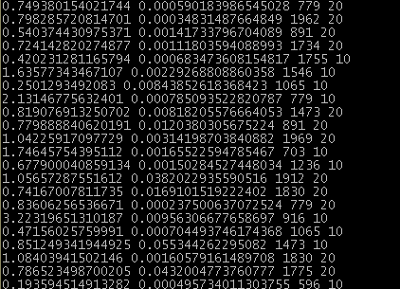
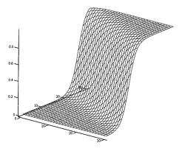
Predictive Modeling:
Algorithms that Learn Functions

Slide 4

Estimating conditional probabilities
P(Buy|Age,Income)
Logistic Regression
Age
p(+|x)=
45
β₀ = 3.7
β₁ = 0.00013
50K
Income
Not interested
p(buy|37,78000) = 0.48
Buy
Notes:
Potential exam question: what is a support-vector machine?

Slide 5
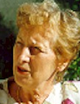
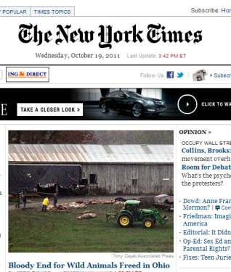




200 Million
browsers
Who should
we target for
a marketer?
Browsing
General browsing
10 Million
URLs
cookies
Does the ad have
causal effect?
Shopping at one of
our campaign sites
conversion
What data should
we pay for?
If we win an auction
we serve an ad
Where should
we advertise and
at what price?
Attribution?
100 ms response time
Ad
Exchange
What requests
are fraudulent?
20 Billion of
bid requests per day

Slide 6

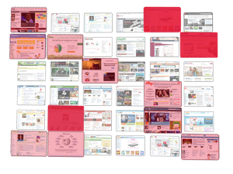

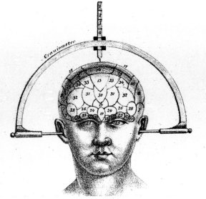
Our Browser Data: Agnostic
A consumer’s online/mobile activity
gets recorded like this:
Brand Event
Encoded
date1 3012L20
date 2 4199L30
…
date n 3075L50
The Non-Branded Web
The Branded Web
Browsing History
Hashed URL’s:
date1 abkcc
date2 kkllo
date3 88iok
date4 7uiol
…
I do not want to ‘understand’ who you are …
Notes:
Makes Data Cheap
PII discussion
It works – I do not want to deal with crawling and analyzing the content of websites
Competitive statement – this is different
6

Slide 7


The Heart and Soul
Targeting Model
P(Buy|URL,inventory,ad)
Predictive modeling on hashed browsing history
  10 Million dimensions for URL’s (binary indicators)
  extremely sparse data
  positives are extremely rare

Slide 8

How can we learn from 10M features with no/few positives?
We cheat.
In ML, cheating is called “Transfer Learning”

Slide 9
The heart and soul
Targeting Model
P(Buy|URL,inventory,ad)
Has to deal with the 10 Million URL’s
Need to find more positives!

Slide 10
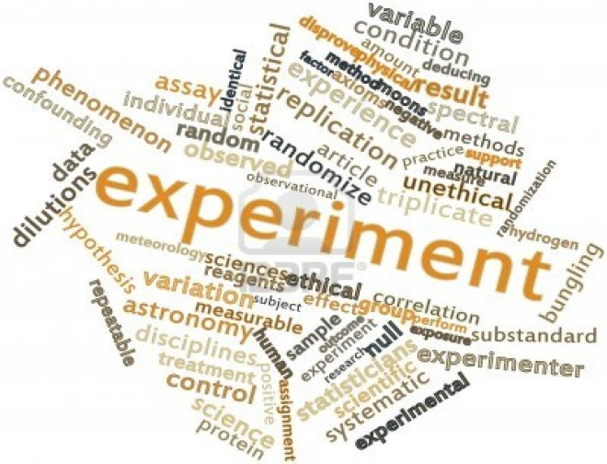
Experiment
Data
Randomized targeting across 58 different large display ad campaigns.
Served ads to users with active, stable cookies
Targeted ~5000 random users per day for each marketer. Campaigns ran for 1 to 5 months, between 100K and 4MM impressions per campaign
Observed outcomes: clicks on ads, post-impression (PI) purchases (conversions)
Targeting
Optimize targeting using Click and PI Purchase
Technographic info and web history as input variables
Evaluate each separately trained model on its ability to rank order users for PI Purchase, using AUC (Mann-Whitney Wilcoxin Statistic)
Each model is trained/evaluated using Logistic Regression

Slide 11
Predictive performance* (AUC) for purchase learning
[Dalessandro et al. 2012]
*Restricted feature set used for these modeling results; qualitative conclusions generalize

Slide 12
Predictive performance* (AUC) for click learning
Optimizing Clicks
does NOT help with purchase
Evaluated on predicting purchases
(AUC in the target domain)
[Dalessandro et al. 2012]
*Restricted feature set used for these modeling results; qualitative conclusions generalize

Slide 13
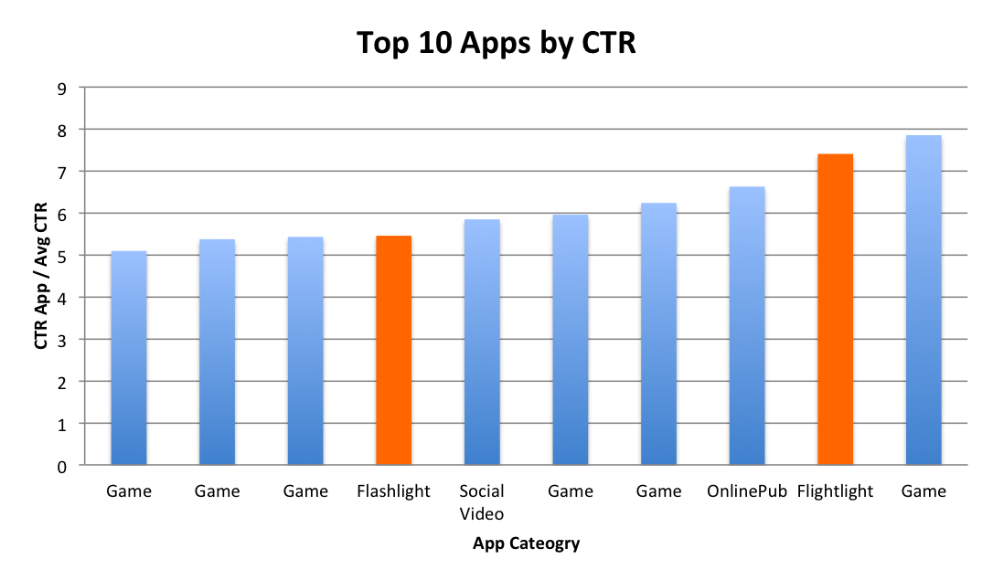
Clickers in the Dark
Top 10 Apps by CTR

Slide 14
Predictive performance* (AUC) for Site Visit learning
1
Significantly better targeting training on source task
8
.
n
o
i
t
u
b
Evaluated on predicting purchases
(AUC in the target domain)
i
r
t
6
s
.
i
D
C
U
A
4
.
2
.
Train on Clicks
Train on Site Visits
Train on Purchase
[Dalessandro et al. 2012]

Slide 15
The heart and soul
Targeting Model
P(Buy|URL,inventory,ad)
Organic: P(SiteVisit|URL’s)
Has to deal with the 10 Million URL’s
Transfer learning:
  Use all kinds of Site visits instead of new purchases
  Biased sample in every possible way to reduce variance
  Negatives are ‘everything else’
  Pre-campaign without impression
  Stacking for transfer learning
MLJ 2014

Slide 16
Logistic regression in 10 Million dimensions
Targeting Model
p(sv|urls) =
Stochastic Gradient Descent
L1 and L2 constraints
Automatic estimation of optimal learning rates
Bayesian empirical industry priors
Streaming updates of the models
Fully Automated ~10000 model per week
KDD 2014
Notes:
Here’s how we do it. Looking across all sites, applying a passion index to reflect how each site resonates with your current customers.
We harness the power of web-wide data to capture your unique BrandSignal. This signal is based on the site visitation patterns of your current customers – those that rank high on the passion index, attract a higher percentage of your current customers on a more consistent basis.
Those that rank low are also key indicators in building your unique BrandSignal.
And keep in mind, no signal is alike and you control how specific or broad based on your marketing needs … from brand, to product, to offer. ... Ensuring that we are reaching the right customer that will become your next brand enthusiast.
Where do we get the data? Larger mapping set of data. Web wide view of data.

Slide 17
Dimensionality Reduction
There are a few obvious options for dimensionality reduction.
Hashing: Run each URL through a hash function, and spit out a specified number of buckets.
Categorization: We had both free and commercial website category data. Binary URL space → binary category space.
www.baseball-reference.com Sports/Baseball/Major_League/Statistics
SVD: Singular Value Decomposition in Mahout to transform large, sparse feature space into small dense feature space.
www.dmoz.org

Slide 18
Algorithm: Intuition & Multitasking
Hierarchical clustering in the space of model parameters.
  Naïve Bayes(ish) model: It’s not a bug, it’s a feature!
Distance function: Pearson Correlation
Cutting the dendrogram:
  Most algorithms cut the tree at a specific “height” in order to produce a desired number of clusters.
  In our case, we need clusters with sufficient representation in the data.
  Recursively traverse the tree and cut when we reach a certain minimum popularity.

Slide 19
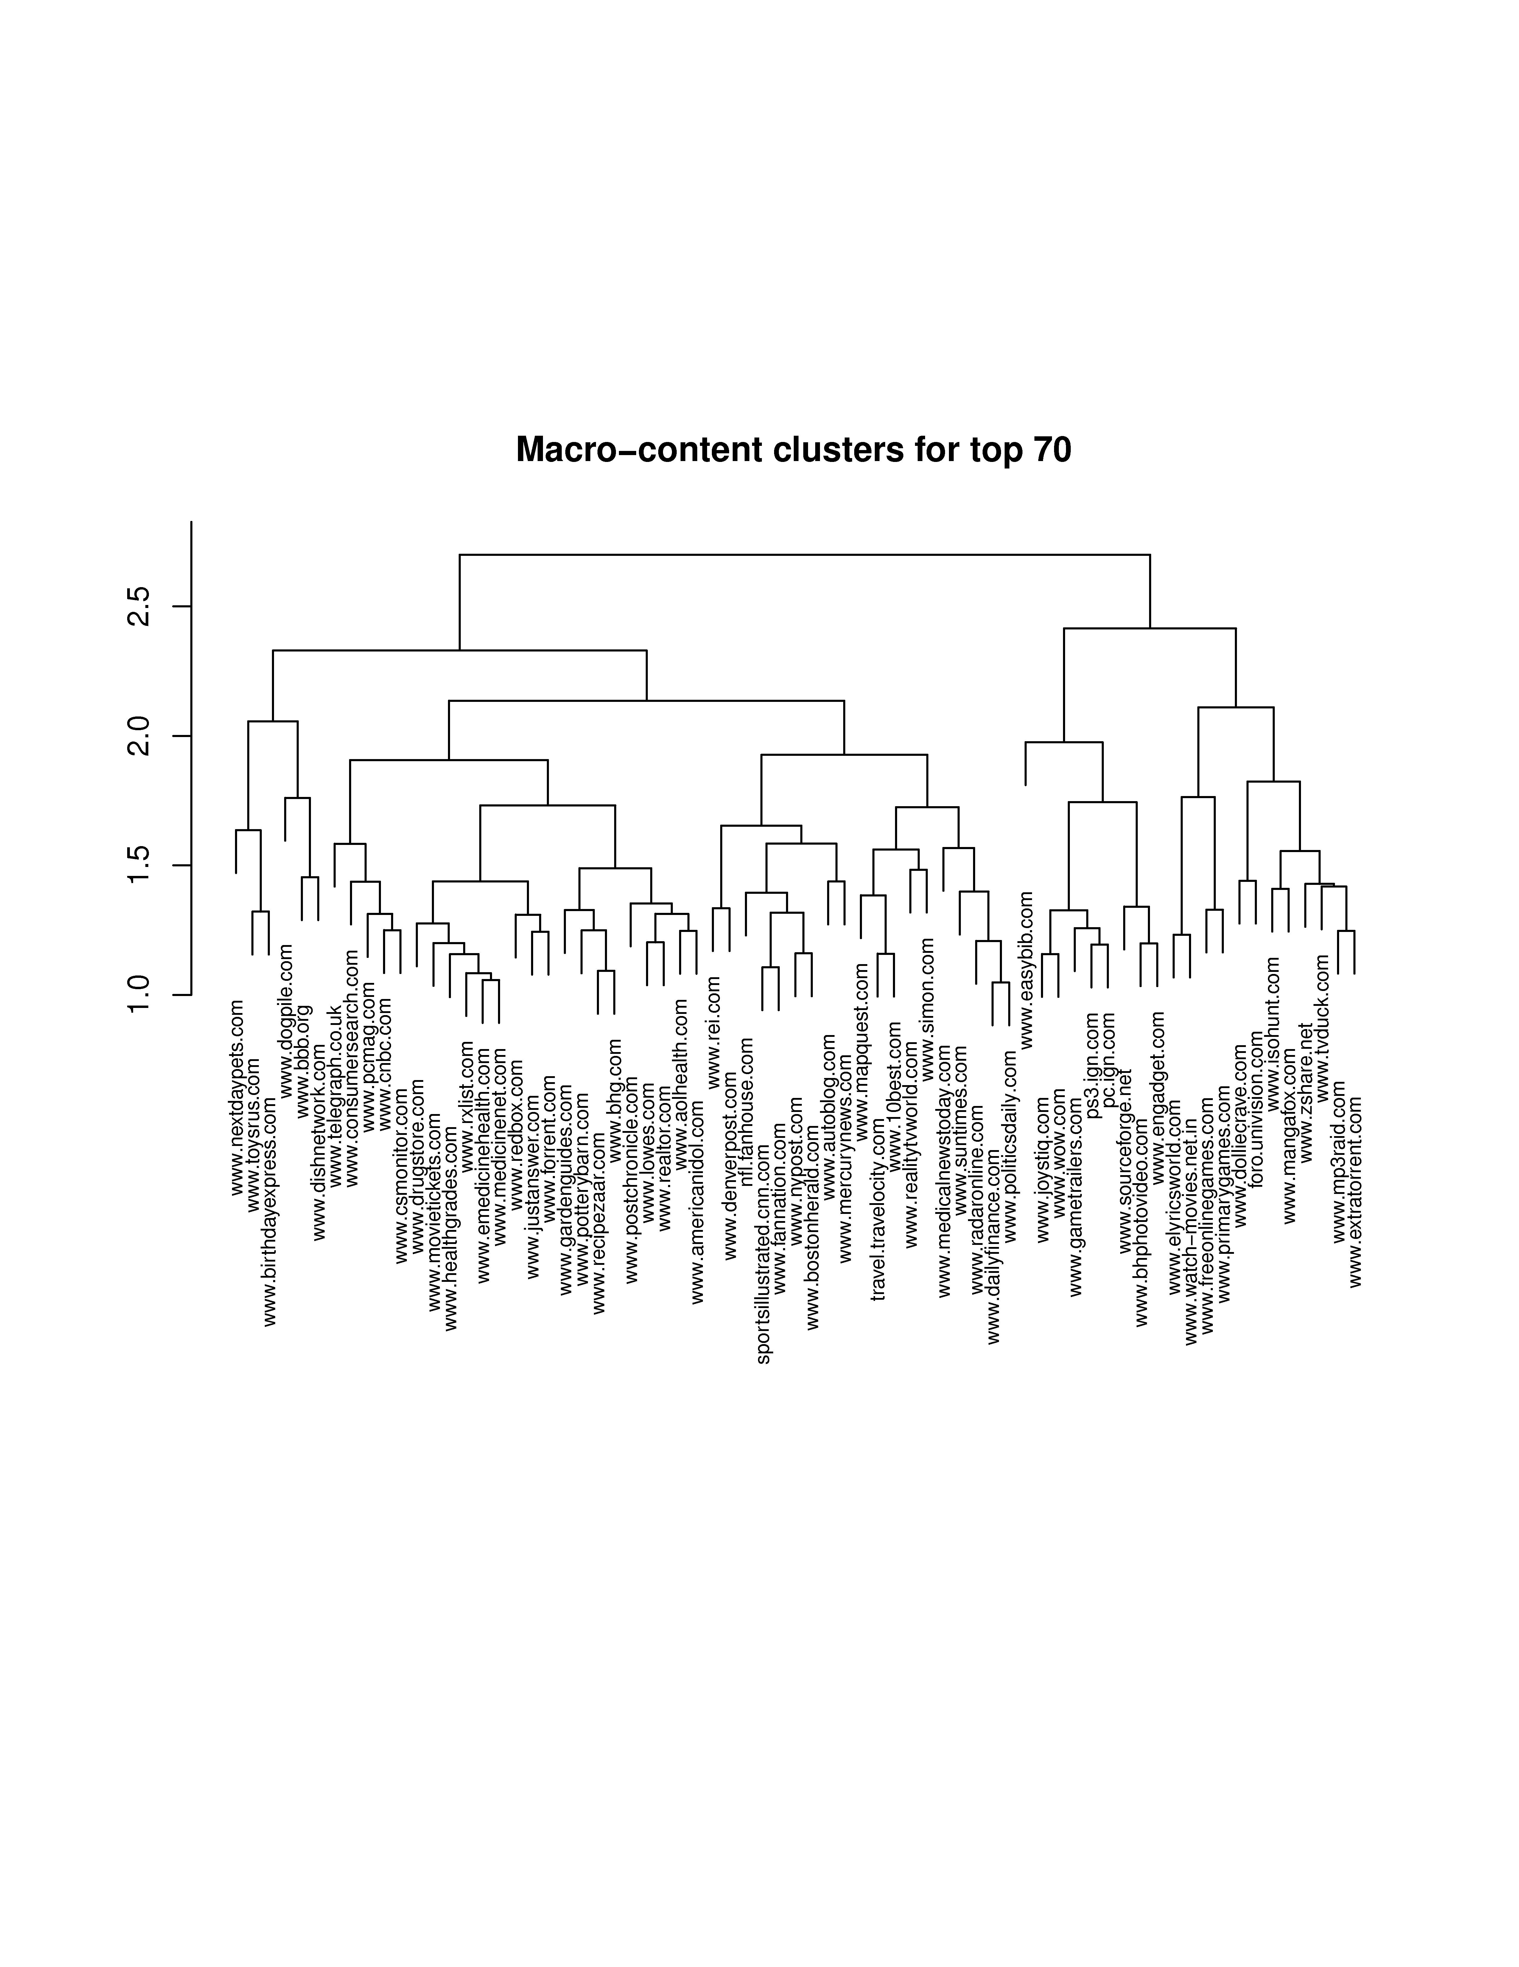
Results
Home
Kids
Health
Home
News
Games
&
Videos

Slide 20
Experiments
We built models off data from 28 campaigns.
Our production cluster definitions have 4,318 features.
We tried to get each of the “challengers” as close to this as we possibly could.
We evaluate on Lift (5%) and AUC.

Slide 21
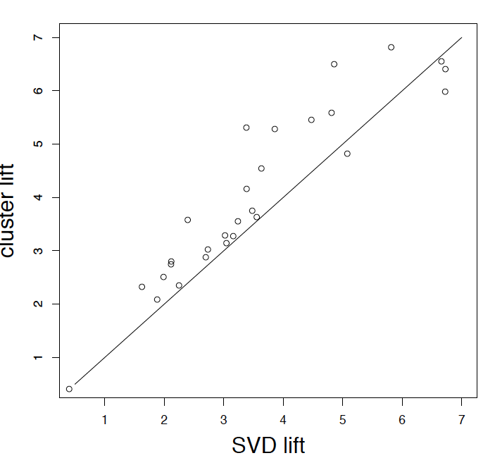
Results
 | Average Lift (5%) | Average Relative Perf. | Win | Loss | Tie | Features
Cluster | 4.024 | 100% | - | - | - | 4,318
SVD | 3.539 | 86.0% | 4 | 20 | 4 | 1,000
Hash | 3.035 | 70.0% | 1 | 26 | 1 | 4,318
Commercial | 3.195 | 71.3% | 2 | 24 | 2 | 1,183
Free Context | 3.643 | 84.4% | 1 | 17 | 10 | 5,984

Slide 22
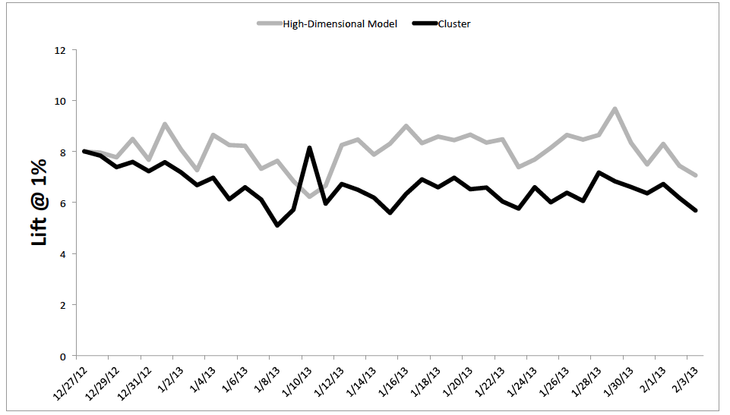
To reduce or not to reduce?

Slide 23
Conclusions
We use the cluster based models for some things
Targeting is still using high-dimensional models whenever possible

Slide 24





Real-time Scoring of a User
OBSERVATION
ENGAGEMENT
Purchase
Ad
Ad
Ad
Ad
ProspectRank Threshold
Some prospects fall out of favor once their in-market indicators decline.
site visit with positive correlation
site visit with negative correlation
Notes:
Let’s now put this into practice with an example of a prospect’s journey. With our ProspectRank scoring system – we are very selective of who sees an ad. We score each prospect as they make their journey along the web and how well it matches the brand signal. Every media6 prospect undergoes an in-depth observation phase - as a prospect visits certain sites (that mirror the brand signal), they move up in their ranking. When they have hit a minimum prospect rank, they are served an ad and move on to the prospect development phase.
During this phase – prospects continue to be ranked based on their online journey. If, for example, someone falls off the path, (dotted line) – maybe because they made an offline purchase – and fall below the minimum prospect rank, that browser is no longer a viable prospect and we will no longer serve them ads.
The 2nd phase of engagement is prospect to completion – the retargeting phase, prompted by the prospect visiting the branded site. Keep in mind, with our retargeting, we take into consideration the full history of the prospect, and serve ads accordingly.
Retargeters, on the other hand, after a site visit, have no historical information and simply serve as many ads as possible.
A 3rd party vendor are similar to retargeters in that they use limited browser experience to make judgment calls – i.e. the browser visited a car site and is now an “auto intender” – they will continue to receive ads – not only from one brand – but from ALL auto brands using that 3rd party data.

Slide 25
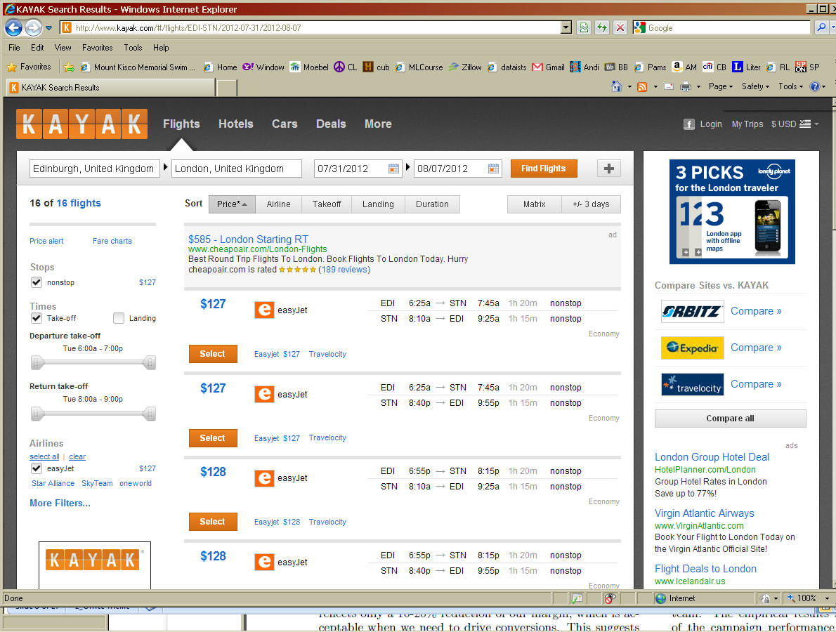
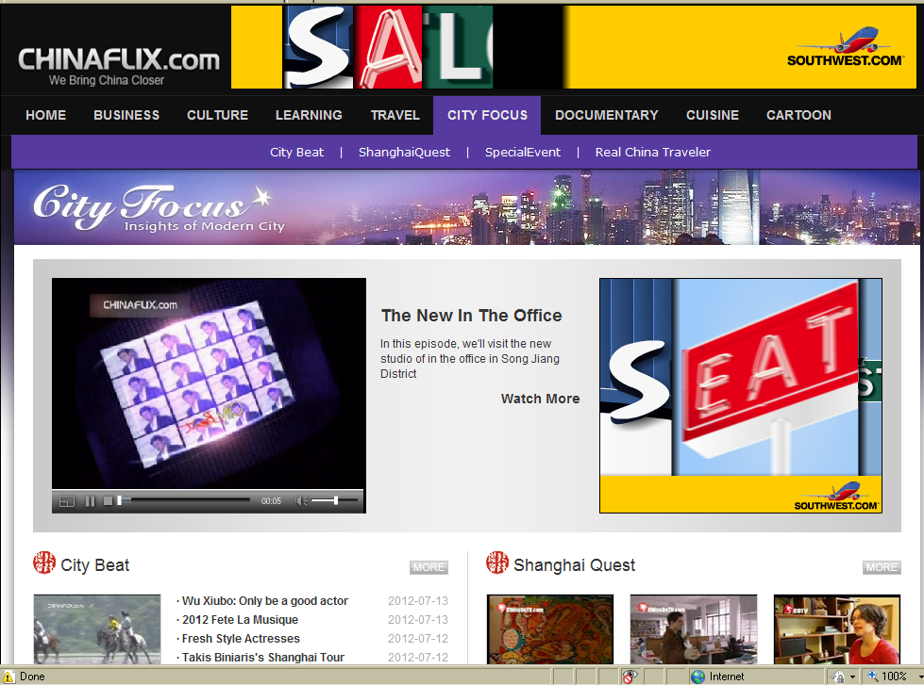
What exactly is Inventory?
Where the ad will be shown:
7K unique inventories + default buckets

Slide 26
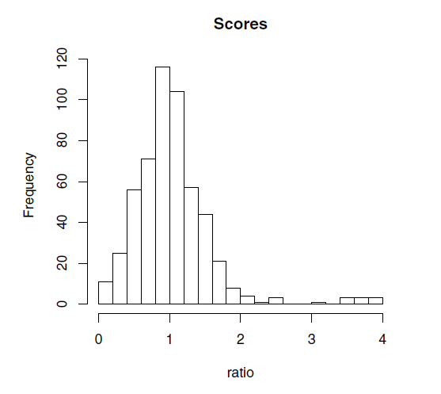
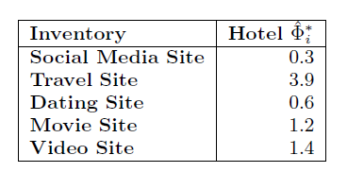

Example of Model Scores for Hotel Campaign
Scores are calculated on de-duplicated training pairs (i,s)
We even integrate out s
Nicely centered around 1

Slide 27

Bidding Strategies
Strategy 0 – do nothing special:
always bid base price for segment
equivalent to constant score of 1 across all inventories
consistent with an uninformative inventory model
Strategy 1 – minimize CPA:
auction-theoretic view: bid what it is worth in relative terms
Multiply the base price with ratio
Strategy 2 – maximize Conversion rate:
optimal performance is not to bid what it is worth but to trade off value for quality and only bid on the best opportunities
apply a step function to the model ratio to translate it into a factor applied to the price:
  ratio below 0.8 yields a bid price of 0 (so not bidding),
  ratios between 0.8 and 1.2 are set to 1 and ratios above
  1.2 bid twice the base price
1

Slide 28
Results
Both lowered CPA. Optimal decision making depends on long vs short term thinking (note: we chose long term, thus Strategy 2).
Increased CR, same CPM = Free Lunch!
Increased CR, but higher CPM. Lowest CPA.

Slide 29
Real-time Scoring of a User
OBSERVATION
ENGAGEMENT
Purchase
Ad
Ad
Ad
Ad
ProspectRank Threshold
Some prospects fall out of favor once their in-market indicators decline.
site visit with positive correlation
site visit with negative correlation
Notes:
Let’s now put this into practice with an example of a prospect’s journey. With our ProspectRank scoring system – we are very selective of who sees an ad. We score each prospect as they make their journey along the web and how well it matches the brand signal. Every media6 prospect undergoes an in-depth observation phase - as a prospect visits certain sites (that mirror the brand signal), they move up in their ranking. When they have hit a minimum prospect rank, they are served an ad and move on to the prospect development phase.
During this phase – prospects continue to be ranked based on their online journey. If, for example, someone falls off the path, (dotted line) – maybe because they made an offline purchase – and fall below the minimum prospect rank, that browser is no longer a viable prospect and we will no longer serve them ads.
The 2nd phase of engagement is prospect to completion – the retargeting phase, prompted by the prospect visiting the branded site. Keep in mind, with our retargeting, we take into consideration the full history of the prospect, and serve ads accordingly.
Retargeters, on the other hand, after a site visit, have no historical information and simply serve as many ads as possible.
A 3rd party vendor are similar to retargeters in that they use limited browser experience to make judgment calls – i.e. the browser visited a car site and is now an “auto intender” – they will continue to receive ads – not only from one brand – but from ALL auto brands using that 3rd party data.

Slide 30
Lift over random for 66 campaigns
for online display ad prospecting
Note: the top prospects are consistently rated as
being excellent compared to alternatives by advertising
clients’ internal measures, and when measured by their
analysis partners (e.g., Nielsen): high ROI,
low cost-per-acquisition, etc.
<snip>
Lift over baseline
median lift = 5x

Slide 31
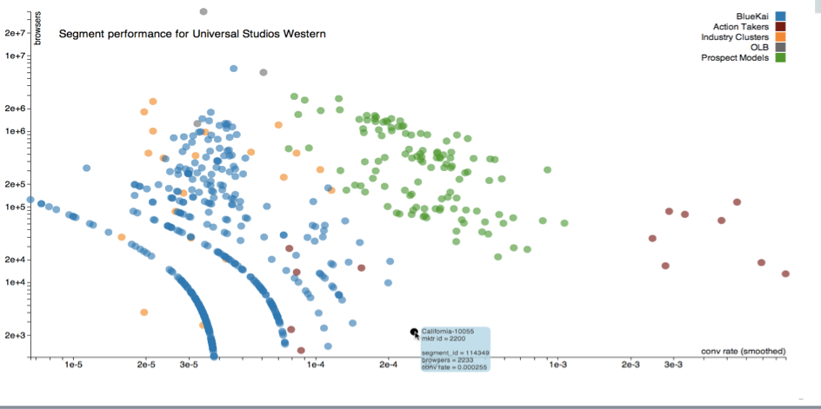
Relative Performance to Third Party

Slide 32
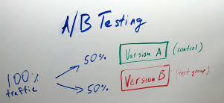

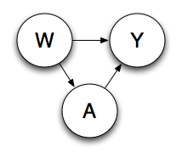
Measuring causal effect?
A/B Testing
Practical concerns
Estimate Causal effects from observational data
  Using targeted maximum likelihood (TMLE) to estimate causal impact
  Can be done ex-post for different questions
  Need to control for confounding
  Data has to be ‘rich’ and cover all combinations of confounding and treatment
E[Y_{A=ad}] – E[Y_{A=no ad}]
ADKDD 2011

Slide 33

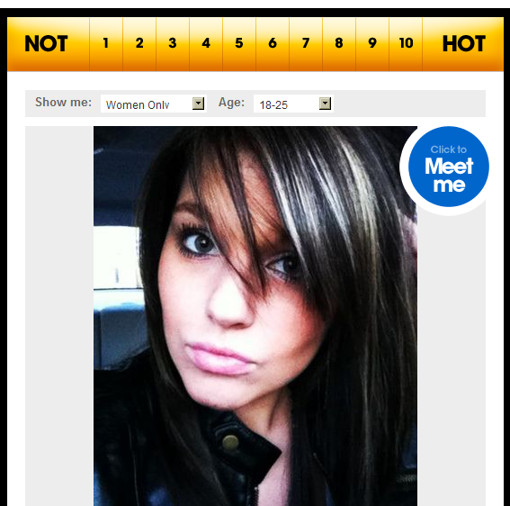



An important decision…
I think she is hot!
Hmm – so what should I write
to her to get her number?

Slide 34
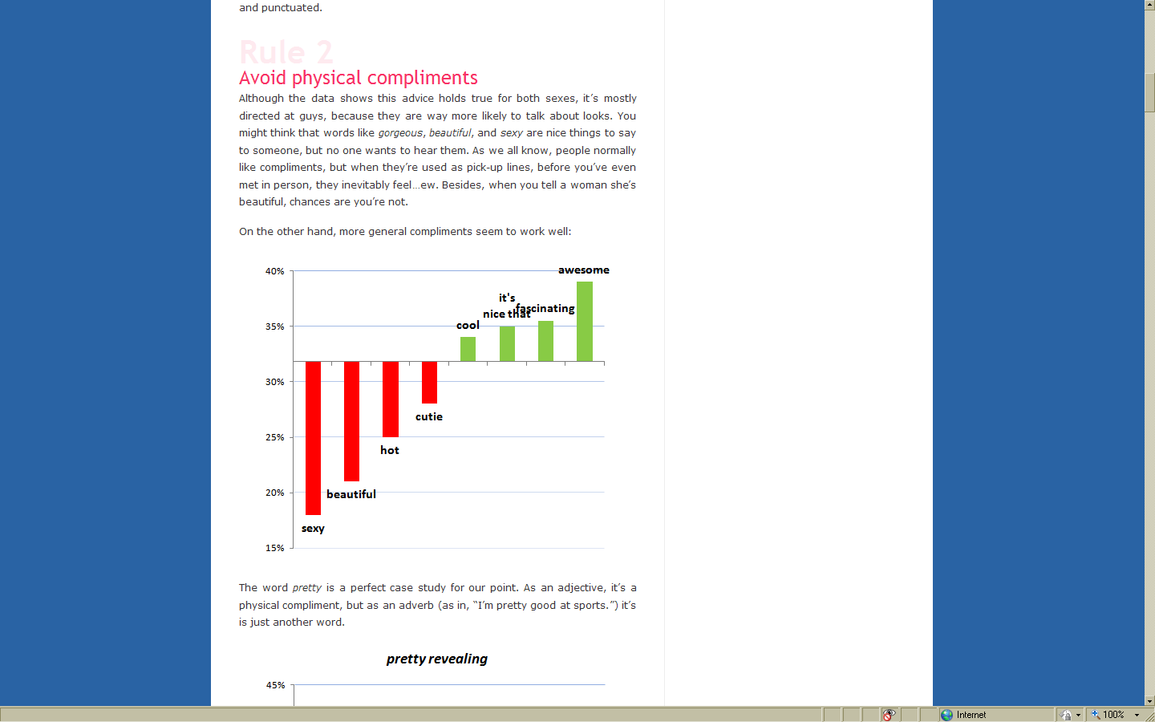
?
?
Source: OK Trends

Slide 35

Hardships of causality.
Beauty is Confounding
  determines both the probability of getting the number and of the probability that James will say it
  need to control for the actual beauty or it can appear that making compliments is a bad idea
“You are beautiful.”

Slide 36
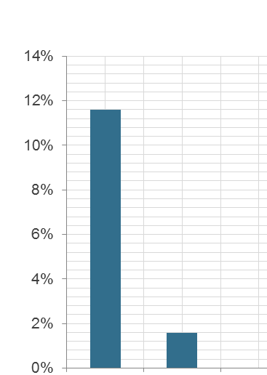
Hardships of causality.
Targeting is Confounding
  We only show ads to people we know are more likely to convert (ad or not)
X
conversion rates
  Need to control for confounding
  Data has to be ‘rich’ and cover all combinations of confounding and treatment
SAW AD
DID NOT SEE AD
Notes:
Assessing the impact of the advertising it is clear that in these cases it is more advantageous to show advertisements to new prospects.
Compared to cost per conversion goals. ROI, Gross Conversion Rates.

Slide 37
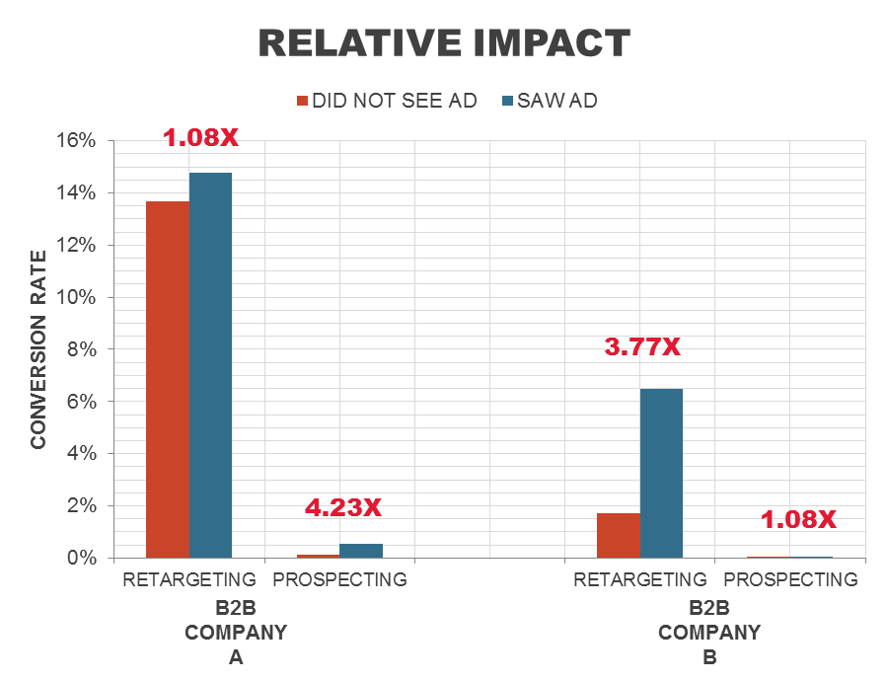
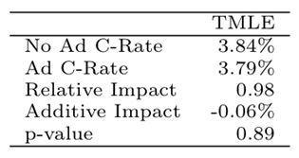
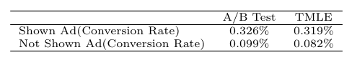
Observational Causal Methods: TMLE
Negative Test: wrong ad
Positive Test: A/B comparison

Slide 38
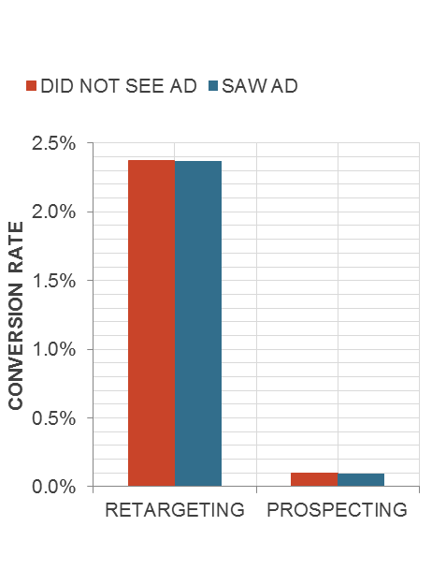

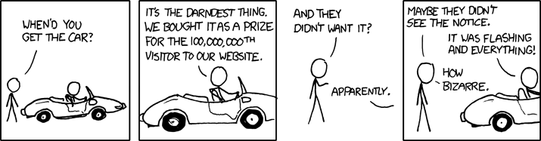
Some creatives do not work …

Slide 39

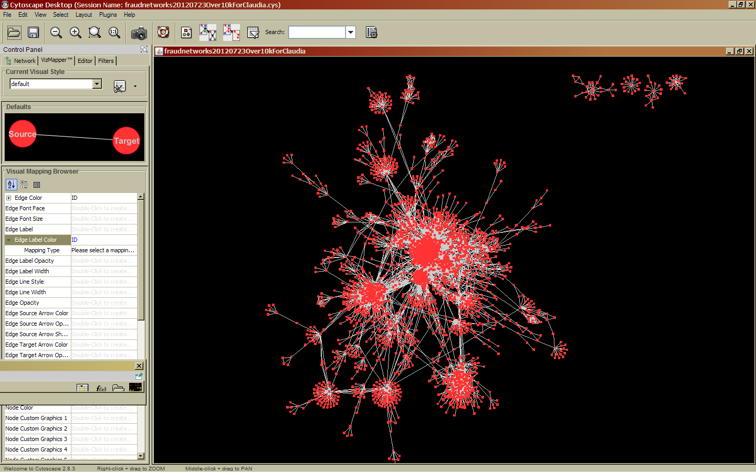
Data Quality in Exchanges
Fraud
KDD 2013

Slide 40

Ensure location quality before using it
Almost 30% of users with more than one location travel faster than the speed of sound

Slide 41
Unreasonable Performance Increase Spring 12
2x
Performance Index
2 weeks

Slide 42
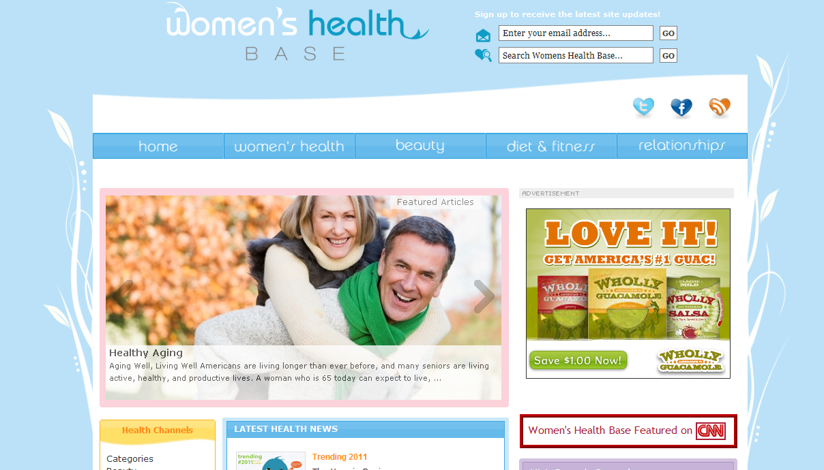
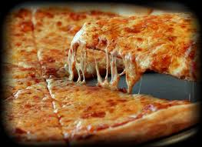




Oddly predictive websites?

Slide 43
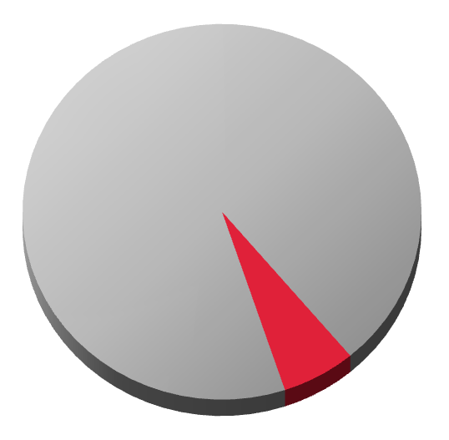
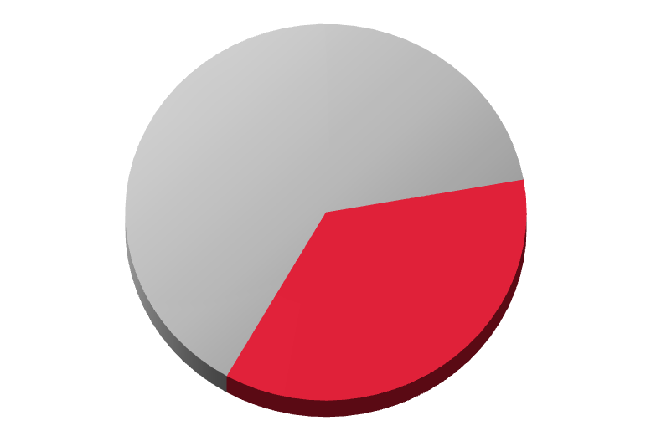

36% traffic is Non-Intentional
36%
6%
2011
2012
Notes:
So how big of a problem is this? Well, according to a recent study by comscore, as of 2012 more than one third of all internet traffic is non-intentional. Which I guess tells you something about the effectiveness of the FBI involvement I guess …

Slide 44
Traffic patterns are ‘non - human’
website 1
website 2
50%
Data from Bid Requests in Ad-Exchanges

Slide 45
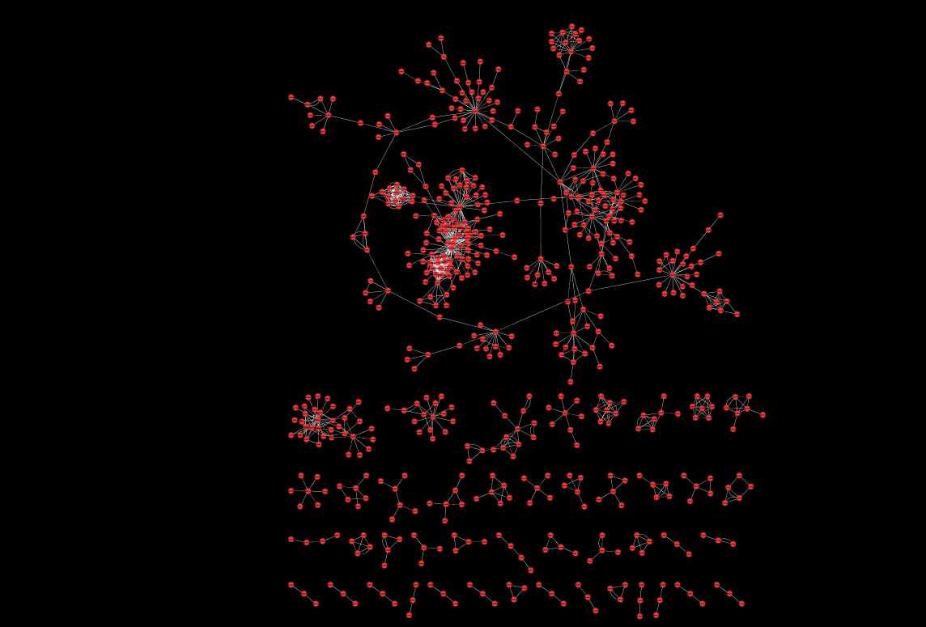
WWW 2010
Node:
hostname
Edge:
50% co-visitation
Notes:
10K in 2 weeks

Slide 46
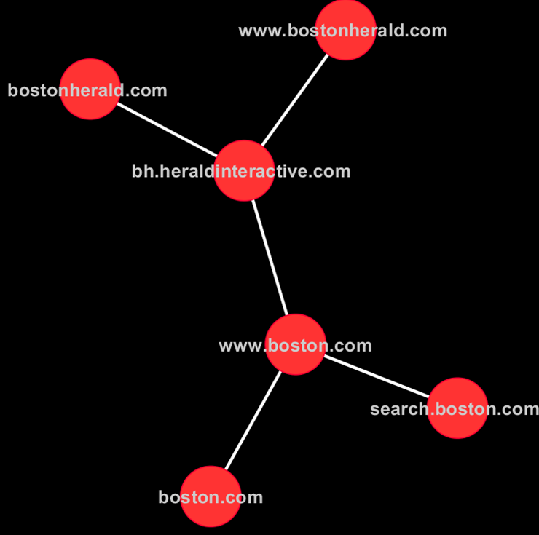
Boston Herald
Notes:
thumbs up

Slide 47

Boston Herald
Notes:
thumbs up

Slide 48
womenshealthbase?
Notes:
10K in 2 weeks

Slide 49
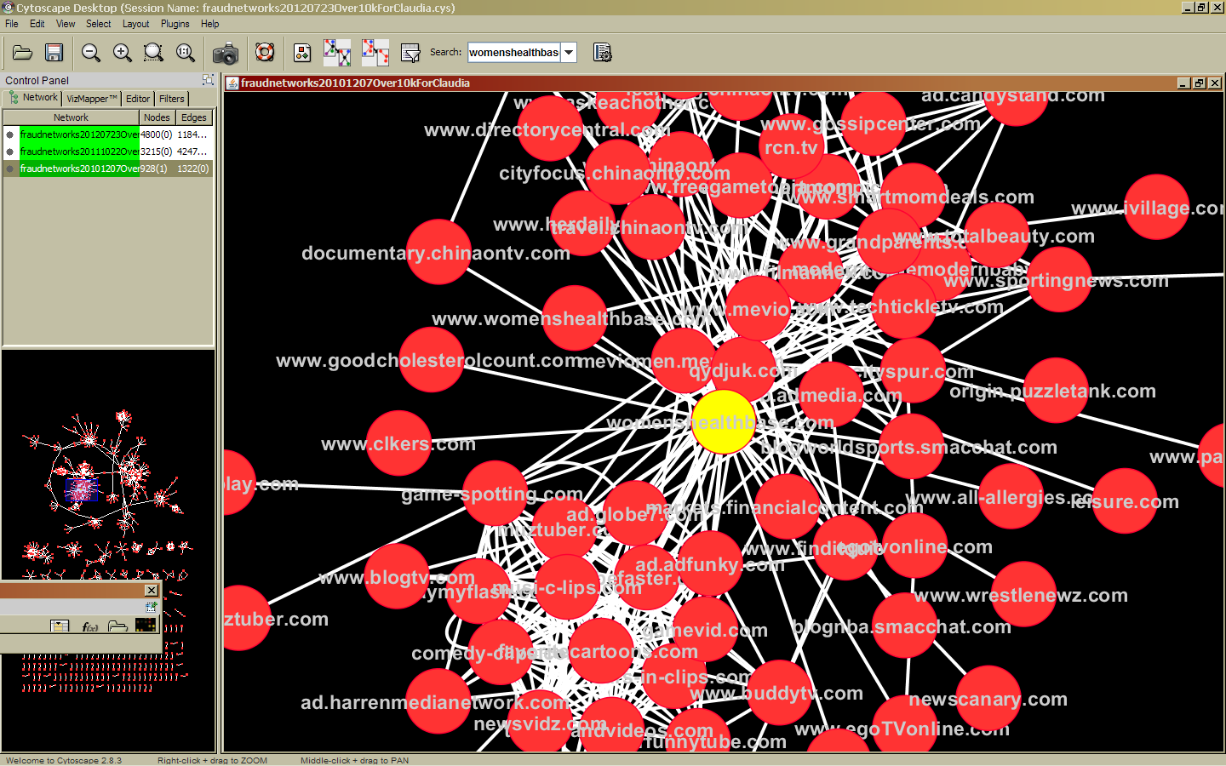
Notes:
I rest my case and go with Simon here. There is no way that this traffic could be intentional

Slide 50
Notes:
I rest my case and go with Simon here. There is no way that this traffic could be intentional

Slide 51

Notes:
I rest my case and go with Simon here. There is no way that this traffic could be intentional

Slide 52
WWW 2012
Notes:
This is what the world looks like in 2012. You see a lot more sites in this network and a lot more links.
So if we get a bid request from any of these sites, we consider that your browser has crossed over to the dark side and you are in a black hole. We will ignore any information we are getting from a person in.

Slide 53
Unreasonable Performance Increase Spring 12
2x
Performance Index
2 weeks

Slide 54
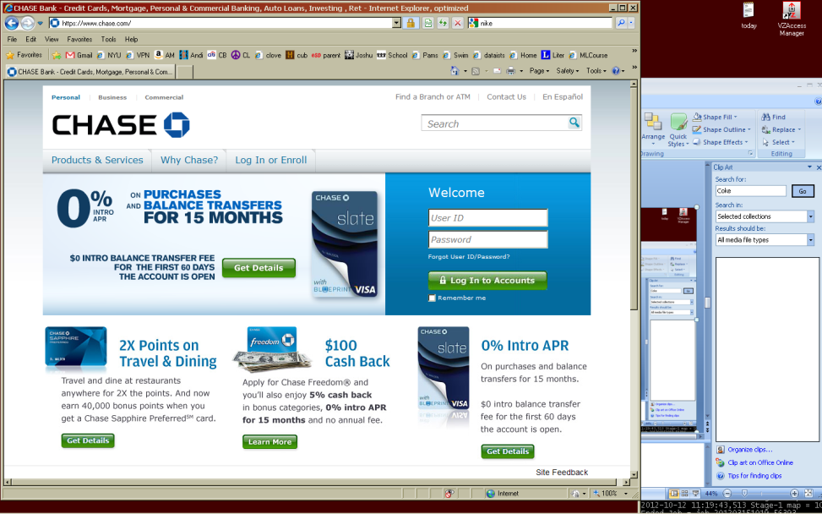
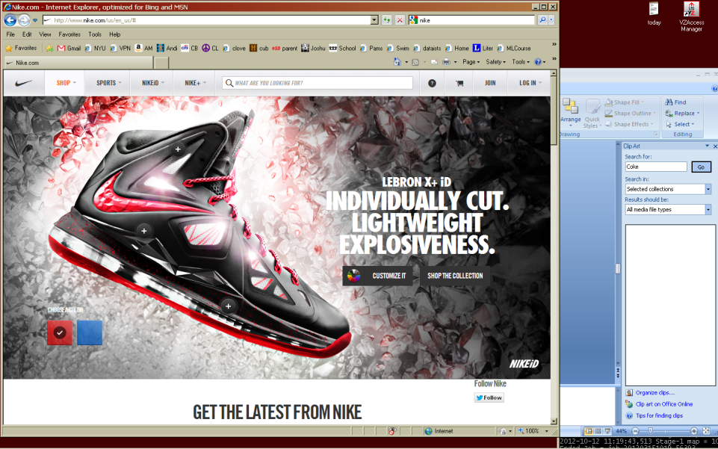
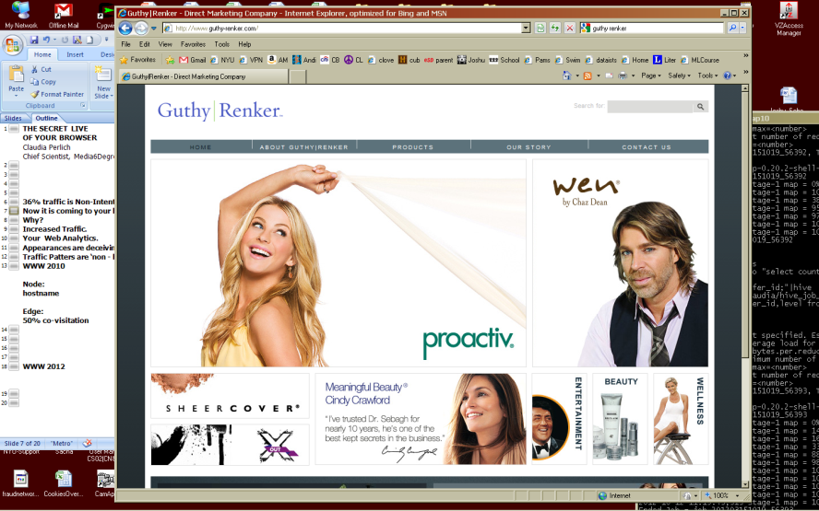
Now it is coming also to brands
‘Cookie Stuffing’ increases the value of the ad for retargeting
Messing up Web analytics …
Messes up my models because a botnet is easier to predict than a human
Notes:
A interesting recent development is that this non-intentional traffic is coming to retails sites too and that is really how I noticed it messing with our predictive models.
Now why would somebody who wrote malware that highjacks your browsers to show you ads on WHB
Lets assume for now that the retailers were smart enough not to actually BUY traffic ….

Slide 55

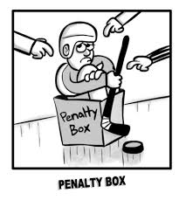
Fraud pollutes my models
Don’t show ads on those sites
Don’t show ads to a high jacked browser
Need to remove the visits to the fraud sites
Need to remove the fraudulent brand visits
When we see a browser on caught up in fraudulent activity: send him to the penalty box where we ignore all his actions

Slide 56
Using the penalty box: all back to normal
Performance Index
3 more weeks in spring 2012

Slide 57
website 1
50%

Slide 58
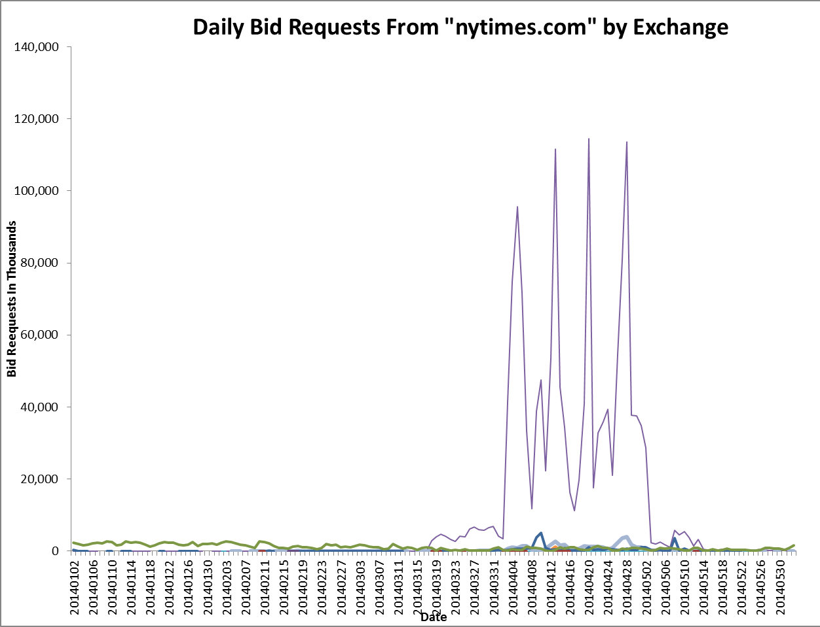
Somebody is posing as nytimes.com

Slide 59
Bottom-line
It is all a question of how good you are at cheating!
And that you can catch the bad guys at cheating …

Slide 60

In eigener Sache
claudia.perlich@gmail.com

Slide 61
Some References
B. Dalessandro, F. Provost, R. Hook. Audience Selection for On-Line Brand Advertising: Privacy Friendly Social Network Targeting, KDD 2009
O. Stitelman, B. Dalessandro, C. Perlich, and F. Provost. Estimating The Effect Of Online Display Advertising On Browser Conversion. ADKDD 2011
C.Perlich, O. Stitelman, B. Dalessandro, T. Raeder and F. Provost. Bid Optimizing and Inventory Scoring in Targeted Online Advertising. KDD 2012 (Best Paper Award)
T. Raeder, O. Stitelman, B. Dalessandro, C. Perlich, and F. Provost. Design Principles of Massive, Robust Prediction Systems. KDD 2012
B. Dalessandro, O. Stitelman, C. Perlich, F. Provost Causally Motivated Attribution for Online Advertising. In Proceedings of KDD, ADKDD 2012
B. Dalessandro, R. Hook. C. Perlich, F. Provost. Transfer Learning for Display Advertising MLJ 2014
T. Raeder, C. Perlich, B. Dalessandro, O. Stitelman, F. Provost. Scalable Supervised Dimensionality Reduction Using Clustering at KDD 2013
O. Stitelman, C. Perlich, B. Dalessandro, R. Hook, T. Raeder, F. Provost. Using Co-visitation Networks For Classifying Non-Intentional Traffic‘ at KDD 2013
Notes:
Add talk on KDD WORKSHOP [CAN YOU FORMAT NICER]

