Slide 1

ADVANCED DATA VISUALIZATION
HTML5 AND RISK ANALYSIS
QCON New York 2014

Slide 2
AGENDA
Context & Background
Visualization & the Financial Industry
Use Case
Conclusion
Q & A

Slide 3

CONTEXT & BACKGROUND
A FRAGMENTED WORLD
CLIENTS
REGULATORS
COMPETITION
TECHNOLOGY
PRODUCT-CENTRIC
SILOS (FUNC. & TECH.)
MIX OF TECHNOLOGIES
DISSEMINATED DATA
EXCEL IS KING
CRM
FINANCE
RISK
COMPLIANCE
MARKETING
Notes:
- who in the audience is working on projects with the financial industry ?
- fragmented/siloed infrastructures, resulting from the evolutions of the business (mergers, acquisitions, new LOBs, etc)
- duplication and dissemination are a significant issue, due to the critical need for Visibility and Transparency
- crisis highlighted how critical visibility and transparency were, potentially threatening the survival of an institution.
+ Pressure from regulators, becoming more and more intrusive and into the very details, only reinforce that highlight and show the weaknesses of the infrastructures
+ from a commercial perspective, visibility has become the priority for most banks, usually pitched as getting a customer's 360 degree view; this is critical for clients retention and commercial activities
+ Technology itself, with solutions gathering unstructured data on the social networks, for example, are increasing volumes dramatically (banks store every year 2x what they can indeed process) , directly challenging Visibility

Slide 4
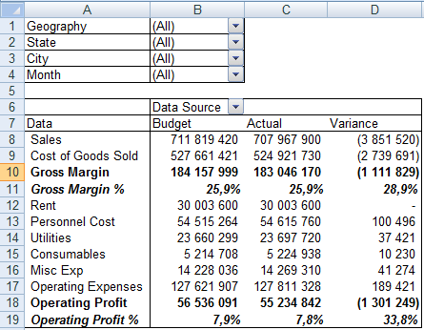
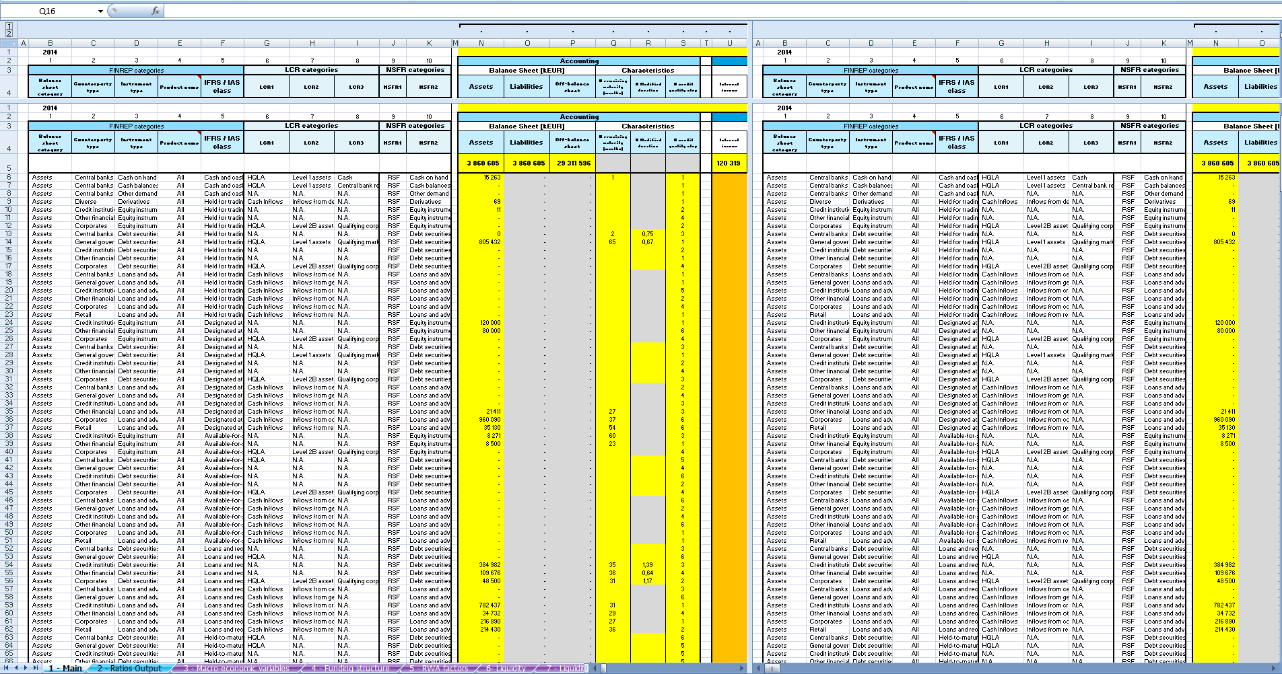
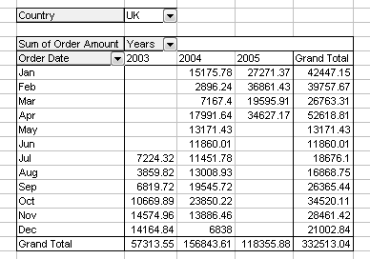
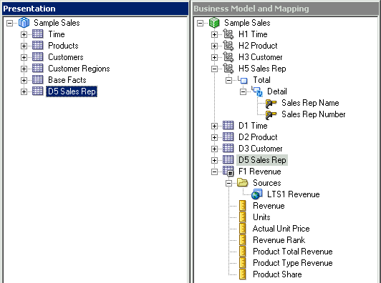
CONTEXT & BACKGROUND
KEY DRIVERS
TRANSPARENCY & VISIBILITY ARE REQUIRED
  AUDITS are more intrusive & detailed
  UNDERSTANDING and REACTING FAST is business critical, more than ever
  Analysts’ COSTS continue increasing with volumes & data types
  Too much data to analyze
  Difficult for non-analysts/statisticians to identify patterns
  Ensure fast & easy access to any level of granularity
Multiple pivot-tables
Complex spreadsheets
BI Setup(s)
Notes:
- volumes and frequencies of updates impose changing habits in the way data is reported
- granularity of data and the multiple dimensions to analyze, impose enhancing the representation of the information; classical charts rapidly reach their limits.
- Navigation becomes a key parameter in the decision making process; it must become as intuitive as possible, to ensure fast access to the required level of detail.
- the challenge being to give a fast access to the information, to a user who is not necessarily an analyst or a statistician.

Slide 5
CONTEXT & BACKGROUND
KEY DRIVERS
NEW DATA PRACTICE
  Offer INTUITIVE and easy navigation capabilities
  Ensure multi-devices accessibility, for better reactivity
  REUSABLE components for faster delivery of dashboards
RELIABILITY & CONSISTENCY
  Connect to GOLDEN SOURCES
  Leverage / work together with “big data” solutions
  Ability to integrate with existing (obsolete) technologies
111001
001101
101011
001001
Notes:
+ information is more and more requested to be accessible anywhere; mobility is a must have.
How to address those requirements, do we have tools and knowledge to adequately respond to our clients ?
Several POCs & projects failed, so WHAT TO DO DIFFERENTLY ?

Slide 6
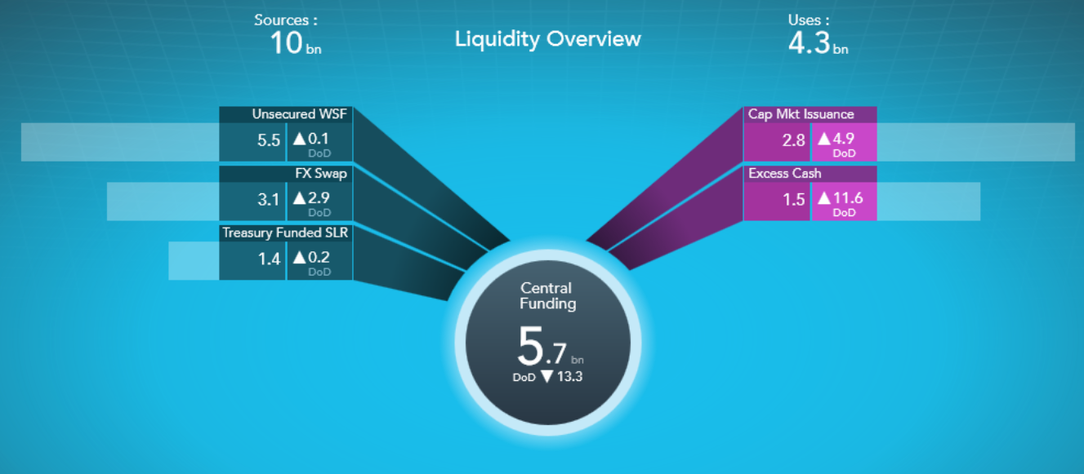
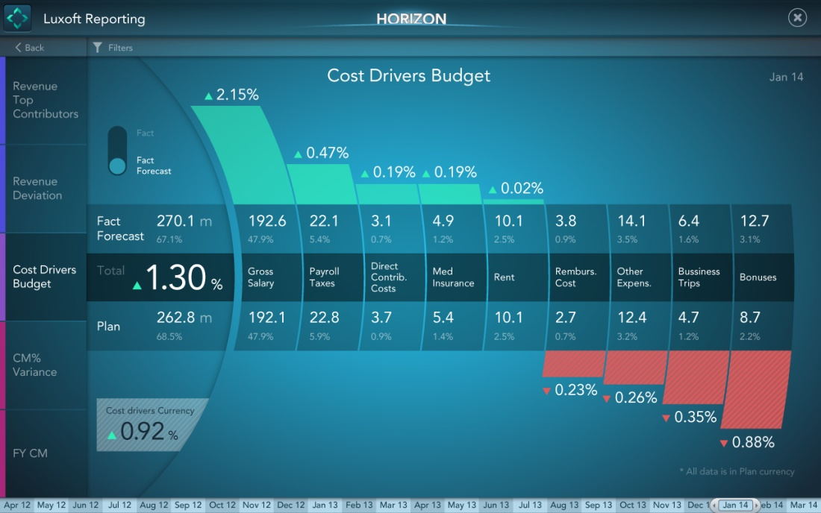
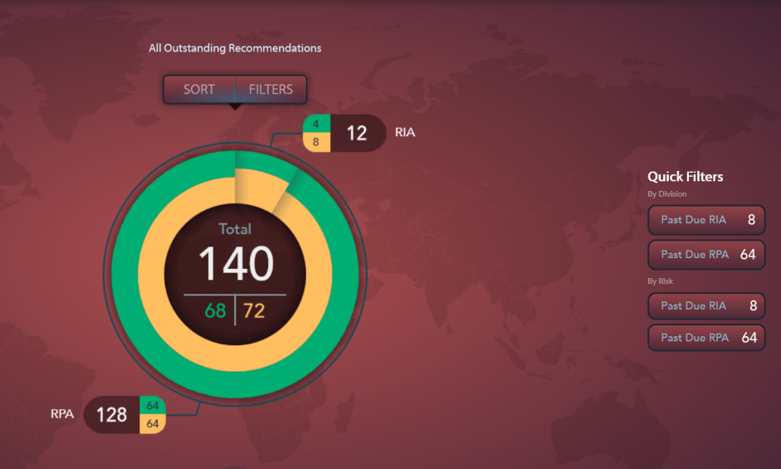
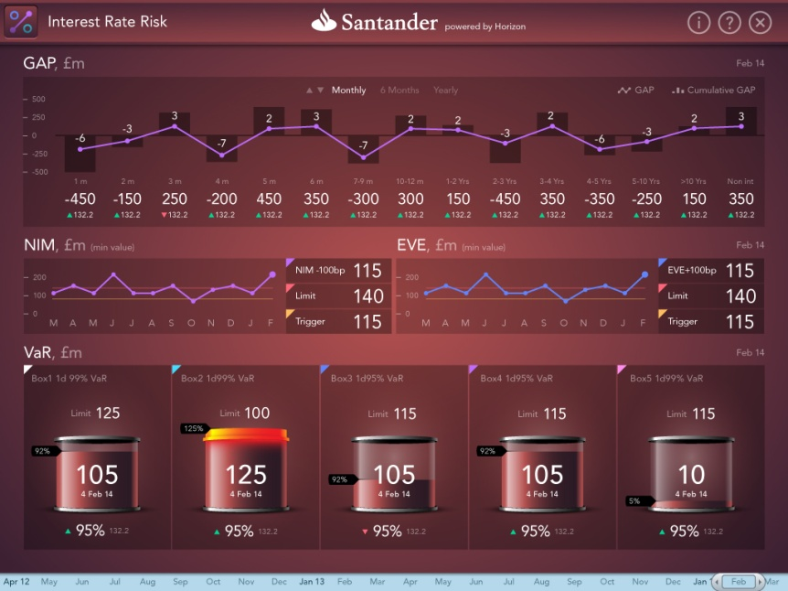
CONTEXT & BACKGROUND
WHAT TO DO DIFFERENTLY ?
HMI & PSYCHOLOGIC
  How to represent multiple dimensions on a graph…
  …so that the user’s brain doesn’t get puzzled ?
  What are the most intuitive actions on that screen ?
  The maximum level of info a user can absorb on a widget
  what is the most intuitive way to represent the components of a value ?
  …
Notes:
Reinventing the way reporting was done was mandatory; it is implying significant changes, in fact.
- First change : representation of data; several companies specialized in data representation, creating innovative widgets, based on psychological methodologies.
- HMI / ergonomics also benefit from cross-industry collaboration; in Luxoft case, leveraging our automotive line, is an interesting case: even though very different, core drivers & paradigms apply very well

Slide 7
USE CASE
multi devices
IE
dnepro
fast
engines
android
mobility
iPad
OSGi
visuals
workflow
navigation
user experience
Spring
JMS
XULRunner
reporting
Magic Circle
design
kiev
Felix
quality
heat map
Bubble Chart
audit
Luxembourg
Supernova
technique
monitoring
WIDGETS
SVG
risks
cache
Radar
GWT
krakov
accelerated
approach
security

Slide 8
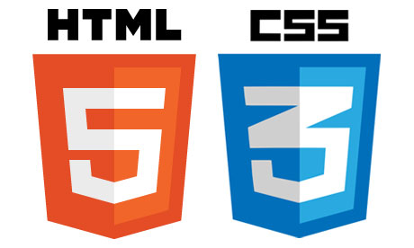

USE CASE
RISK MANAGEMENT – INVESTMENT BANKING 2011
DRIVEN BY CRO’S VISION
CULTURAL CHANGE – SAME LANGUAGE & KPIs ACROSS THE GROUP
ANALYTICS & DATA INFRA AGNOSTIC
DEPLOYABLE & MOBILE
SECURITY
Notes:
- came from the need & vision from DB's CRO, wanting to address the issues mentioned before : silos, dissemination of data, etc.
- global visibility and understanding of what happens across the group was becoming crucial for some senior guys, especially in the Risk and Audit departments.
- reactivity was necessary: too much was done on paper and involving more and more analysts
- iPad compatibility was required from day 1
They were conscious that a cultural change was necessary and convinced that technology could help.
Time is key in such change, so it was out of question to wait for the completion of transformation of the analytics layer, or any DWH program : the solution had to be flexible and agnostic enough to adapt to changes.
Working with DB CTO group, HTML5, CSS3 and JS imposed themselves pretty quickly.
Other solutions were screened, based on past projects (silverlight, Flash/Flex) but were excluded.

Slide 9
USE CASE
ORIGINAL STACK
CLIENT
GWT
3 MAIN PILLARS:
GWT (2.2)
SPRING FRAMEWORK
APACHE FELIX (OSGi)
RPC
SECURITY
LOGGING
GWT
SHARED
SERVICES
SERVER
CACHING
APPLICATION REGISTRY
INTEGRATION
HIBERNATE
SOURCES
JDBC
vDB
Notes:
- OSGi was chosen (Felix), as considered efficient in terms of team collaboration and to impose a structure/way of working, especially regarding bundling & deployment.
- GWT was chosen, in order to leverage the existing Java expertise and also as DB had positive experience of it (performance wise, optimized javascript code)
+ it was mature, with existing communities, documentation + code examples, etc
+ in terms of staffing, the ability to rapidly grow the team, with people already experienced on such stack was important.
The solution proven efficient, rapidly adopted by more department, covering Risk (Credit, Market, Treasury/Liquidity), Audit, Clearing, Op Monitoring.
DB won several awards for that work (show logo ?).
NOW, LOOKING AT SOME SPECIFIC ASPECTS, LIKE RENDERING, THE APPROACH WAS BASIC

Slide 10
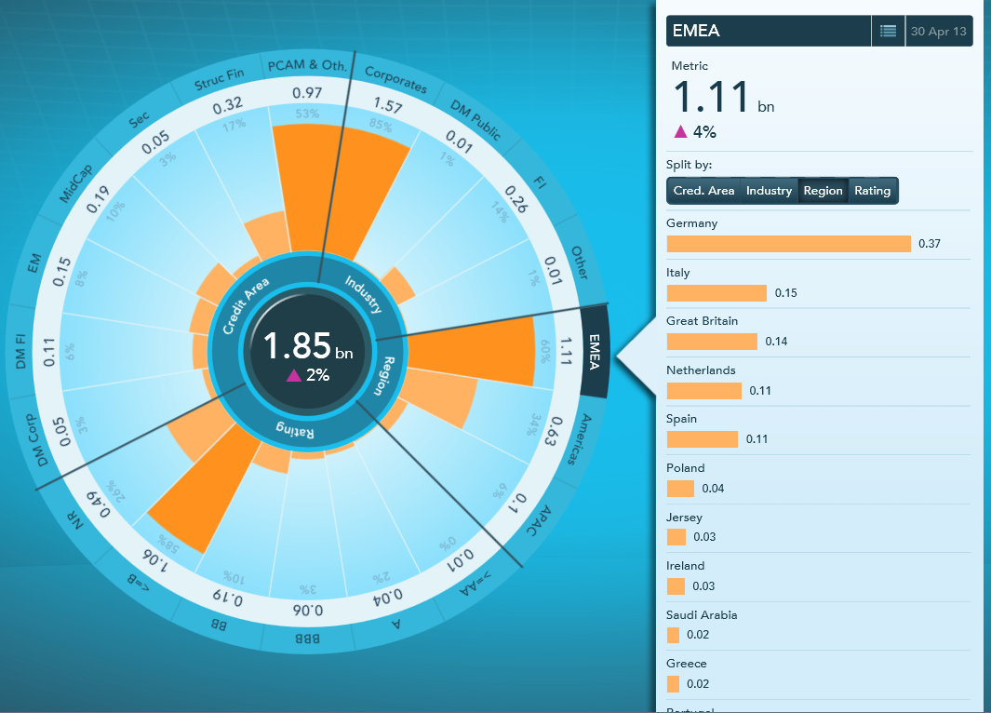
USE CASE
CANVAS, PERFORMANCE & DATA QUALITY
Single Canvas
heavy developer workload
DOM size
SCENE GRAPH
Direct Draw
101010110101010101010101011110101
101010101000101010101010100100100
001010101001010101010101010010100
101011101010101010101010101101010
001010101010101010101010100010101
110101010010101010101010101111101
010100101010101010101010100010101
110101010101010100101010011010101
CACHING
Single Cache & Manager
VIRTUALIZATION
TEIID Performs well, but…
quality of data is crucial
dependency on sources availability
Notes:
- JS Canvas important, as efficient for animations, considered key for user adoption
- caching was implemented in the classical way, with a single cache manager per application and a pure statistical mode
- data virtualization seemed super-promising : connect to the golden sources, build a star-schema as vDB, avoiding duplication and providing super fast access
Issues:
- single scene graph: heavy development required, everything was programmatic, so delivery timeframe was higher than what expected (especially as demand was increasing => team as well)
- virtualization showed limits due to the disparate quality of the golden sources (consistency/matching records, quality of data)
But it helped identifying areas of improvement, as even though people know they have some issues with DQ, they usually struggle to identify them precisely (TBC in a specific section)
- caching is impacted by the depth of each dimension and proven not optimal in some cases

Slide 11
USE CASE
CHALLENGES & ISSUES
LEVERAGE WEB/UI DEV BETTER
FULLY (JAVA) PROGRAMATIC
PERFORMANCE / FLUIDITY
DATA CONSOLIDATION & QUALITY
CONSISTENCY
IMPROVE CACHING
PROJECT METHODOLOGY
ANALYTICS LINK
Notes:
Successful project, but not challenges & issues - free, like any bespoke development.
The idea here is to share with you the most frequent and recurring ones and what kind of workaround/solutions we applied.
Especially in the light of the acquisition of the IP by Luxoft last June : we turn a bespoke development into a product, i.e. addressing more clients & needs.

Slide 12
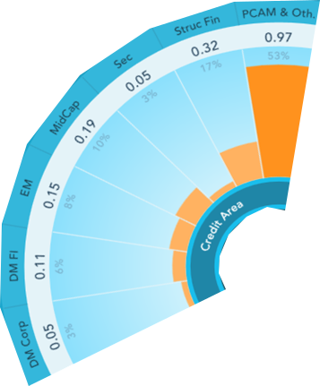
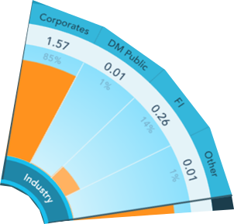
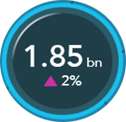
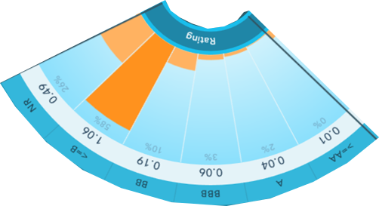
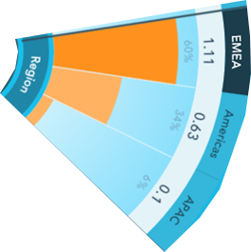
USE CASE
CANVAS, PERFORMANCE & DATA QUALITY
Composite Canvas
developer assembles layers
reuse components for multiple widgets
SCENE GRAPH
Composite
COMPONENTS
Canvas
Widget-level cache manager
specific logic / context-aware
optimize strategy for each source
image cache
CACHING
Multiple Layers
Widget Manager
VIRTUALIZATION
Notes:
- composition : java devs use objects designed by WEB devs and code only the composite scene graph
- not canvas systematic: if no need for advanced caching, full html works well (example of supernova)
- cache can be tailored to the use patterns: not everything can be cached, obviously and the statistic method can be improved by pre-loading the cache by anticipating the actions the user will make (usually click first on high values, excesses, etc)
=> config allows chosing which fields drive caching priority, ability to set thresholds, reserve space
=> periodic procedures / specific dates handling allow improving performance when working with historical data
- use virtualization when really meaningful (quality, availability of sources)
- fast updates resulted in some flickering and animations were not always fluid : hired devs with game background to implement specific features like double buffering to avoid flickering, or image caching (sprite-like technique), render only visible components

Slide 13
USE CASE
CANVAS, PERFORMANCE & DATA QUALITY
Specific efforts / outcome:
higher involvement of Web/UI devs
  dashboard delivery time -40%
  costs decrease in line (UI dev vs Java)
increased number of composite widgets
extended caching strategies…
…when meaningful : canvas not systematic
game dev techniques useful
SCENE GRAPH
Composite
COMPONENTS
Canvas
CACHING
Multiple Layers
Widget Manager
VIRTUALIZATION

Slide 14
ANALYTICS
IE
shocks
dnepro
fast
delta
android
custom
iPad
OSGi
what-if
workflow
simulations
user friendly
reporting
Spring
JMS
XULRunner
Magic Circle
Real-time
Felix
kiev
heat map
Bubble Chart
audit
Luxembourg
Supernova
technique
monitoring
engines
approach
bias
SVG
Radar
cache
excel
POI
krakov
accelerated
security
Notes:
- decision making requires simulations/what-if
- usually performed by analysts, based on fixed scenario given by management
- challenge is to avoid bias (model bias) => connect directly to the engines
As in many cases, Excel was the chosen "engine"...opportunity to integrate specific framework in the solution: Apache POI
Still, workflow manager was put in place to perform exchanges with other engines.

Slide 15
USE CASE
ANALYTICS LINK
CLIENT
EXTERNAL SYSTEM
GWT
WEBSOCKETS
REST
(JSON/JSONP)
RPC
WEBSOCKETS
SECURITY
LOGGING
GWT
SHARED
SERVICES
SERVER
CACHING
APPLICATION REGISTRY
INTEGRATION
SPRING INTEGRATION
HIBERNATE
SPRING DATA
OLAP4J
APACHE POI
JMS
ESB
SOURCES
JDBC
vDB
SOAP
REST

Slide 16
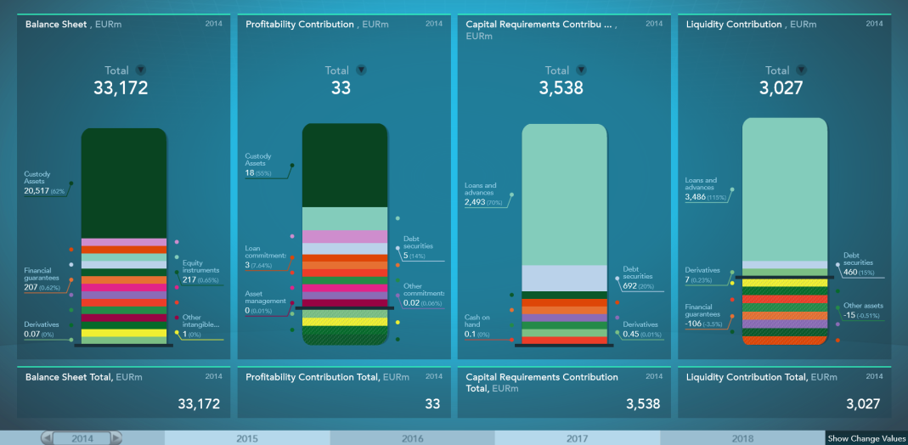
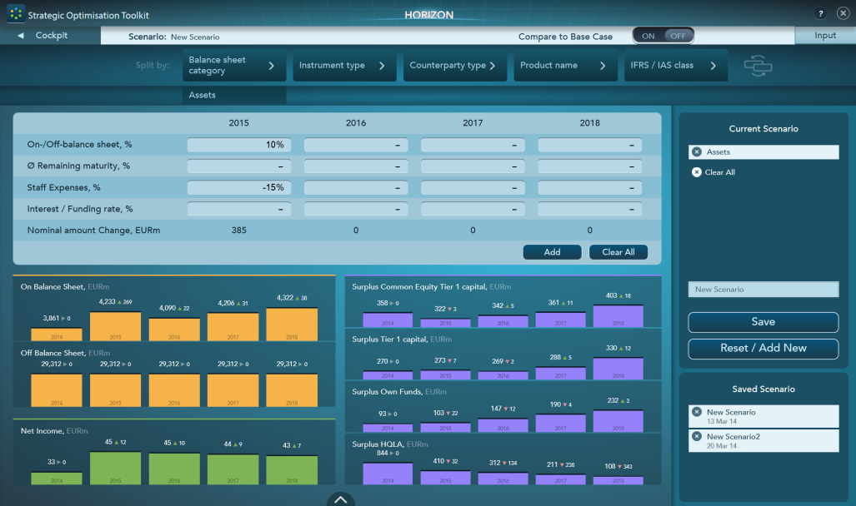
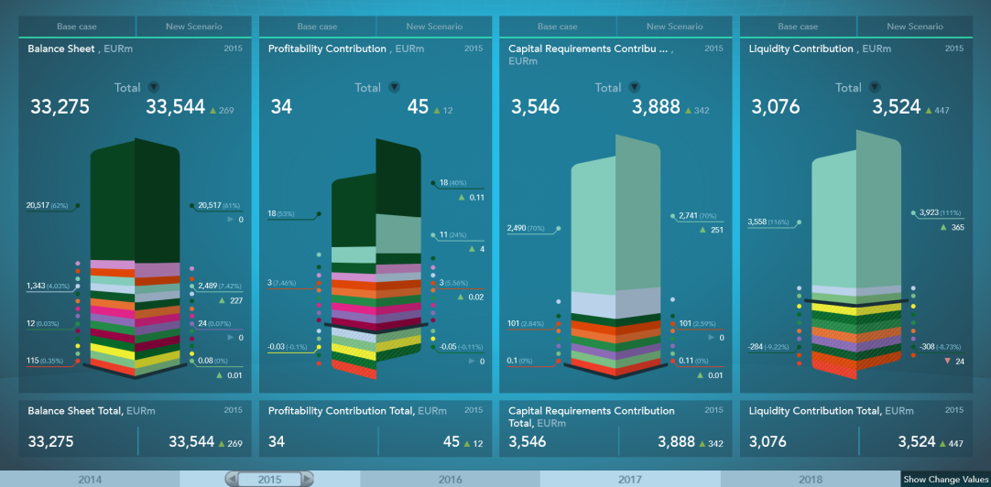
USE CASE
ANALYTICS LINK – integration with Excel
SPRING
POI
Simulations
Performance drops with big sheets/formulas
Preferred native (COM) approach for updates & recalc
Runtime pool of processors (pre-open workbook)
Notes:
Takeaways:
- careful on the "Standard" way of simulating : duplicate Excel workbook, rapidly becoming disastrous (=> combine simulations in a Simulated workbook, or persist somewhere else and swap)
- when working with 3D graphs, for high quality, better use a specific library, don't try to do it yourself, you're going to lose lots of time, probably (we used ThreeJS)

Slide 17
DATA CONSOLIDATION
hibernate
sybase
fast
DB2
MDX
consistent
HDFS
ORACLE
quality
query
workflow
Spring
JMS
vDB
JDBC
join
design
kiev
Magic Circle
speed
Bubble Chart
OLAP4J
gigaspaces
audit
datamarts
controls
TEIID
sources
SVG
SQL
gaps
cache
Radar
krakov
consistent
approach
security
Notes:
- we don't pretend bringing a solution to the problematic

Slide 18
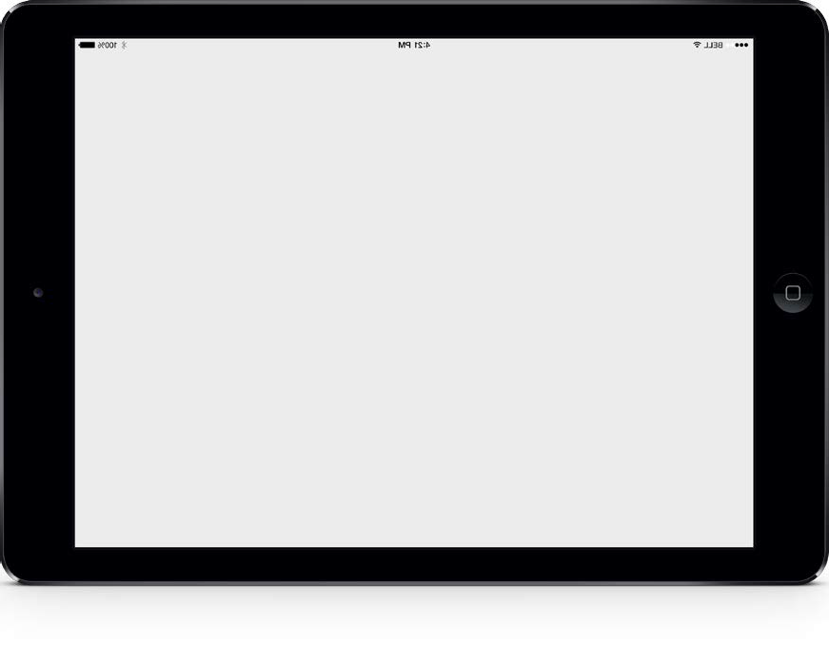
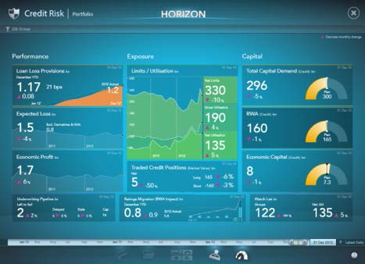
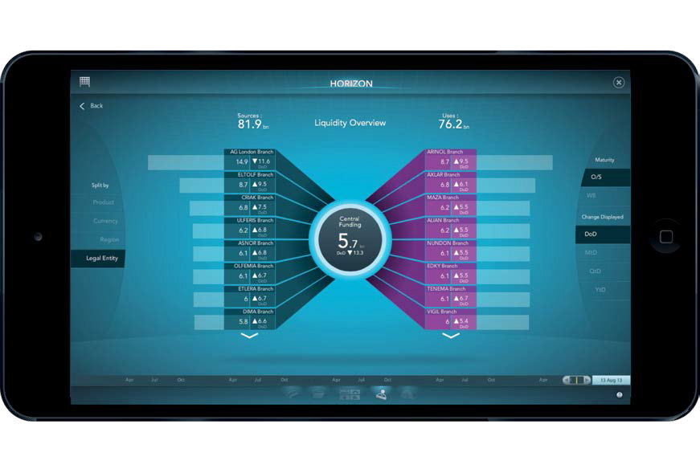
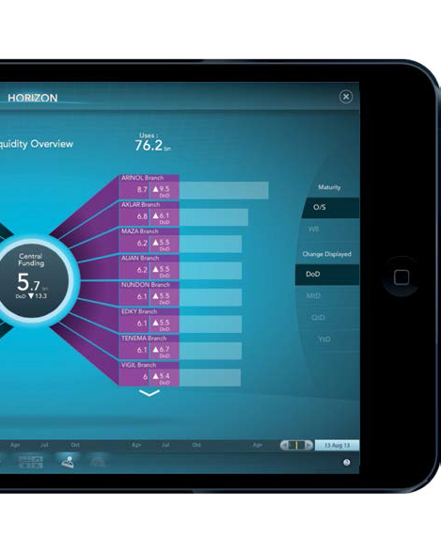
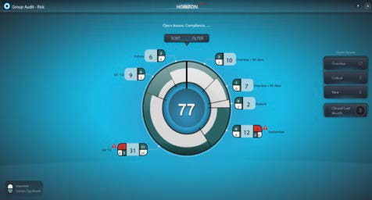
USE CASE
DATA CONSOLIDATION & QUALITY – classical approach
MERGER OF DATA MODELS
RATIONALIZE ANALYTICS & PROCESSES
BUILD UNIQUE USER EXPERIENCE
TIME CONSUMING
LITTLE VISIBILITY / INTERMEDIATE DELIVERY
QUALITY CONTROLS IN PLACE AT THE END
MAIN PORTAL
FINANCE
LIQUIDITY
RISK
COMPLIANCE
TAX / REPORTING
DATAWAREHOUSE / DATAMARTS
PROTOTYPE
PROJECT
3 MONTHS
2+ YEARS
Notes:
- Usually in projects : start at the data infra layer, try to merge all models of all systems involved to get a CDM, build DQ processes => several months and conflicts about master system for specific fields

Slide 19
USE CASE
DATA CONSOLIDATION & QUALITY – top-down approach
START FROM THE EXPECTED DASHBOARDS
GO DOWN, IDENTIFY KPIs and COMPONENTS
DEDUCT DATA MODEL / STAR SCHEMA
IMPLEMENT EXTRACTION FROM GOLDEN SOURCES
BENEFITS
AGILE-FRIENDLY
BETTER AWARENESS & ADOPTION
BETTER KNOWLEDGE OF DATA
IDENTIFY “WEAK” SOURCES
QUALITY CONTROLS EARLIER
REDUCE NUMBER OF SOURCES
CAN HELP DWH PROJECT
MAIN PORTAL
FINANCE
LIQUIDITY
RISK
COMPLIANCE
TAX / REPORTING
PROTOTYPE
PROJECT
1 MONTH
12 MONTHS
Notes:
- noticed that the top-down approach allows simplifying the issue, by narrowing down the set of fields to work with: start from KPIs, decompose them for all drills + dimensions and identify golden source
- benefit: - rapidly able to propose a vDB model and begin parallel run (extract from GS, reg tests, etc)
- get people responsible of the extract queries very familiar with the data sets, identifying the areas generating problems
- eventually ultimately identify systems to be merged/made redundant (e.g DB)

Slide 20
DEPLOYMENT
phonegap
jvm
fast
cordova
zip
security
https
chrome
browser
iPAD
workflow
Spring
JMS
chrome frame
IE
native
Magic Circle
speed
Bubble Chart
safari
firefox
html5
obsolete
old
XUL
mobile
SVG
OVM
krakov
Radar
desktop
cache
consistent
approach

Slide 21

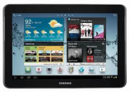
USE CASE
DEPLOYMENT
still running obsolete browsers, poor HTML5 support
still reluctant to deploy client on user station (e.g. XULRunner)
if IE 7-8, use Chrome Frame
frequent to see modern browsers next to obsolete IE
want to use the same web app, so no native deployment
wrapper v.s. “installed web app” (clean approach)
mobile browsers reliable and stable – more or less
wrapper is necessary when strong security is required (token)
Notes:
- banks not up-to-date in terms of browsers (IE 7-8 still very much represented)
- reluctance to deploy software on user stations (XULRunner)
- security considerations (especially for Mobile deployments) : local caching not accepted in lots of cases
=> for IE, worst browser for HTML5, Chrome Frame was giving good results (even though obsolete now, but features will still work) - banks are kind of used to run obsolete things, so they are ok to continue
=> on mobiles, native mode has been excluded, except for a simple wrapper : embeds a webkit that runs the web app, but no native code so far : performance levels in HTML5 are sufficient so far, no need for OPENGL, etc
- browser full screen mode is preferred and now gives good & stable results; requires being careful with the cache management on Safari, as FS doesn't behave as browser mode - a bug in our view
- allows easier support with versions upgrades of the OS, which happen quite fast in that world
- quite easy to put in place, with specific meta tags; tested on Safari and Chrome - need to be in every HTML + JS file

Slide 22
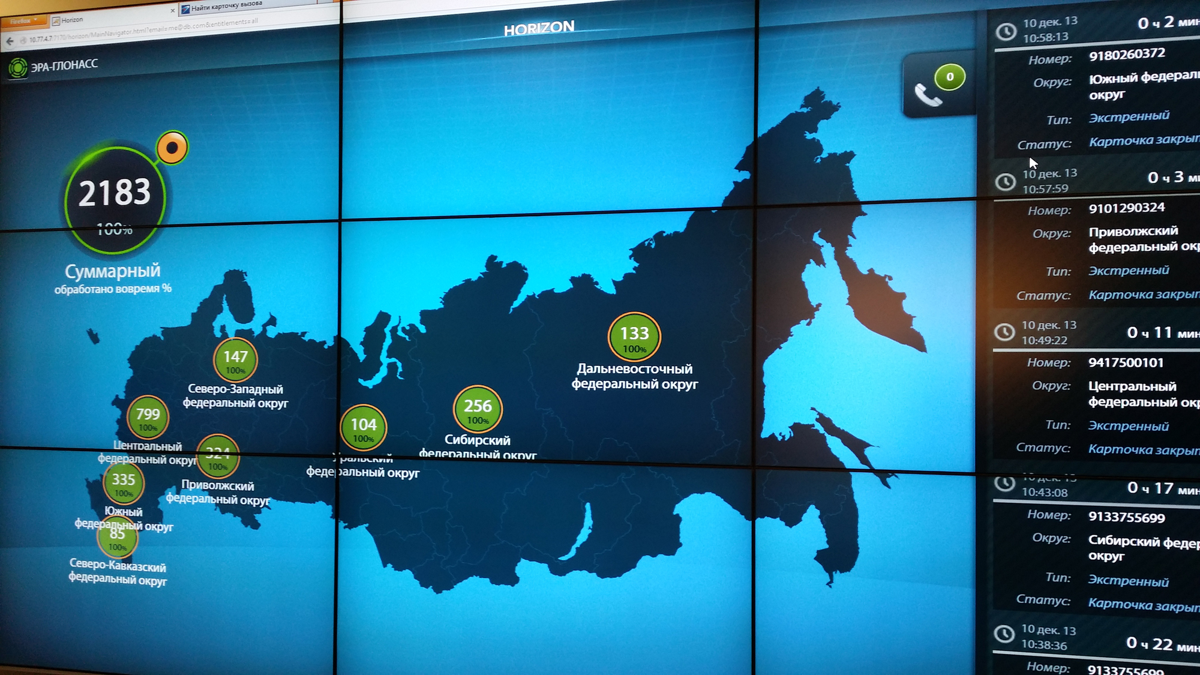
CONCLUSION
Visibility & Transparency more than ever business critical
ADV is seen as a potential facilitator
Provides an interim solution, with a faster time to market
Technology is mature and reliable, can cope with most restrictions from banks
Act as a door opener for some open-source technologies, sometimes banned
Good opportunity to bring the banks to a technological level similar to other industries
Notes:
banks can benefit a lot from technological evolutions in Visualization
it helps in critical areas like regulation and strategy/decision making
risk management is an area where it develops fast, thanks to the visibility of some awarded technologies
the main challenges are still related to the outdated infrastructures and technologies, as well as agility/deployment pace of new technologies
solutions improve to cope with deployment restrictions
added value justifies some exceptions, as we notice in current projects

Slide 23
THANK YOU !
Q & A

Slide 24


FOR MORE INFORMATION PLEASE CONTACT:
FABRICE ARESU
FAresu@luxoft.com
Head of Business Support Group
Tel: +352 621 541180

