Slide 2
Places @ Facebook
Justin Moore
6/12/2014

Slide 3
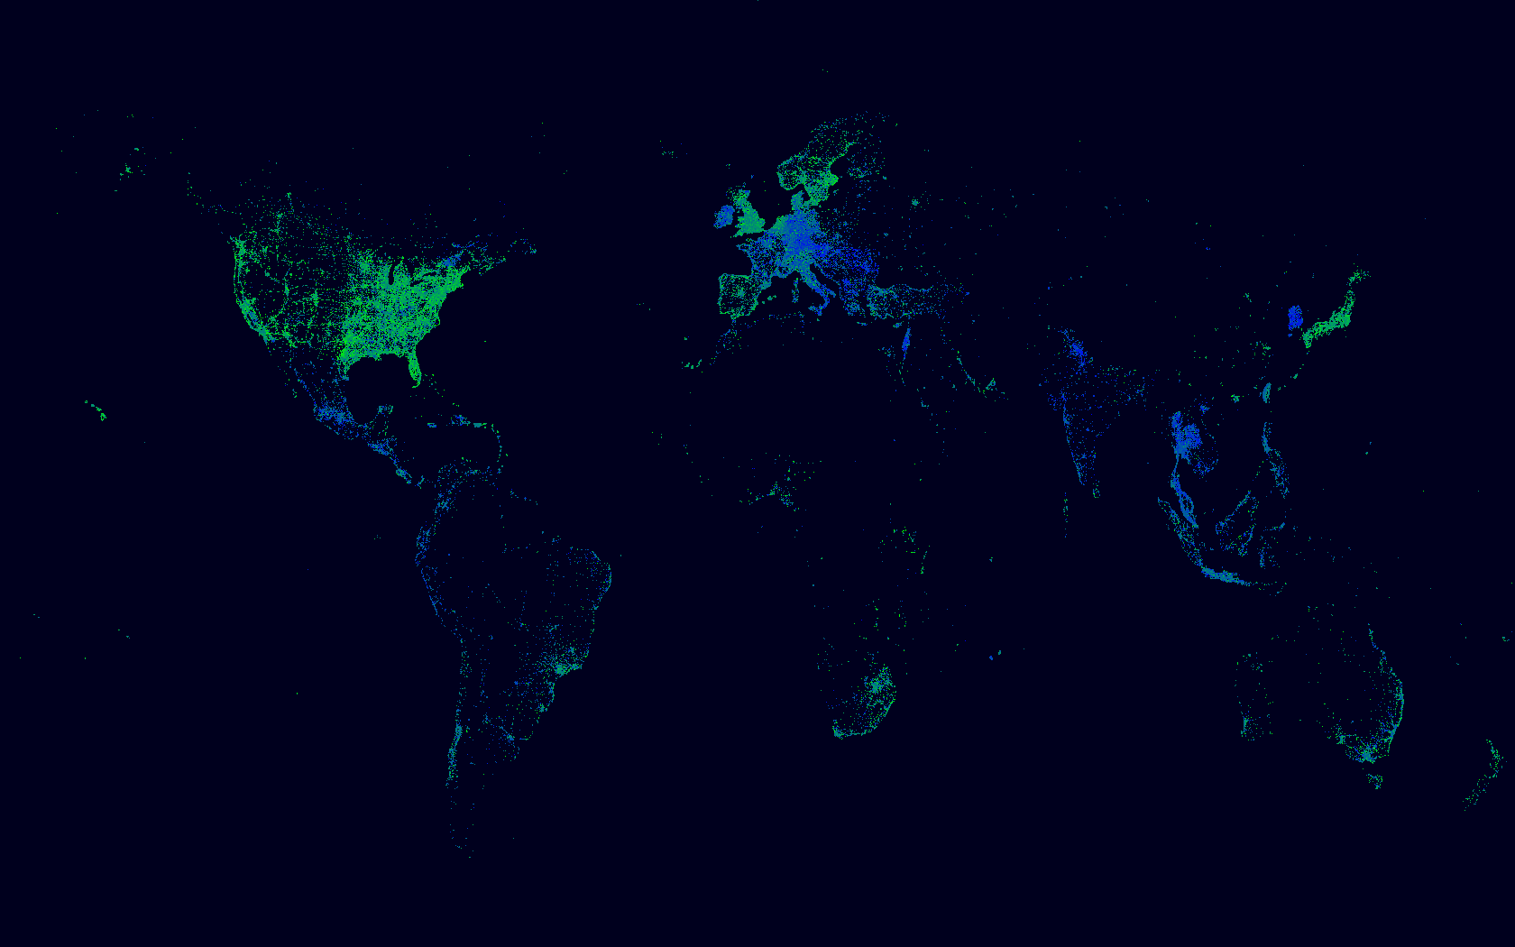
Our goal is to enable engagement based on a world-class POI database
We believe that competitive quality in the following 5 dimensions is a sufficient basis for competitive product experiences:
Coverage: Want to know about every place in the world
Completeness: Want to know everything about them
Accuracy: Attributes are accurate
Junk: No homes, non-public places
Dupes: Only one place for every real entity
Notes:
Facebook has the largest and richest crowdsourced database of places in the world. Here you can see a map of one day’s worth of our 1.2bn monthly active people tagging location in our product

Slide 4
Notes:
And it’s truly a global database. You can see initially how people started to interact, but as we extend six months at a time over the course of the product, you can see how deeply we have penetration into countries where you can’t build a database based on government data, there may not even be an organized local government

Slide 5
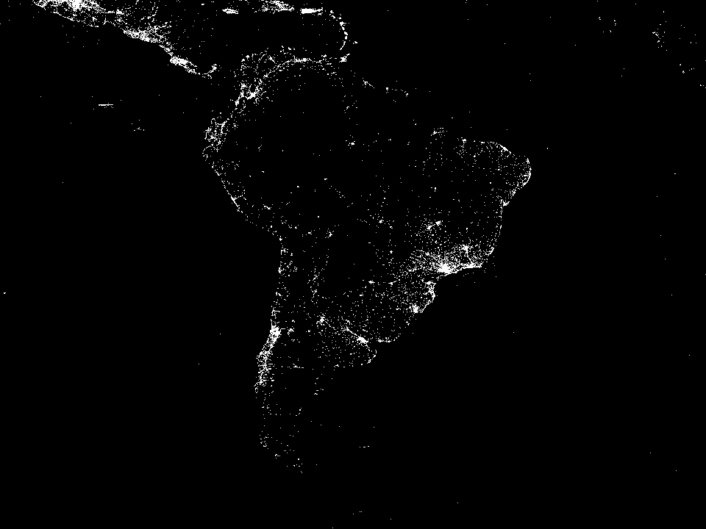

Slide 6
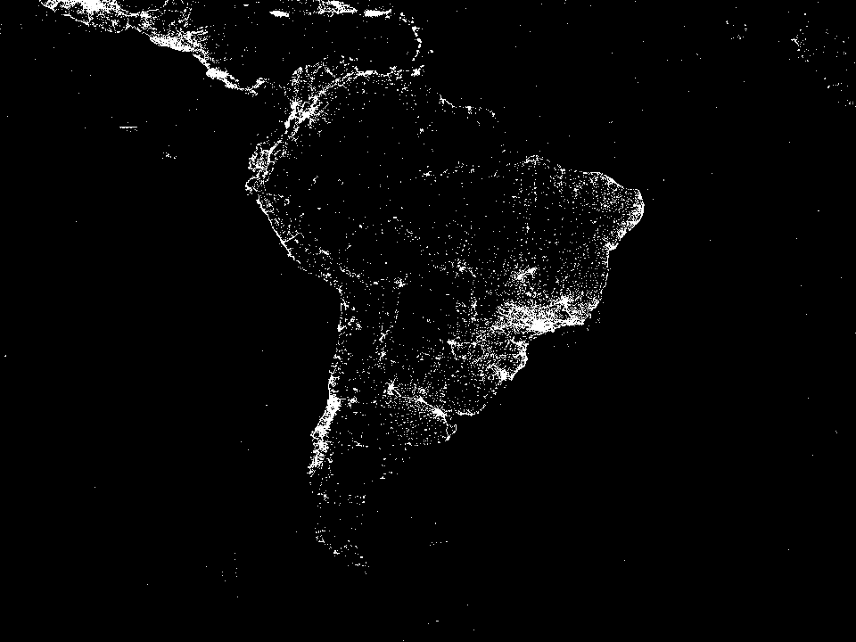

Slide 7
Notes:
But with the ability to crowdsource locations, we can find out about every place that someone is connecting to, wherever we have people using the facebook product

Slide 8
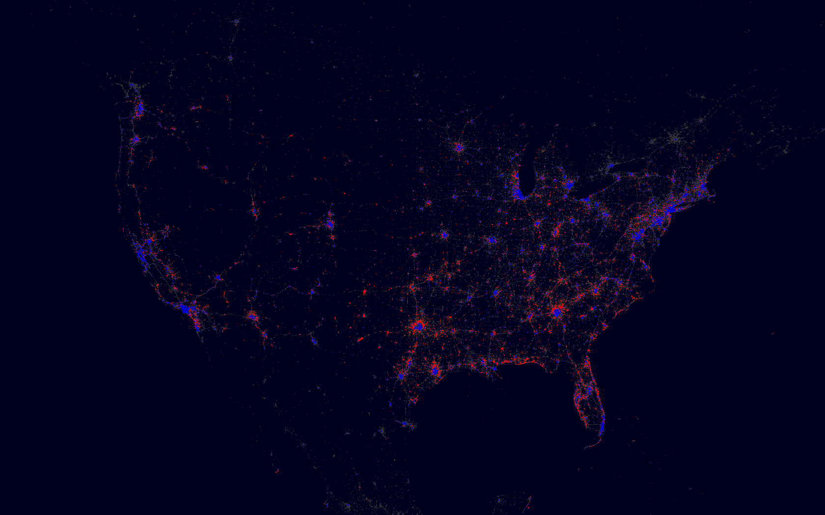
Structured Data
Explicit entities, connections
Allows
Notes:
And we don’t just have a great global database of crowdsourced places, but we also have a rich graph connecting real identity and people’s interests across the whole Facebook ecosystem. This is an example of a mashup where we plot places that republicans tend to check-in and democrats like to visit. You’ll notice a finer grained map than you can get with just county statistics and the entrenched cities of democrats surrounded by republican suburbs.

Slide 9
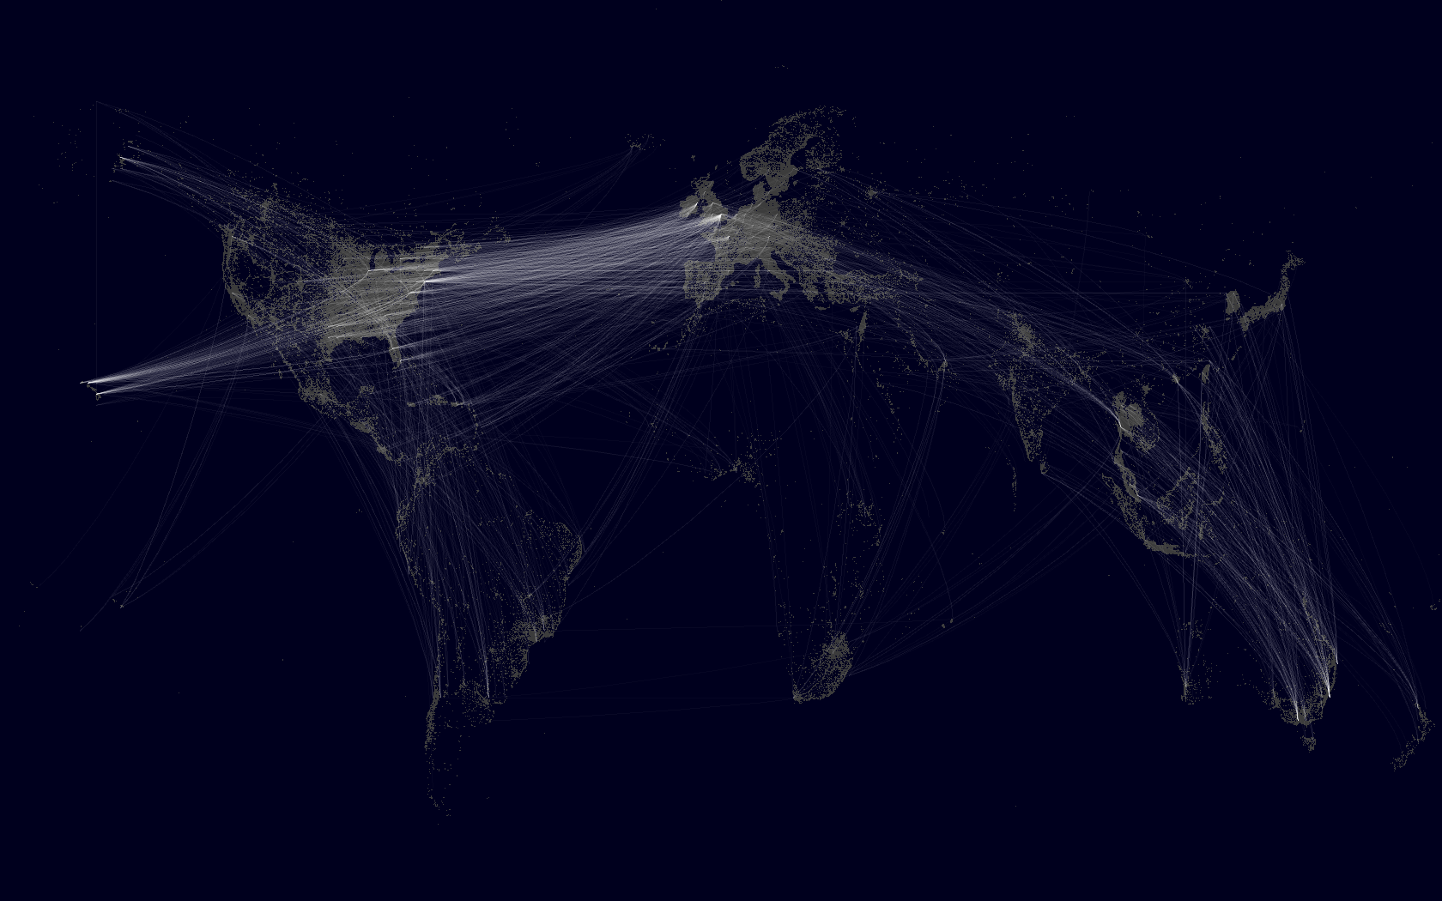
Structured Data
Explicit entities, connections
Allows
Notes:
And we can also use this to think about user mobility. When is someone traveling and what types of experiences do we want to surface. This is a map of all the check-ins that differ by more than a few hundred miles over the course of a day. You can see common travel patterns across the world.

Slide 10
Search Quality
Oops →
Notes:
Our job is to make as high quality an experience as possible for our users. These problems span across improving our dataset of places, building accurate ranking models, and making sure the product surfaces the right information.

Slide 11
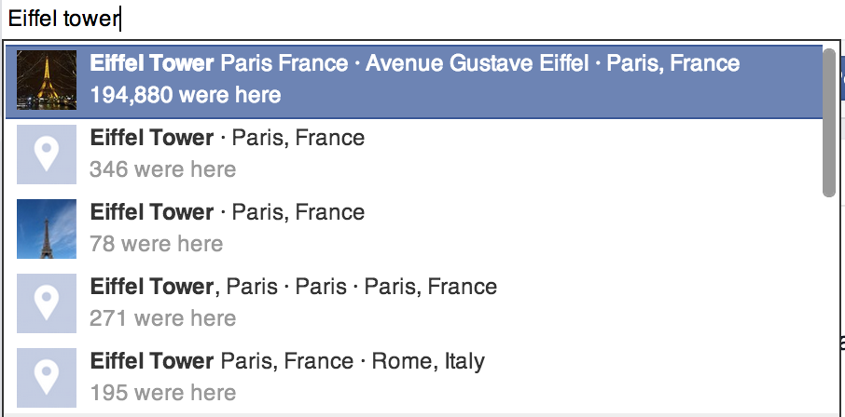
Location in name
Duplicates
Mislocated
Notes:
Generally these are the types of problems we cannot measure automatically. To achieve this, we have a team of highly trained annotators who look at anonymized search logs and annotate issues that don’t match with our quality bar. We leverage these insights to drive quality improvement efforts.

Slide 12
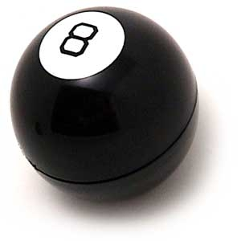
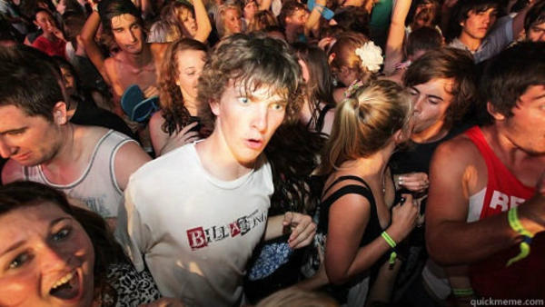
Not Duplicates
My sources say No
Are they
duplicates?
Ask Again
Later
Decidedly So
Duplicates
Notes:
Based on some of the poor user experiences we find, we generally tackle it in two ways. First, we leverage the powerful machine learning systems we have at Facebook to make decisions about results we think of as bad. Are these two places the same and shouldn’t show up together, is this place closed? For things we can decide with a high level of certainty, we can set automatically, but things we’re only 50% sure of, we can ask the crowd. This gives people the ability to vote on likely matches so you don’t’ waste their time, and have them help by deciphering tricky cases that are hard for a machine to learn.

Slide 13
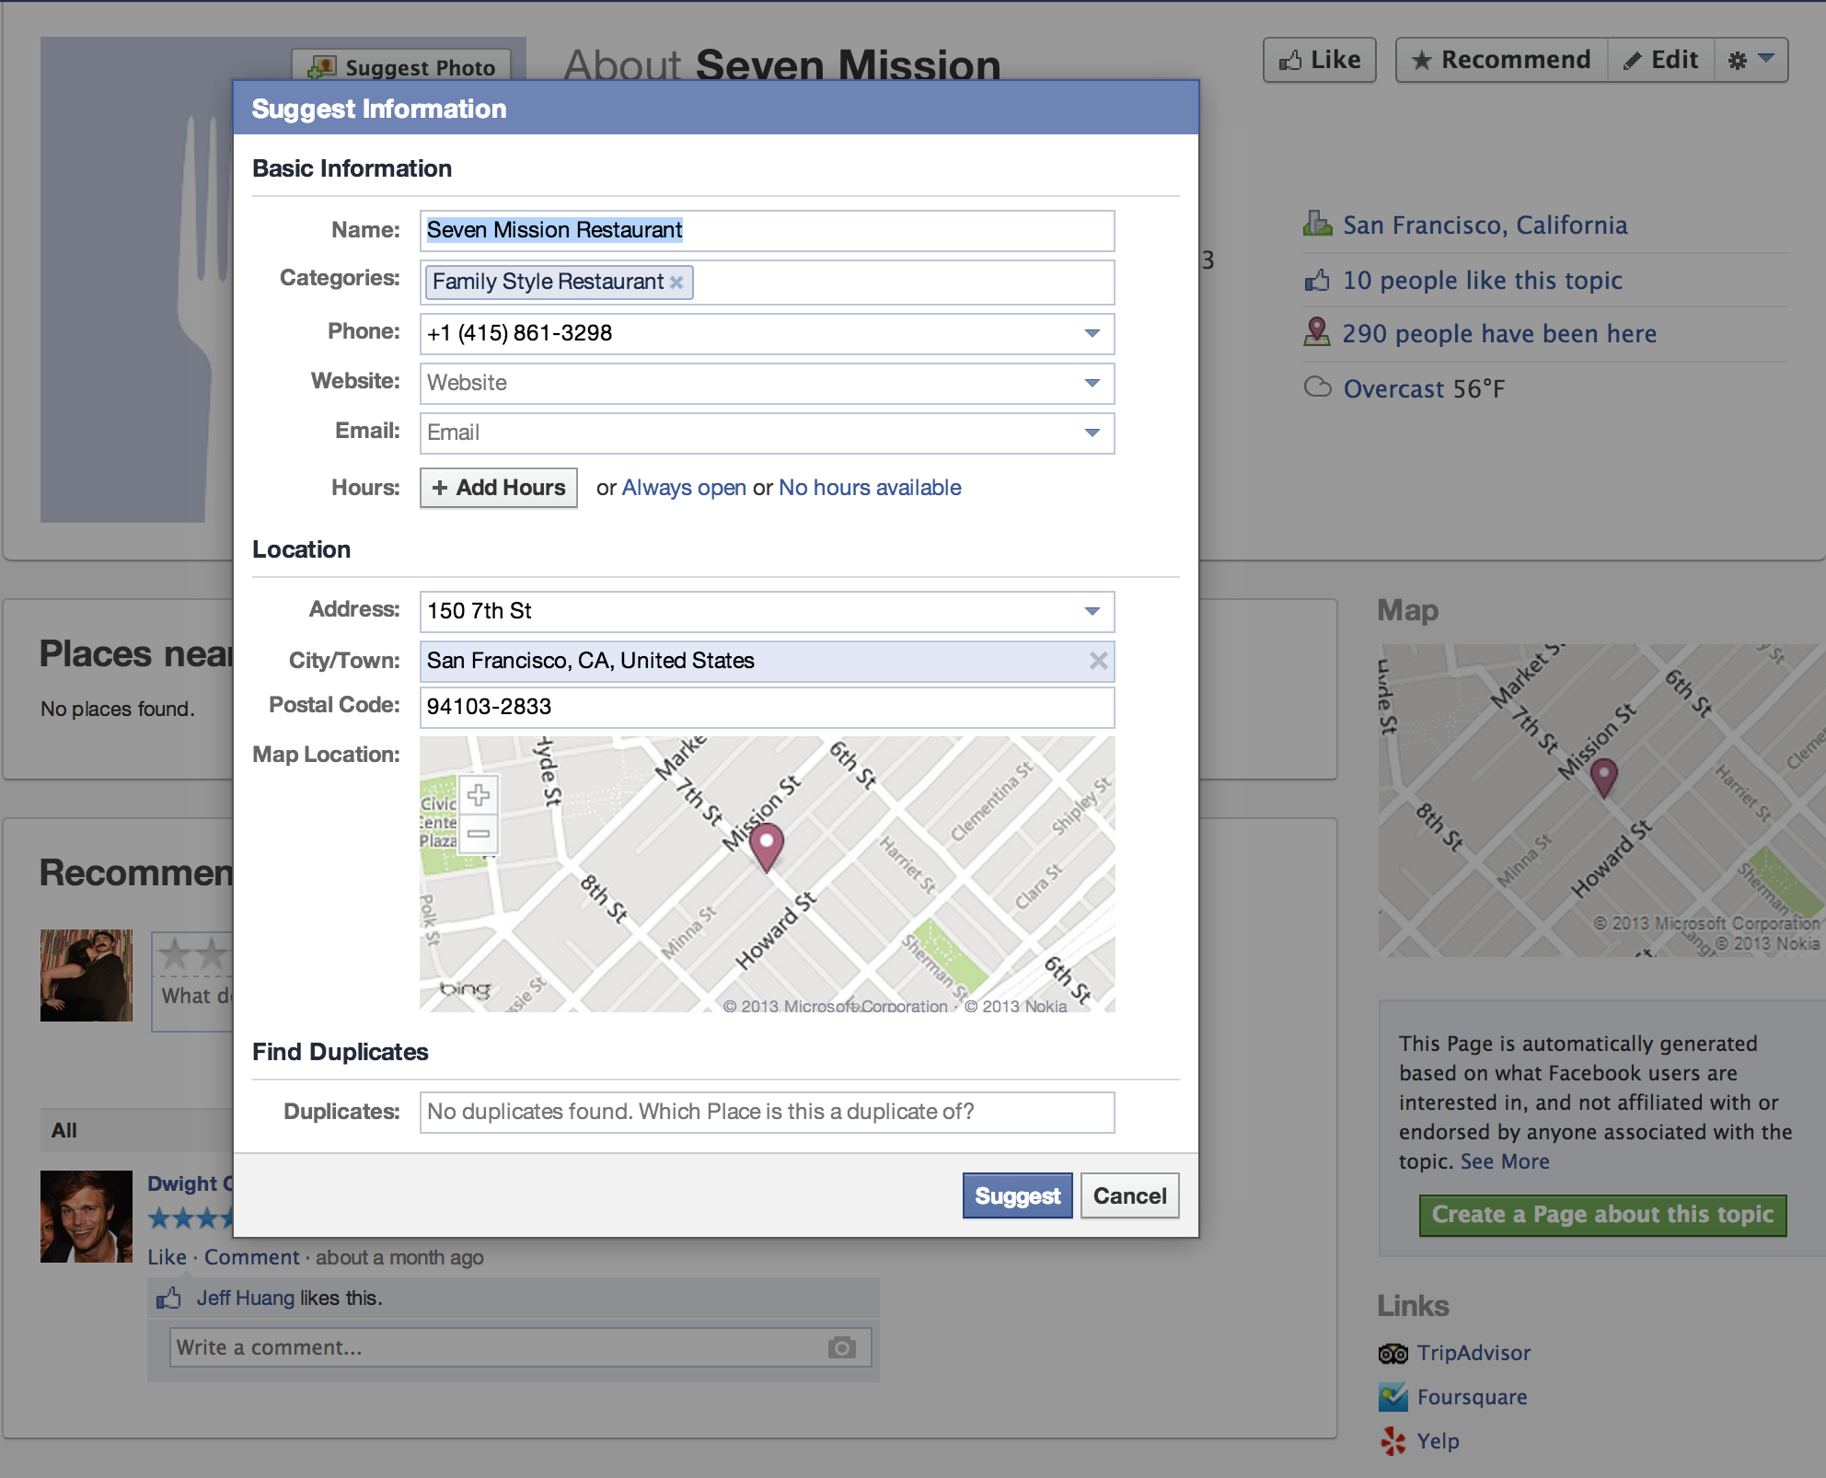
Crowdsourcing

Slide 14
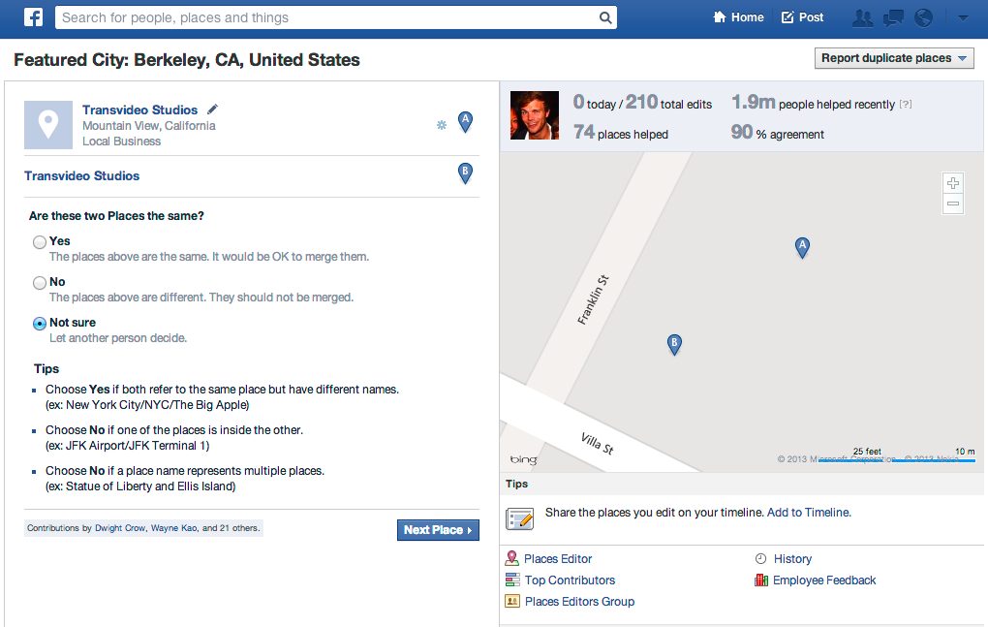
Crowdsourcing

Slide 15
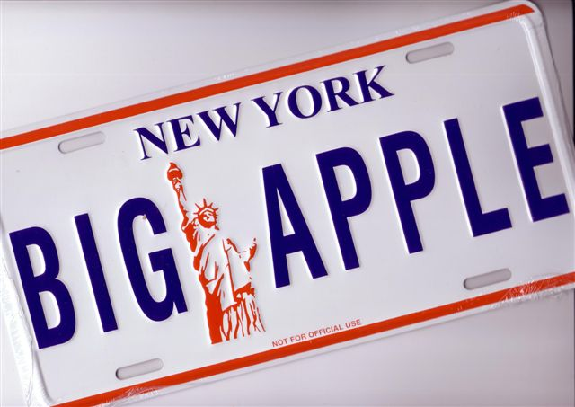
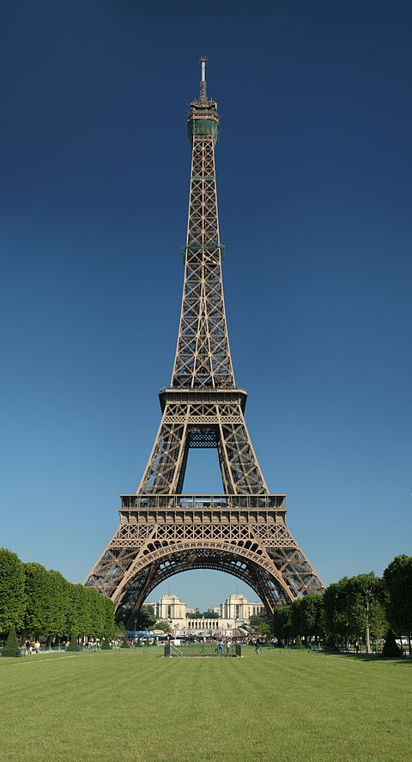
Hard to Match
Crowd
Machine Learning
More Popular
Notes:
Using this hybrid method allows us to have strengths for most types of entities in our database. Given a finite amount of recall and/or judgements, the crowd is stronger at judging popular entities. This applies to easier judgements like the eiffel tower, but also to difficult matches like saying the big apple is the same as new york, which is easy for any new yorker, but really difficult for a machine to understand. On the flip side, a machine can scale much more and it can learn about many places in the world without the constraints of physical size, popularity, etc. Thus, it can make many more simple judgements than even a large set of engaged crowdsourcers can do. Thus, for easy stuff, it can easily scale to millions or billions of judgements in a single run. This leaves us with a bit of a gap for harder to make decisions in places that aren’t as popular. These NY examples are probably not great because they actually are pretty popular, but ambiguous small entities like Joe’s Pub at the Public and even “The library at the public” may be difficult if not many people know about it to help crowdsource information and a machine may easily confuse it with the public library.

Slide 16
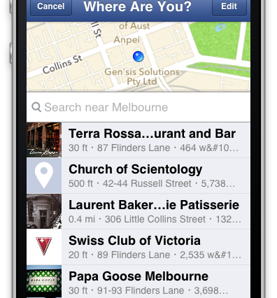
Product
Notes:
All of these efforts enable us to create better product experiences for the people using places on faceook. They can connect to official pages, get better information, and have a richer experience. The better pages on the right are the result of correctly deduplicating and directing the experience toward high quality connections.

Slide 17
Deduplication
Notes:
I talked a lot about deduplication issues and how they surface in the product, but wanted to take a deeper dive into how we use machine learning to solve this problem. We allow people to tag statuses to places anywhere in the world, which means we need to surface any place

Slide 18
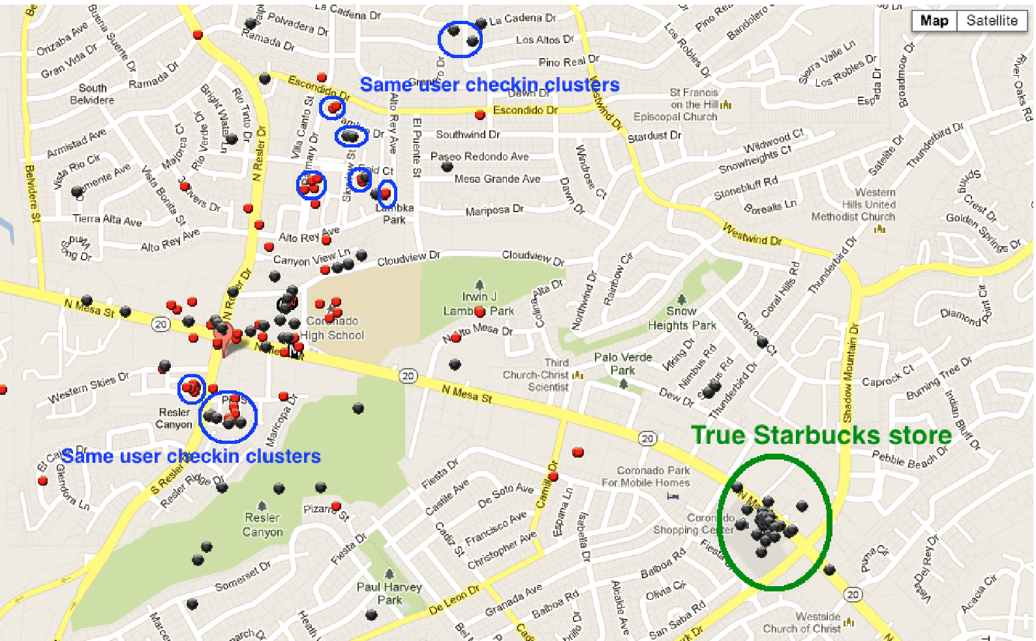

Slide 19
Candidate Fetch
Pairwise Classification
Clustering
?
?

Slide 20
Candidate Fetch
Domain of (Place, Place) is in the Quadrillions!
Name Edit Distance
Classification Boundary
Same Name
Close
Physical Distance

Slide 21
Hashing FTW!
Name Edit Distance
Classification Boundary
Physical Distance

Slide 22
Deduplication, cont.
Extremes are difficult
Chains - lots of little clusters
Landmarks - one big cluster
Landmarks of chains – one big cluster among lots of little clusters

Slide 23
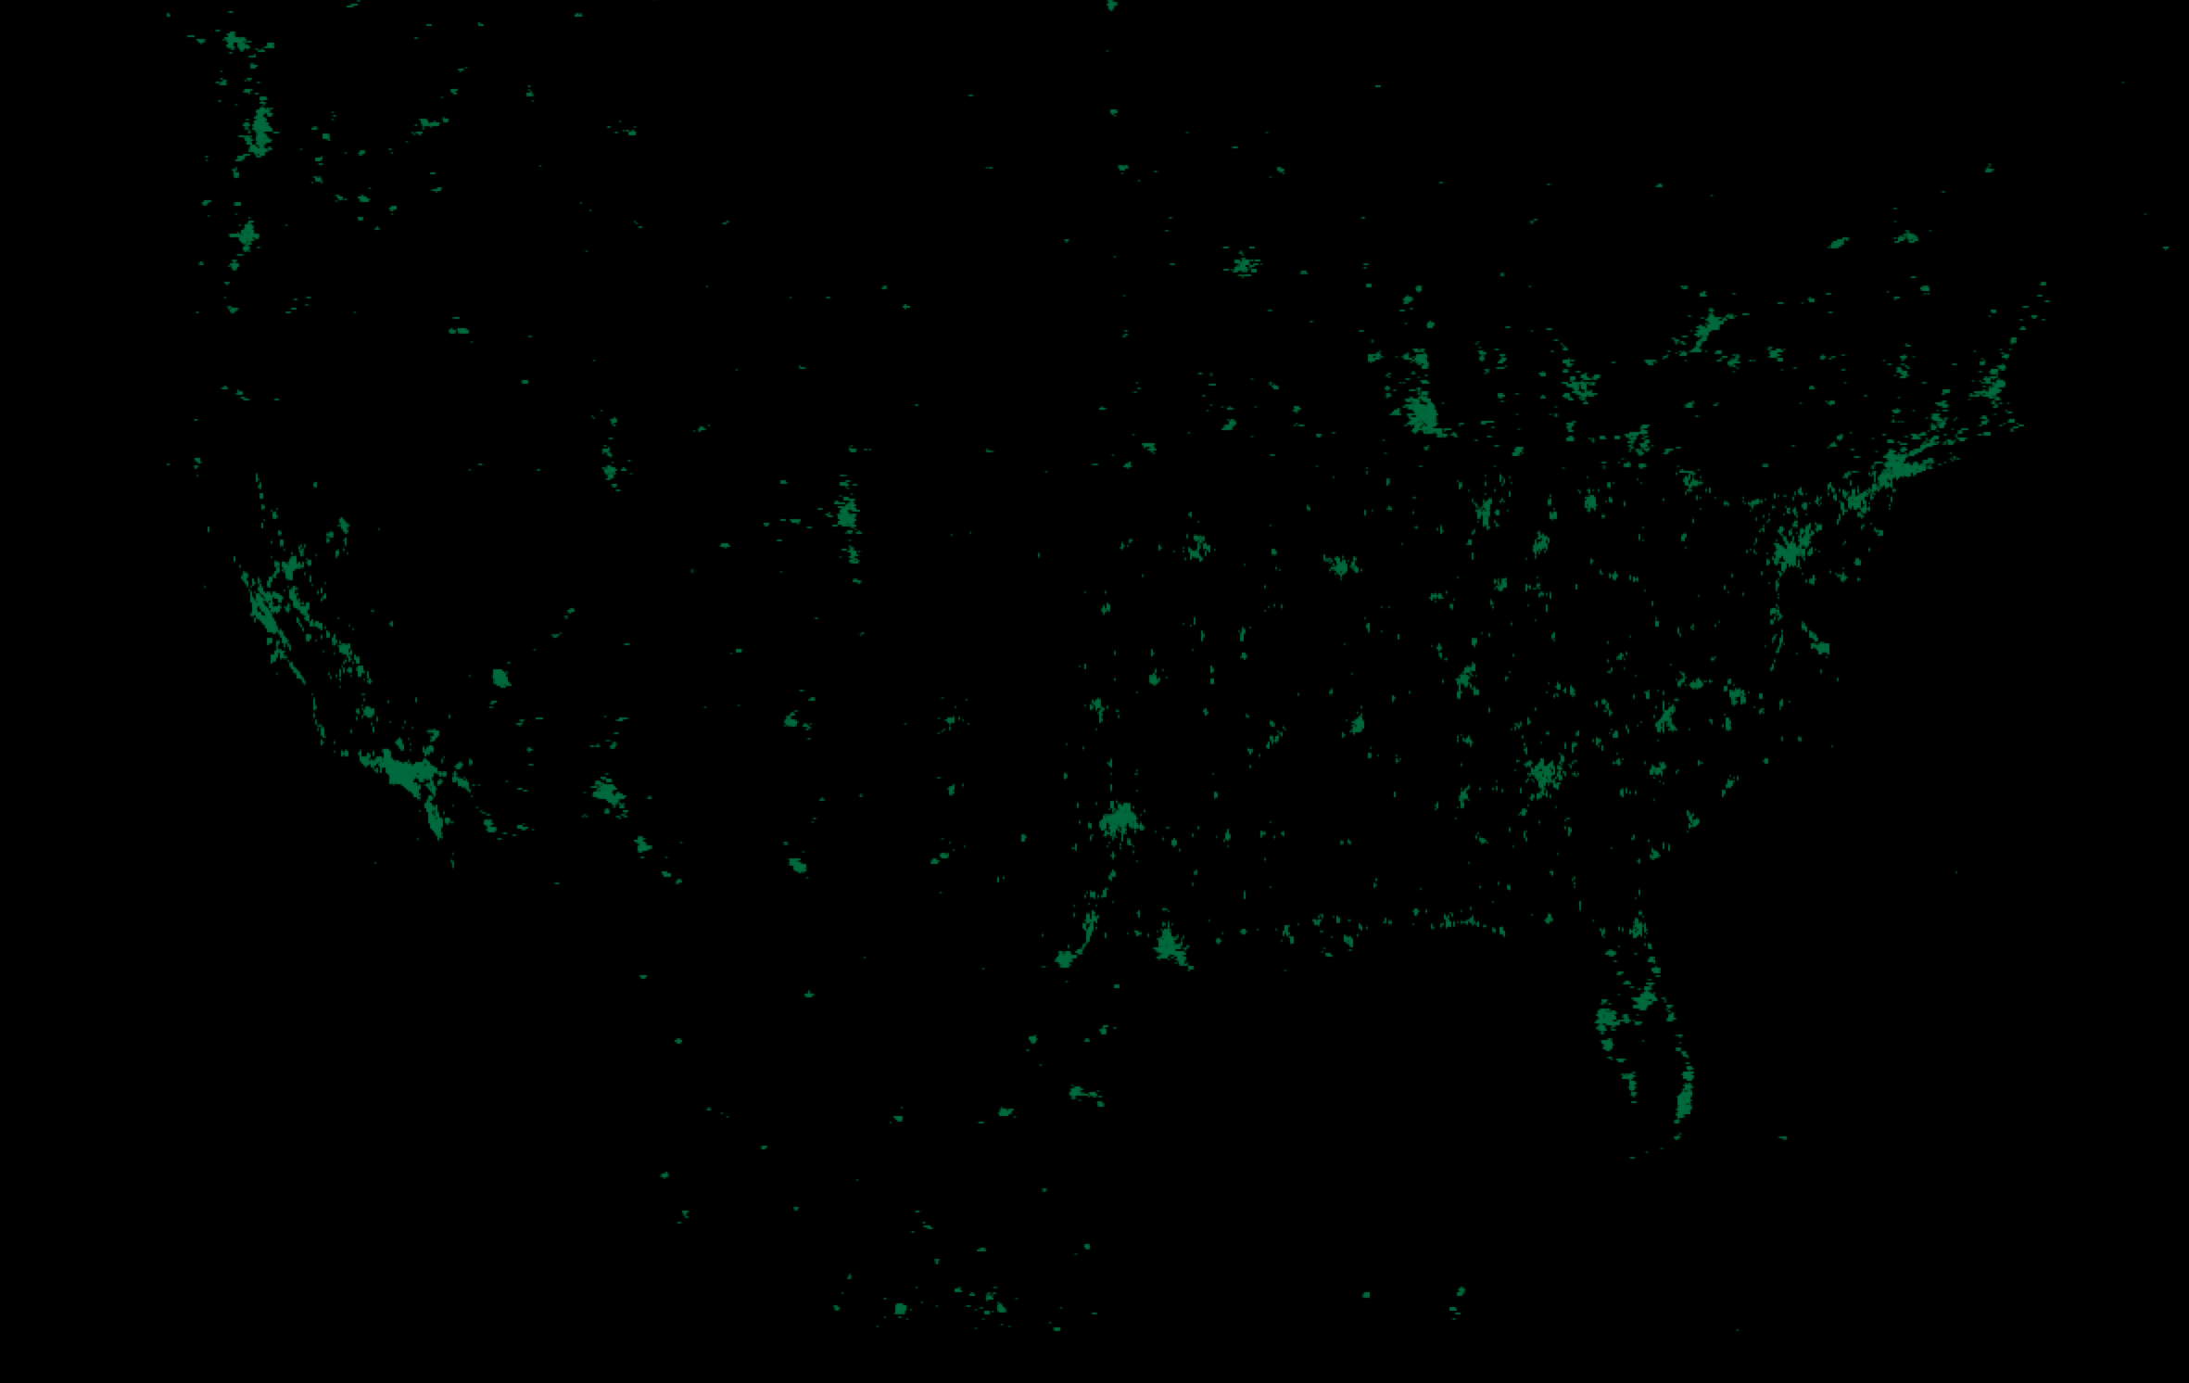
Notes:
People can create duplicate locations if they can’t find the right one. It can be hard to detect these duplicate places. This is a map of all the Starbucks in the US. To the untrained eye, they can look like duplicates.

Slide 24
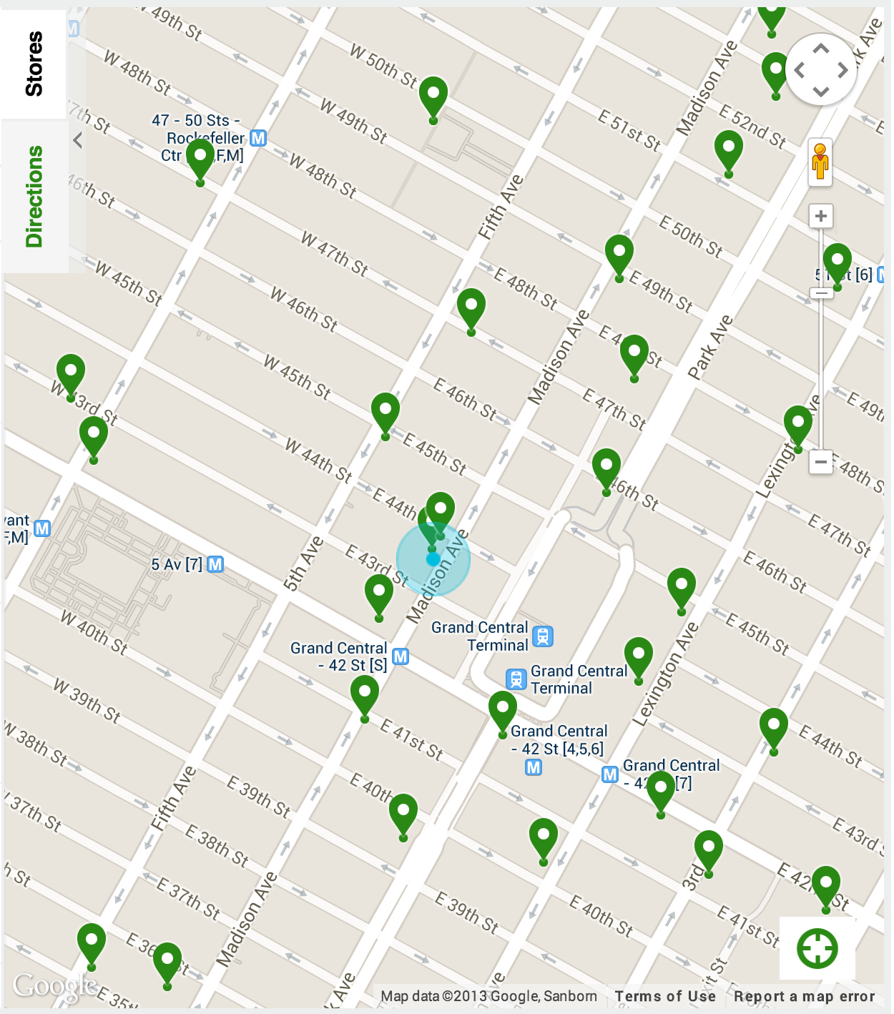
Notes:
It’s even harder in NY. Lots of dense places, places on top of one another. This is midtown, near where our office used to be. There were twenty starbucks within a quarter mile, at least one of which was underground. With no wifi, it’s nearly impossible for your phone to locate you in dense areas like this. If there is a duplicate somewhere in the mix, good luck!

Slide 25
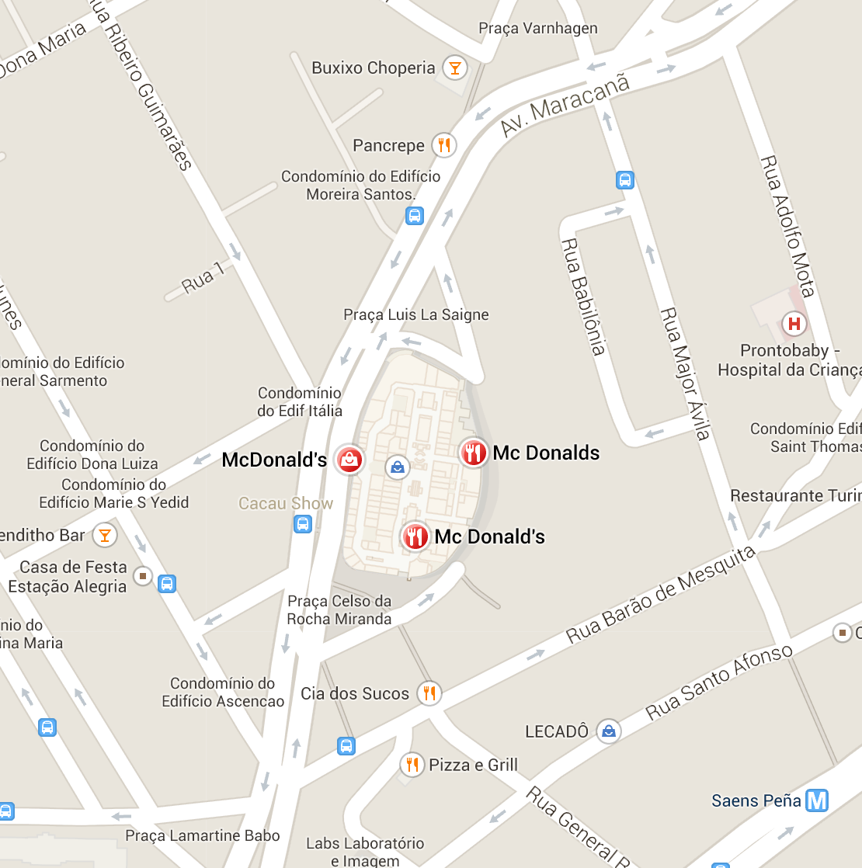
Notes:
Some of these you can easily solve using some form of artificial intelligence. I actually took this from Google Maps instead of Facebook, but it shows how you can see cases where there are almost certainly duplicates. For cases where places are very close by and have practically the same name, it’s not hard to train a machine learned system to recognize these types of issues and quickly clean them up. Even though it’s a very common restaurant, it is highly unlikely that there are three McDonalds in the same shopping mall.

Slide 26
Deduplication, cont.
What is the same?
“New York Sports Club” != “New York Sailing Club”
Places inside other places
“Starbucks Grand Central” = “Starbucks”, != “Grand Central”

Slide 27
Deduplication, cont.
Classify pairwise, clustering breaks transitivity
Solve chains, landmarks specifically
Use domain knowledge, add constraints
Official pages are not duplicates
Different sources have different behavior
Starbucks
Starbucks
SF Airport Starbucks
SF Airport
SFO
SJC Airport
SFO Airport
SJ Airport
SJC

Slide 28
Evaluation
Lots of manual evaluation
Supervised classification
Qualitative metrics (how many dupes are there today?)
Post-run precision labeling
Tiered method
Hand label
In house data raters
Crowdsourcing or Turk

Slide 29
How do you evaluate clusters?
Building golden sets is difficult
Weighting toward more common problems
Could require exhaustive search!

Slide 30
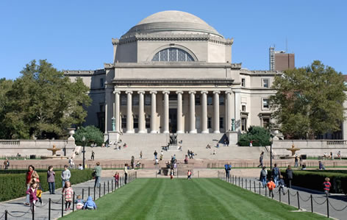
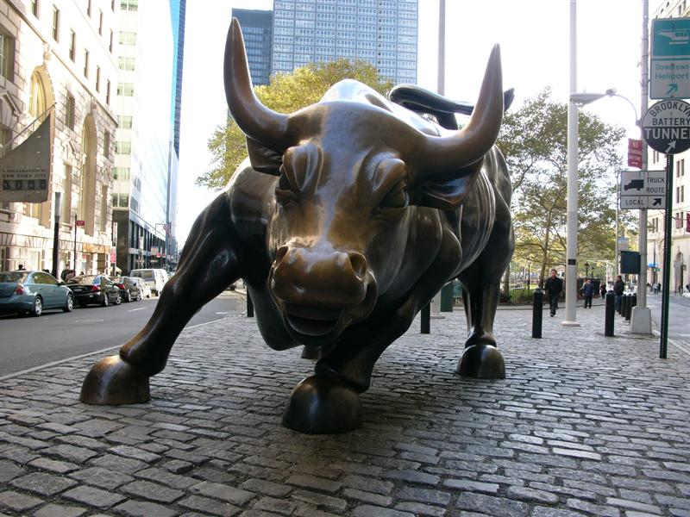
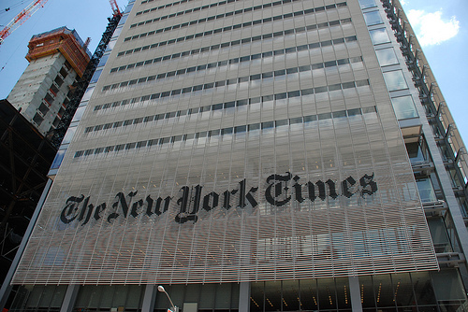
Notes:
New York is a great landscape to be tackling these problems because it has a diverse set of people coming from backgrounds ranging from a huge density of academic and college settings, math and data heavy finance firms, as well as many other historical roots. The confluence of academics, product oriented media, and math focused industry makes for a great breeding ground for folks interested in building data driven product at scale.

Slide 31
Notes:
I personally have a fairly diverse background that brought me to Facebook. I started a graduate program at Columbia, quickly dropped out and went to the then dominant industry in NY, eventually found my way over to the correct side

Slide 32
Questions?
justinm@fb.com
@injust
facebook.com/jtm
Facebook NY is hiring! -- facebook.com/careers

