Slide 1


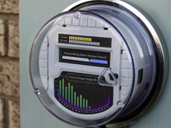

Leveraging the strength of OSGi to deliver a convergent IoT ecosystem
An example based on Smart Energy Profile 2.0 (SEP 2.0) deployment use case
Oleg Logvinov, Luca Celetto, Carlo Parata, Fabien Castanier, Mridupawan Das
STMicroelectronics
OSGi DevCon – June 12, 2014
Notes:
Abstract
This talk will present a platform designed for application development to serve the new markets enabled by the Internet of Things, with a particular focus on Home Automation, Smart Energy, and e-health. It will provide the reasons why OSGi has been chosen and show how the platform works.
The Internet of things is the next revolutionary wave following profound changes brought to us by Personal Computers (connecting places) and Mobile Phones (connecting people on the go). This third wave heralds the beginning of the new era of pervasive connectivity, embedded intelligence, and application convergence. It will be the world where smart things will communicate among themselves and with us, enabling a more efficient, and more comfortable environment.
Designed to jumpstart application development, the STMicroelectronics Smart Home Platform is composed of a gateway in production-ready form factor and a set of sensor/actuator nodes, along with a Java Virtual Machine, ProSyst's OSGi framework and a working demonstration application fully supported by STMicroelectronics. The built-in OSGi stack provides Java-level abstraction of the network interfaces of the gateway and its nodes as well as cloud integration features such as a web server, web services and standards-based remote management. The OSGi framework is the key enabler of the product lifecycle and remote application management mandatory for service provider driven deployments.
The JAVA/OSGi software abstraction layer provides zero-effort portability across the all STMicroelectronics' CPUs enabling the developers to select an SoC based on application and/or interface convergence requirements. Successful demonstrations of the same home automation software built on this platform have been already made on an entry-level gateway (based on ARM926) as well as a high-end multimedia gateway (Dual-Cortex A9 multimedia processor).

Slide 2







ST: Where you find us
Our MEMS & Sensors are augmenting the consumer experience
Our digital consumer products are powering the augmented digital lifestyle
Our automotive products are making driving safer, greener and more entertaining
Our Microcontrollers are everywhere
making everything smarter and more secure
Our smart power products are making more of our energy resources
Notes:
Positioned to cover the full specturm of the SmartHome: sensors, microcontroller, connectivity, gateways

Slide 3



















ST is involved in Standardization
Member
Promoter
member
Alliance
Member
Alliance
BoD
Sponsor
Member, BoD
Project
Contributor
Alliance
BoD
PAP15
Contributor
Alliance
BoD
DKE461
Contributor
Alliance
CTO, BoD
HP GP
Chair
P2413
Chair
Members, contributors
P1901.2
Vice-chair
Editor
Alliance
BoD
P1901
Vice-chair
Full
member
Notes:
ST is member/helping shaping many of IoT related standards/alliances

Slide 4



New Things to Augment Life
Smart City
Reduce traffic congestion
Better use of resources
Improve security
Smart Me
Healthcare
Empower patients
Help physicians monitor and diagnose remotely
Smart Car
Reduce emissions
Increase safety
Save fuel
Smart Me
Fitness & Wellness
Help to lead healthier lives
Optimize sports performance
Early warning of illness
Smart Home
Make entertainment more interactive and immersive
Increase comfort
Save energy
Notes:
Regulation and lifestyle changes are driving change: The need to conserve energy, to increase efficiency and use technology to work for us and how we live. We are living longer and want to stay healthy while enjoying our new extended life.

Slide 5

















Embracing the Smart Home
Sensors, intelligence and connectivity being added to many devices in the home
Innovative nature of the products allows new companies to challenge established leaders
ST present with many of the leaders in the first wave of augmented things in the home
Smart Lighting
Entertainment
Intelligent Locks
Smart Appliances
Smart “Me”
Electric Vehicle
Smart Energy
Toys & Games
Notes:
Security
Energy management
Gadgets
The over the top STB market AppleTV/Amazon Fire/Chromecast – FDSOI. Cool Industrial Design requires ultra low-power footprint.

Slide 6

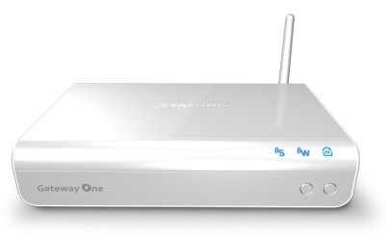
Smart Home GW Platform
GatewayOne by Tatung
ARM 926EJ-S@333MHz
360 DMIPS; 200 when running HPAV Linux + JVM + OSGi framework
WiFi 802.11n BT Smart Ready Ethernet USB 2.0 HomePlug AV Optional Zwave and ZigBee
STreamPlug
Press release: http://www.st.com/web/en/press/p3478
Notes:
512MB NAND
512MB RAM
ST2100 (ARM926EJ-S 32bit RISC, 333MHz)
Memory and
Storage
SDRAM Memory DDR2: 512MBytes (256M x 8bit x 2)
Flash Memory
NAND flash: 512MBytes(SLC type)
Serial NOR flash: 16MBytes,
Communication
PLC HomePlug A/V, Green PHY
Ethernet IEEE802.3 10/100Based-T
Wi-Fi or Wi-Fi + Bluetooth combo Either 802.11 b/g/n (1Tx 1Rx) Wi-Fi Direct, or
Wi-Fi + BT combo(BT 4.0, or Low Energy dual mode)
HomeMatic , Z-Wave or ZigBee
Either eQ-3 HM-MOD-UART-AW-SH HomeMatic transceiver module,
Z-Wave V6.02 module, or ZigBee module
Gateway One Specification
External I/O
USB 2.0 1 Type A connector
Button Total 2 buttons: one for WiFi(WPS) & one for PLC. Push for ~3 sec for being
connected/paired. Push PLC button for 6~ 10 sec for factory reset.
LED Indicator Total 3 LED indicators: 2 for blue color LEDs for RF & Wi-Fi
one for dual color(blue & red) for PLC/Alert.
Power IEC 60320-C8 Inlet; AC in 90-240V, 50-60Hz
Antenna 1 swivel antenna (Wi-Fi 1Tx1R)
Ethernet RJ-45 1
Wired Control 1 3.5mm phone jack typed UART port
Internal I/O
USB 2.0 1 internal type A connector for extension
UART
2: one for either HomeMatic module, Z-Wave module, or ZigBee module.
one for UART wired control, debugging or connecting to an UART/RS485
converter.
mini PCI-e 1 for Wi-Fi module, or optional Wi-Fi & BT combo module
Manufacturing Options 1 GPIO connector
Mechanical
Dimension 6.97”/177mm(W) x 1.46”/37mm(H) x 4.53”/115mm(D)
Weight (TBD)
Enclosure material PC + ABS, Flammability rating UL94 V-0
QR-Code Marking 25 x 25 mm of Size
Security Kensington lock hole for the main unit. (Lock not provided)
Wall-mount Screw holes for mounting.
Environmental
Operating Temperature 32ºF/0ºC to 104ºF/40ºC
Storage Temperature -4ºF/-20ºC to 158ºF/70ºC
Software Environment Linux V2.6.35 & drivers

Slide 7







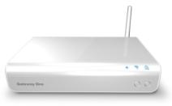













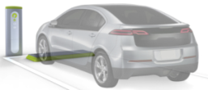

Ecosystem
Support Energy Management, Comfort & Convenience, Safety & Security, and Assisted Living applications
Cloud Services
Gateway Plug
Other level or segment of the house
Wi-Fi
Sub GHz/ZigBee/Z-Wave/HomeMatic Devices
Residential
Router
HomePlug, WiFi,
or Ethernet
Sensor
Actuator
Smart
Plug
Strobe
Alarm
Lighting
Appliance
AC
Power
Line
HomePlug
Wi-Fi Devices
IP Cam
Hand-held devices
& smart TV accessible
Optional
Bluetooth
EV Charging
HomePlug
Camera
Smart
Meter

Slide 8


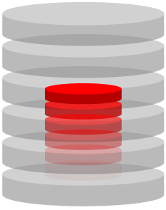














Smart Home End2End Architecture
Developer
Remote Access
Local access
Gateway
Consultable remotely by phone, tablet
Backend
System
Notes:
An explanation of the eco-system from the software point of view. Gateway is connecting to a well-known Internet server through a secure channel (in this way solving the problem of a gateway behind a NATted environment). This Backend System allows connecting a remote Internet device (like a mobile phone, a tablet) to the house to understand its status and set rules to automate processes. The same tablets could directly connect to the gateway when at home.
Gateways could be remotely updated by the Backend System. A developer may provide new apps and functionalities to the gateway, and these functionalities may be distributed to CPEs via the secure channel.

Slide 9
Key Requirements for the software stack
Large Eco System
Can be applied to all use cases
Productive for application developers
Secure
Hardware Independence: SW portability & reuse across platforms
Ease to deploy and manage applications
Single Application Framework from Devices to Data Centers

Slide 10
The Role of Gateways for IoT
Integrate heterogeneous devices and local network technologies
Provide local services – caching, sensor-actuator control loops, data processing, ...
Semantics and metadata capable – the first step toward sematic interoperability of various applications
Unified platform designed to be used by multiple services and applications
Meeting point of multiple stakeholders – owners, service providers, telecom operators, ISPs, ...
Enhance security of device area networks
Provide a uniform approach to the integration of legacy components into the IoT ecosystem

Slide 11
Smart Home Gateway Stack
Customer Applications & Services (optional)
WEB Apps
Pre-Integrated Smart Home Software
JSON RPC
Home Automation Manager
Remote Management
Home Device Manager
Network
Config
Zigbee
ZWave
BT
SEP2
OSGi
JVM
Gateway One
Pre-integration
3rd party
ST
Notes:
ST pre-integrated the full SW stack in a reference code that could be used to build the final product. Customer should focus only on the parts that provide him competitive advantage, as the white boxes in the slide, i.e. Customer Application and services and Web Application. (An example of those two boxes are provided by ST as a unique purpose of example, and are not intended to provide a product out of them).
ST pre-integrates at product level all the software stack behind these boxes, through agreement with 3rd parties and internal development. The internal development is intended to integrate the parts that are platform-specific and integrates other hardware coming from ST and its partners.
benefits of our ST software platform:
One platform for all gateway designs;
Reuse the bundles, ease of start-up
Devices: Zero Configuration, Automatic Discovery, Automatic Security
User: Web or App based, Aggregated Views (locations and objects)
Cloud: Provisioning, Integrated Device Management, Gateway (FW) Upgrades, Backup, RT Notifications

Slide 12
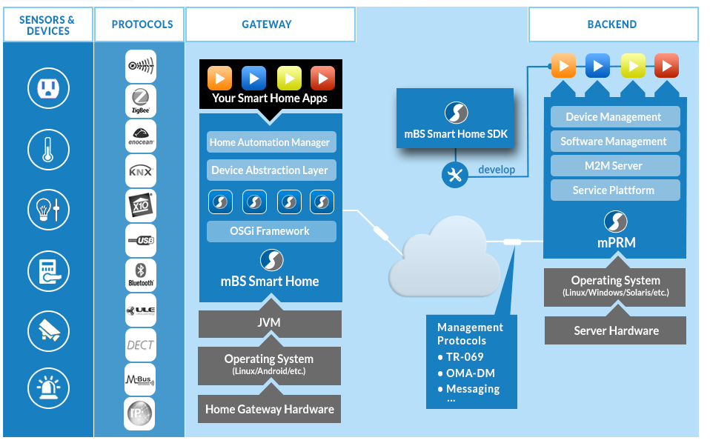
ProSyst OSGi on ST platforms
Source: http://www.prosyst.com/what-we-do/smart-home-smart-energy/products/
Notes:
From the Cloud to the platform the full Prosyst solution. The main advantage of the mBS stack is to provide an abstraction layer for any kind of sensors and a secure channel to export the data to the Cloud. TR-069 allows remote system updates and providing a tool to distribute 3rd party applications.

Slide 13
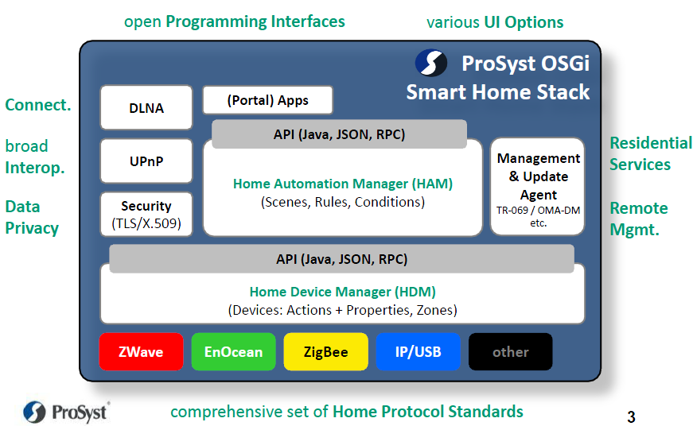
More on the Abstraction Layer
Notes:
More in-depths on the abstraction layer. There is a Device abstraction layer (HDM) that allows creating classes of devices that can be handled seamlessly without dealing with lower layers connectivity details (i.e. Zwave, ZB etc. connectivity is hidden to the programmer). The second layer allows automatizing of the rules to manage sensor and actuators (i.e. if temperature > 25 C then switch on air conditioning).
JSON RPC methods allows setting controls, accessing data from remote through the secure channel. Remote management and update allows managing the gw from remote and provide new SW functionalities.

Slide 14

Application layer interaction
Remote Gateway Management
Secure channel
Service POV
GW
JSON-RPC/Websockets
Cloud
GUI extensions
GUI
JAVAscript commands
Graphical Interface
RPC extensions
Browser callable methods
Service bundle
JAVA code implements functionality
Interface HW/SW on platform
Allows exporting data to cloud
1
JSON RPC bundle
Developer POV
2
Service bundle
3
Notes:
Here are the three bundles that are part of the SEP2 application framework developed on top of G2H. The GUI extension bundle contains JAVAscript, HTML and images that contributes to create the GUI of the solution. The JSON RPC bundle provide JSON RPC commands extensions for the SEP2 application. Service bundle is the JAVA code that interacts with the G2H application and interfaces the OS running on the platform.

Slide 15
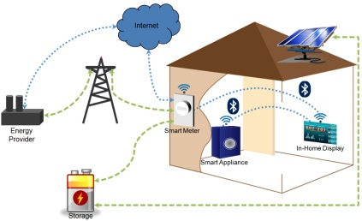
SEP2 Applications
Smart Grid, Smart Homes and Smart Meters are key element of Smart Energy Ecosystem
Bi-directional information flow between consumer and energy provider
SEP/ZIP
SEP/ZIP
Notes:
Smart grids and smart homes (smart appliances, gateways etc.) and smart meters (electricity, gas, water) are key elements of the smart energy ecosystem. Smart home appliances are typically those devices consumers interact with daily. By enabling these devices to talk to each other and be controllable by the consumer, a whole new dimension of convenience is added.
Usage data flows from the consumer to the energy provider and, at the same time, pricing data flows from the energy provider to the consumer. This bi-directional flow of information allows consumers to make decisions to manage consumption.

Slide 16
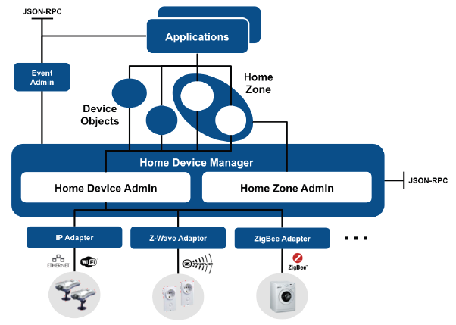
Why SEP2 in Prosyst OSGi?
Homogeneous device management model
  SEP2 devices can be accessed from application in the same way of other device are
Notes:
Benefits for ST customers from the integration in Prosyst, in particular to non-Prosyst customers and companies that could partnership with us from the cloud, i.e. the homogeneus APIs from cloud perspective, i.e. JSON-RPC
Explain benefits from the customer standpoint. New chapter explaining Cloud application in the existing SW architecture to explain value to solution to partners.
It is logical to have one integrated system for all devices in SmartHome system. So that user has to know (and use) only one interface for all devices in Smart Home.
Prosyst provides an integrated device management framework for devices irrespective of under-lying protocols. This makes device management from an application point-of-view very easy as developer/user do not need to be concerned about protocol details.
All SEP2 devices will be accessible from the higher application layers like any other device making seamless application development possible on the platform
It is possible to add new protocol adapters if not supported to extend and services

Slide 17
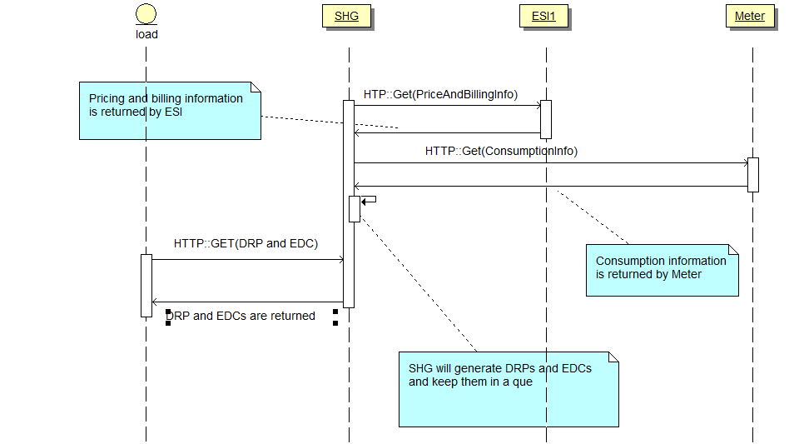
Example of a Thermostat controlling the temperature (1)
Notes:
Because heating and cooling represent the largest sheddable loads for utility demand response programs, connecting thermostats are a driving force for smart grid to home applications.
The SHG generates the control instructions(EDCs) after taking input from other connected SEP2 devices in the house like ESI interfaces (Metering and Pricing information).
Because heating and cooling represent the largest sheddable loads for utility demand response programs, connecting thermostats are a driving force for smart grid to home applications.
Any SEP2.0 load device in the HAN will be connected to the SHG through the IP network and will periodically poll(GET) control instructions for itself. The SHG in this case is the server implementing the Demand Response/Load Control function-set and the load device is the client.

Slide 18
Example of a Thermostat controlling the temperature (2)
SEP2
App
Notes:
The gateway is normally the server for the load devices or thermostats that are needed to be controlled. Hence the SEP2 app is on the server side for this particular use-case. The gateway server for load control needs to be prepared for serving EDC’s (End Device Control) to the client connecting to the gateway and which is trying to get control messages for itself.

Slide 19
SEP2.0 SW ARCHITECTURE
OSGi INTEGRATION
OSGi
= Prosyst original code
SEP2
HDM Adapter
HDM
= ST OSGi/SEP2 code
Porting
Layer
SEP2
Protocol Driver
Linux
Optional Zigbee IP data path
SEP2 Application
Wi-Fi
data path
HomePlugAV data path
SEP2 Stack
Network/Socket
Linux I/F
UART Driver
Ethernet driver
WLAN Driver
PCIe Driver
HPAV driver
ZB IP device
ETH device
WiFi device
HPAV device
= SEP2 stack
= SEP2 connection hardware
= Linux drivers
Notes:
SEP2 is not available in Prosyst, therefore STM has to perform the development.
Integration with Prosyst is done at HDM level by developing a SEP2 HDM Adapter.
ST-Micro is developing following modules.
SEP2 HDM Adapter responsible of the integration of SEP2 in HDM.
SEP2 Protocol Driver that interacts with the native application to set and get information from SEP2 appliances.

Slide 20
SEP Protocol Driver
OSGi/Java Space
SEP2.0 HDM Adapter
PricingImpl
MeterImpl
ThermostatImpl
InHomeDisplayImpl
SEP2.0 Protocol Driver
ProtocolDriverClass
Linux Native Space
SEP2 Native Application Interface
= SEP2 OSGi Bundles
= OSGi/Java Space
= Linux Native Application
= Linux Native Space
Notes:
The SEP2.0 Protocol Driver (SPD) is direct interface between the SEP2.0 Native Application stack and the HDM adapter. The main functionality of the SPD is that to take instructions from device class objects and forward these requests to the SEP2.0 stack.
ProtocolDriverClass will expose a uniform API to the device object classes. This will help in maintaining uniformity while making calls from the HDM to the Protocol Driver layer and will also help in maintaining portability.

Slide 21
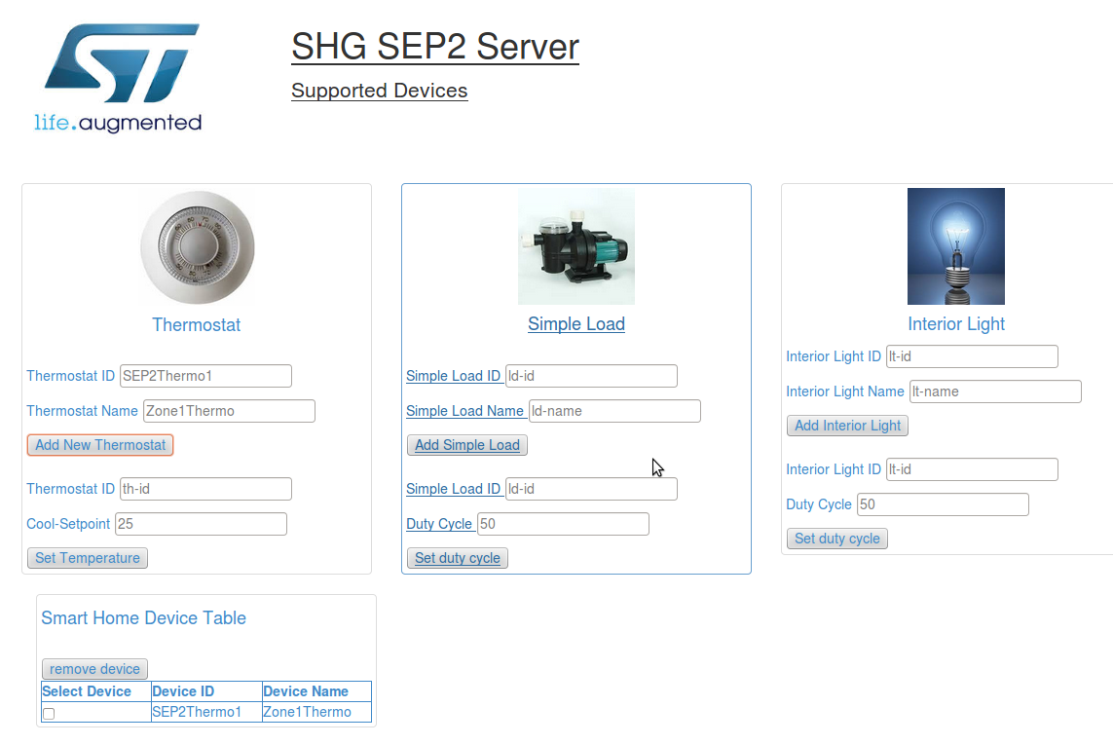
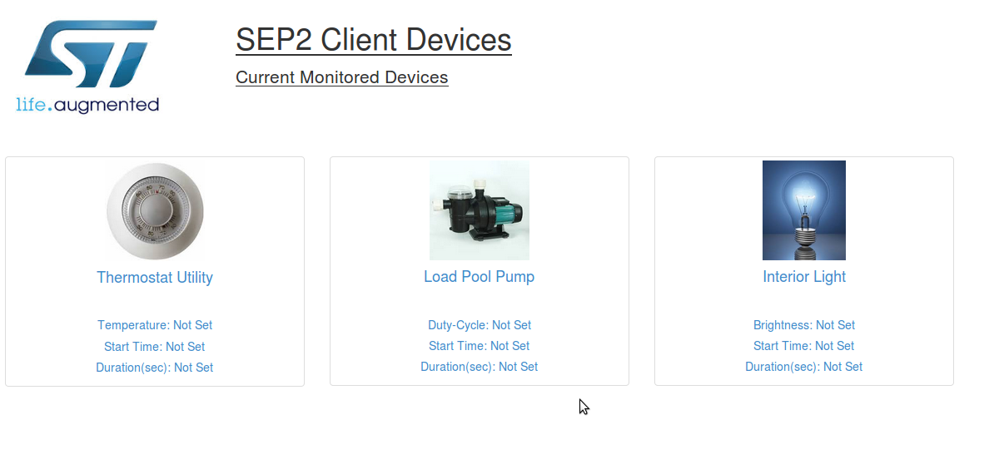
SEP2 demo description
SEP2 Server
  GUI Server side set controlled devices
  Uses JSON-RPC commands to interact with HDM abstraction layer
  Register new resources and control them
SEP2 Client Devices
  Emulates the presence of SEP2 appliances
  Usually it is run on a PC with Tomcat
  Emulated devices are controlled by the SEP2 Server
Notes:
Visual Description of the SEP2 Server (running on the SHG) functionalities and the SEP2 Client Devices emulators running on the PC. The two are connected through an IP-based interface.

Slide 22
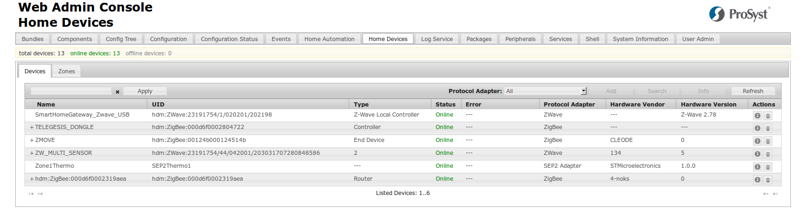
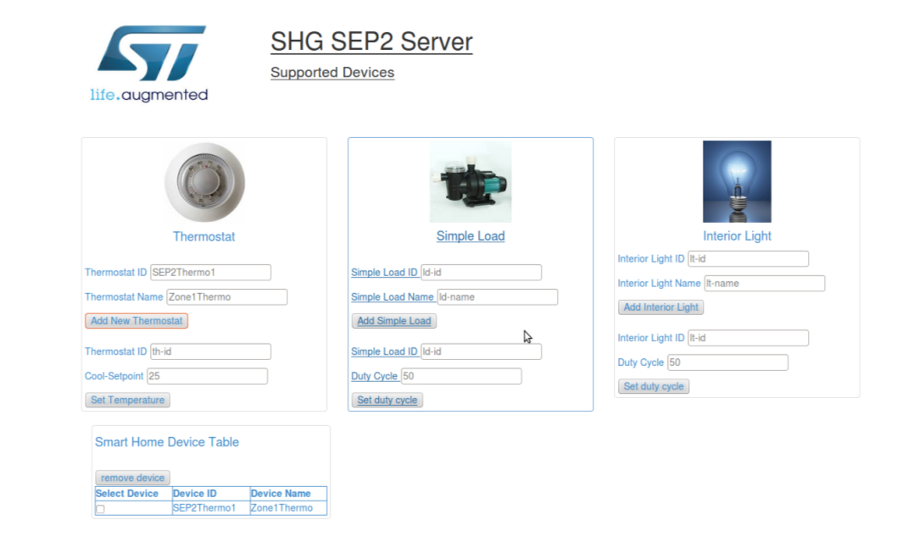
SEP2 resources in Prosyst console
Registered resources are seen as devices in the Prosyst console and listed as SEP2 Adapters
Notes:
Here you can show the fact that adding a SEP2 server thermostat translates in a new devices appearing in the Prosyst console. ST implementation is compatible with HDM abstraction model, hence devices are seen in the Prosyst WebConsole when instantiated. You can use standard HDM commands to pilot any connected device.

Slide 23
JSON RPC Methods to control/access SEP2 devices
SEP2 devices in the network could be controlled or accessed through HTTP/IP protocol from any other device using JSON-RPC methods described in the Prosyst framework
On top of Prosyst JSON-RPC methods, new methods are defined to access SEP2 devices, described in the following:
  Sep2Json/addSEP2Device
    This JSON RPC can be used to add new SEP2 device.
  Sep2Json/removeSEP2Device
    This JSON RPC can be used to remove a SEP2 device.
  Sep2Json/getDeviceCount
    This JSON RPC can be used to get the number of SEP2 devices connected to the gateway.
Some standard JSON-RPC methods can be used to do things like modify attributes/values, access device objects:
  HDAccess/getDeviceClassObjects
  HDAccess/SetDCOProperty
  HDAccess/getHomeDevices
Notes:
We added few JSON-RPC methods that allows the connectivity with remote sensors.
addSEP2Device and removeSEP2Device allow adding/removing standard HDM devices that are connected with the remote (emulated) sensors and actuators via SEP protocols. As they are standard devices, they could be managed via standard JSON RPC APIs coming from Prosyst as any other sensor that is abstracted by the HDM layer
getDeviceCount counts how many SEP2 devices are managed through this methodology
At the bottom of the page, we present some standard JSON RPC methods (coming from the standard Prosyst implementation for the HDM abstraction layer) that are normally used to interface the sensors and get/set their properties.
All methods are available at the following page
http://dz.prosyst.com/pdoc/mBS_SH_SDK_7.3.0/modules/hdm/jsonrpc/devices.html
It is needed to go through Prosyst documentation for understanding JSON-RPC methods provided by Prosyst e.g. HDAccess/getHomeDevices.

Slide 24
Application layer interaction
Remote Gateway Management
Secure channel
Service POV
GW
JSON-RPC/Websockets
Cloud
GUI extensions
GUI
JAVAscript commands
Graphical Interface
RPC extensions
Browser callable methods
Service bundle
JAVA code implements functionality
Interface HW/SW on platform
Allows exporting data to cloud
1
JSON RPC bundle
Developer POV
2
Service bundle
3

Slide 25
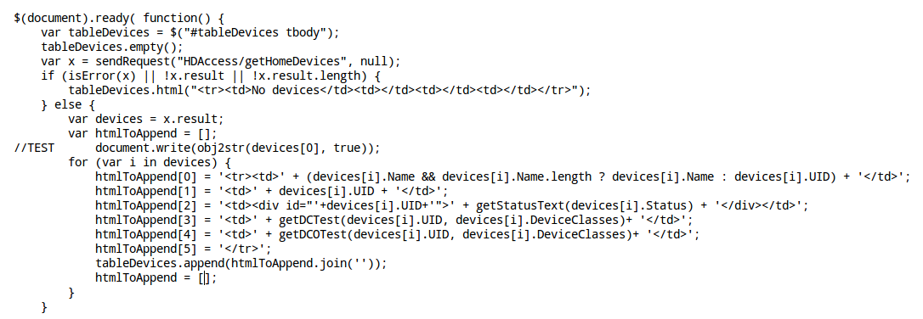
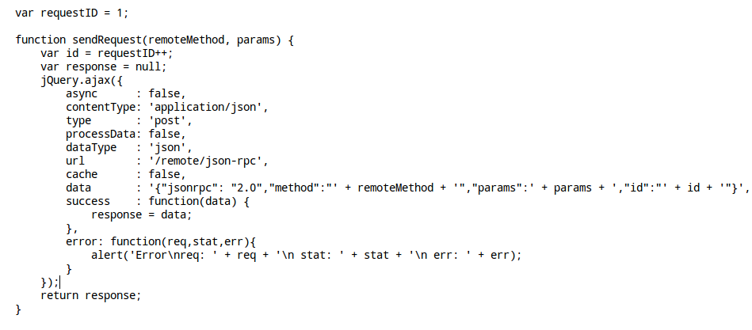
HTML/JAVA page JSON/RPC 1/2
Initial scanning of the available displayed resources
The JSON/RPC function call…
Notes:
Here is an example of a JAVAscript that invokes the JSON-RPC methods to get all devices in the home. We are then using a JSON RPC method from the Prosyst HDM abstraction layer.
Results are then parse to show the devices in the table of devices at the bottom of the page.

Slide 26
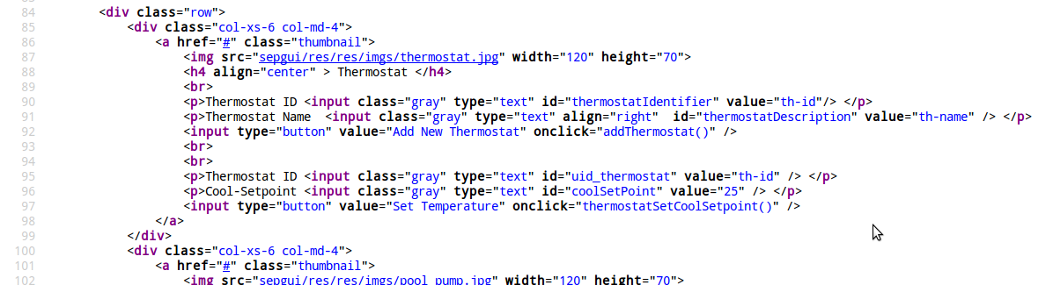
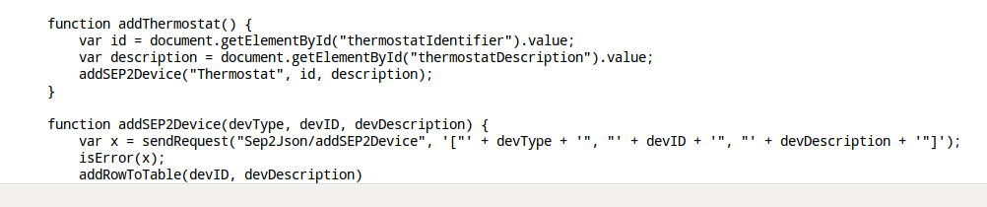
HTML/JAVA page JSON/RPC 2/2
Insertion of a new device in the setup…
… and the related JSON/RPC request.
Notes:
This is an example to show the link of the HTML page button with the JAVAscript world that invokes the JSON-RPC method that add a new thermostat controller in the framework. Pressing the “Add new thermostat button” invokes the Javascript method that invokes the addSEP2Device function. That function sends the JSON/RPC request that is coming from the JSON-RPC extensions from STM bundles.

Slide 27
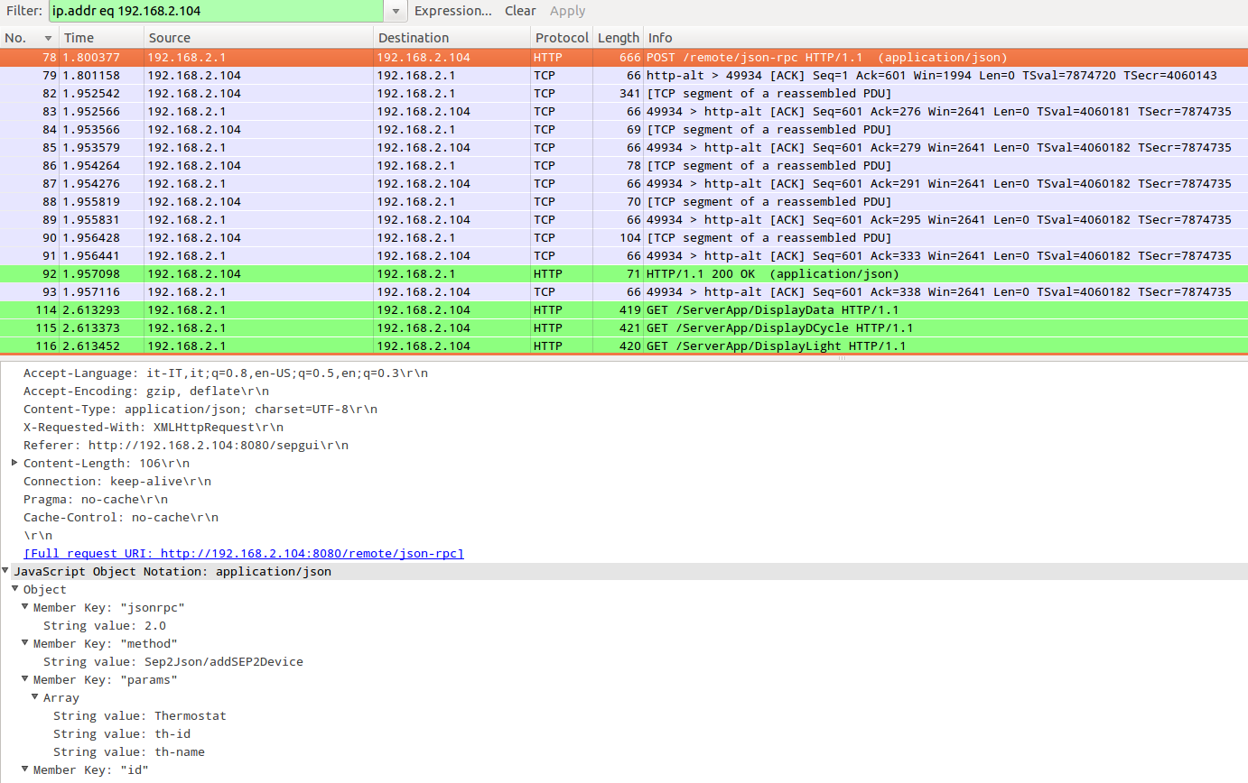
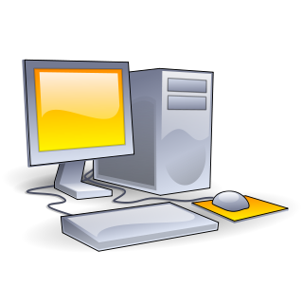
Network transactions
1
2
1
2
192.168.2.1
192.168.2.104
Notes:
An example of the transactions occurring on the network. Connecting PC/tablet has IP 192.168.2.1, gateway 192.168.2.104. The JSON-RPC request packet is exploded at the bottom of the Wireshark window, showing the request of calling the remote addSEP2device method. In transaction marked (2), the Gateway replies with a OK.

Slide 28
Application layer interaction
Remote Gateway Management
Secure channel
Service POV
GW
JSON-RPC/Websockets
Cloud
GUI extensions
GUI
JAVAscript commands
Graphical Interface
RPC extensions
Browser callable methods
Service bundle
JAVA code implements functionality
Interface HW/SW on platform
Allows exporting data to cloud
1
JSON RPC bundle
Developer POV
2
Service bundle
3

Slide 29
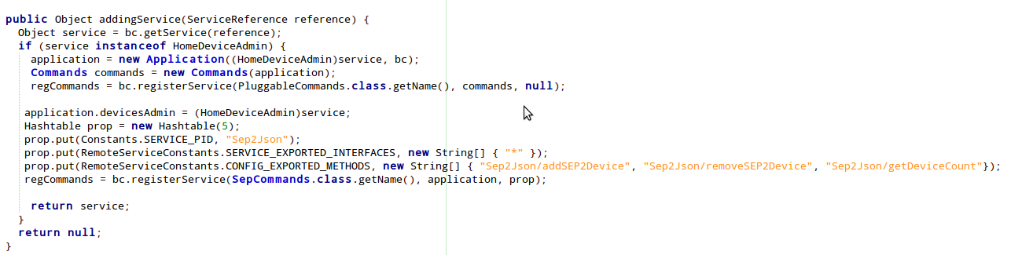
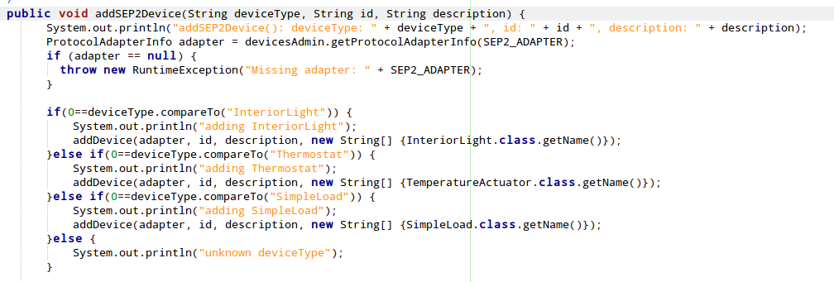
JAVA bundle code
Declarations for JSON RPC call registration…
…and the addSEP2Device definition
Notes:
An example of a JSON RPC registration for the new added methods. Registering a new JSON-RPC requires very little effort as demonstrated by these few lines of code. The method itself is quite simple.

Slide 30
Application layer interaction
Remote Gateway Management
Secure channel
Service POV
GW
JSON-RPC/Websockets
Cloud
GUI extensions
GUI
JAVAscript commands
Graphical Interface
RPC extensions
Browser callable methods
Service bundle
JAVA code implements functionality
Interface HW/SW on platform
Allows exporting data to cloud
1
JSON RPC bundle
Developer POV
2
Service bundle
3

Slide 31
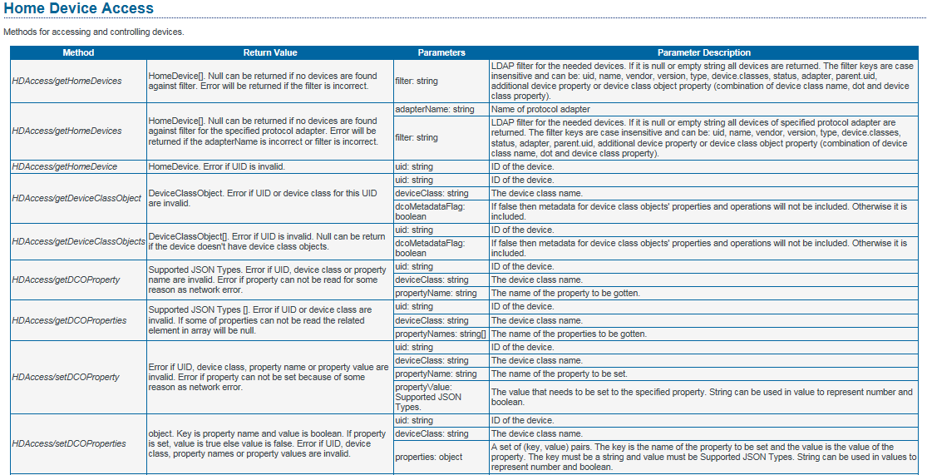
JAVA bundle API
Using the devices requires standard HDM APIs that are available at
  http://dz.prosyst.com/pdoc/mBS_SH_SDK_7.3.0/modules/hdm/jsonrpc/devices.html
Notes:
Lower layers of the STM implementation of SEP2 are not directly accessible to the user, because they can be accessed through the standard APIs of the HDM. Hence we give here the reference to the page you can use to get/set parameters to the created objects. Particularly interesting are
getHomeDevices(): a list of devices in the home (possibly filtered if you require so)
Given the list, you can use it to access each device and get the data you need HDAccess/getDeviceClassObject and format the results on your page
Moreover, there are the additional APIs that were mentioned at slide 23

Slide 32
Conclusions
ST and its partners have developed a comprehensive solution portfolio for Smart Home and Energy gateways
  This presentation provided an overview of available HW/SW technologies
ST provides an extensible SEP2 based framework fully integrated in OSGi for which we presented a demo and use cases
ST software solution is based on ProSyst mBS Smart Home OSGi
  OSGi benefits of modularity and easy software reuse
  ProSyst Abstraction Layer simplify access to devices
  STM integration of hardware devices in a complete solution
  → Programmers can focus only on applications development

Slide 33
Thank You

