Slide 1
In-Memory Data Grid
Use Cases & Patterns
Jean-Noel Moyne
TIBCO Fellow

Slide 2
The State of the Market
The Right Technology to Address These Challenges
Challenges Faced
Next Steps and Q&A
Sample Use Cases and Patterns

Slide 3
The State of the Market

Slide 4
The State of the Market
Used to be: centralized SQL DBMS was the only tool
SSD
Column oriented
Caching
In-memory
Distributed data stores
Map/reduce
What data store should I use?

Slide 5
The Challenges

Slide 6
The Challenges
Big Data: scaling databases
Cloud: scaling in virtual environments
Faster data access: for reads and writes
Elasticity: handling spikes
Achieving fault-tolerance and disaster recovery
Bridging the gap between ‘data at rest’ and ‘data in motion’
Eliminating incoherence due to data being copied over many datastores
It’s not just about “Big Data”, it’s also about “Fast Data”!

Slide 7
The Right Technology to Address These Challenges

Slide 8
TIBCO ActiveSpaces In-Memory Datagrid
“Like a database”:
Store and retrieve data:
  Key/value store
  Queries with indexing
  Data stored with a schema, self-describing Tuples
  Work on data
    Immediately consistent
    ACID properties
    Locking and ‘Compare and Set’ operations
“Like a messaging system”:
Real-time ‘push’ over the network
  Listeners
  Continuous queries
“Like a compute grid”:
Remote invocation for map/reduce processing

Slide 9
ActiveSpaces Architecture
True peer-to-peer distributed design
Distributed storage using monotonic hashing algorithm
Horizontal scalability
Elasticity
In-memory storage with durability
Replication
Persistence to disk

Slide 10
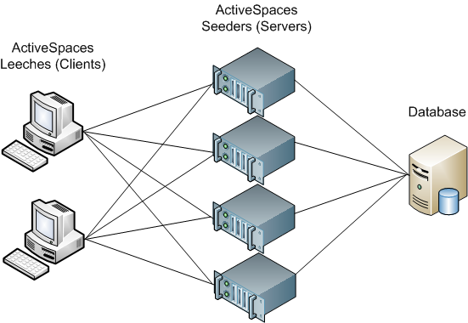
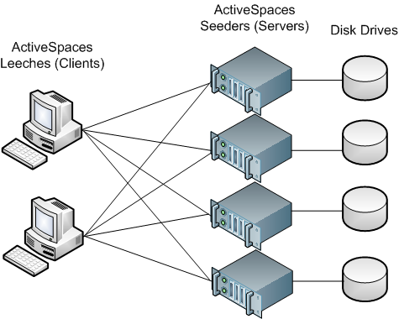
Persistence
Shared-All
Shared-Nothing

Slide 11
ActiveSpaces Architecture (continued)
True peer-to-peer distributed design
Distributed storage using monotonic hashing algorithm
Horizontal scalability
Elasticity
In-memory storage with durability
Replication
Persistence to disk
Platform independent middleware
Stores Tuples (rows), not objects
C, Java, .Net API
Embeddable
Written in C/C++, stores everything outside of the heap
Multisite
Secure

Slide 12
Key Features of ActiveSpaces
Scalability and elasticity: True peer-to-peer distributed design for linear scalability
Software-only
Not “just for caching”
Can be deployed in multiple data centers
More than just storage (e.g. eventing, distributed processing)
Integrated into (and used by) the TIBCO stack of products
Notes:
Full text:
Scalability and elasticity: True peer-to-peer distributed design for linear scalability
Software only
No need for network load-balancers
No requirement for RAID arrays or SANs
On commodity hardware
There is no special hardware available in virtual environments!
Can be deployed in multiple data centers
Routing
Not ‘just for caching’
Replication, persistence to disk, ACID properties make ActiveSpaces a viable SOR
More than just storage
Eventing
Distributed processing

Slide 13
The ActiveSpaces “Sweet Spot”
When you have the “need for speed”
When you know what kind of questions you are repeatedly going to ask about the data
When you know the analysis you want to run, and you run it all the time (repeatedly, as soon as the data changes)
When you need both distributed scalability and ACID properties
When you want scalability in software on commodity hardware (or virtualized environment)
When you want fault-tolerance without the need for special hardware
When you want events about the changes to the data
When you need data-store and eventing capabilities in a single package
Notes:
Full text
When you know what kind of questions you are going to ask about the data
When you want events about the changes to the data
Analytics: when you know the analysis you want to run, and you run it all the time (repeatedly, as soon as the data changes)
In-memory map/reduce
Lookup or shared data
Intermediary data
When you have the ‘need for speed’
When you need both distributed scalability and ACID properties
When you want scalability in software on commodity hardware (or virtualized environment)
When you want fault-tolerance without the need for special hardware
When you need data-store and eventing capabilities in a single package

Slide 14
Compared to Other Offerings
Pure in-memory with optional disk persistence
  Distributed and replicated built-in disk persistence
  Can be used to provide cache-through access to existing DB tables
  Queries return even ‘evicted’ data
  Everything stored off-heap
Immediately consistent with ACID properties
Platform independent middleware
SQL-like query language
Event pushed over the network in real-time
Built-in transactional cross-site replication
Event-driven map/reduce processing
Speed and throughput!

Slide 15
Use Cases and Patterns

Slide 16
ActiveSpaces Use Cases
Generic: Low latency data access
Telco: Real-time offer generation and fulfillment
Retail: In-memory product catalog, in-memory inventory
Retail Banking: Fast temporary shared storage for EDI context data, fast account lookup
Transportation: Real-time tracking and incident management
Capital markets: Real-time processing

Slide 17
Generic: Low Latency Data Access
When you need low latency access to data, including:
Data that you read all the time (or repeatedly)
Data that you write all the time
Temporary (or ‘working’) data
Any data with a short shelf-life (e.g. events)
And when every millisecond (microsecond, even) counts!
Notes:
Full text:
Lower latency of access to the data
Data that you read all the time (or repeatedly)
Data that many applications need to access
Data that you process for real-time analytics
Data that you write all the time
Temporary (or ‘working’) data
Any data with a short shelf-life (e.g. events)
Every millisecond (microsecond, even) counts!
Not every interaction with the data store can be parallelized
Low latency is the key to higher throughput in a single thread of execution
Simple math:
1 millisecond response time = 1,000 interactions per second
2 milliseconds response time = 500 interactions per second

Slide 18


Telco: Real-Time Offer Generation and Fulfillment
Purchase 3G Package
Cross-sell Voice/SMS package to subscriber who purchases 3G Mobile Package
Total: 3 mio / day
Peak: 50 events per sec
Purchase BB Package
Voice Call
Reload
Give 100 free SMS to subscriber who tops-up >
$xxx
IDD Call
Fulfill SMS Package
Total: 12 mio top-up / day
Peak: 300 top-up per sec
Offer Message
Reminder
Message
Fulfill 3G Package
OnNet Call
Reload
Voice Call
Give discount VOIP package to subscriber who makes a IDD call
Fulfill Voice Package
SMS Usage
Fulfillment
Message
Fulfill SMS Package
Total: 200 mio / day
Peak: 12,000 events per sec
SMS Usage
Give discounted SMS package to subscriber who sends SMS more than 10 times a day
46,7 millions subscribers
2,000 SMS notifications per seconds
500 offer fulfillments per second
Total: 750 mio / day
Peak: 27,000 events per sec
Event Cloud
Event Handling and Processing
Touchpoint Integration
Billing, Offer Fulfilled

Slide 19
Telco: Real-Time Offer Generation and Fulfillment
Event handling: CDRs coming from the cell network compare event against lists
Campaign trigger: offer is being qualified according to occurred / tracked events from the subscriber
The Numbers
1 billion events per day
Peaks of 40 to 50,000 events per second (for hours, during peak usage period of the day) from Network
2 BW servers, 2 AS servers (active-active)
Notes:
Full text:
Event handling: CDRs coming from the cell network
Compare event against:
Blacklist / Whitelist / Target subscriber list
Campaign trigger: offer is being qualified according to occurred / tracked events from the subscriber
Implemented by BusinessEvents (on top of AS)
Also uses ActiveSpaces outside of BusinessEvents (accessed from it through channel)
Peaks of 5,000 events per second
Offers, reminders, fulfillment

Slide 20
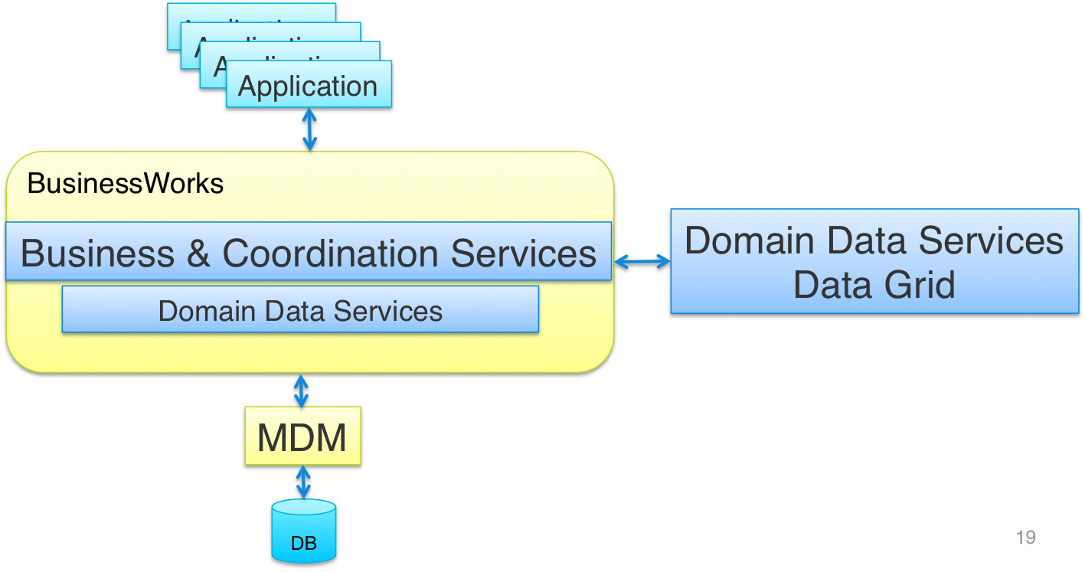
Retail: In-Memory Product Catalog

Slide 21
Retail: In-Memory Product Catalog
Product MDM implemented using TIBCO MDM
Used by approximately 25-30 applications
The challenge is that the load generated by all those applications is too high for MDM to handle directly
ActiveSpaces used to speed up the data access
  Applications can read/write from/to the data grid rather than hit MDM directly
  Created a service layer on top of ActiveSpaces implemented with BusinessWorks (ActiveSpaces plugin)
The Numbers
800 million records
Peak load: 200,000 operations per second
AS: 16 VMs (8 cores, 128 Gb of RAM each)
50% growth expected in the next 6 months
Notes:
Full text
Product MDM implemented using TIBCO MDM, used by approximately 25-30 applications
Problem: the load generated by all those applications is too high for MDM to handle directly
ActiveSpaces used to speed up the data access
Applications can read/write from/to the data grid rather than hit MDM directly
read, write, query, lock, and batch data extraction to files
Created a service layer on top of ActiveSpaces implemented with BusinessWorks (ActiveSpaces plugin)
About 60 BusinessWorks processes, interacting directly with ActiveSpaces, many more applications using those services to access the product master data

Slide 22
Retail: In-Memory Inventory
Real-time store inventory for US national retailers
Problem: too many layers, too much delay introduces in-coherency
Buy online, pick-up at the store
Smart fulfillment
Opens new possibilities: “Triggers” outside of the System of Record (SOR) servers
Notes:
New possibilities: dynamic pricing
Larger setup: 3 servers each around 330 Gigs of RAM
About 200 M records (largest space 155M)
Also used as CLE
Full Text:
Real-time store inventory for US national retailers
Lots of items, lots of stores, lots of sales
Buy online, pick-up at the store
Open box
High value or desirability limited inventory items
Real-time feed to Web app servers with the ability to ‘replay’ any current values
Opens new possibilities
‘Triggers’ outside of the System of Record (SOR) servers
Problem: too many layers, too much delay introduces in-coherency
Point of Sale (POS) transactional SOR is a mainframe or a single database
Retail does most of their business in a short period of time
Can you afford to have every web query hit the SOR directly while you’re already very busy?

Slide 23
Retail Banking
Fast Temporary Shared Storage for EDI Context Data
Fast Account Lookup for Monetary Authority of Singapore G3 rules
  Real-time transaction settlement
  Real time alerts on account activity
EDI Service
External Partners and Banks
EAI HUB
Sender EDI Process
TIBCO BusinessWorks
Sender EDI Process
Send Message for
Requesting to Partner
Sender EDI Process
Send Request
Message
Bank
Process
Put message
in AS with GUID key
Space
Reply Asynchronously
with Sender’s GUID
Process
...
VAN
Take message
from AS with GUID key
Receive EDI Process
…
Receive EDI Process
Receive Message
Receive EDI Process

Slide 24

Transportation: Real-time Tracking/Incident Management
Real-time tracking of packages, containers, ships, etc.
Incident management
  Equipment breaking triggers a plane change
  Real-time ODS for train schedule status
Notes:
Total almost 1 Billion rows, 2 servers with 1 TB of RAM (x2 for FT)
Full text:
Common use cases
Airlines
Railroad operator
Logistics
‘Incident management’
Equipment breaking triggers a plane change
Spare plane not always exactly the same model
Re-seating process needs access to a lot of data (almost 1 billion records)
Process needs to be extremely fast
Real-time ODS for train schedule status
Delays or breakdowns have cascading effects
Needs to be calculated as fast as possible, as soon as something happens
Tracking packages, or containers or ships in real time

Slide 25
Capital Markets
Real time distributed processing
  Thousands of accounts, each with hundreds of positions
    Positions to be updated for all accounts as market data updates arrive
    Risk calculation
  Thousands of market data updates per second result in many hundreds of thousands of position updates per second
AS shows linear scalability into the millions of updates per second
  “Affinity” to leverage data locality is key to performance and scalability

Slide 26
Emergence of a Generic Pattern
Application
MDM
ActiveSpaces
ODS
Correlation
Aggregation
Application
ESB
_{Historical}
Application
Analysis
Application
CEP
_{Closing the loop}

Slide 27

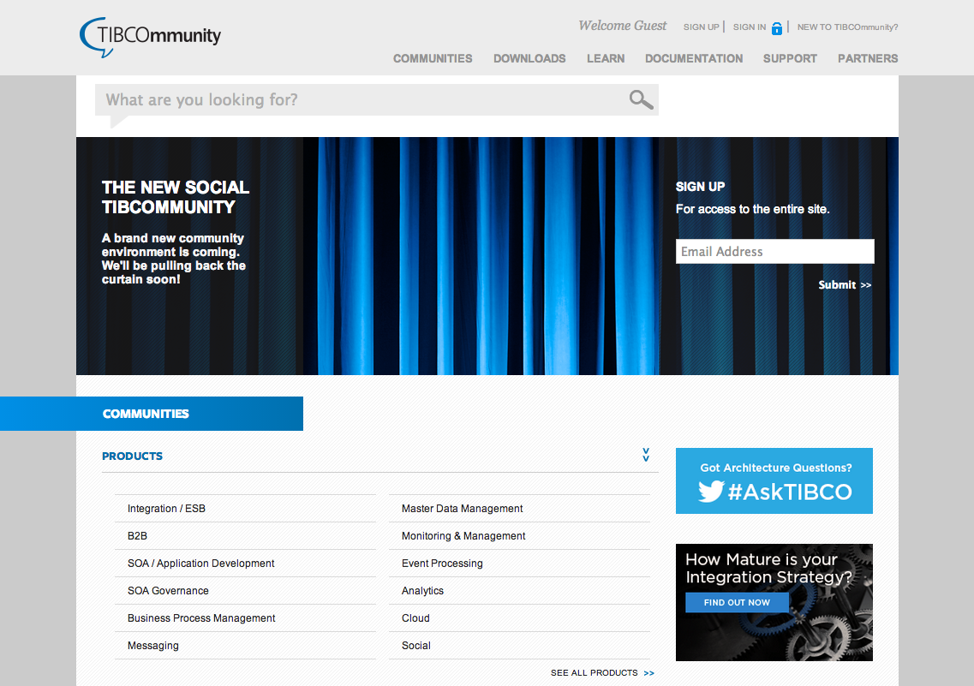
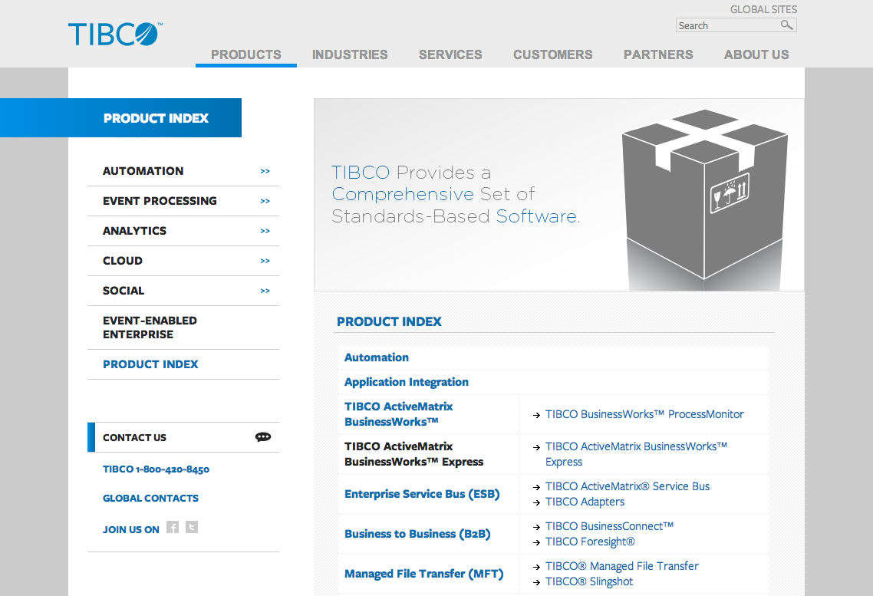
Next Steps
Check out a demo at our booth
  Win an AnkiDrive artificial intelligence race car!
Download a 90-day trial
  activespaces.tibco.com
Learn more, discuss, support
  tibco.com
  tibcommunity.com

Slide 28
Questions?

