Slide 1
PaaS Design and Architecture: A Deep Dive into Apache Stratos
Samisa Abeysinghe
VP Delivery, WSO2
Member Apache Software Foundation
10th June 2014

Slide 2
What is Apache Stratos ?
A Platform-as-a-Service (PaaS) Framework from Apache Community
Initially developed and maintained by WSO2
Donated to Apache Software Foundation
Evolved within the Apache Community for nearly a year
Significantly re-architected and improved in Apache
Graduated to an Apache TLP last month (May 2014)

Slide 3
What does it Do?
Elastic scalability for any type of service using underlying infrastructure cloud
Managing logging and metering for services
Provides foundation services
User management
Storage
Billing

Slide 4
Topics Covered
Architecture
Scalable and dynamic load balancing
Multi-factored auto scaling
Controlling IaaS resources
Smart policies
Multi-tenancy
Cloud bursting
Logging, metering and monitoring

Slide 5
Architecture

Slide 6
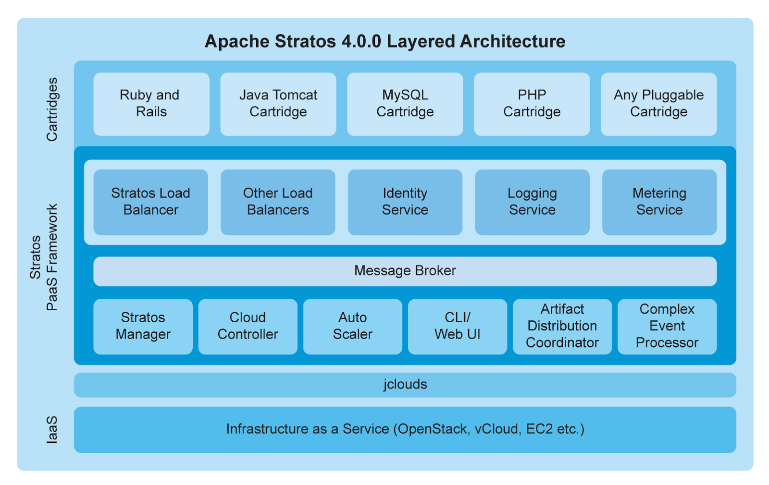
Apache Stratos Layered Architecture
*

Slide 7
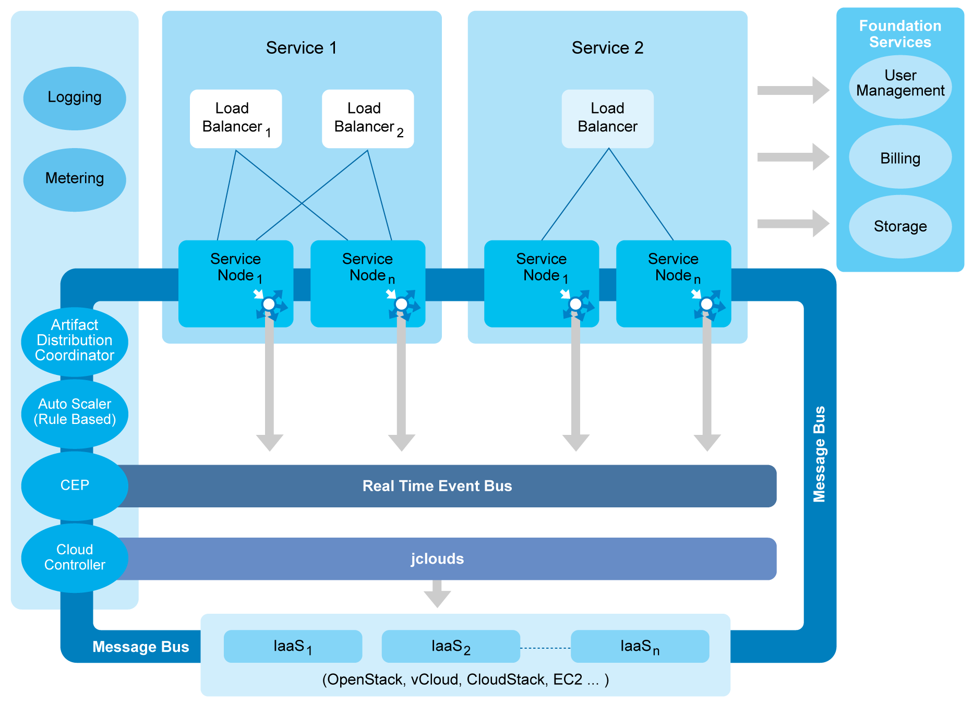
Stratos Architecture

Slide 8
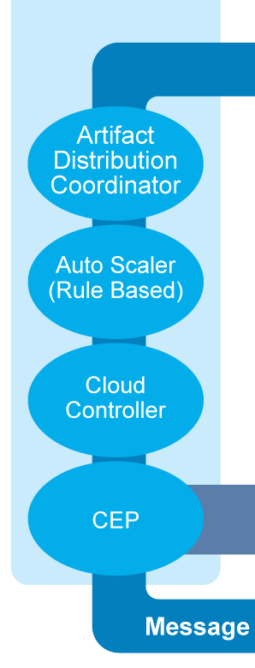
Stratos Controller

Slide 9
IaaS Integration with jclouds

Slide 10
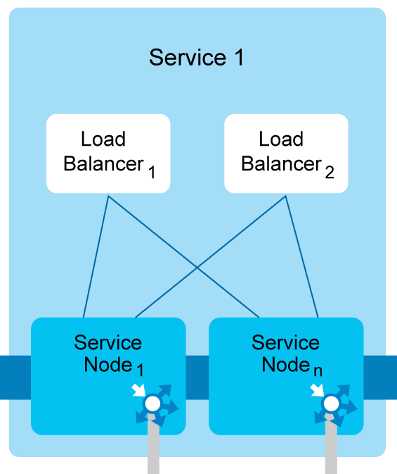
Services

Slide 11
Real Time Event Bus

Slide 12
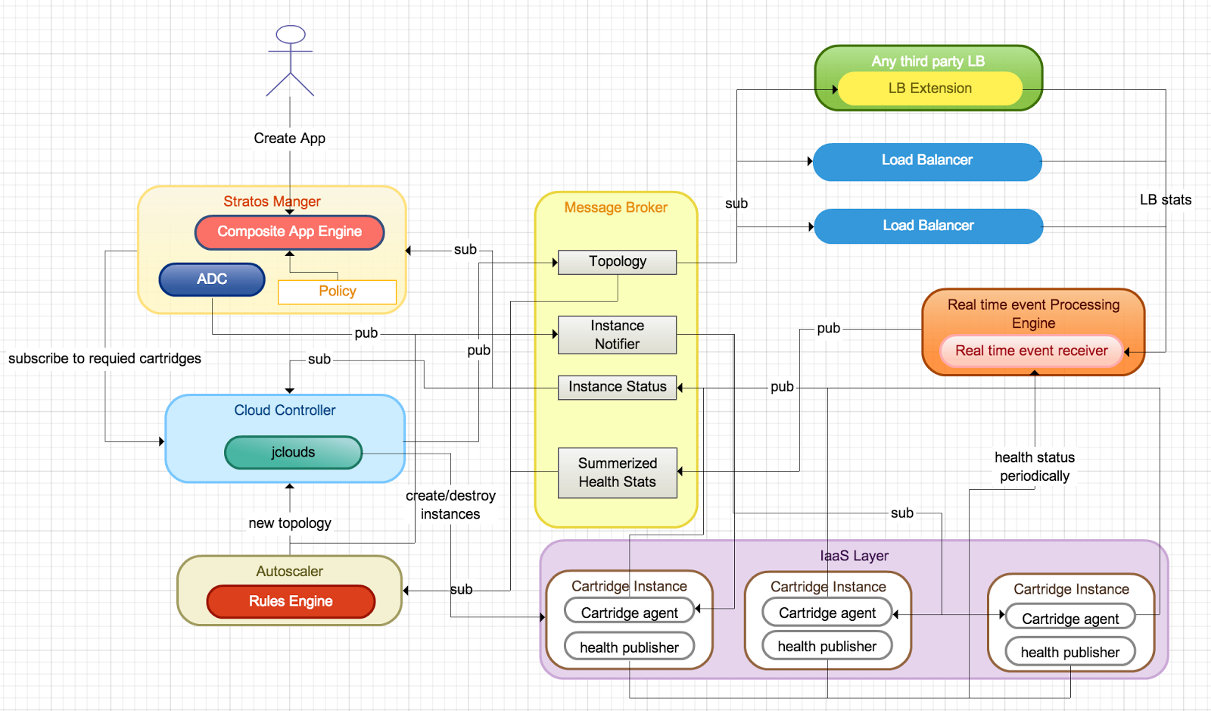
Apache Stratos Message Flows
*

Slide 13
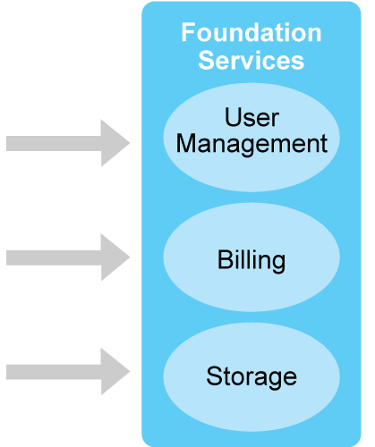
Foundation Services

Slide 14
Stratos Architecture

Slide 15
Architecture Advantages
Why is this architecture so important?
Unified communication across components in the PaaS using message broker
Ability to plugin any third party load balancer using message broker model
A real time event bus to capture and process complex events
Centralized monitoring and metering with unified logging framework
Ability to plugin any third party health checking/monitoring framework
Ability to plugin any IaaS due to the use of jclouds API
Cartridge model enable bringing in even legacy apps into cloud as service nodes
*

Slide 16
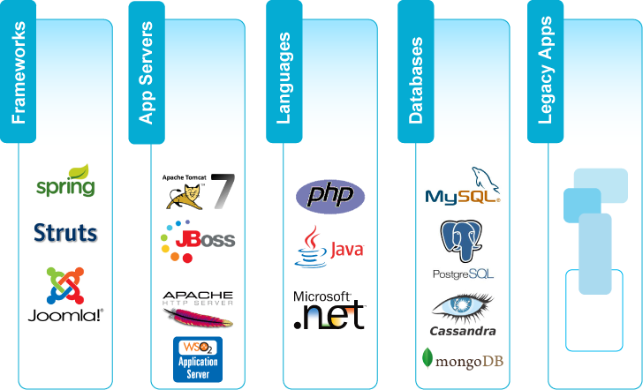
Stratos Cartridges
Not only Web Oriented: e.g. Can Scale Thrift Services

Slide 17
Scalable and Dynamic Load Balancing

Slide 18
Scalable and Dynamic Load Balancing
How Scalable it is?
In theory infinite
- horizontal scaling
- limited by resource (instance capacity) availability
How Dynamic it is?
Load Balancers are spawned dynamically
- LB too is a cartridge
In case of multi-cloud, multi-region, LB can scale per cloud/region
Per service cluster LB
*

Slide 19
Scalable and Dynamic Load Balancing..
What is unique about Stratos
Cartridge based LB model
Can bring any third-party LB
- HAProxy, nginx, AWS ELB
- As easy as plugging into LB extension API
*

Slide 20
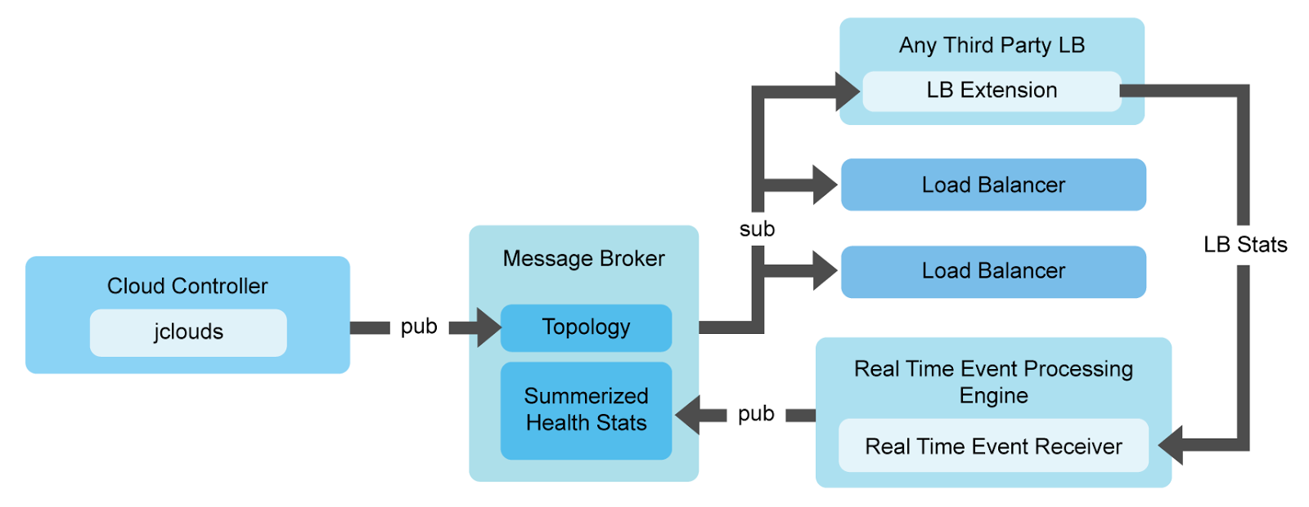
Scalable and Dynamic Load Balancing..
*

Slide 21
Multi-Factored Auto Scaling

Slide 22
Multi-factored Auto Scaling
What is it?
Scaling algorithm can use multiple factors. such as
- Load average of the instance
- Memory consumption of the instance
- In-flight request count in LB
Capable of predicting future load
- Real time analysis of current load status using CEP
integration
- Predict immediate future load based on CEP
resulting streams
- Predicting equation s=ut + ½ at²
- s=predicted load, u=first derivative of current
average load, t= time interval , a=second derivative
of current load
*

Slide 23
Multi-factored Auto Scaling...
Why should one care?
Maximise resource utilization
Easy to do capacity planning
Dynamic load based resource provisioning
Optimizing across multiple clouds
What are the advantages?
Make DevOps life easy
More accurate capacity planning
*

Slide 24
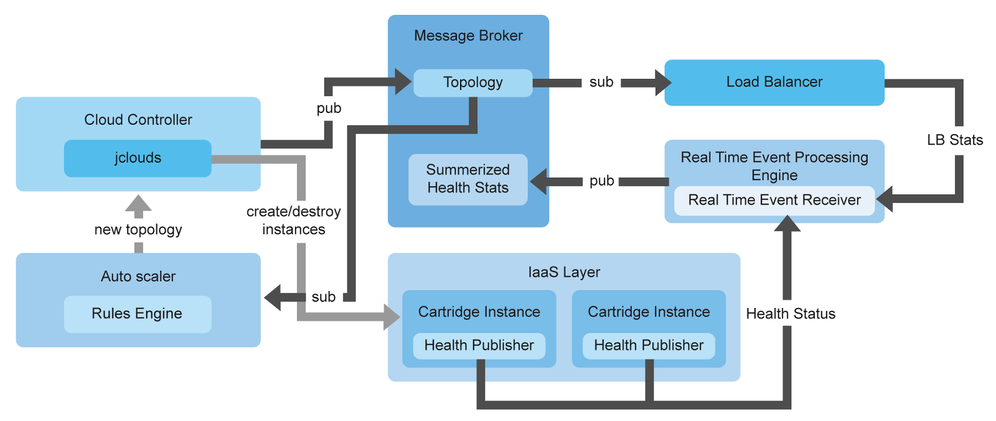
Multi-factored Auto Scaling...
*

Slide 25
Controlling IaaS Resources

Slide 26
Controlling IaaS Resources
What is a Partition?
Logically group IaaS resource locations
Partitions are important to make application high availability
Cartridge instances are spawned inside these partitions
Partitions are defined by DevOps
What is a network partition?
Logical groups multiple partitions, that are in the same network
Stratos will spawn Load Balancers per network partition
Since LB instances and cartridge instances reside in same network, they can communicate using private IP addresses
Used in deployment policies
*

Slide 27
Controlling IaaS Resources
What are the advantages?
Can control
per cloud, per region, per zone, ...etc
Can achieve high availability, disaster recovery
Help for cloud SLA
Control the resource utilization
Help with geo based deployments
help comply with geo rules/regulations
*

Slide 28
Smart Policies

Slide 29
Smart Policies
What are the smart policies?
Auto scaling
Deployment
Auto scaling policy
Define thresholds values pertaining scale up/down decision
Auto Scaler refer this policy
Defined by DevOps
Deployment policy
Defined how and where to spawn cartridge instances
Defined min and max instances in a selected service cluster
Defined by DevOps based on deployment patterns
*

Slide 30
Smart Policies
Why should one care?
Can provide cloud SLA
What are the advantages?
Make DevOps life easy
- Help keep to SLA
Make SaaS app delivery life easy
- Do not have to worry about availability in application layer
*

Slide 31
Multi-Tenancy

Slide 32
Multi-tenancy
What MT model does it support?
Container MT
- virtual Machine, LXC, Docker
In-container MT
- within VM/LXC/Docker tenancy
What is unique?
Can have high tenant density
What are the advantage of this model?
Optimizing resource utilization
Sharing resource such as CPU, memory across tenants
low footprint, based on utilization/usage of the
tenants app
No need dedicated resource allocation for tenants
*

Slide 33
Cloud Bursting

Slide 34
Cloud Bursting
What is it?
Expanding/provisioning application into another cloud to handle peak load.
Why Should one care?
Resource peak time can be off-loaded to third party clouds/resources
What is unique about it?
Can off-load to any cloud
- Private, Public and Hybrid
Easy to managed with the model of LB per busting cloud
What are the advantages?
Make DevOps life easy
Low TCO, and higher utilization existing dedicated resources
*

Slide 35
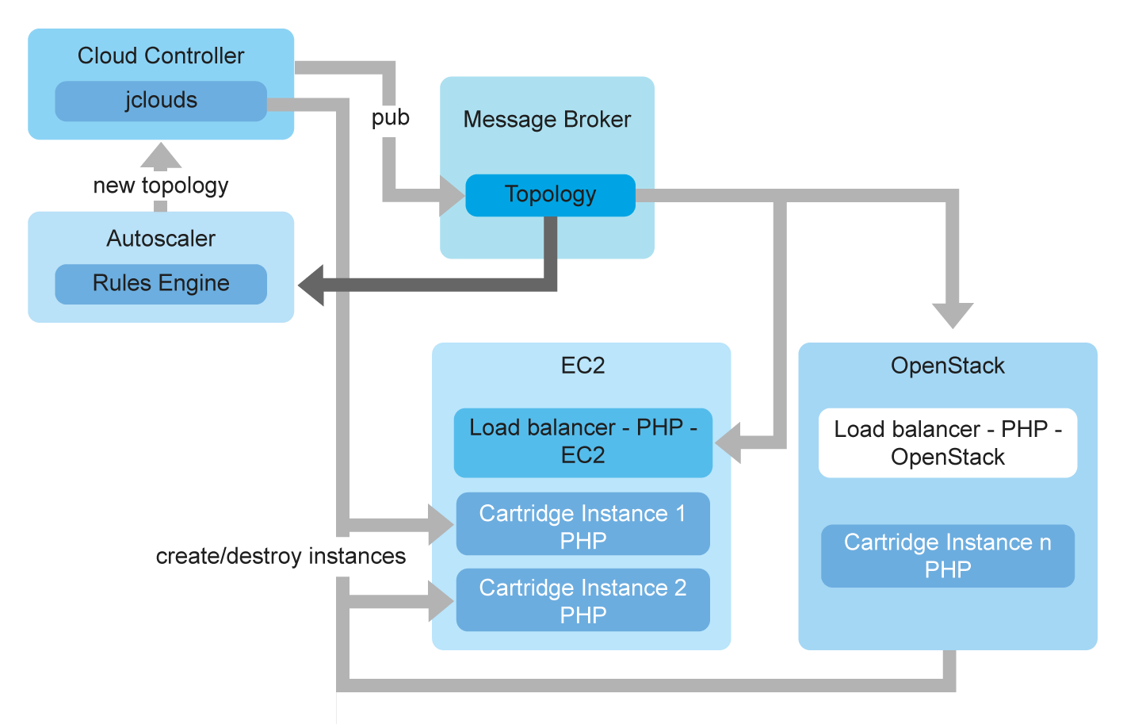
Cloud Bursting

Slide 36
Logging, Metering and Monitoring

Slide 37
Logging, Metering and Monitoring
How detail it is?
Instance up/down time
Each and every instance public health status
application health, OS health like load average, memory consumption
Application logs
Why should one care?
Centralize view for all logging, metering and monitoring
What are the advantages?
Easy to make throttling
DevOps life easy
centralize log viewer
centralize dashboard
*

Slide 38
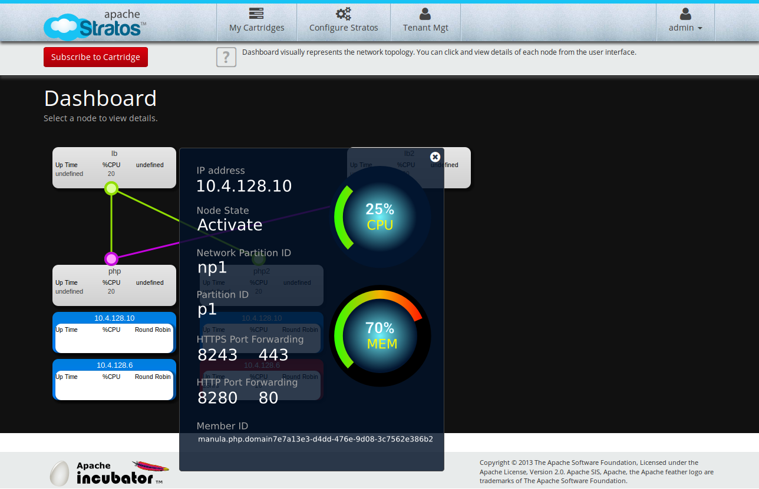
DevOps Tooling

Slide 39
Be Part of It

Slide 40
What are the Advantages
Elastic scalability for “anything” – not only HTTP based services
Cloud bursting
Scale across multiple infrastructure clouds (IaaS) simultaneously
Multi zone/data center support
Multiple tenant isolation levels
In container multi tenancy
OS container (LXC, Docker)
Virtual machines
Physical machines

Slide 41
What Can you Do with it?
Build your SaaS applications on top of it
Create Cartridges to extend the services
Cloud enable your applications
Scale your legacy applications

Slide 42
Apache Stratos
Try it!
Be part of it!!!
Contribute Cartridges – Cartridge Store
Join the community!!!
http://stratos.apache.org/index.html
Facebook: https://www.facebook.com/apache.stratos
LinkedIn: http://www.linkedin.com/groups/Apache-Stratos-5131436
Twitter: https://twitter.com/ApacheStratos

