Slide 1
Mobile DevOps Mobile Apps + APIs = Mobile DevOps
Alex Gaber
Crittercism
QCon New York 2014

Slide 2
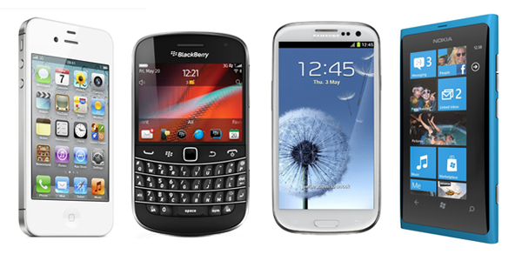
Mobile App Introduction
Mobile Apps are a new paradigm of application development

Slide 3
Mobile App Introduction
How did we get here?

Slide 4
Software Application History
When was the last time you bought a box of software?

Slide 5
Software Application History
1990’s
Thin / Thick Client Software
Client – Server application architectures
Waterfall Methodology
Slow release cycles

Slide 6
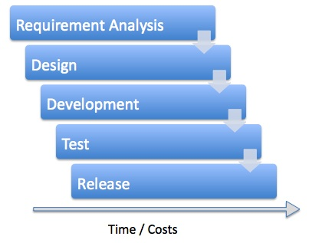
Waterfall Development Methodology

Slide 7
Web Applications
Web application development
Continuous Integration
Monitoring vs. Testing
Browser access and CDNs
Agile / Iterative / Scrum

Slide 8
Web Applications
Web application development
Single Code Base
REST APIs enable app developers to mash multiple services together

Slide 9
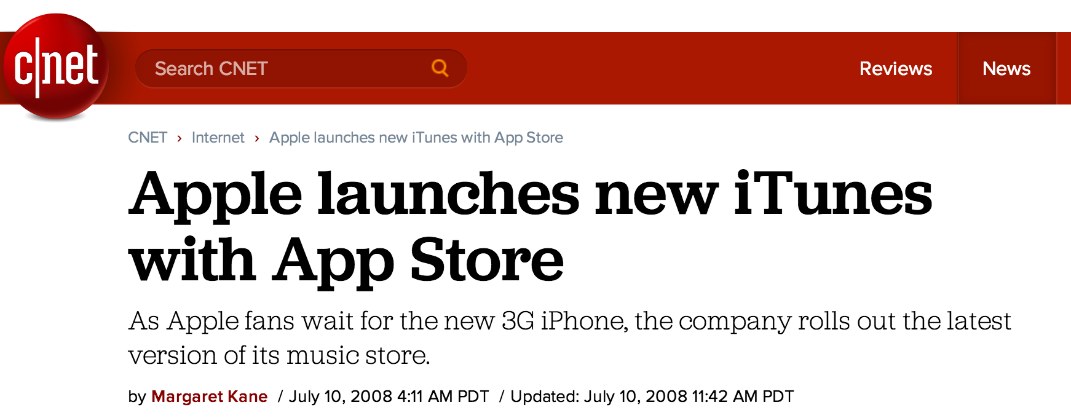
Apple Launches the App Store in 2008
2008 – Apple
launches App Store

Slide 10
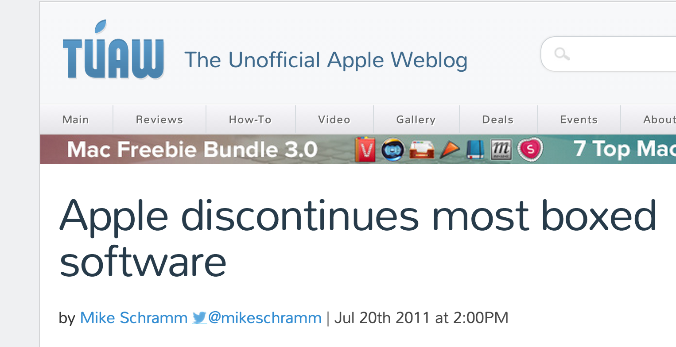
Packaged Software Fades into History
2011

Slide 11
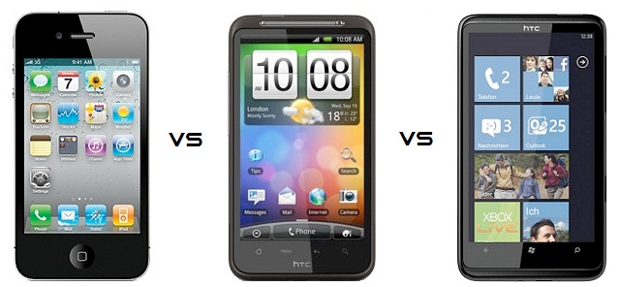
Mobile App Launches Continue to Grow
Mobile App Platforms Grow
40k Apps / Month Added

Slide 12
Mobile Applications
Mobile application development
Multiple Code Bases
API connectivity + persistence becomes an issue due to 2G / 3G / 4G

Slide 13
Mobile Device Ecosystem is Fragmented
Mobile App Devices are Fragmented

Slide 14
Mobile Applications
Mobile application development
New Challenges
More Difficult

Slide 15
Mobile App Demo
App Demonstration

Slide 16
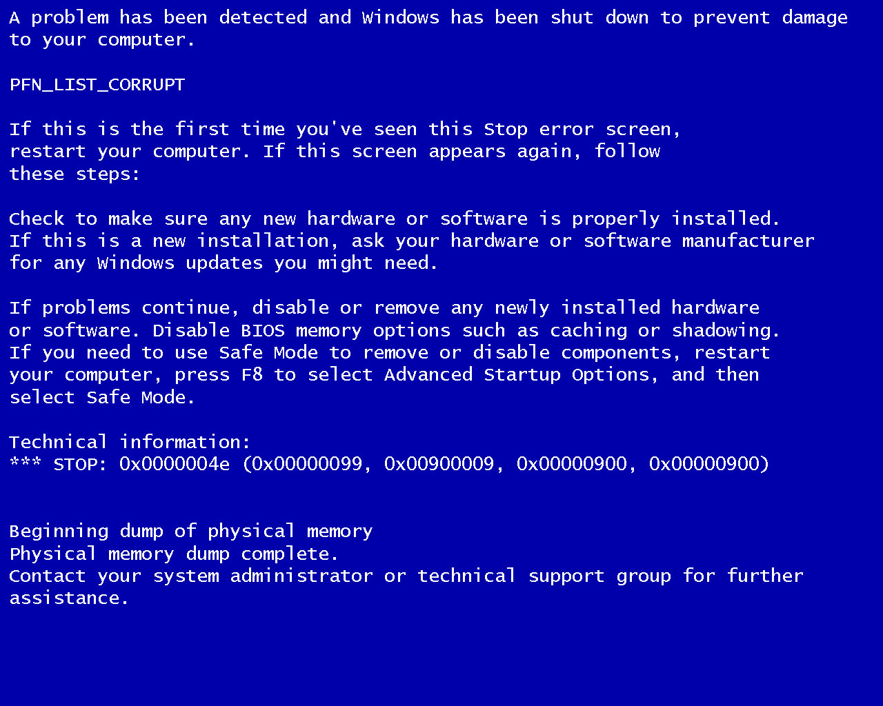
History of Software Development

Slide 17
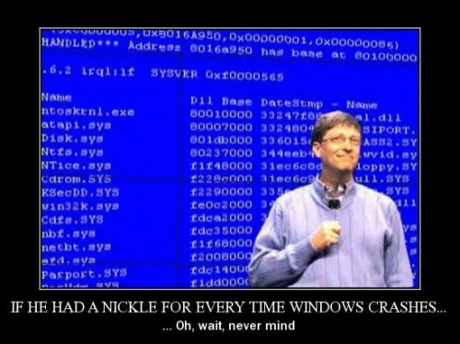
Applications Crash, but Users Already Paid

Slide 18
What Caused the Error, the OS or the Application?
Was it Windows that crashed or was it the application?

Slide 19
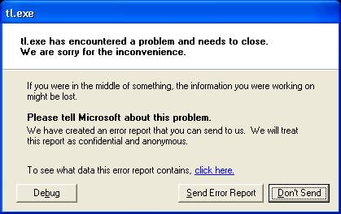
Quick Poll – How Effective are Proactive Feedback Loops?
When was the last time you clicked “Send” ??

Slide 20
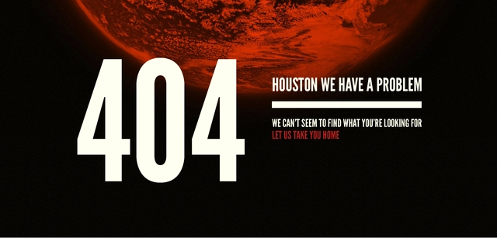
Web Application Crash
Web 404 error – Do you notify the site?

Slide 21
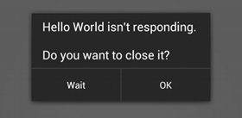
Android App Crash
Android Apps Crash !

Slide 22
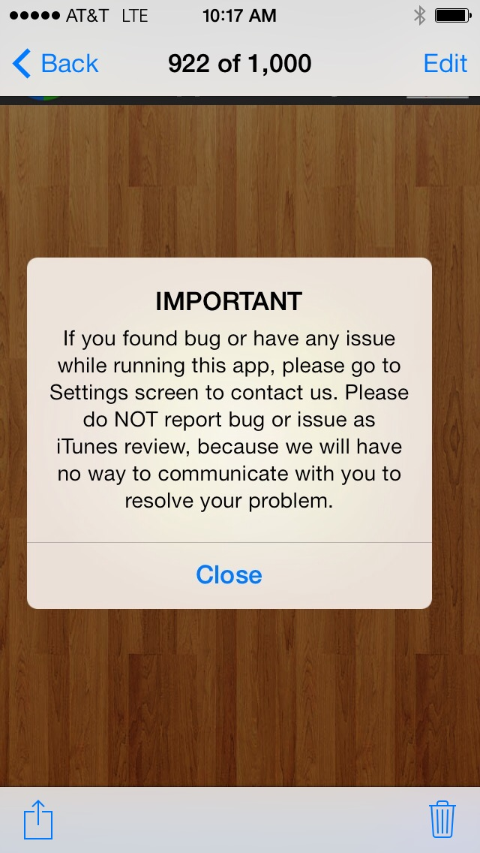
Mobile App Users Cannot Communicate Easily

Slide 23
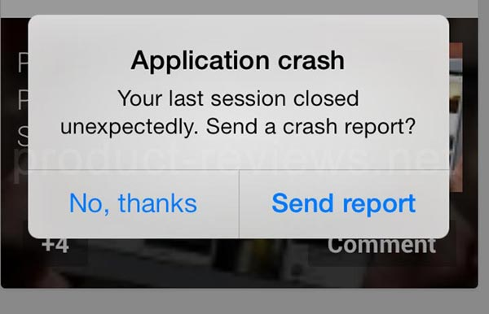
iOS App Crash
iOS Apps Crash !

Slide 24
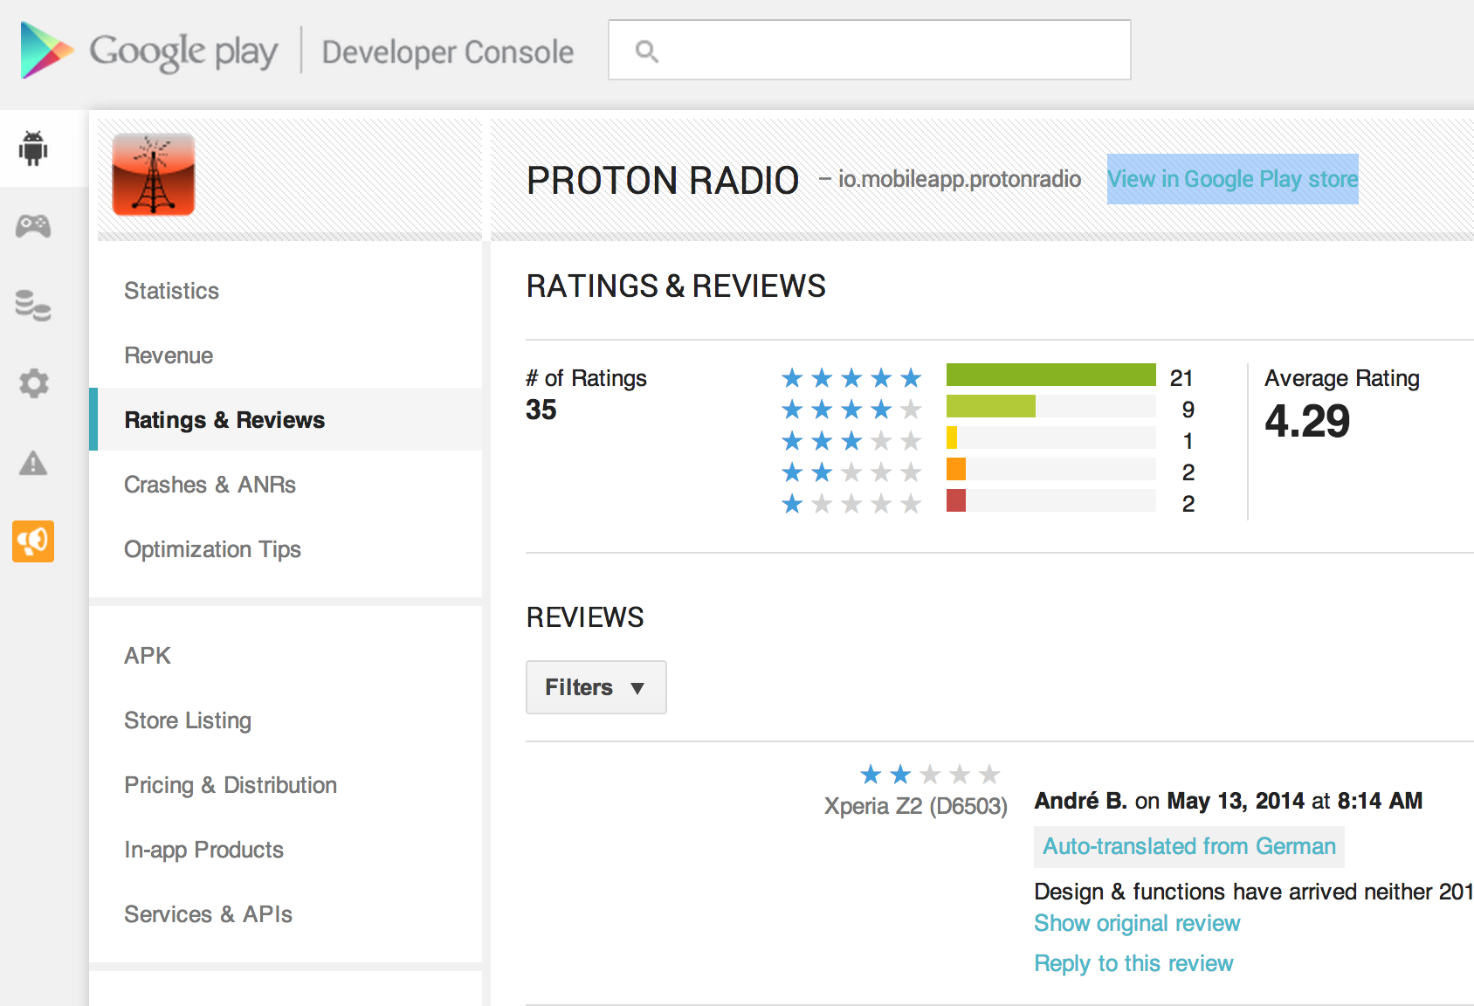
For the First Time, User Experience has a Feedback Loop

Slide 25
Question
Do end-users want to help the app developer?
Mobile App Stores created developer reputation / feedback loop

Slide 26
How Users React to Poor App Performance
How Customers React to Poor App Performance
What Do Users Do When the App is Slow?
Source: Crittercism end-user survey Q4’2013

Slide 27
Testing vs. Monitoring
“If everything is tested, we don’t need to monitor”
TRUE or FALSE

Slide 28
Implementing Performance Monitoring for Android
What cannot be tested prior to launch?
Apps Crashes & Exceptions
Downtime due to app crashes
API & Network Errors
HTTP Errors like 404’s, Errors accessing Cloud Services
Unresponsive Apps
Slow performance, High latencies
Transaction Errors
Failure of shopping cart check-outs, referrals, etc.
Location
Performance issues due to geography

Slide 29
What is mAPM?
Mobile App Performance management (mAPM) intertwines mobile app development with DevOps

Slide 30
Comparing Web to Mobile App Development
Web Applications expect
> 99.9% Uptime
Mobile Applications achieve
< 99% Uptime

Slide 31
APIs Powering Mobile Apps
BEWARE of REST APIs causing sleepy mobile apps!

Slide 32
Mobile App API Calls
18% of API calls from mobile apps have an error rate of over 5%
UNACCEPTABLE
9% of APIs in mobile apps have greater than 1 Second response
UNACCEPTABLE
Source: Crittercism Mobile Benchmark Report

Slide 33
SDKs Will Impact Mobile App Performance
BEWARE of SDKs slowing down your Mobile Apps!
Sample Mobile App Scenario
Free Version | Paid Version
Uses a 3rd Party Mobile Ad SDK ~ 3% Crash Rate | No Ads, No 3rd Party Mobile Ad SDK < 1% Crash Rate

Slide 34
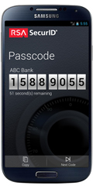
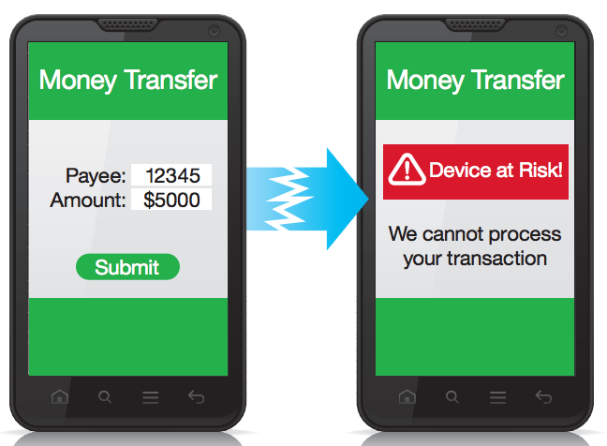
Mobile Apps Have Lots of 3rd Party Dependencies
3rd Party APIs and SDKs can slow down your Mobile App
Mobile Security SDKs
Mobile Ad SDKs

Slide 35
Speaking of SDKs in your Mobile Apps…
The average mobile application consumes 6 different APIs / web services (Crittercism Mobile Benchmark Report 2014)
Mobile AD SDKs
Mobile Security SDKs
Mobile Analytics SDKs
Mobile Monitoring SDKs
RESTful APIs

Slide 36
Monitor Those APIs the Way DevOps Monitors Servers
Mobile App Developers need to monitor the APIs and SDKs that their mobile app is consuming
Trust but Verify
Teamwork ->
+ Mobile App Developers
+ DevOps Team
= Mobile DevOps

Slide 37
Optimizing Web Service API Integration to Mobile Apps
Never make the UI wait for an API
Decouple API from UI
Pre-fetch when possible
Cache data in local storage or SQLlite
Always test Apps in Offline Mode
Monitor from Mobile App as Endpoint
Web server monitoring is not enough
Consider Mobile Tax of 2G / 3G / 4G

Slide 38
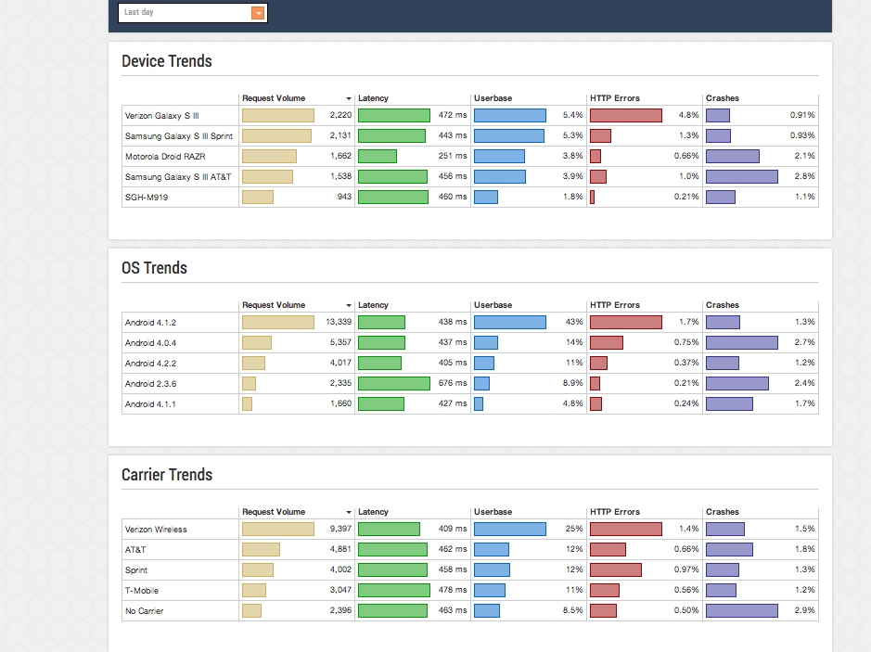
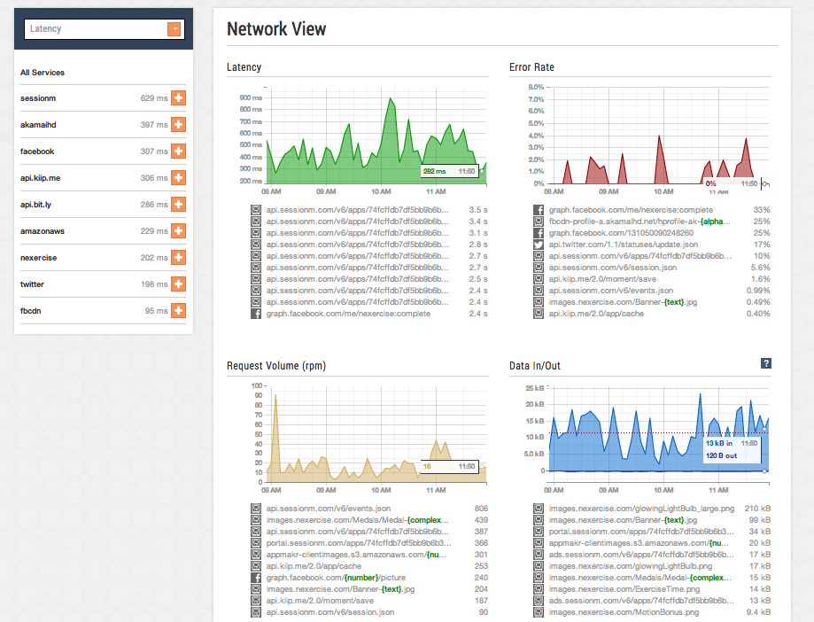
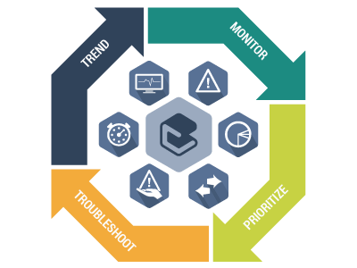
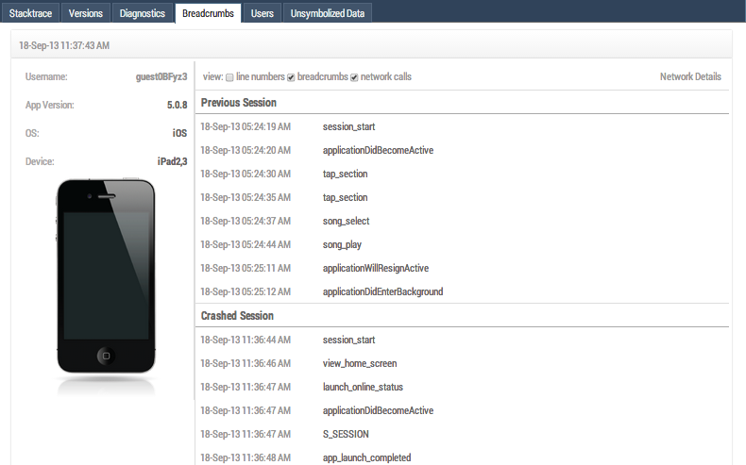
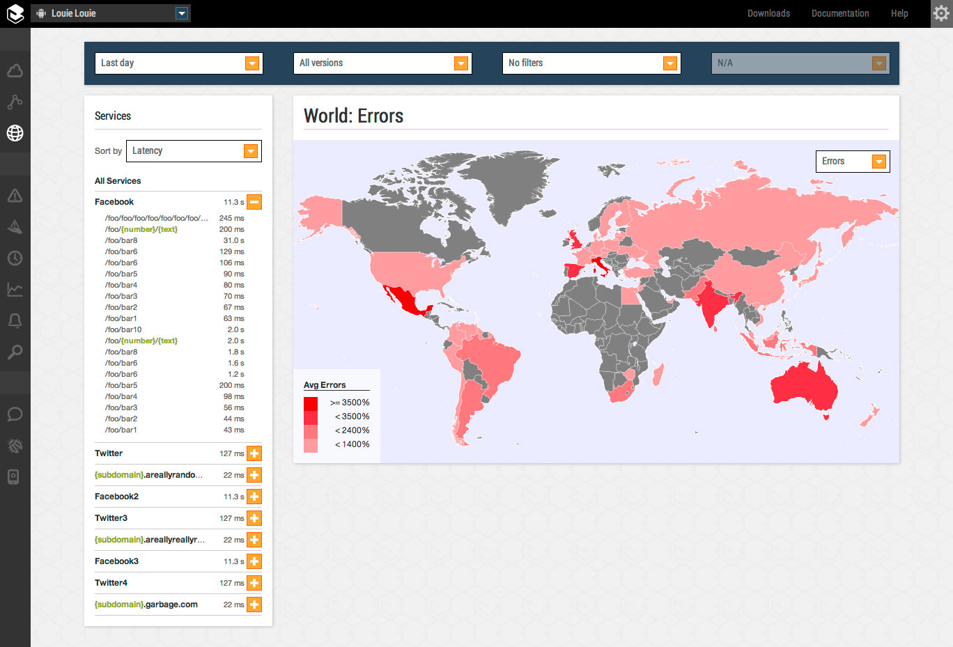
What Does Mobile DevOps Look Like?

Slide 39
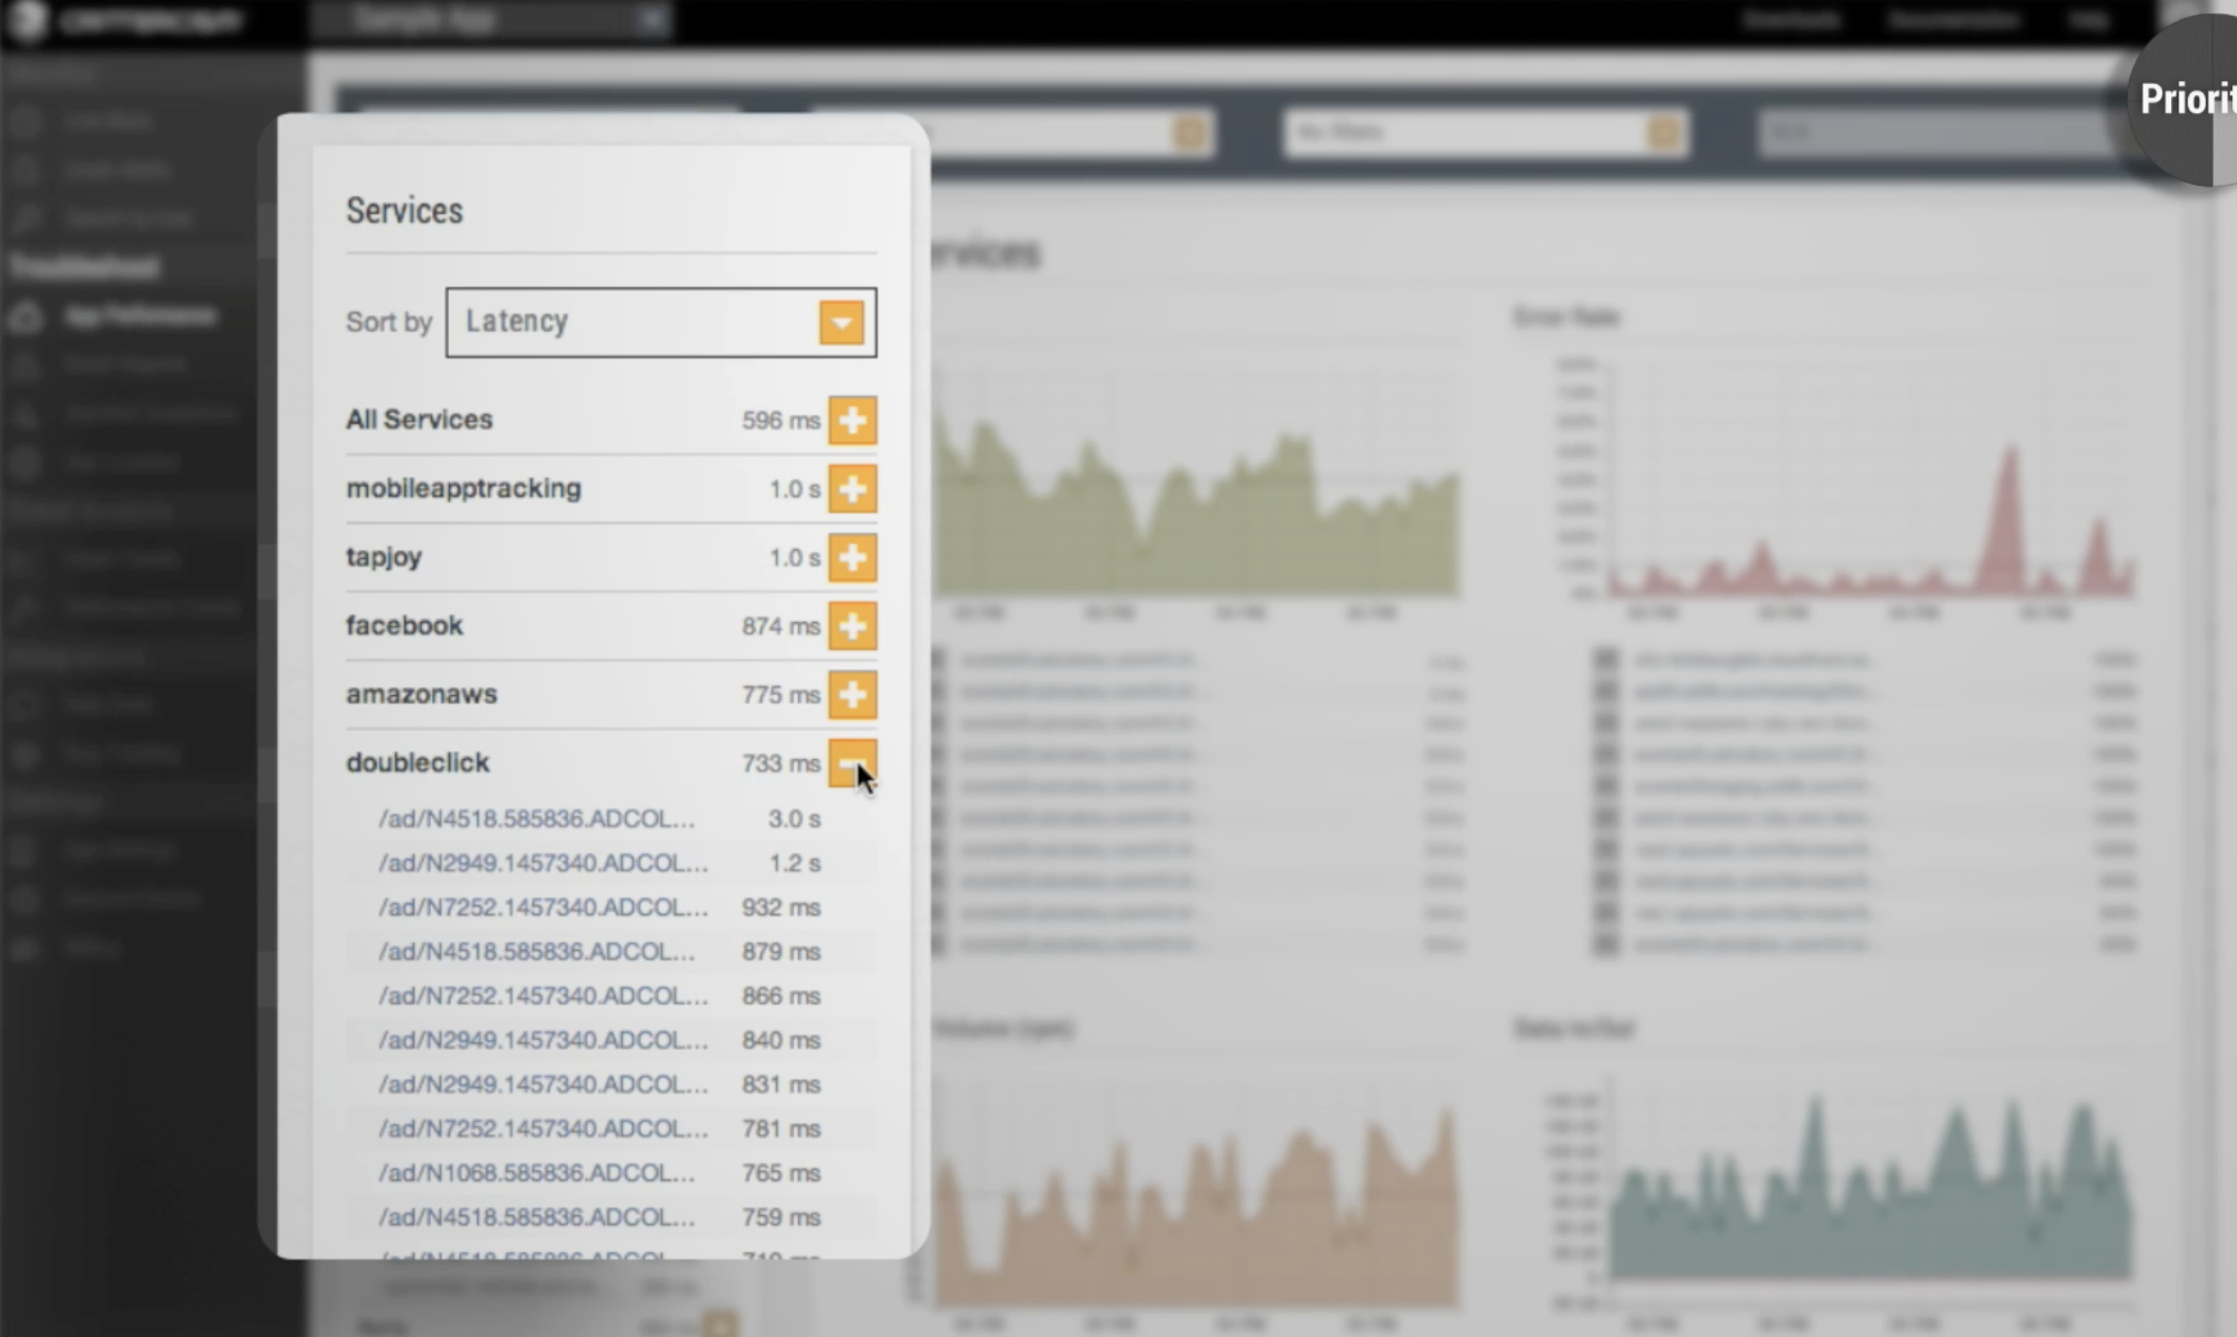
What Does Mobile DevOps Look Like?
One Endpoint has a 3.0 second roundtrip

Slide 40
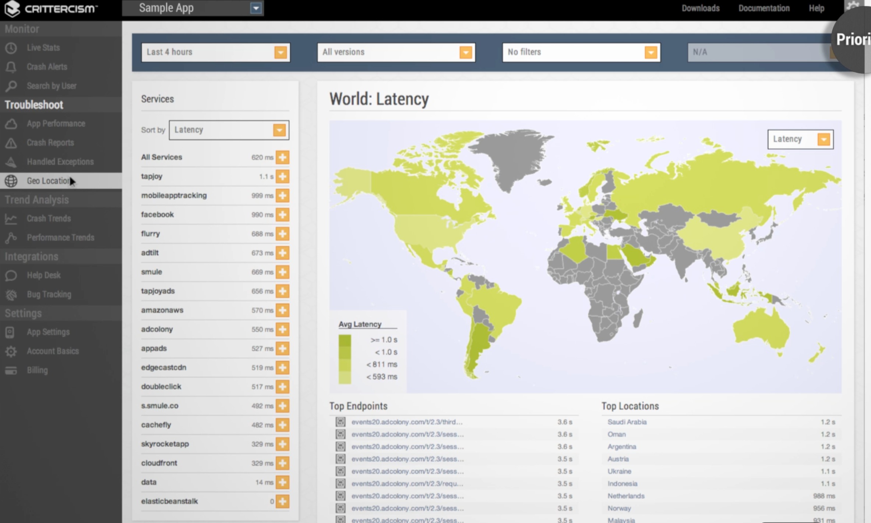
What Does Mobile DevOps Look Like?
Adjust APIs based on geographical performance

Slide 41
What Does Mobile DevOps Look Like?
Take Feedback from Mobile DevOps to improve your overall mobile app user experience.

Slide 42
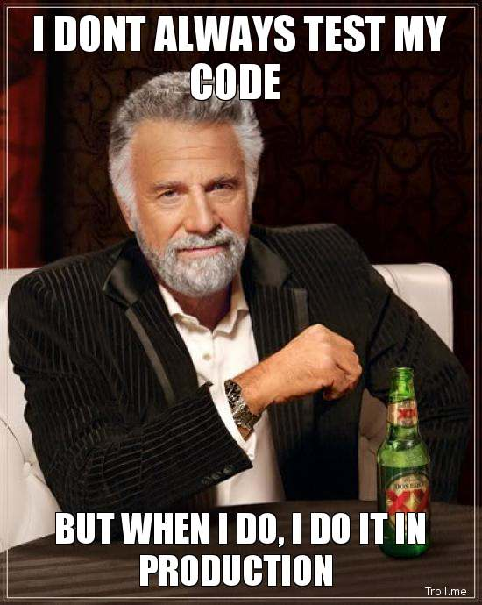
Testing Code in Production is Monitoring

Slide 43
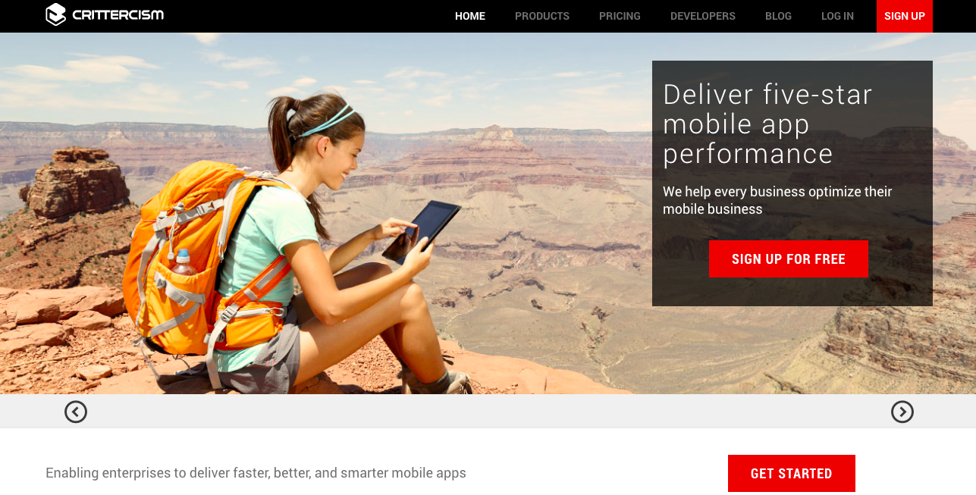
Thank You QCon 2014 - Questions
Thank You
Alex Gaber @intalex
Crittercism @Crittercism

