Slide 1
The Idea Stack: Finding your product vision

Slide 2
Josh Wexler

Slide 3
Outcomes
Understand the value of vision
Using the Idea Stack to articulate a vision
Grab one or two pieces that might work for you and try it

Slide 4
3 Pitfalls of Product

Slide 5
“Politics”

Slide 6
Lack of trust

Slide 7
Unclear vision

Slide 8
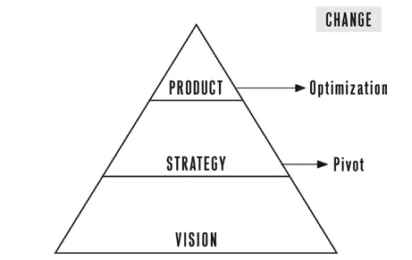

Slide 9
IDEA STACK
Problem
Inspiration
Goals
Customers
Personas
Narratives
Paper Prototype

Slide 10
Purpose Driven Development
VISION DEFINITION
PURPOSE DRIVEN DEVELOPMENT (PDD) SPRINT
Idea Stack Workshop
2
3
Validate
Story Capture
Prototype & Iterate
Technical Recommendations
1
4
Prototype
Code & Test
Plan
6
5
User Testing
& Analytics
Release
Deliver

Slide 12
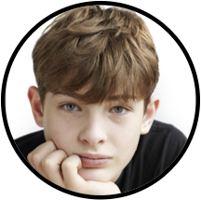

Slide 13
IDEA STACK
Problem
Inspiration
Goals
Customers
Personas
Narratives
Paper Prototype

Slide 14
Problem Statement
1-2 sentences that describe an issue (need) that a person or group has.

Slide 15
Students don’t know that there is a process based way to write well and even if they do know about it, it is hard to practice without explicit instruction.

Slide 16
Inspiration
Other systems that attempt to solve the problem or inspire with their design or functionality

Slide 17
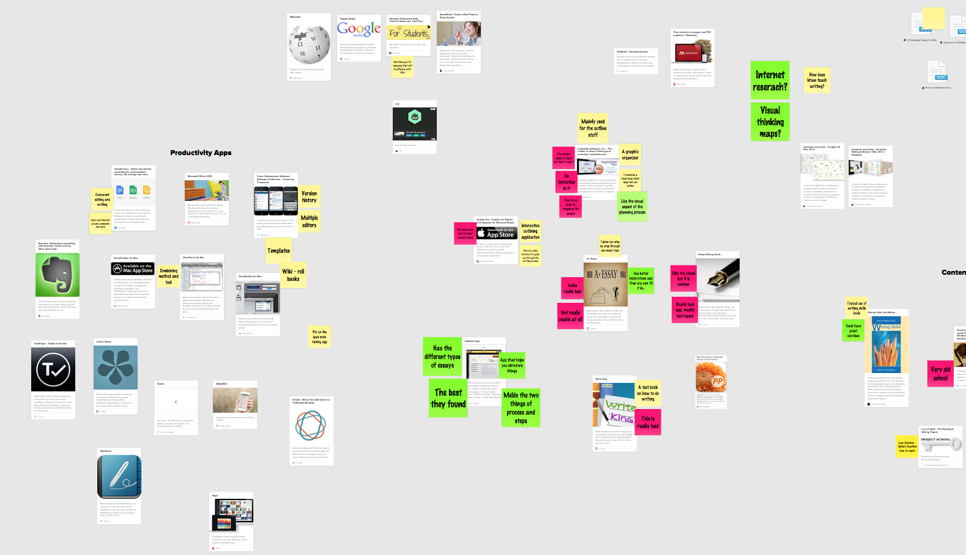
Mylo’s Inspiration Board

Slide 18
Goals
A desired result the product should achieve once built

Slide 19
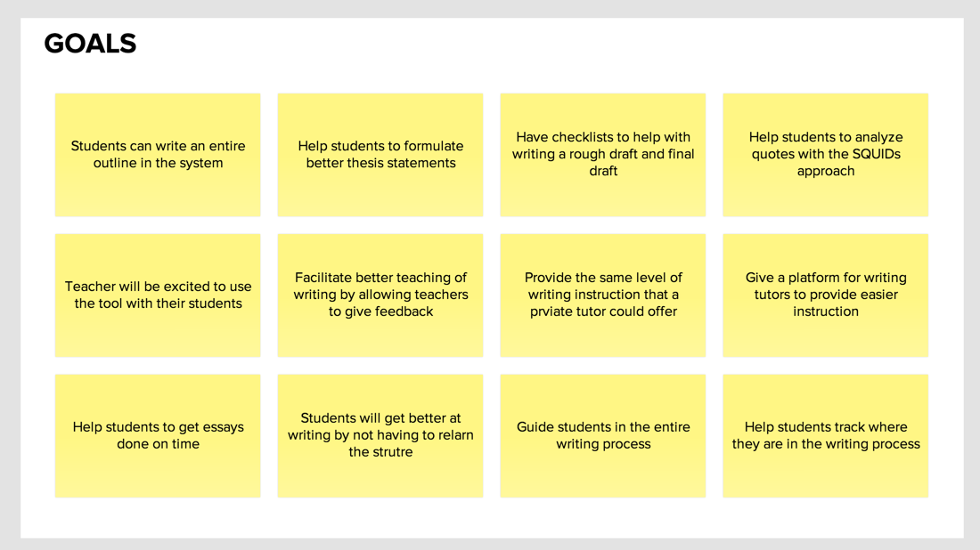
Mylo’s Goals

Slide 20
Customer Definition
Groups of people who might be using the solution. These are the primary customers (i.e., early adopters) and are the people who feel the pain of our problem the most.

Slide 21
Students in 8th to 11th grade in private schools in NYC

Slide 22
Personas
Characters created to represent the different user types within the targeted demographic, attitude and/or behavior set that might use the solution.

Slide 23
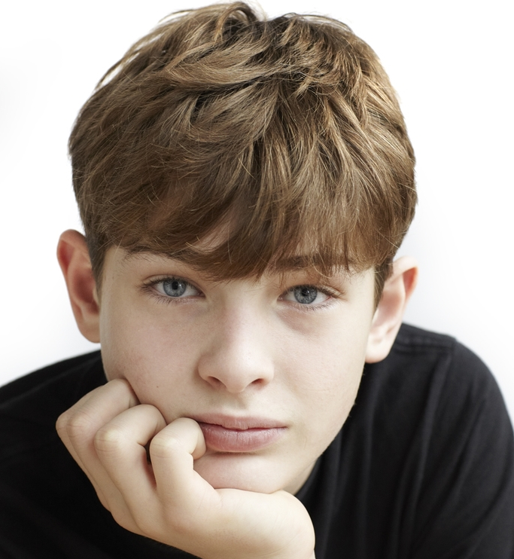
Meet Mylo
Background:
Motivated to do well in class
Struggles with putting ideas into text, organization, hard to get started, easily overwhelmed (starting a sentence)
Loves technology and wants to apply it to everything
Uses a laptop to write (uses Microsoft word, Google drive, and inspiration)
Has a learning specialist that helps with writing
Struggles to take in information
Overly depends on parents and parental figures to get things done
“writing is hard, I am not good at it"
Goals:
Independence – not needing his parents or others to help him get through the writing piece
Wants to do well in school
Feel a sense of accomplishment
Might like the technology for technologies sake
Frustrations:
Reduce the struggle in writing
Reduce his anxiety
Avoid negative feedback from the teachers
Name: Mylo
Age: 13
Customer group:
8th Grader in private school

Slide 24
Persona Narrative
A narrative about how one of the personas would use and interact with the solution in the world. Narratives are different than features, but they can contain features.

Slide 25
Mylo’s Narrative
Background:
Mylo has to read Lord of the Flies for English class. He listened to the book and followed along on text. He participates in class discussions and answers response questions. After the book wraps up, Mylo’s teacher gives them a final essay assignment. He chooses a topic.
Story:
Set up – new doc
Mylo logs into our system online
He sees a dashboard (my projects, what is in progress, what you can learn etc.)
He creates a new assignment and specifies what kind of essay he needs to write, literary response
He sees a set up wizard that first asks which book(s) is the paper going to be on? He inputs load of the flies and that book is then pulled into the system
Idea/topic phase
The next thing he is asked is "what the main question/prompt", he inputs "Which boy is the best suited to lead the society on the island and why?
He is then prompted to come up with an idea statement but he can't think of anything
So Myles access the Shmoop page through the site and can read about all the characters in lord of the flies to …
…

Slide 26
Paper Prototype
A hand drawn version of a persona narrative that gives a visual to the story.

Slide 27
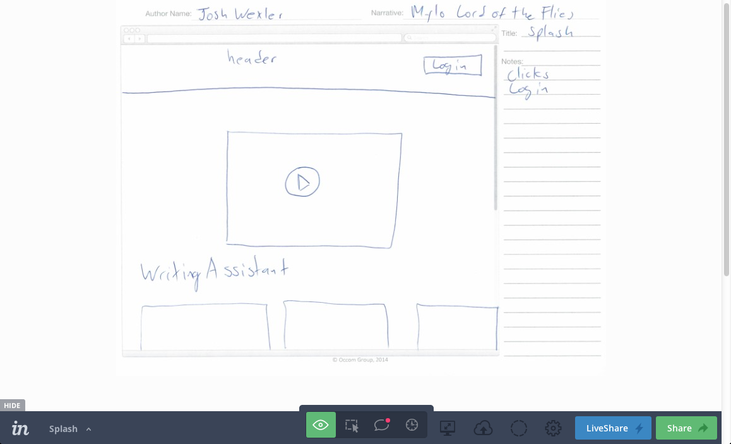
Paper Prototype

Slide 28
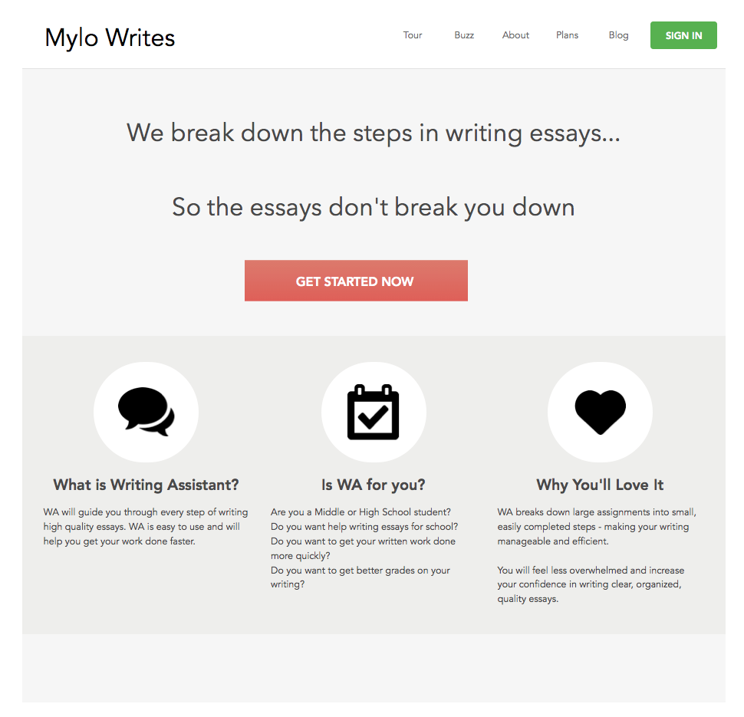
Prototype Development

Slide 29
Why?
Shared Understanding

Slide 30
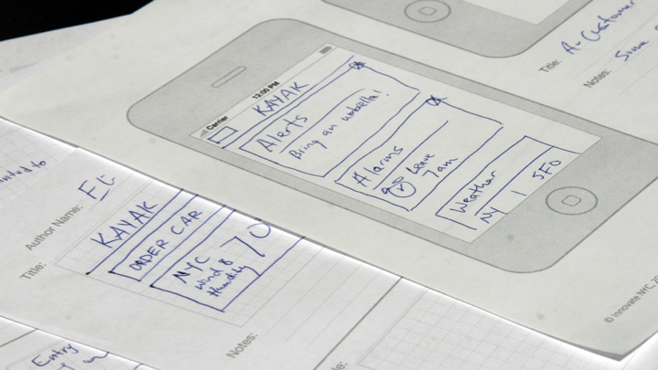
Low Fidelity

Slide 31
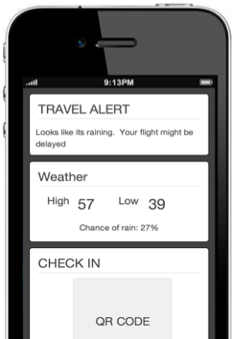
Medium Fidelity
Layout
Data
Get feedback

Slide 32
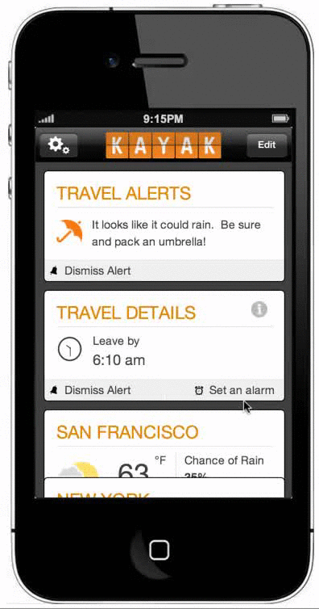
High Fidelity
Design
Interaction
Data

Slide 33
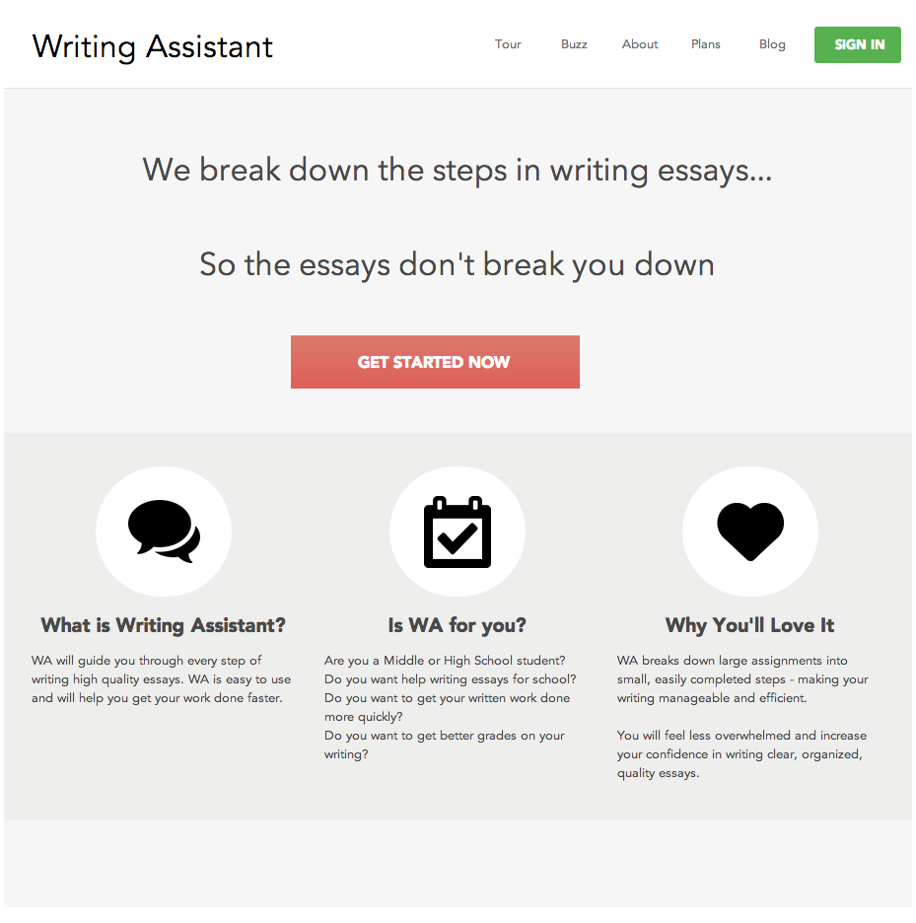
Mylo vision prototype

Slide 34
Takeaways
Articulate a vision quickly and together
Prototype as a way to engage and iterate
Write down as much as you need to capture and learn

