Slide 1
How WebMD Maintains Operational Flexibility with NoSQL
Rajeev Borborah, Sr. Director, Engineering
Matt Wilson – Director, Production Engineering – Consumer Web Operations
@mattwilsoninc
Notes:
Raj

Slide 2
In some situations, failure is not an option
Notes:
Matt

Slide 3
Apps as well as infrastructure need to fail…

Slide 4
Apps as well as infrastructure need to fail…gracefully

Slide 5
Sometimes apps and infrastructure don’t fail gracefully

Slide 6
Well, that’s why we have jobs

Slide 7
About WebMD Technology
WebMD, Medscape, MedicineNet, eMedicine, UK cobrand
Serving nearly 1.2 Billion Pageviews a month, 136 million unique visitors
Running over 200 separate applications, vast majority in-house developed
Environments: Dev/Devint, QA01/02, QA00, Production/DR
Two main data centers, geographically diverse
OS: mix of Linux and Windows
Datastores: Sql Server, Oracle, Mongo, Vertica and mysql
Web: mix of Apache and IIS
App: mix of Tomcat, ASP, .Net 2.x - 4.x
Service: ActiveMQ, Memcache, Couchbase

Slide 8
Anatomy of a Request
Notes:
Matt

Slide 9
Anatomy of a Request

Slide 10
Anatomy of a Request

Slide 11
Anatomy of a Request

Slide 12
Anatomy of a Request

Slide 13
Anatomy of a Request

Slide 14
What We Had
Architecture – 9 Years Old
Key Assumption – Everything Will Change
Presentation
Data Rendering
Business Logic
Data Source
Provider Model
Very Stable and Robust
Notes:
Raj

Slide 15
Before The Change
DB
Data Provider
DCTMAssetProvider
Widget
NAS
XSLT Provider
File Repository
Request
Page
Widget
Widget

Slide 16
Two Problems
NAS
Single Point of Failures
Switchover To backup took finite Time
Scaling Up required more investment in Expensive NAS hardware
The Solution
DB
Scaling Up – still had Single Point of failure
Site non functional if DB is not available
The Solution
Change in Architecture
Change in Infrastructure
Notes:
NAS – Raj
DB - Matt

Slide 17
We formed a team from Dev, Ops, QA and Project Management
Notes:
Matt

Slide 18
Phases
Phase I -Reduce NAS Access
Phase II - Database Scaling
Phase III – Change Driven Push Caching

Slide 19
NAS Problem
Problem Constraint:
Still need a proven storage method
Ubiquitous protocol
Solution Constraint:
200 apps to update …or not
Use NAS as a backup method
Notes:
We still needed to store stuff somewhere. And it needed to be reliable.

Slide 20
What can replace a NAS Filestore?
Does the solution need to provide SMB / NFS interface? Can we use something else
Notes:
I don’t think anyone on the team including development wanted to replace the NAS.
We just wanted to make the platform more reliable and available…. Development folks had to buy-in to the solution as well as the operations team.
But we started asking some fundamental questions.. Do we have to use SMB / NFS to access content?

Slide 21
What can replace a NAS Filestore?
Does the solution need to provide SMB / NFS interface? Can we use something else
Remember, we have 200 apps to update
Notes:
If we choose a different access method, then all 200 apps will need to be updated.

Slide 22
What can replace a NAS Filestore?
Does the solution need to provide SMB / NFS interface? Can we use something else
Remember, we have 200 apps to update
Looked at Scality, Cassandra, MongoDB, Couchbase
Notes:
Scality – based on the CHORD protocol from MIT. Had scalable storage, but not SMB/NFS interface.
Cassandra – not many developers had experience with Cassandra
MongoDB –Some developers using it at them time for proof of concept.
Couchbase – memcached based – persistent storage.. Key /value.

Slide 23
What can replace a NAS Filestore?
Does the solution need to provide SMB / NFS interface? Can we use something else
Remember, we have 200 apps to update
Looked at Scality, Cassandra, MongoDB, Couchbase
Notes:
This is what we picked

Slide 24
Integrating Couchbase
Can the architecture Support It?
How difficult would it be to do?
Will it disrupt the planned business roadmap?
How are we going to do this?
How do we Minimize the Risk?
Notes:
Raj

Slide 25
Key Development Goals
Transparent Change to Existing Architecture
No Rewrite of Business Rules
Backward Compatible
Performance Same or Better
Reliability and Scalability Better than Before
Short time to Execute, Test and Deploy
Notes:
Raj

Slide 26
Data Provider
DCTMAssetProvider
SQL Server
Widget
XSLT Provider
File Repository
Request
Page
Widget
Widget
NAS
File Data Provider
Persistent Data Provider
File With Couch Data Provider
Couch Data Provider
Couchbase

Slide 27
Controlling the Cache
<PersistentDataStoreProvider defaultProvider="CacheAndFile">
<add name="FileOnly" type="WebMD. PersistentDataStore.FileDataProvider, WebMD.Portal.Repository" />
<add name="CacheAndFile" type="WebMD.PersistentDataStore.CacheAndFileDataProvider, WebMD.Portal.Repository" cacheProvider="Couchbase_WXML" />
<add name="CacheOnly" type="WebMD.PersistentDataStore.CacheDataProvider, WebMD.Portal.Repository" cacheProvider="Couchbase_WXML" />
</PersistentDataStoreProvider>
<CacheProviders>
<add name="FileCache" type="WebMD.Caching.FileCache.FileCache,WebMD.Caching" filecachedir="C:\cache\filecache" maxthreadsinfilecache="3" deletefilecacheonstartup="false" asyncfilecreate="false" />
:
:
<add name="Couchbase_WXML" type="WebMD.Caching.CouchbaseCache, WebMD.Caching.Extensions" configSectionName="couchbase_wxml" />
<add name="Couchbase_WIDGETS" type="WebMD.Caching.CouchbaseCache, WebMD.Caching.Extensions" configSectionName="couchbase_widgets" />
</CacheProviders>

Slide 28
Couchbase Design
Cache Key – File Name – Too Long –MD5 Hash
Data Storage – Binary
Can Store Other Objects
Performance
No Query Requirements

Slide 29
Filling up the Cache
Two Choices
The Runtime Web Application could populate cache after the initial fetch from NAS
The Publishing System could push into the Couchbase

Slide 30
Filling the Cache
NAS
Publishing System
SQL Server
Couchbase

Slide 31
Why we Choose This
No Additional load on the Runtime System. Performance is not impacted
Do not have to deal with synchronizing multiple writes
Ties in with our Phase III goals

Slide 32
Reliability Testing
Negative testing
No NAS
No Couchbase
No Database
Combinations of above

Slide 33
Testing Results
NAS Failure system runs at 20% better performance, no downtime or user impact
Couchbase failure – system runs at performance before architectural changes. No downtime or user impact
DB Failure – Site is impacted

Slide 34
What We Were Able to Achieve
Performance Improvement – 20%
NAS Access Reduced – 87%
Reliability – Multiple Levels
Local Cache
Central Cache
NAS
Scalability
Ability to Add Servers without requiring additional NAS hardware

Slide 35
Phases
Phase I -Reduce NAS Access
Phase II - Database Scaling
Phase III – Change Driven Push Caching
Phase IV – Reduce Database Access

Slide 36
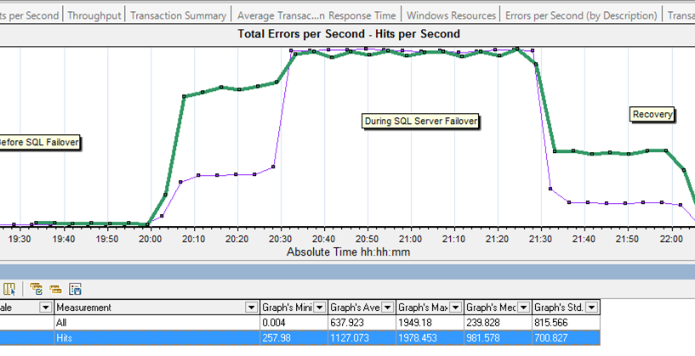
Notes:
This is what happens to the site when the DB is not available…The site turns into a 500 error machine.

Slide 37
DB Problem
Problem Constraints:
Improve Availability
Improve Scalability
Solution Constraints:
No code updates. Needs to “just work”

Slide 38
Like changing the tires while the bus is moving

Slide 39
*My* DB Problem is easy to solve
Notes:
It’s not as bad as you think… here’s why…

Slide 40
Data Access Pattern
“narrow-read” workload – many copies on many nodes
Database workload does not exceed server hardware
All data is read only
Load balancing works better than clustering in this pattern

Slide 41
DB Solution

Slide 42
DB Solution

Slide 43
What’s Next
Phase I -Reduce NAS Access
Phase II - Database Scaling
Phase III – Change Driven Push Caching

Slide 44
The Cache
Based on Polling Time Intervals on the Web Application
Polling Queues are too longs at times
Web Servers not in synch
Notes:
Raj

Slide 45
How We are Doing It
Move Cache Refresh to be Changed Based
Changes Notification to Web App
Web App Refreshes Only those caches which actually have changed

Slide 46
What it going to look like
NAS
Web Server
Publishing System
Message Queue
SQL Server
Web Server
Couchbase

Slide 47
Was it worth it?
Fixed DB problem by using Peer to Peer replication and Load Balancing – no code changes
Fixed NAS problem by adding caching layer to reduce calls to NAS
Fixing cache pull model with push model for the content publishing system – reduces publishing times to all web servers in seconds and all web servers have the same cached content
Serving content is now faster – less latency
Able to virtualize the web servers

Slide 48
Questions?
www.webmd.com/careers

