Slide 1
Stress and depression - The Taboo and What We Can Do About It
Qcon New York, June 2015
Gitte Klitgaard @nativewired

Slide 2
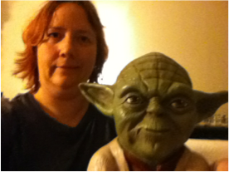
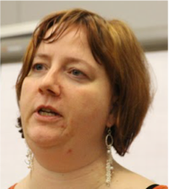
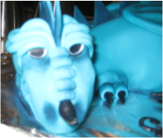
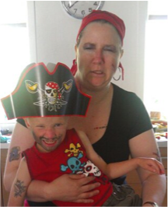
Gitte

Slide 3
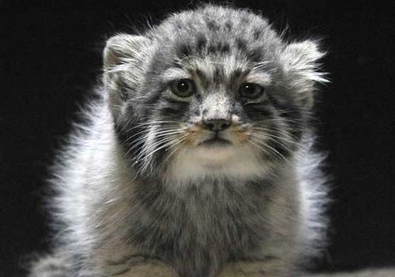
Why am I here?

Slide 4
How does stress show?
It depends!

Slide 5
How did it feel for me?

Slide 6
How did my brain feel?

Slide 7
What can I do?

Slide 8
A few tips – some I even tried
Plan preparation time
Relax your brain
Meditation
Mindfullness
Exercise
Ask for help
Be authentic

Slide 9
World Mental Health Day
https://www.youtube.com/watch?v=do8mqz6XmTE

Slide 10
What can I do to help others?

Slide 11
DON’T
Say
Pull yourself together
Many people are worse of than you
You have no reason to be depressed/stressed
Its all in your head
Ignore them
Don’t give unfounded advice

Slide 12
Do
Offer your help – subtle
Listen (grow your ears and open your heart)
Tell them to go to a professionel
Respect what they feel
Care

Slide 13
Include people
Notes:
Eyeore

Slide 14
Wrap-up
Ask for help
Offer help
Talk to eachother
Care

Slide 15
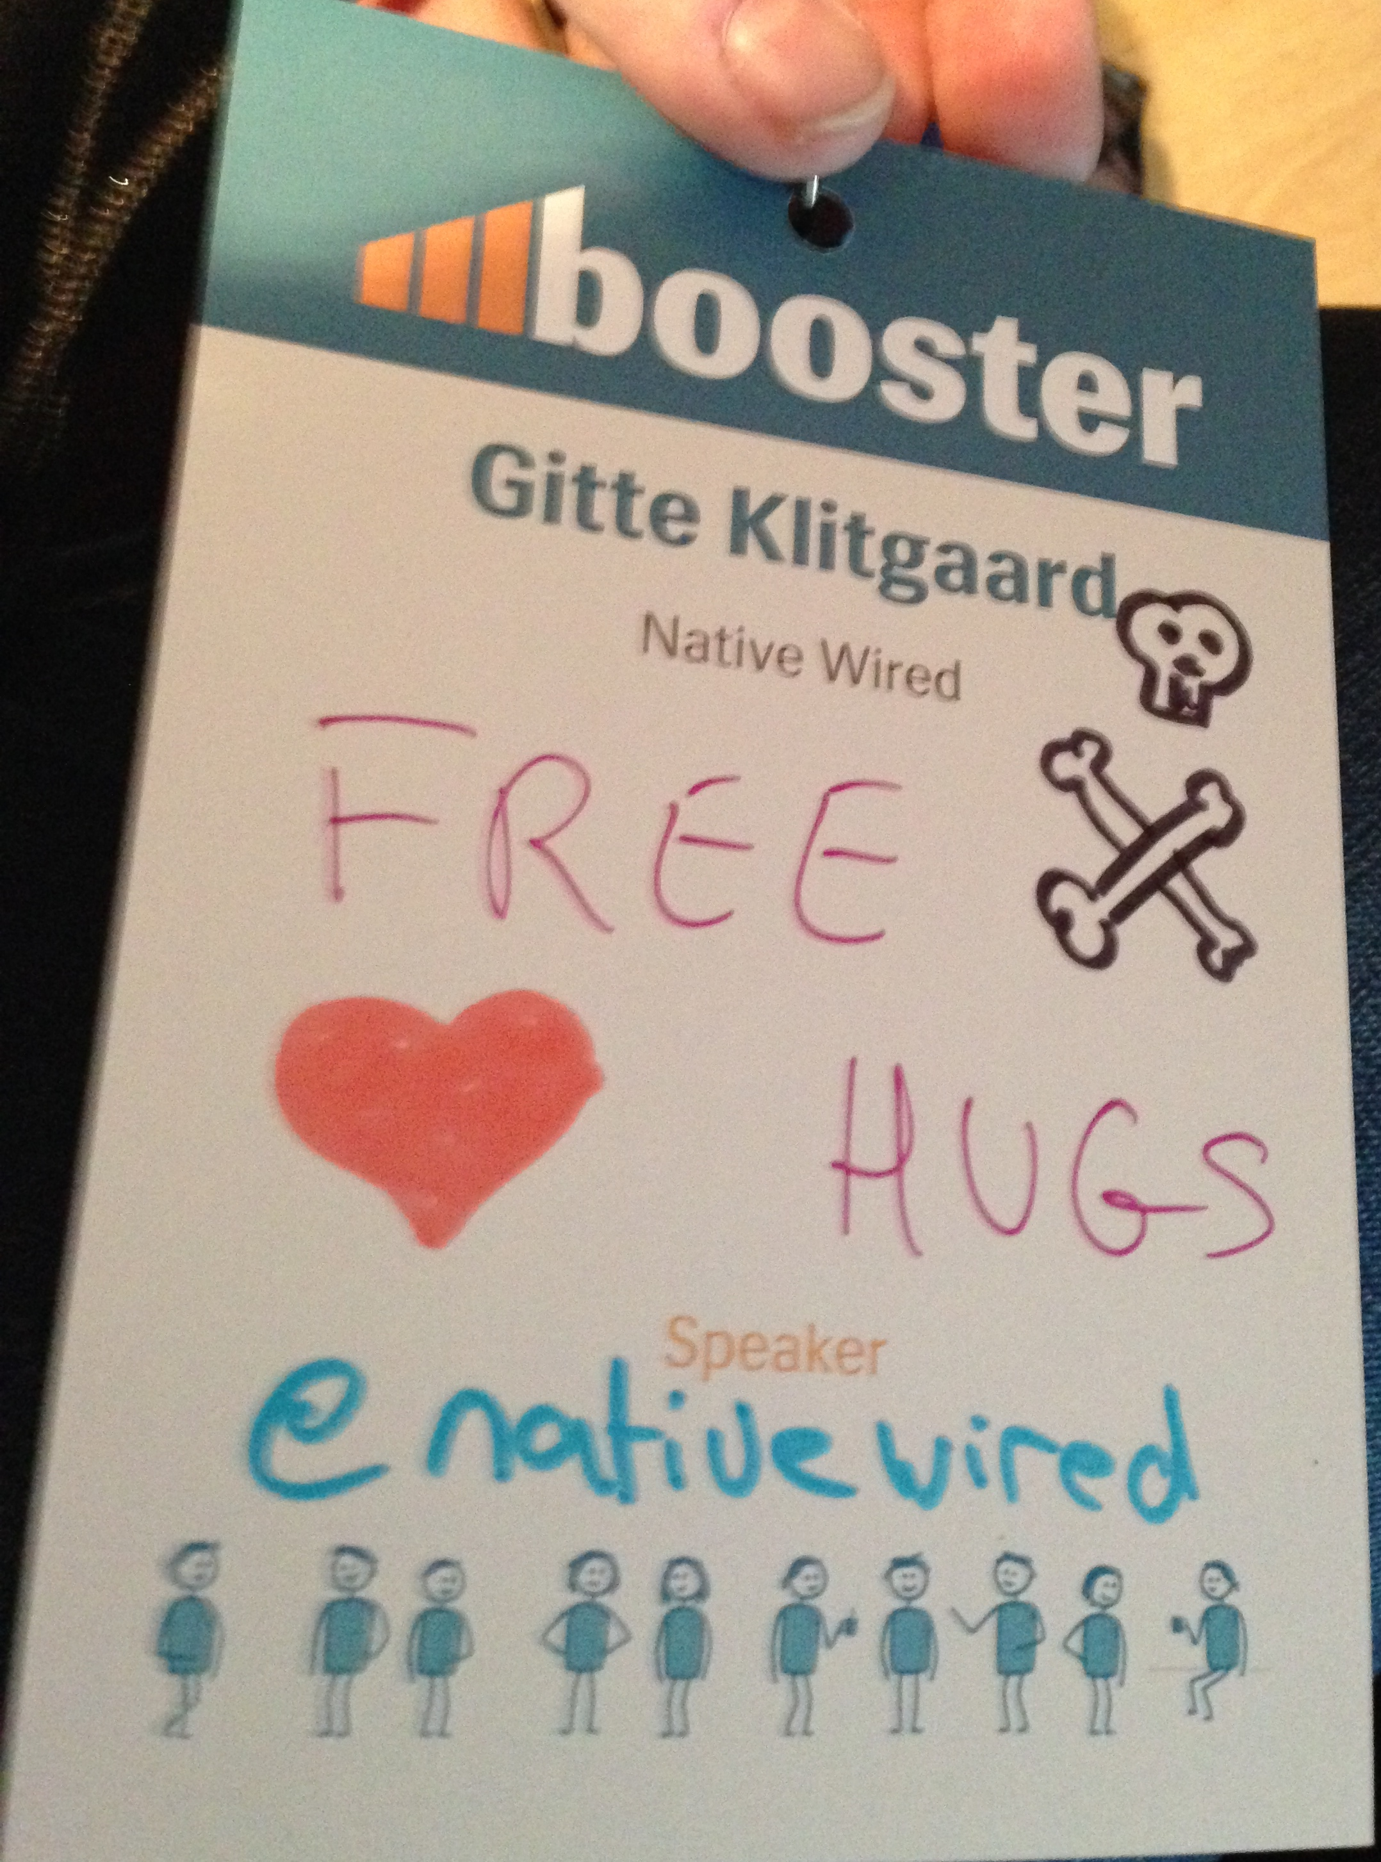
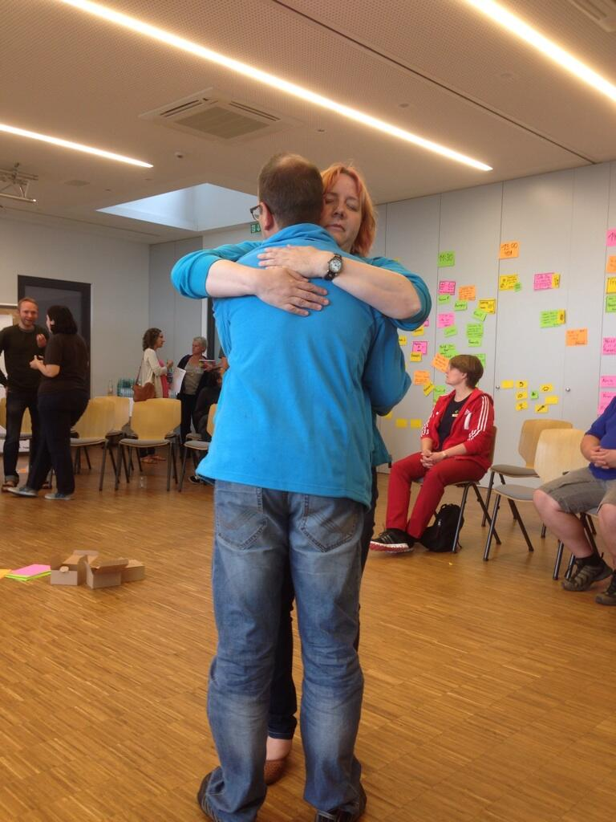
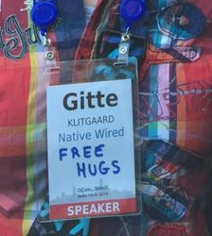
Free hug

Slide 16
I love connecting :)
Feel free to contact me:
XING
Gitte.klitgaard@yahoo.dk
http://www.agilebyheart.com/
dk.linkedin.com/in/gitteklitgaard/

Slide 17
Links and more
Karojisatsu
http://itrevolution.com/karojisatsu/
Burnout is killing us (John Willis)
http://itrevolution.com/karojisatsu-in-plain-english-burnout-is-killing-us-video/
Stress
http://glasgowspcmh.org.uk/information/stress/
Depression
http://glasgowspcmh.org.uk/information/depression/
I had a black dog, his name was depression
https://www.youtube.com/watch?v=XiCrniLQGYc
Living with a black dog
https://www.youtube.com/watch?v=2VRRx7Mtep8

Slide 18
Extra slides

Slide 19
Knowledge workers
”What differentiates knowledge work from other forms of work is its primary task of "non-routine" problem solving that requires a combination of convergent, divergent, and creative thinking”
Reinhardt, W.; Schmidt, B.; Sloep, P.; Drachsler, H. (2011). "Knowledge Worker Roles and Actions – Results of Two Empirical Studies". Knowledge and Process Management 18 (3): 150–174

Slide 20
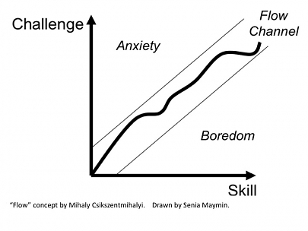
Flow

