Slide 1
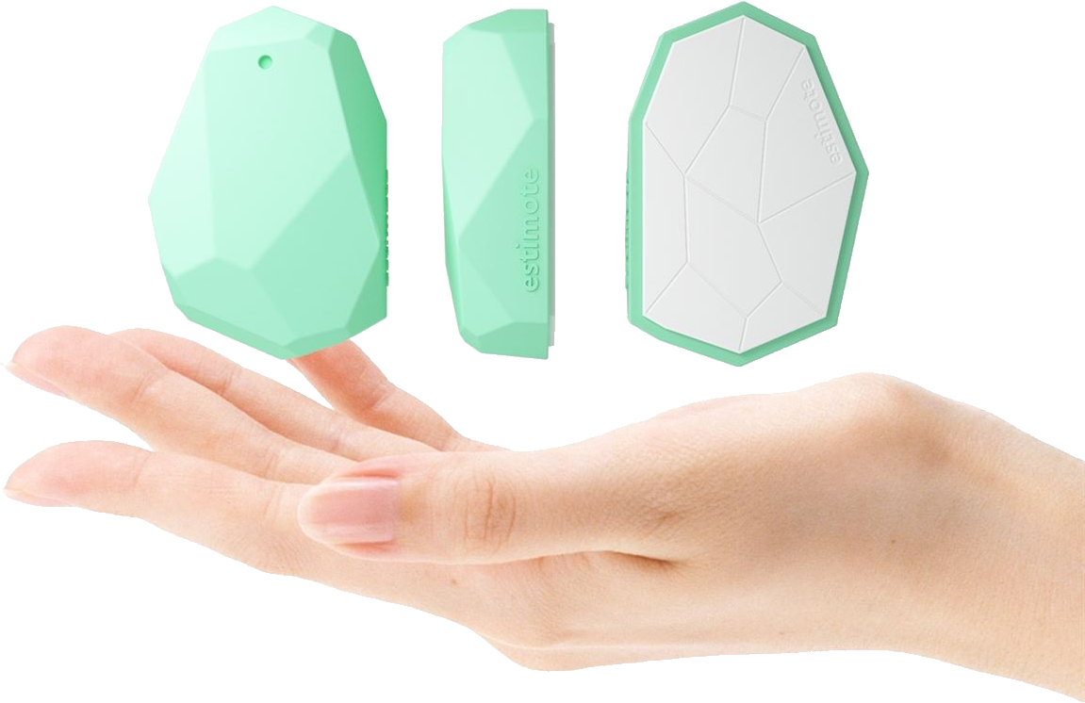
Getting up close and personal with IoT Nearables
Jen Looper

Slide 2
Jen Looper
Developer Advocate, Telerik
http://www.ladeezfirstmedia.com
@jenlooper

Slide 3
What’s a beacon?

Slide 4
More like this

Slide 5
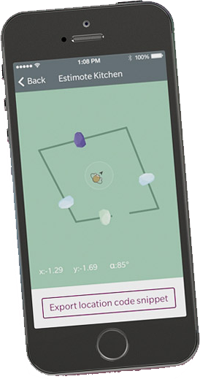
Except much more precise: indoor location FTW
Use several beacons to triangulate your location in a room

Slide 6
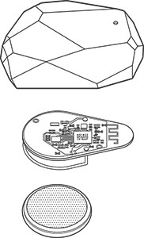
Beacons might feature:
A bit of memory
Accelerometer
Temperature sensor
Bluetooth (Smart, or BLE)
Long-lived battery
Gecko-style sticky backing

Slide 7
Bluetooth signal
Beacons broadcast using bluetooth
Find them between two inches and 230 feet distance
Invisible underwater

Slide 8
Your phone picks up a signal (“advertising packet”) and your app processes it
Estimates distance
Places phone in a context
Measures signal strength
Can ping 10x/second

Slide 9
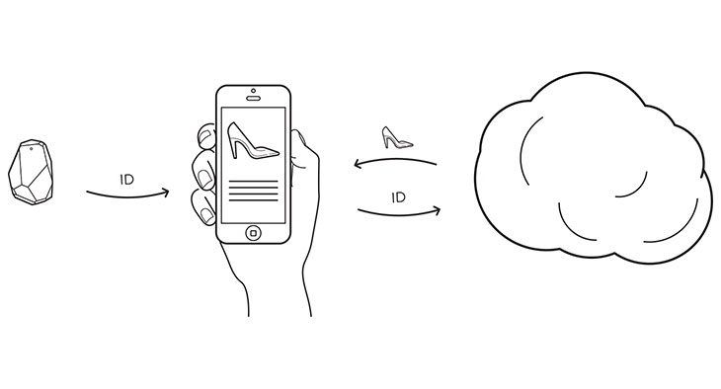
Beacons have a unique Id
Associate this id with a product or a call to action

Slide 10
And moar!
Micro-location
Geofence users
Detect context changes
Proximity marketing
Turn-by-turn navigation

Slide 11
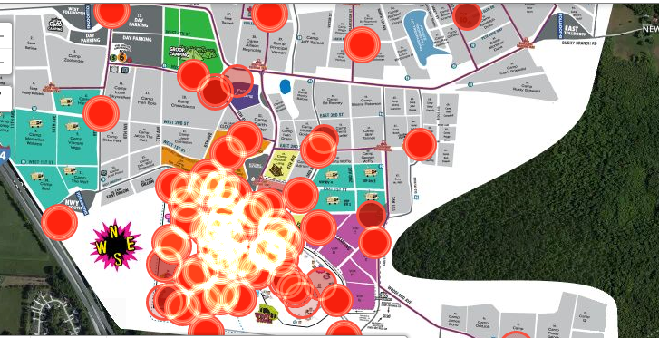
Not just for selling stuff
Kontakt.io use cases include:
Public beacons for use by the blind
Beacons for music festivals (Bonnaroo) to ‘heat map’ areas of the festival and create ‘retrospective itinerary’ as a festival souvenir for the users
Restaurant interactions – check in, get free appetizers, etc
Allow businesses to pay for patron parking fees in a movable parking meter system
‘beaconizing’ SFO airport by offering voice-routing to visually-empaired passengers
Beacons in Africa – track and manage outbreaks
Culture and tourism***

Slide 12
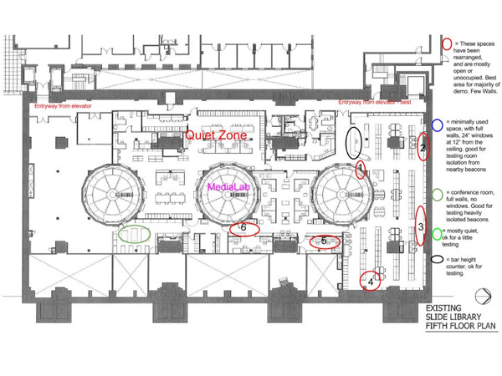
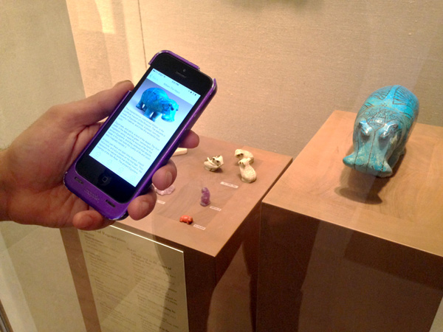
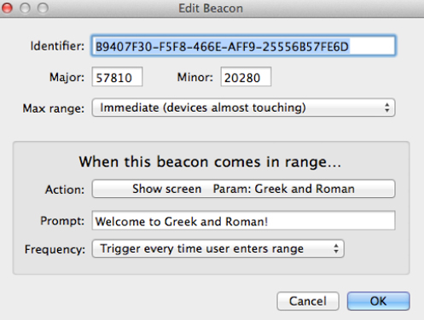
Museums!! Check out the Metropolitan Museum’s ‘Beacon Walk’
http://bit.ly/met-museum-beacon
Uses Estimotes with Beacondo service

Slide 13
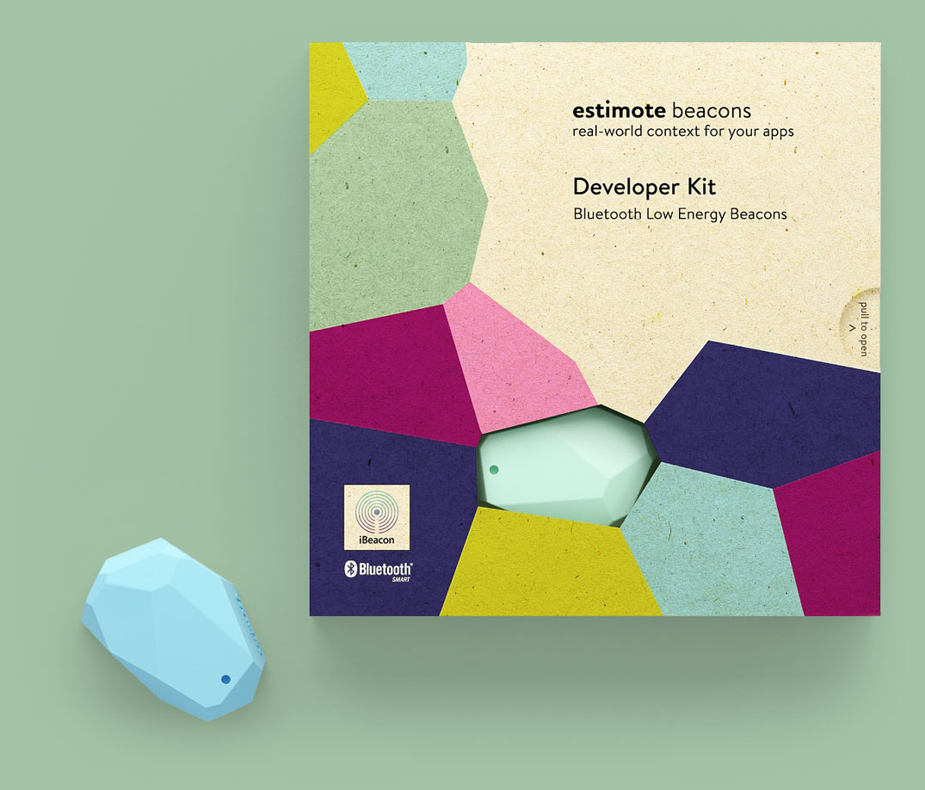
What about iBeacon?
iBeacon is a protocol created by Apple, for iOS 7 and 8 devices
Many hardware beacons leverage iBeacon technology

Slide 14
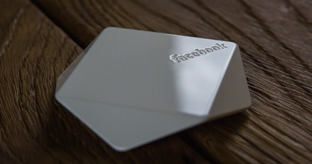
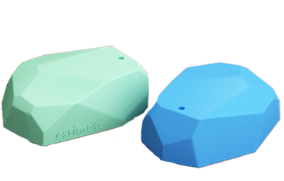
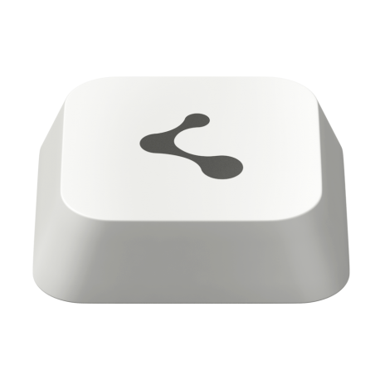
What types of hardware beacons are available now?
DIY – Bluetooth dongle can be turned into a beacon
Facebook Bluetooth Beacons
Estimote beacons
Kontakt.io beacons

Slide 15
Periculum!

Slide 16
Beacons can be hacked
☹
→

Slide 17
Hacking the CES scavenger hunt
http://bit.ly/ces-hack

Slide 18
Estimotes have beefed up security
Manage your beacons’ UUIDs

Slide 19
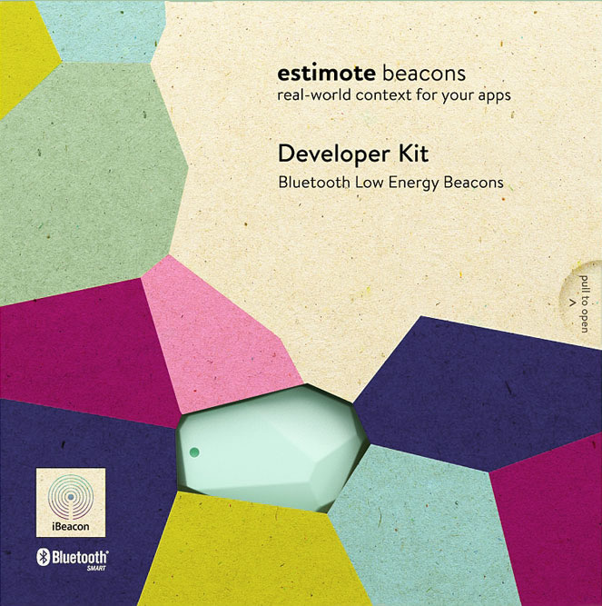
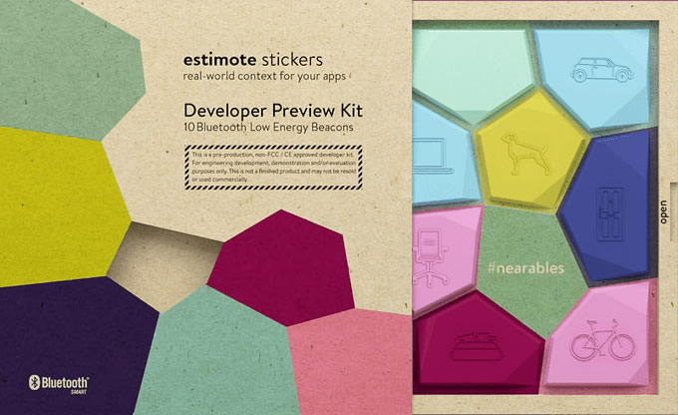
A look at Estimote’s offering
Beacons and Stickers, $99 per pack, SDK + Cloud

Slide 20
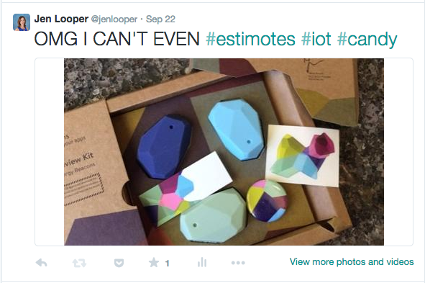
The unboxing

Slide 21
Let’s build something!

Slide 22
A Civic Project - BookBeacon
Requirements:
Create a mobile app for a public library
Library will hide a beacon in the stacks, near a book with an ISBN code
Mobile app will help users find the beacon and, when found, open barcode scanner to scan ISBN
ISBN is used with an API to get more info about the book

Slide 23
Full tutorial:
http://bit.ly/beacons-appbuilder
Github repo:
https://github.com/jlooper/estimote-kendo

Slide 24
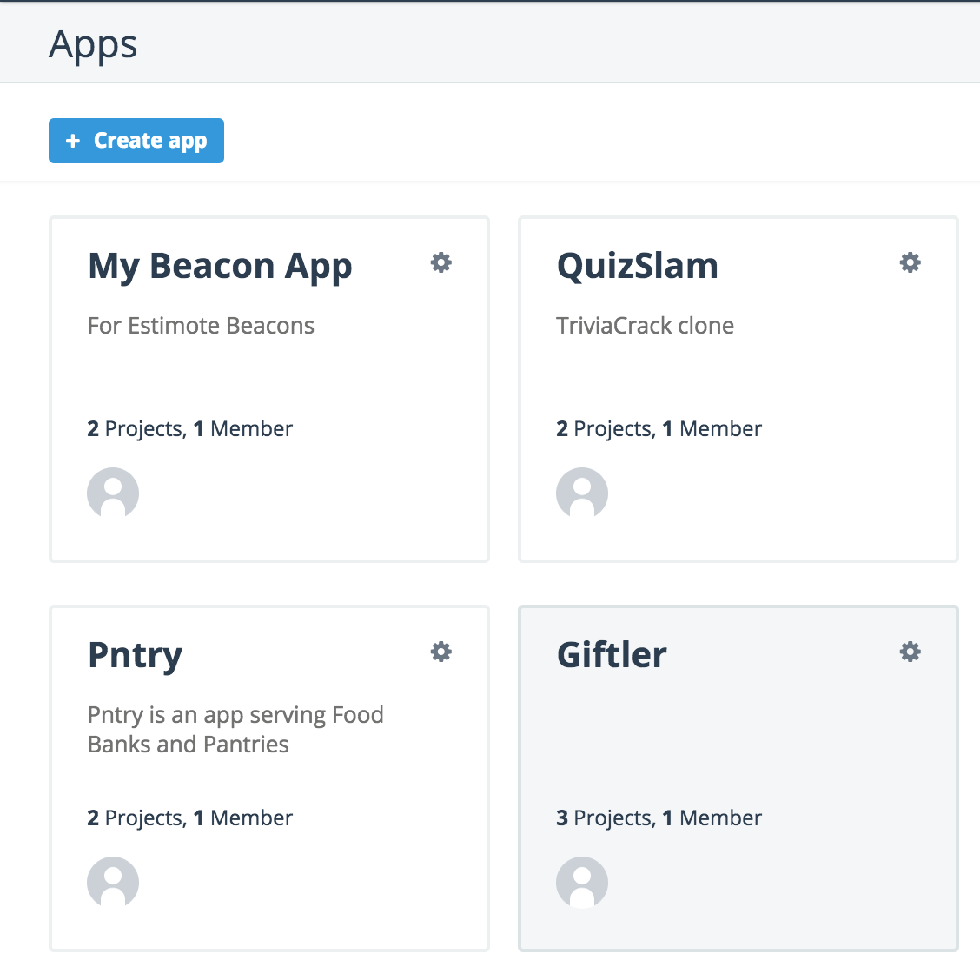
Create a mobile app – Telerik AppBuilder + Kendo UI Mobile
Create a hybrid mobile app project in Telerik Platform (http://platform.telerik.com)

Slide 25
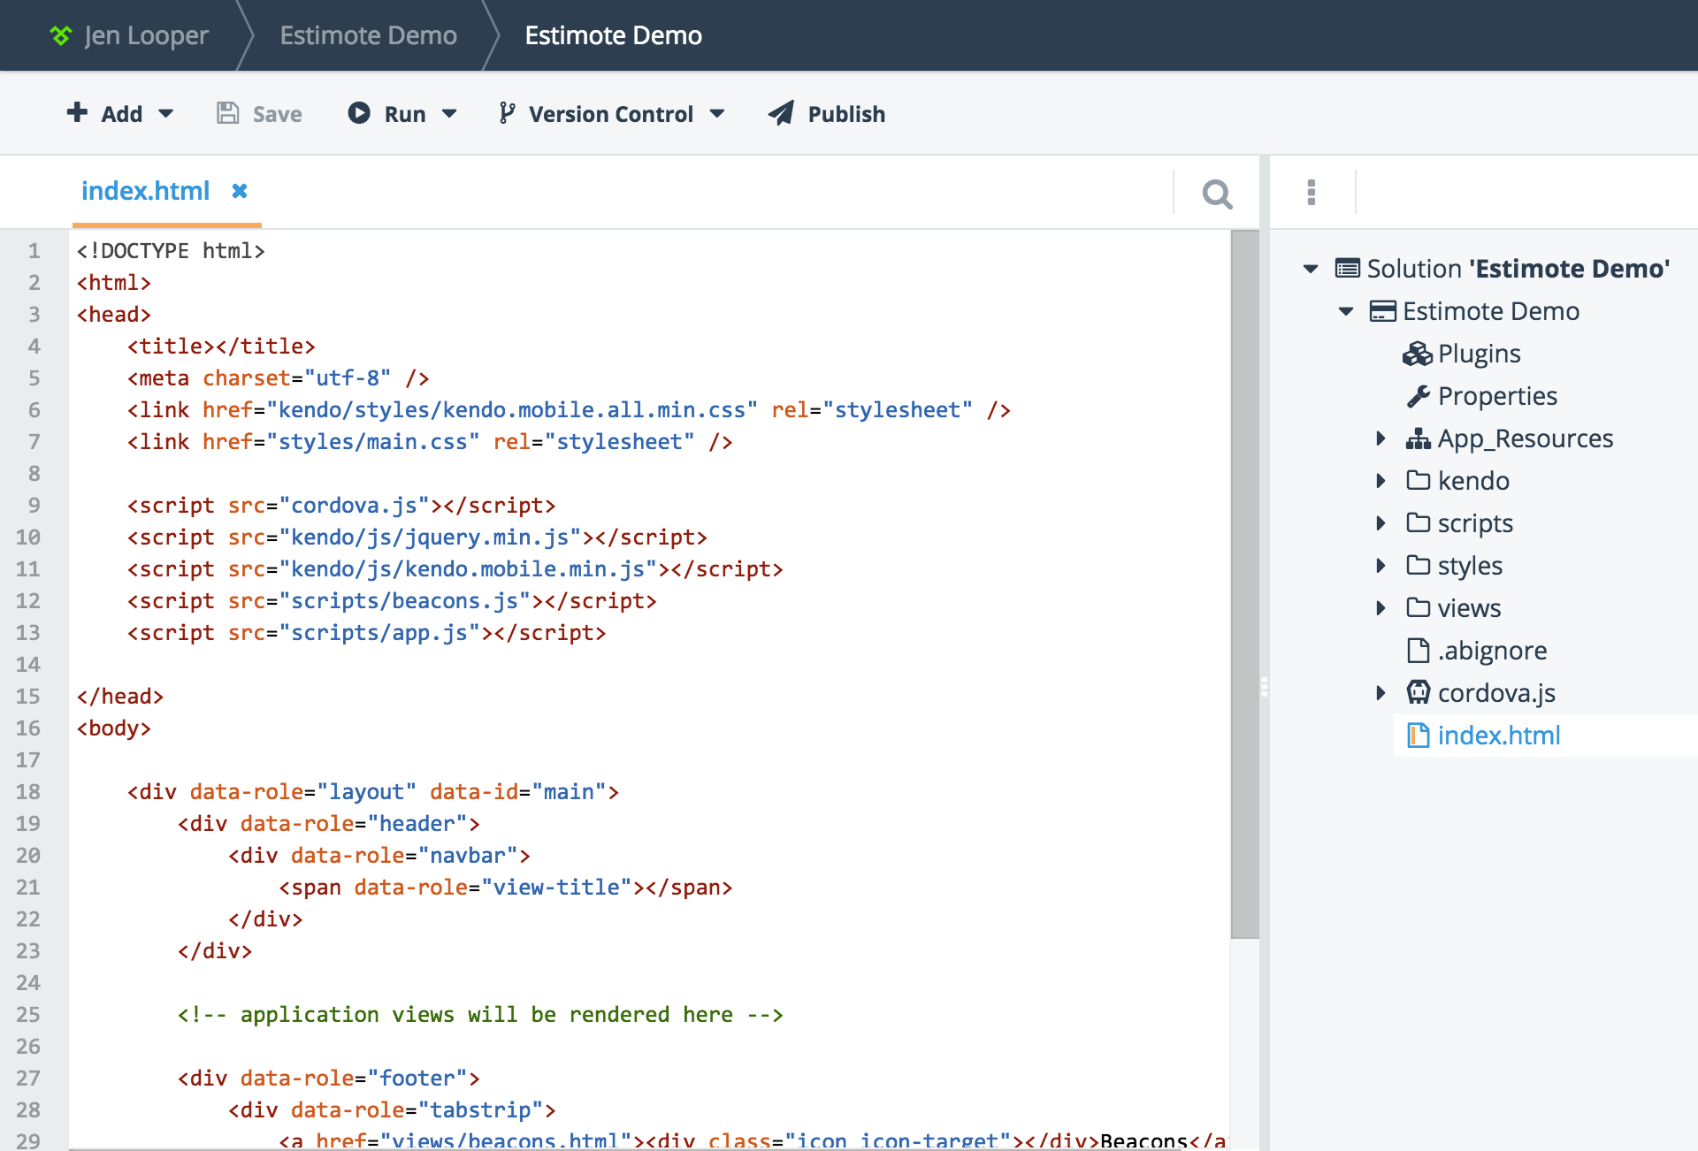
Two views – manage beacons, scan books
/views/beacons.html
/views/scan.html

Slide 26
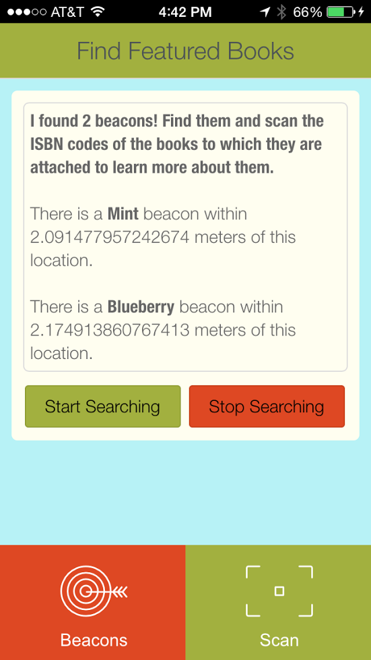
Two buttons in beacons.html: start and stop scanning for beacons
<div data-role="view" data-title="Find Featured Books" data-layout="main" data-model="app.beaconService.viewModel">
<div class="rounded">
<div id="beaconlog">
Looking for beacons...
</div>
<div class="buttons">
<button data-role="button" class="button start" data-bind="click: start">Start Searching</button>
<button data-role="button" class="button stop" data-bind="click: stop">Stop Searching</button>
</div>
</div>
</div>

Slide 27
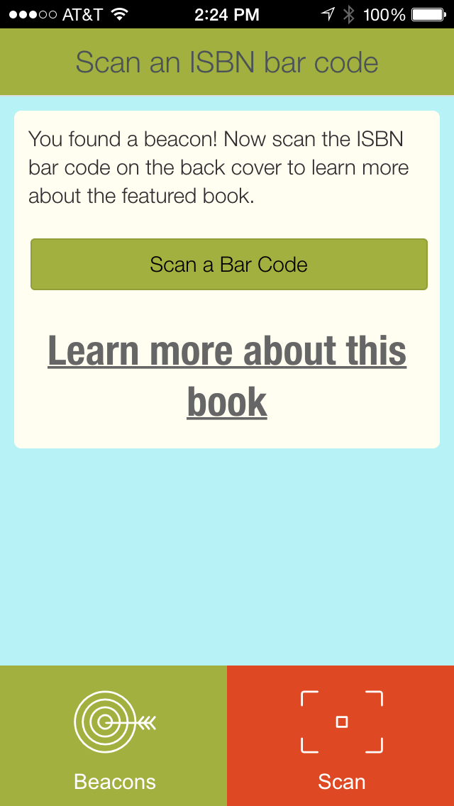
One button and one link in scan.html
<div data-role="view" data-title="Scan an ISBN bar code" data-layout="main" data-model="app.beaconService.viewModel">
<div class="rounded">
You found a beacon! Now scan the ISBN bar code on the back cover to learn more about the featured book.
<div class="buttons">
<button class="button scan">Scan a Bar Code</button>
</div>
<div id="bookinfo”></div>
</div>
</div>

Slide 28
Wire up the beacon scanning procedure
function onBeaconsReceived(result) {
if (result.beacons && result.beacons.length > 0) {
var msg = "<b>I found " + result.beacons.length + " beacons! Find them and scan the ISBN codes of the books to which they are attached to learn more about them.</b><br/>";
for (var i=0; i<result.beacons.length; i++) {
var beacon = result.beacons[i];
if(beacon.distance > 0){
msg += "<br/>";
if (beacon.color !== undefined) {
msg += "There is a <b>" + beacon.color + "</b> beacon ";
}
…

Slide 29
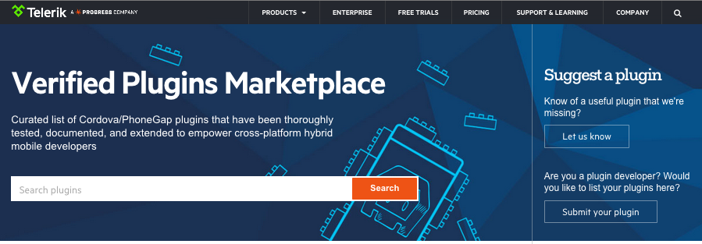
Plug in the plugins!
Use two plugins from http://plugins.telerik.com - curated Cordova plugins marketplace:
Estimote and BarcodeScanner

Slide 30
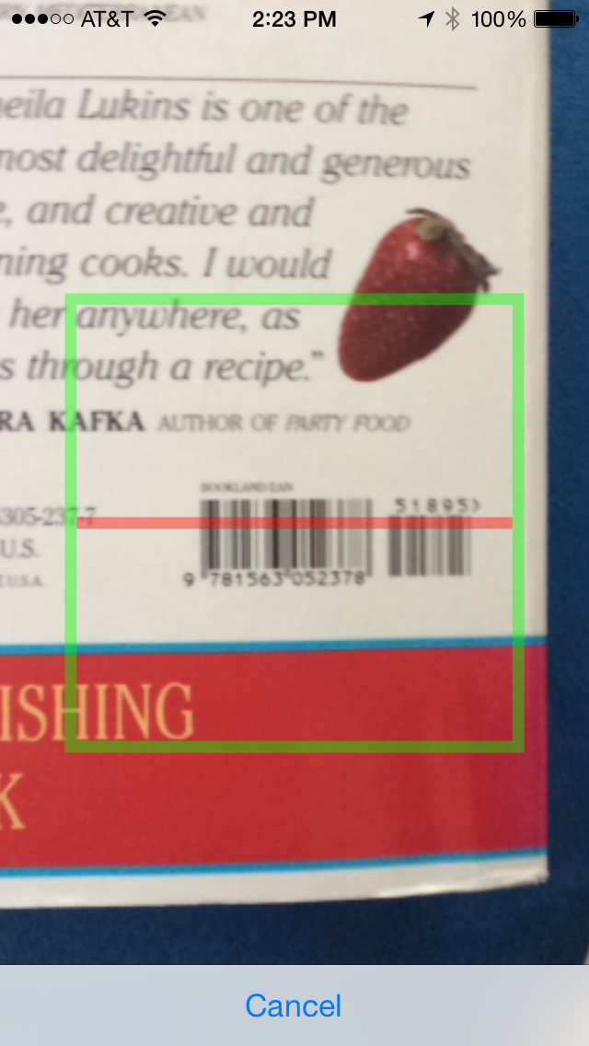
Integrating Barcode Scan plugin
scan: function () {
cordova.plugins.barcodeScanner.scan(
function (result) {
setTimeout(function() {
var url = 'http://www.lookupbyisbn.com/Search/Book/' + result.text + '/1';
var bookinfo = "<a href='#' onclick=window.open('" + url + "','_blank')>Learn more about this book</a>";
document.getElementById('bookinfo').innerHTML = bookinfo;
}, 0);
},
function (error) {
alert("Scanning failed: " + error);
}
)
},

Slide 31
Test on device

Slide 32
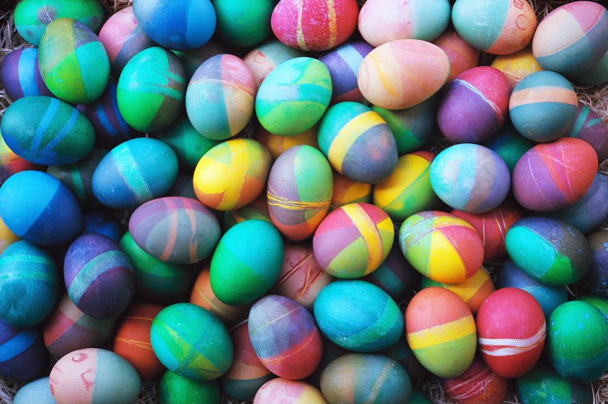
Let’s build something else: Beacon Hunt

Slide 33
Full tutorial:
http://bit.ly/beacon-hunt
Github repo:
https://github.com/jlooper/beacon-hunt.git

Slide 34
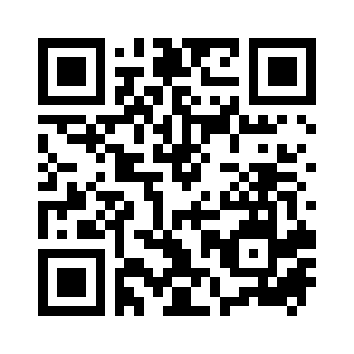
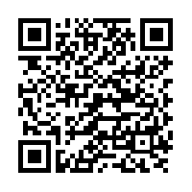
Introducing Beacon Hunt!

Slide 35
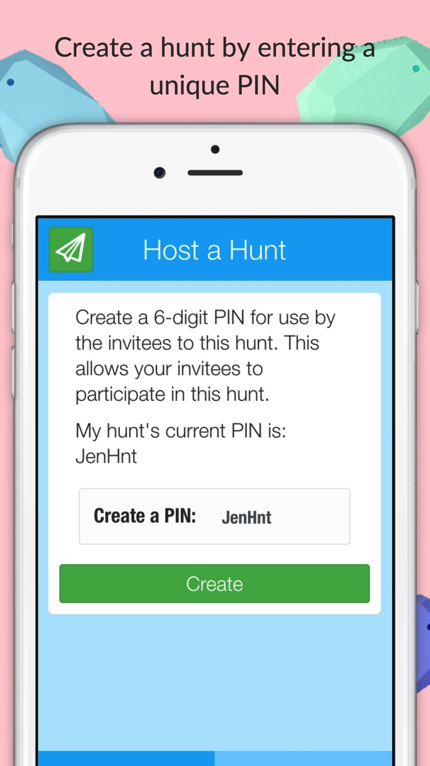
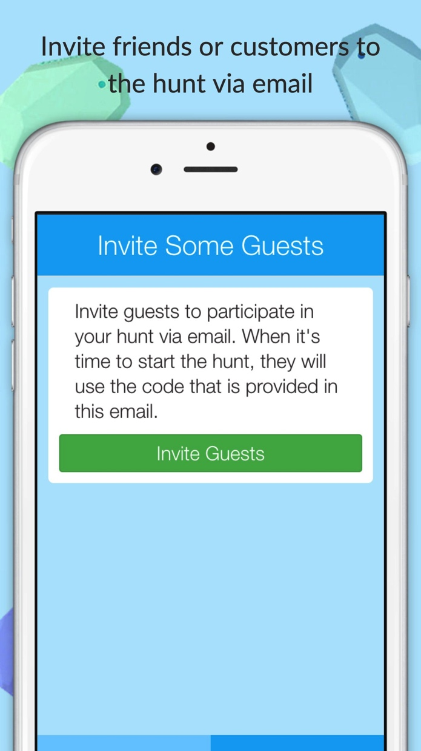
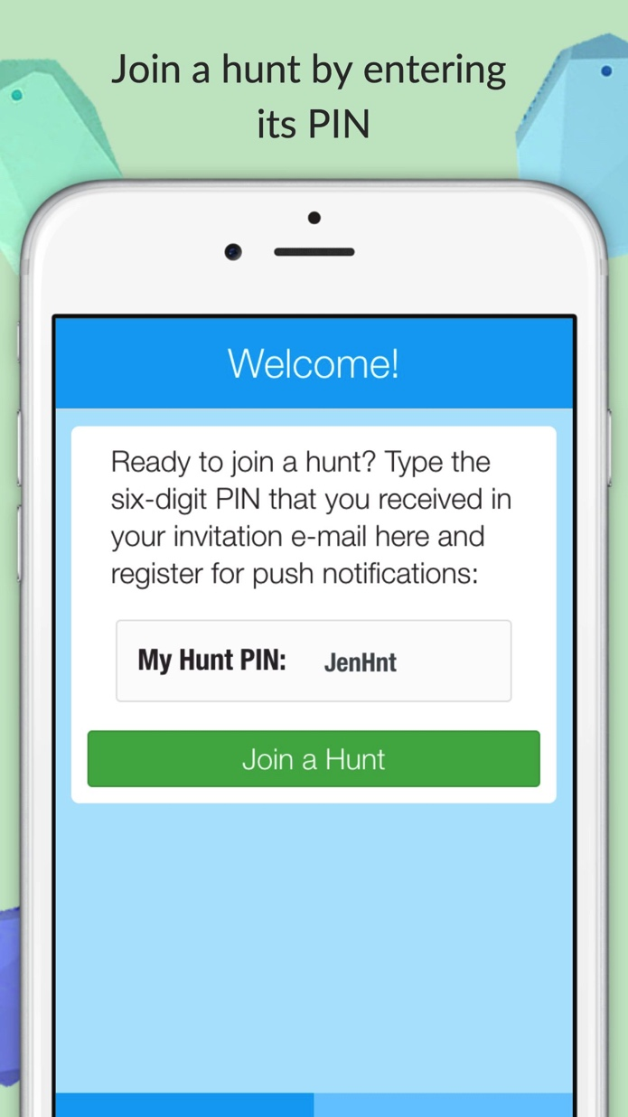
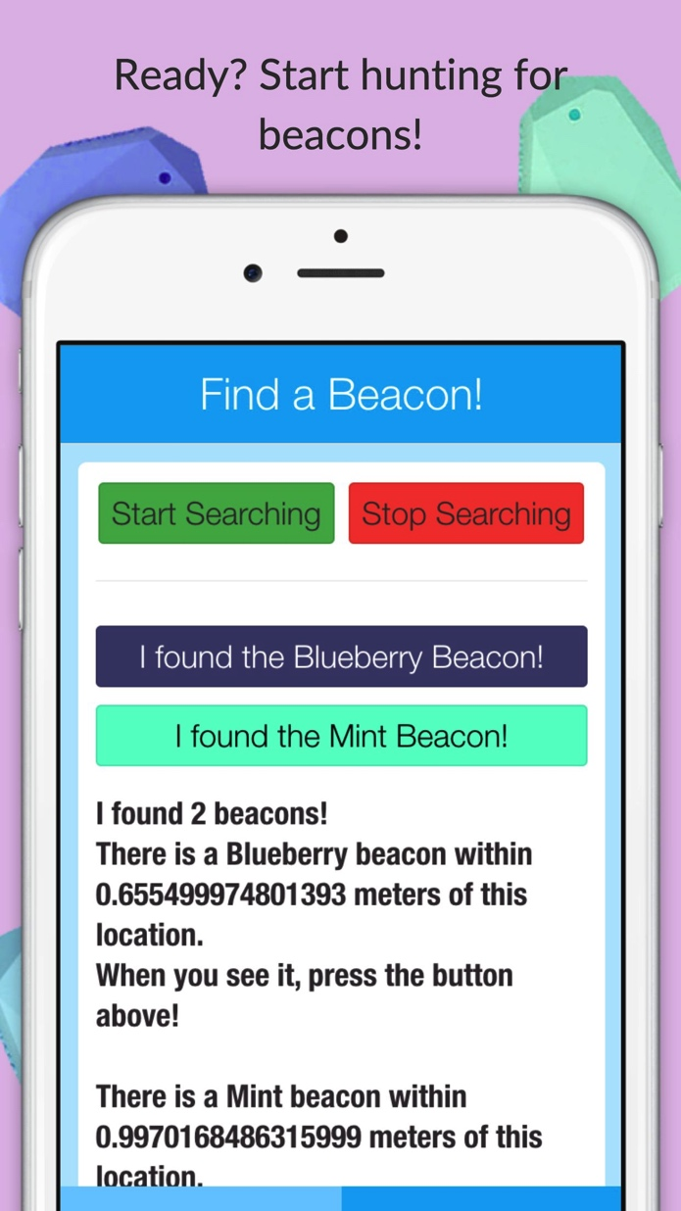
Estimote Beacons + Plugin + AppBuilder + Telerik Backend Services = fun app!

Slide 36
Beacon Hunt Requirements:
Allow an administrator or host to create a Beacon Hunt by creating a 6-digit PIN unique to that hunt
Enable sending this PIN to users of the app via email
Allow invitees to the hunt to input the PIN and subscribe to a push notification channel unique to the hunt
On push of ‘start’ button, app starts pinging for beacons
If beacon is found, appropriately colored button is generated, and when pressed, a push notification is sent to the members of the hunt that this color beacon has been found (“claimed”).

Slide 37
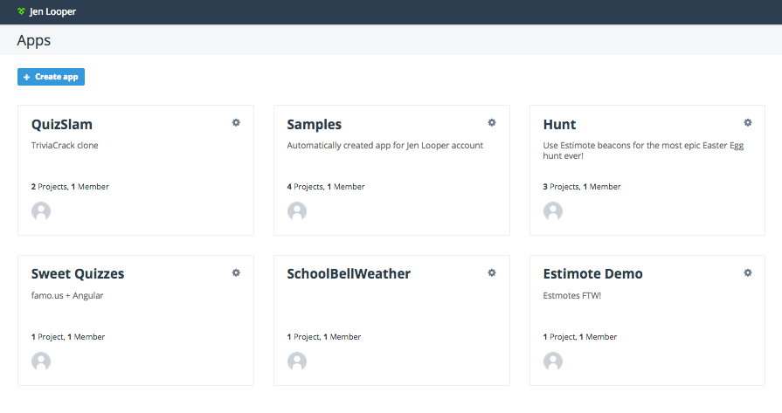
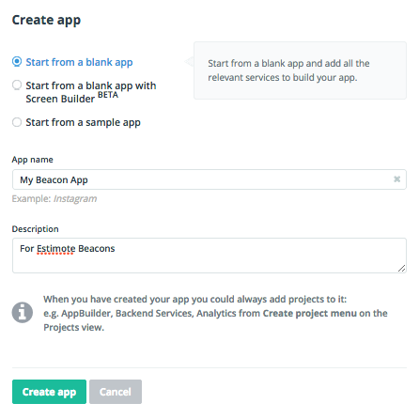
Building the app – Step 1 - Setup
Create an account at platform.telerik.com and create an app
Using Telerik Platform makes it easy

Slide 38
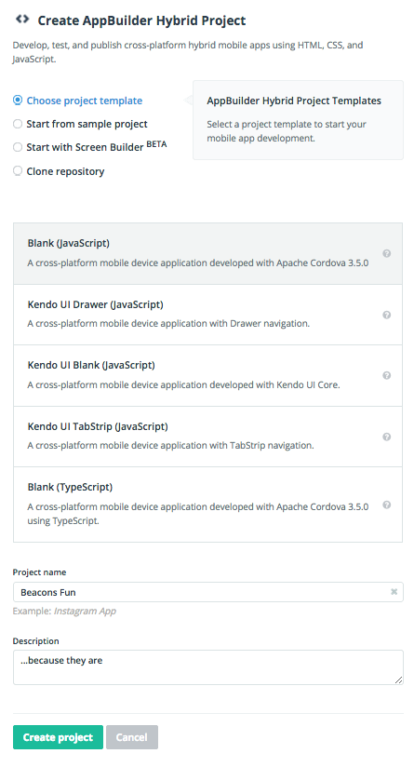
Building the app – Step 2 – Scaffold
Scaffold a basic Kendo UI Mobile app
Create a hybrid project using a blank JavaScript template

Slide 39
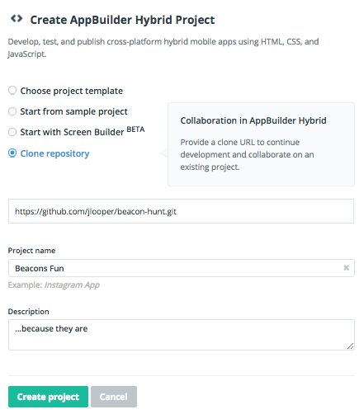
Building the app – (quick ‘n’ dirty)
Scaffold your app using code from github
https://github.com/jlooper/beacon-hunt.git

Slide 40
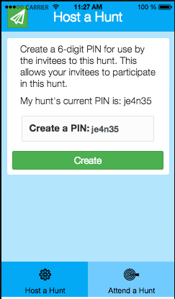
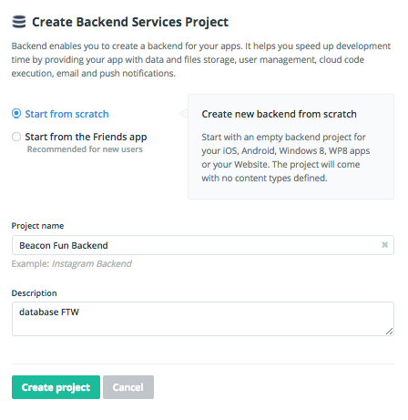
Building the app – Step 3 – Build ‘host’ screen
A 6 digit PIN will reserve your hunt ID. Use Telerik Backend Services to store it.
Add Backend Services to your project to store data

Slide 41
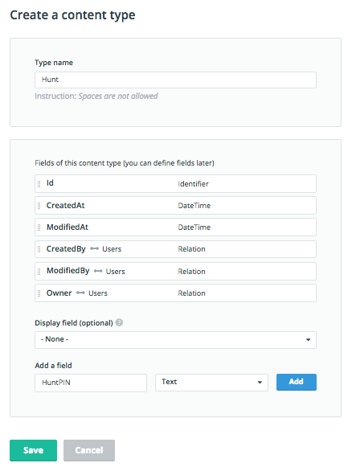
Build Data tier for ‘host’ screen
Add push notifications and cloud data to your app project’s backend configuration
Create a ‘content type’ to store HuntPINs so they will remain unique for use as push segments

Slide 42
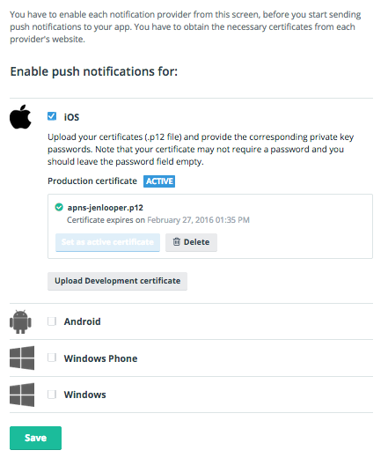
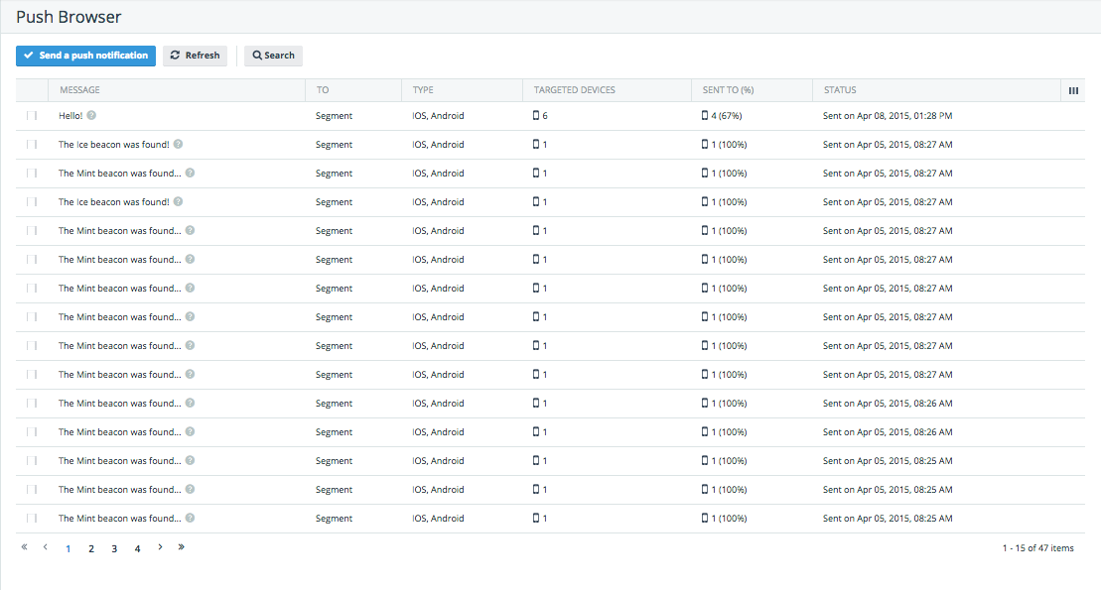
Configure push notifications
Manage your app provisioning (takes time to do on iOS especially!)
Keep track of push stats in the backend

Slide 43
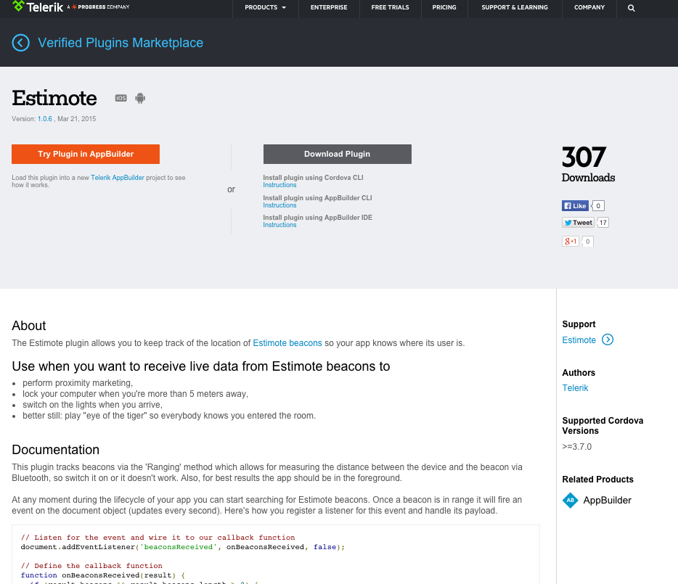
Build the app – Step 4 – Plugins!!
Plugins.telerik.com

Slide 44
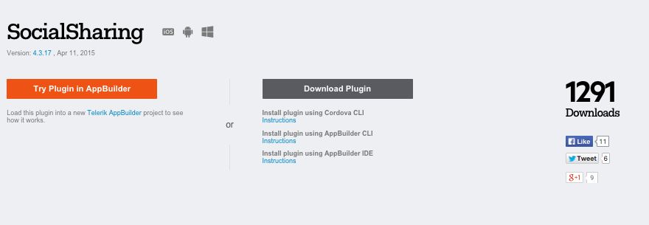
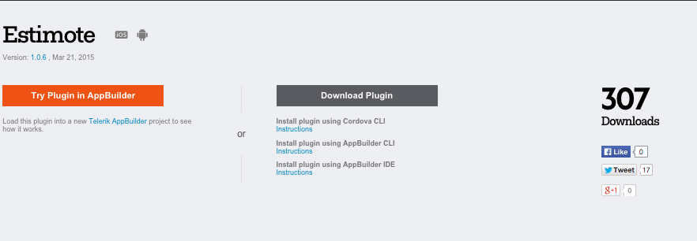
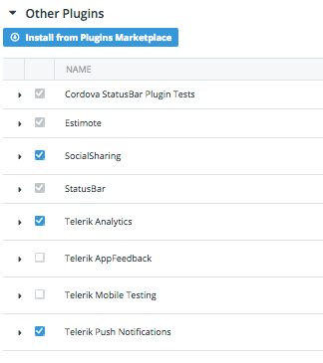
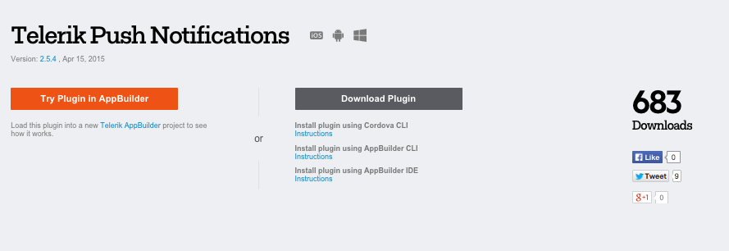
Integrate 3 plugins:
Install Custom plugins from the Plugin marketplace in-browser

Slide 45
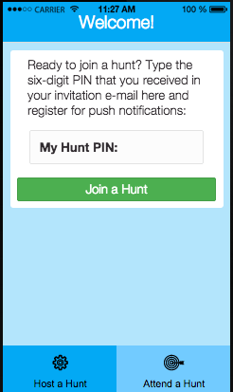
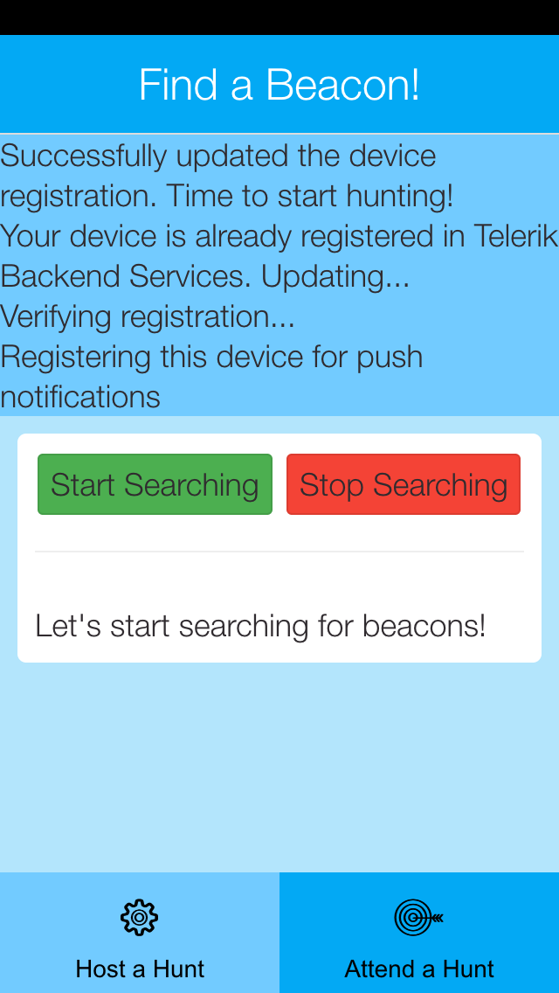
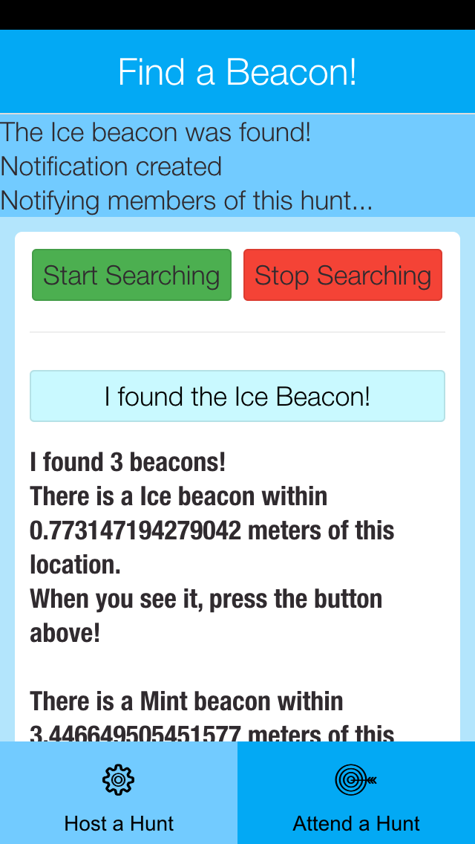
Build the app – Step 5 – Participant screen
Type the PIN, subscribe to a push segment, start searching, claim a beacon, send push

Slide 46
Build the app – Step 5 – Participant screen
Your Hunt is geofenced according to the segment you are subscribed to, per your hunt PIN which is stored in localStorage:
var customDeviceParameters = {
"Hunt":localStorage.getItem('registeredHunt')
};
…
currentDevice.register(customDeviceParameters)
.then(function (regData) {
model._onDeviceIsSuccessfullyRegistered();
}, function (err) {
model._onPushErrorOccurred(err.message);
});

Slide 47
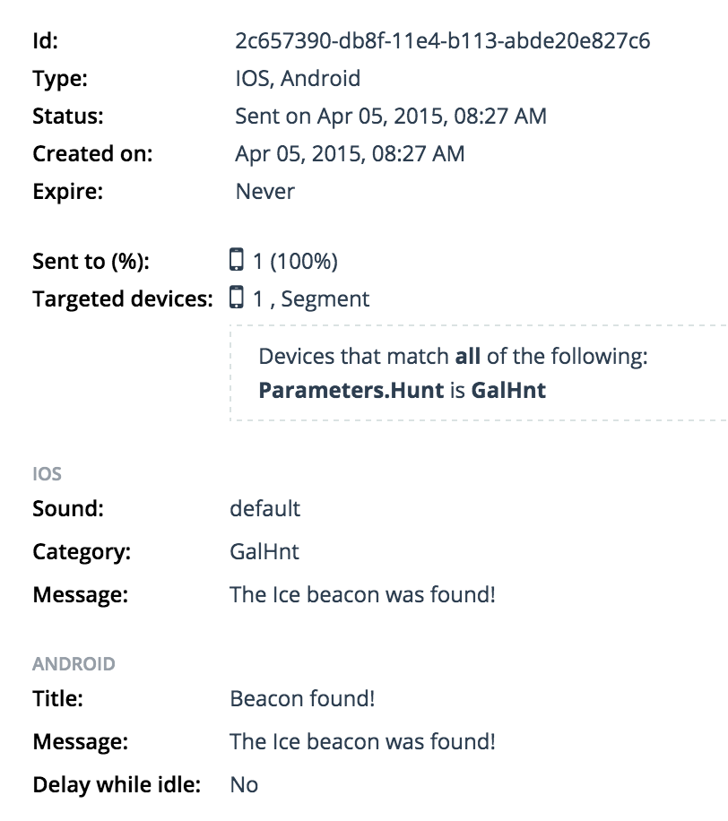
Push to a segment
The user claimed the ‘ice’ color beacon
Anyone signed into the GalHnt segment received this push

Slide 48
The final result!

Slide 49
Beacons are awesome.
What will you build?

Slide 50
Did you download Beacon Hunt? Ready to hunt for beacons?

Slide 51
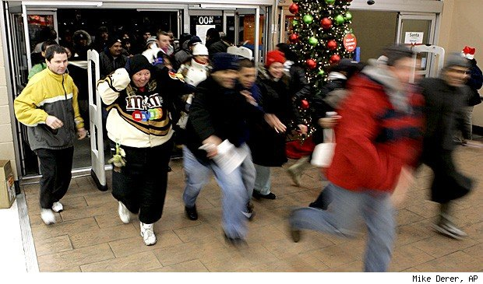
Let’s go! Hunt PIN: HntFTW

Slide 52
Thanks!
Jen Looper
Developer Advocate, Telerik
http://www.ladeezfirstmedia.com
@jenlooper

