Slide 1
Building Cognitive Apps with IBM Watson on Bluemix

Slide 2
Please Note
IBM’s statements regarding its plans, directions, and intent are subject to change or withdrawal without notice at IBM’s sole discretion.
Information regarding potential future products is intended to outline our general product direction and it should not be relied on in making a purchasing decision.
The information mentioned regarding potential future products is not a commitment, promise, or legal obligation to deliver any material, code or functionality. Information about potential future products may not be incorporated into any contract. The development, release, and timing of any future features or functionality described for our products remains at our sole discretion.
Performance is based on measurements and projections using standard IBM benchmarks in a controlled environment. The actual throughput or performance that any user will experience will vary depending upon many factors, including considerations such as the amount of multiprogramming in the user’s job stream, the I/O configuration, the storage configuration, and the workload processed. Therefore, no assurance can be given that an individual user will achieve results similar to those stated here.

Slide 3
Hi There !
Salil Ahuja
Senior Prod Manager @IBMWatson
Twitter - @salilahuja
LinkedIn- salilahuja

Slide 4
What We’ll Cover Today
Introduction to Watson
Watson Developer Cloud Services
Cool examples from the Community

Slide 5
Watson is creating a new partnership between people and computers that enhances, scales and accelerates human expertise.
Notes:
The next era of computing will fundamentally redefine the way we work.
So let’s look at three ways organizations are applying Watson:
To how they engage their customers
To how they discover and innovate
To how they make decisions

Slide 6
IBM has radically expand access to Watson services
Access restricted to partners and IBM developers
Accessible by anyone with a Bluemix account
Wait until services are GA to release
Release in Beta and gather input from user community
North America
Global
One service
Eight services, expanded to twelve, and more coming

Slide 7
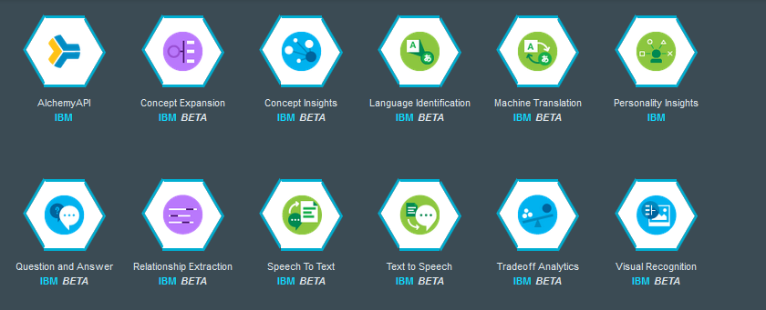
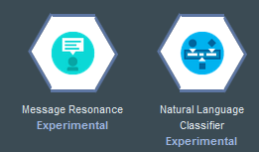
Launched in 4Q14 and Expanded in 1Q15, a new way to interact with IBM Watson technology
Notes:
Launch video
Youtube preview: https://www.youtube.com/watch?v=EPgqZh6uBMo
Download: https://w3-connections.ibm.com/files/app#/file/804adb2c-9999-47d0-b4e8-7200cbe03820

Slide 8
Recent acquisition of Alchemy Language API
Watson gets smarter with Alchemy Deep Learning and Knowledge Graph
Entity Extraction
Sentiment Analysis
Keyword Extraction
Concept Tagging
Language Detection
Relationship Extraction
Taxonomy Classification
Author
Extraction
Mircoformats Parsing
Feed
Detection
Linked Data Support
Text Extraction

Slide 9
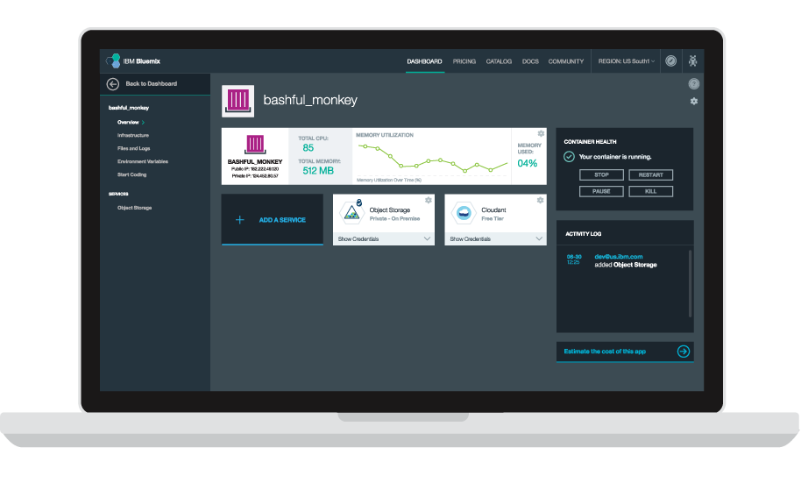
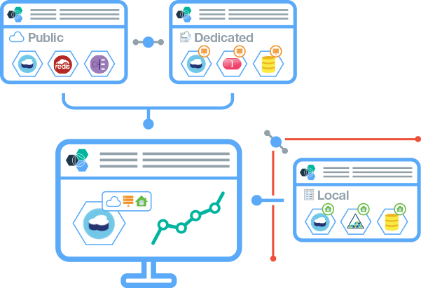
So what is Bluemix?
Where are Watson Services: IBM Bluemix
Bluemix is an open-standards, cloud-based platform for building, running, and managing applications.
Build your apps, your way
Use the most prominent compute technologies to power your app: Cloud Foundry, Docker, OpenStack.
Deploy and manage hybrid apps seamlessly
Get a seamless dev and management experience across a number of hybrid implementations options.
Scale more than just instances
Development, monitoring, deployment, and logging tools allow the developer to run and manage the entire application.
Layered Security
IBM secures the platform and infrastructure and provides you with the tools to secure your apps.
Coming Summer 2015

Slide 10
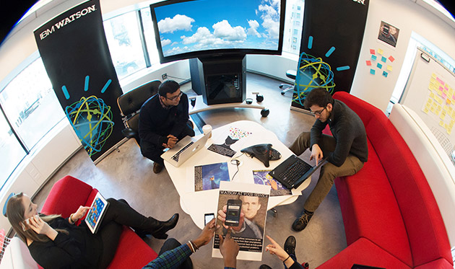
Let’s take a look

Slide 11
Get started today!
Check Out Our Services
https://ibm.biz/watsondevcloud
Sign Up on Bluemix
https://ibm.biz/Austin_Watson
Build you first app
http://ibm.biz/wdc-github
Let’s get connected
Twitter - @salilahuja
LinkedIn - salilahuja

