Slide 1
Design vs. Data
Enemies or Friends?

Slide 2
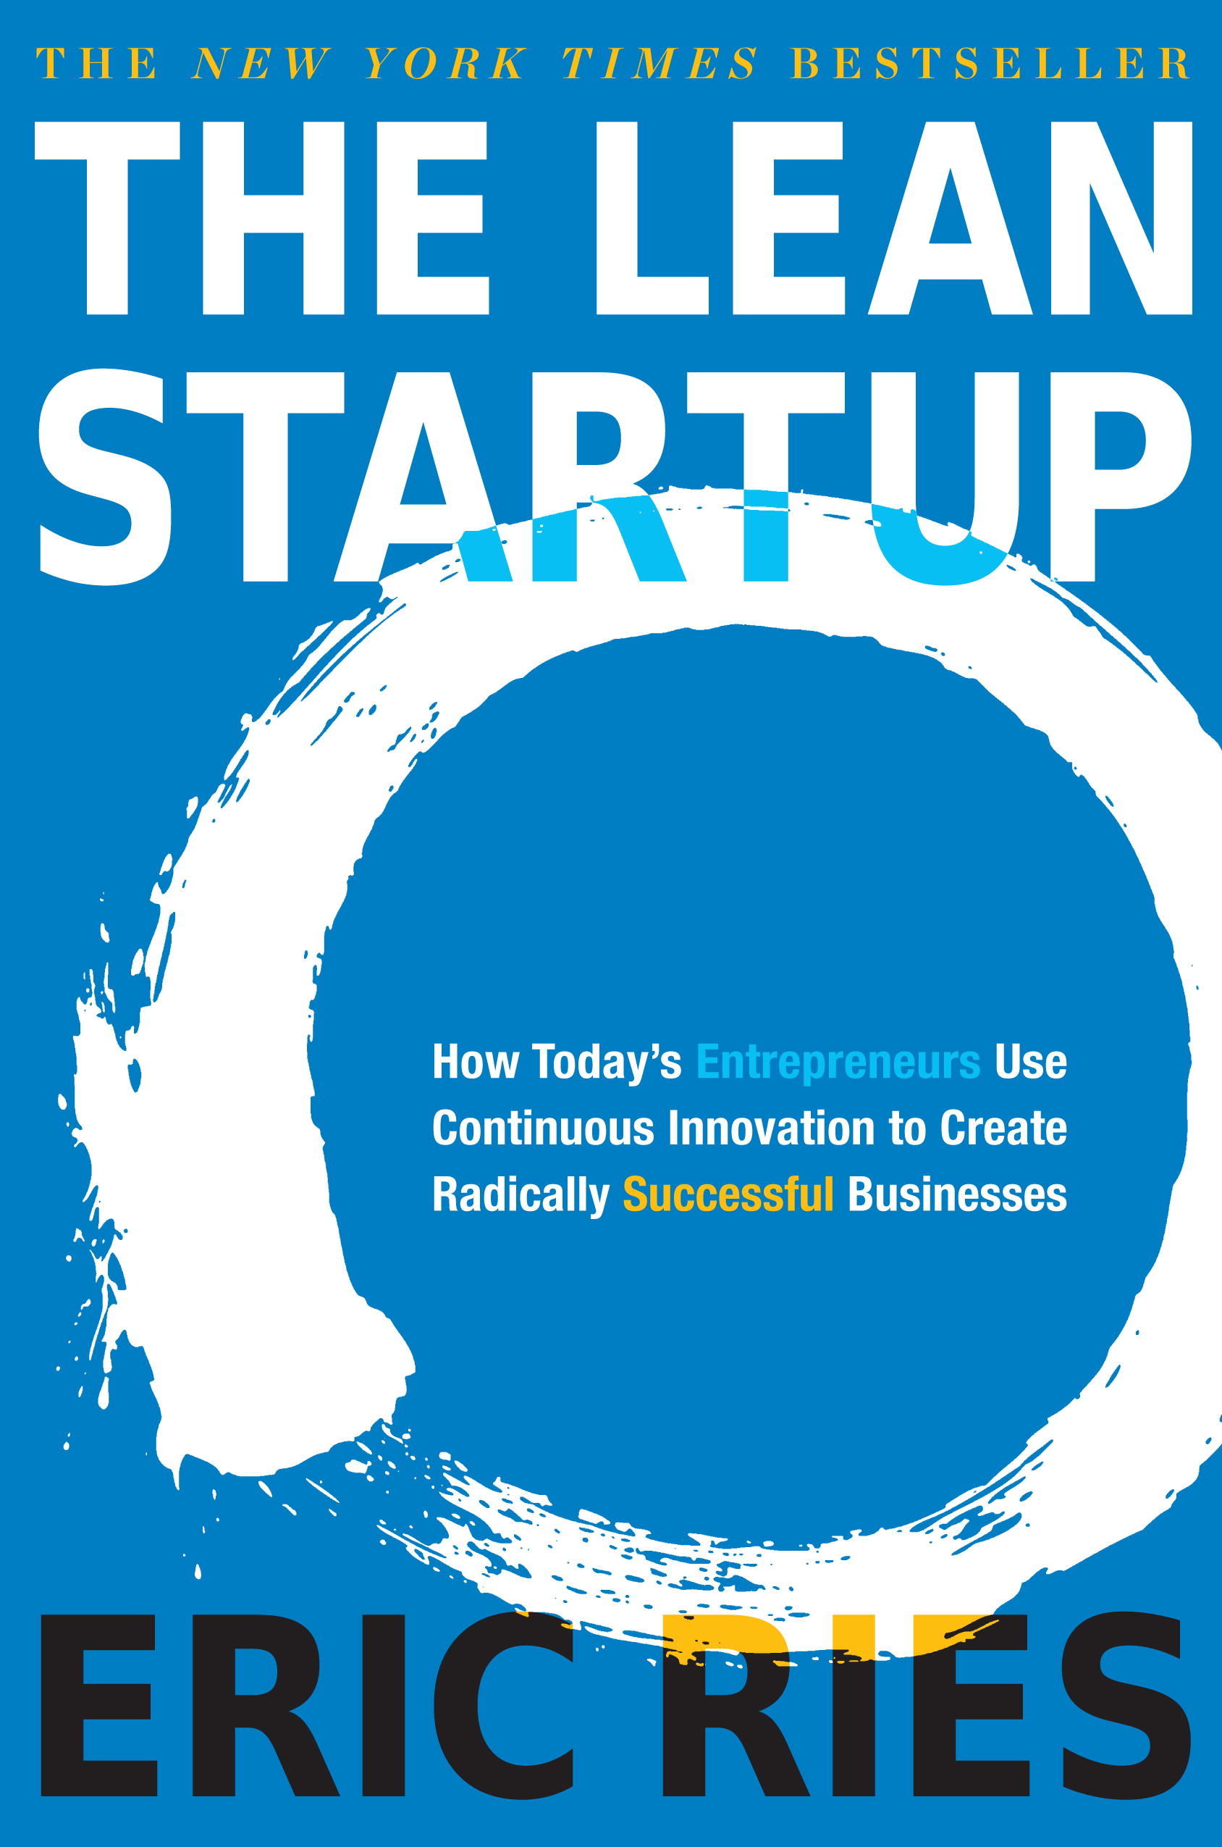
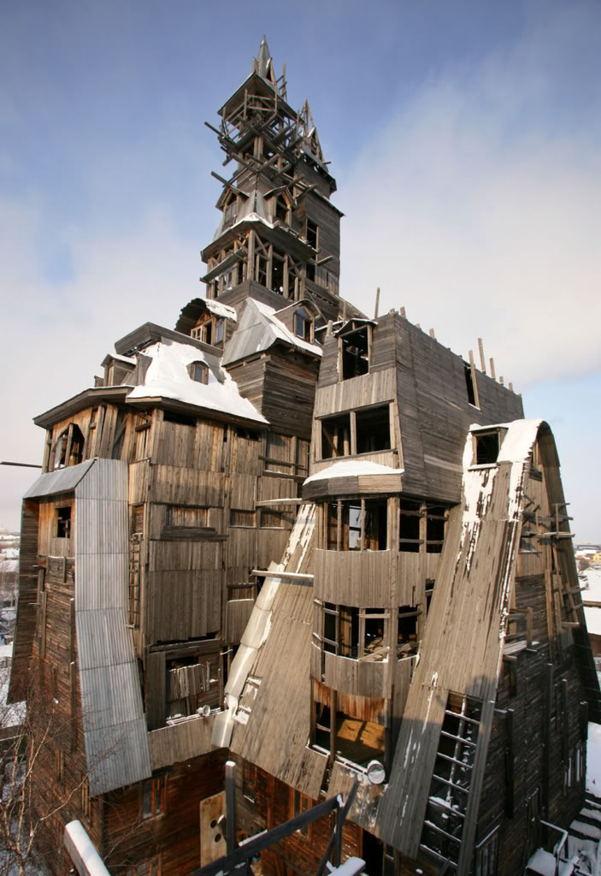
How do we avoid this?

Slide 3
Notre Dame de Paris 1163-1345
1850

Slide 4
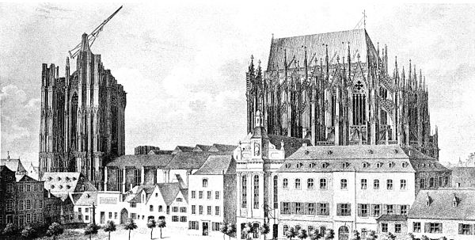
Cologne Cathedral 1248-1473 & 1842-1880
1824

Slide 5
1510
1160
Chartres Cathedral (~1134-1220)
Poitiers Cathedral (~1160 – 1290)

Slide 6
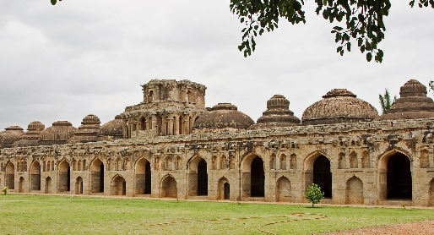
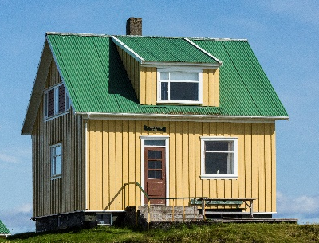
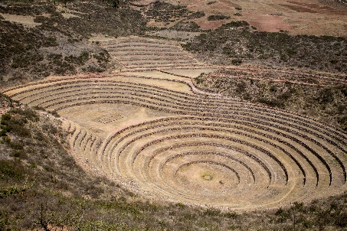
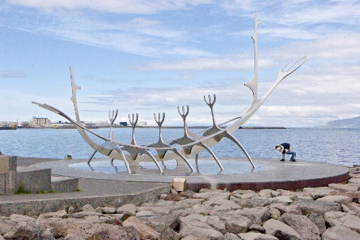
Theory of Centers* – Fifteen Properties of “Wholeness”
Levels of Scale
Strong Centers
Boundaries
Local Symmetries
Alternating Repetition (Recursion)
Echoes (Patterns)
Positive Space
Good Shape
Not-Separateness
(Connectedness)
Simplicity
Deep Interlock
(Ambiguity)
Roughness
Contrast
Gradients
The Void
*Christopher Alexander

Slide 7
Properties of Wholeness for Software*
Levels of Scale
Strong Centers
Boundaries
Symmetry
Recursion
Patterns
Space
Shape
Simplicity
Connectedness
Hypothesis:
Learning through ongoing experimentation is not an excuse for sloppy system design. On the contrary:
Strong systems grow from a design vision that helps maintain “Properties of Wholeness” while learning through careful analysis and rigorous experiments.
(Left Out):
Ambiguity
Roughness
Contrast
Gradient
Void
*With credit to Christopher Alexander

Slide 8
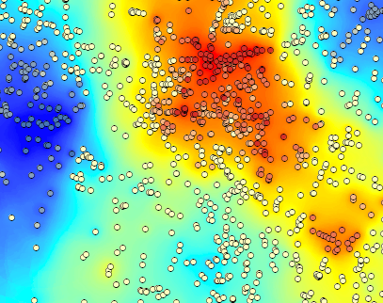
A Design Vision to Make Data a Strong Center
Understand Data and how to use it.
Data is central
A picture is worth a thousand data points
Appreciate statistics
Analyze / Experiment – know the difference
Everyone is on the same team
Simplify the Job of Data Scientists.
Data pipelines must be wide and fast
Develop API’s for learning and control
Experiments need design and structure
Use an architecture that supports learning
See, Think, Gain Amazing Insights
Know how to use the best tools and models
Be explicit about assumptions
Share the search for patterns and outliers
Get inside the data
Test insights rigorously
Shape
Boundaries
Connectedness
Space
Simplicity
Levels of Scale
Patterns
Symmetry
Recursion

Slide 9
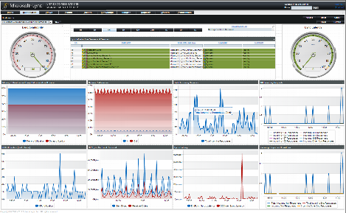
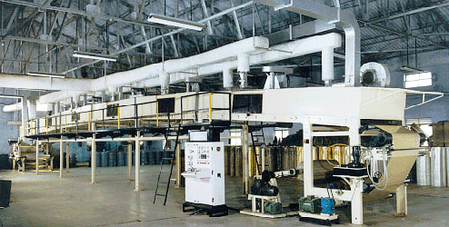
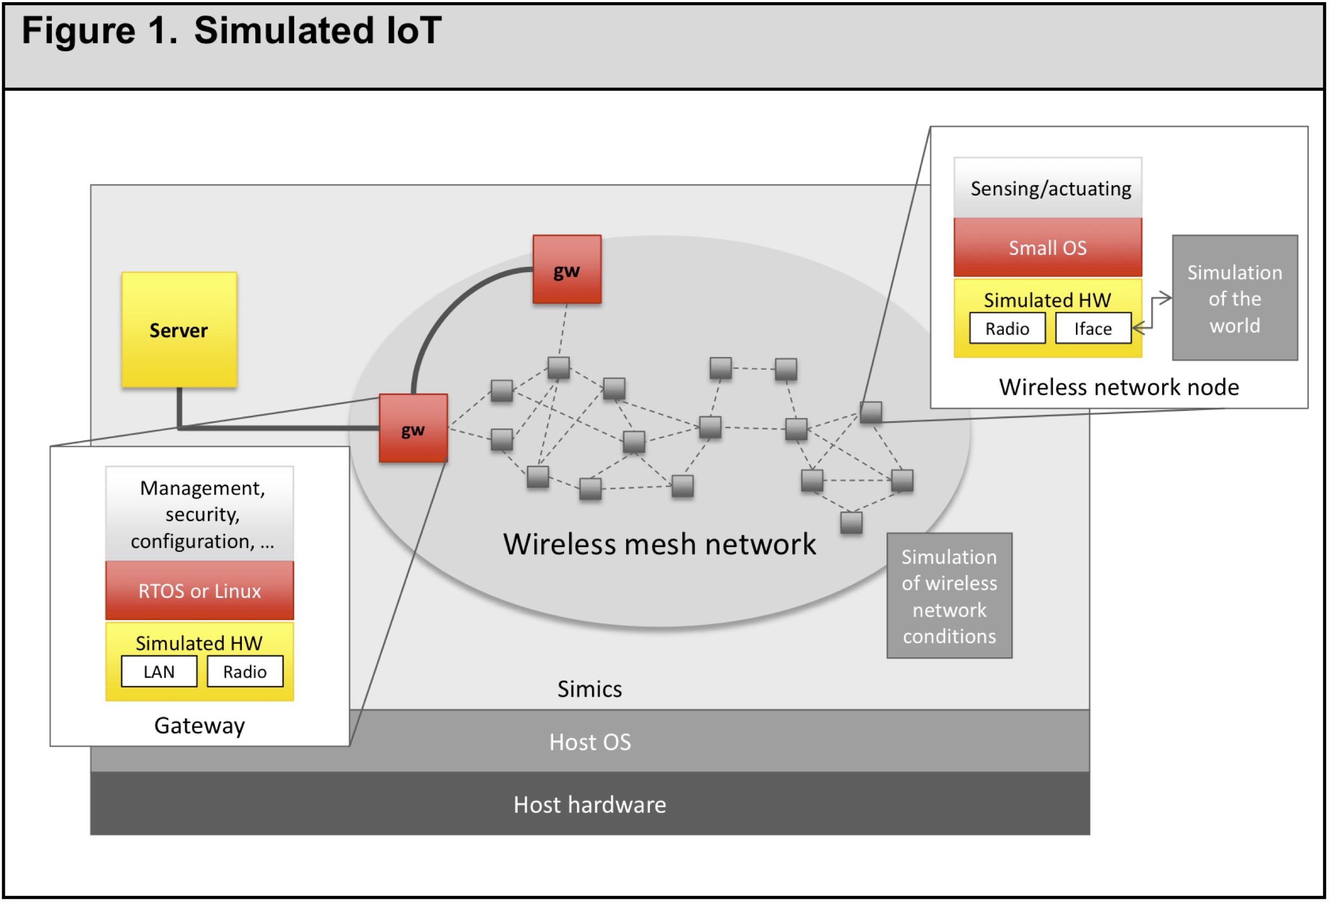
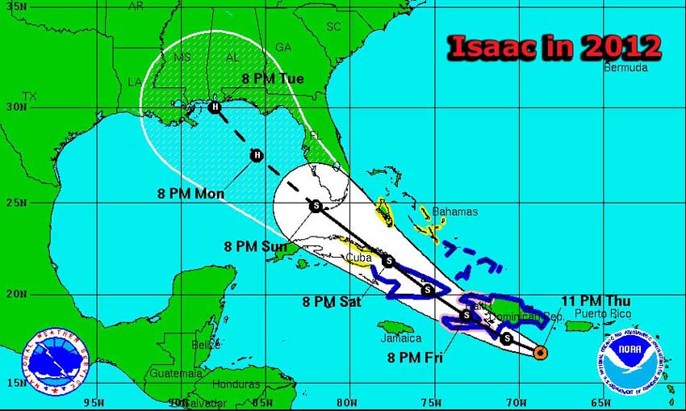
How we Use Data
Monitor
Control
Simulate
Predict

Slide 10
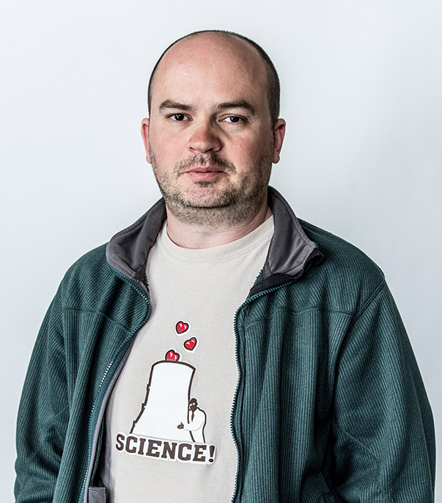
Monitor
Mickey Dickerson
Something went wrong and the system is down. Lots of people are frantically looking under every rock, and finding dozens of things that are not right.
What went wrong in 1984?
Pinpoint the moment in time when everything went wrong.

Slide 11
Control
Controllers regulate temperature, position, speed, pressure, flow, weight, force,
thickness, chemical composition, and practically every other variable that can be measured.
P = Size of the error
I = Residual error that accumulates over time
D = Rate at which error is changing

Slide 12
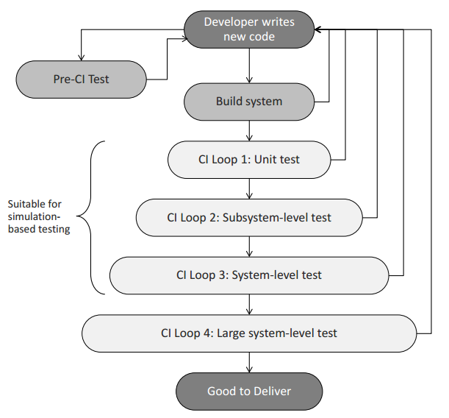
Simulate
For many embedded systems lack of hardware, complexity of hardware, or inconvenience of setup limits the ability to use Continuous Integration (CI).
Simulation makes it possible to use standard PCs and servers to run code destined for even deeply embedded target systems, making an effective CI possible that is more flexible and cheaper than relying on hardware alone.
Credit for this page: Jakob Engblom, Wind River, Kista, Sweden

Slide 13
Predict
The new arrival – the Data Scientist
1. Insights:
Extracted from data.
2. Predictions:
What will happen, when, what will be affected, and what factors influences it.
Optimizations:
The most valuable use of computational analytics is knowing “what to do next”.

Slide 14
Exploratory Data Analysis (EDA)
An approach/philosophy for data analysis that employs a variety of techniques (mostly graphical) to maximize insight into a data set
Uncover underlying structure
Extract important variables
Detect outliers and anomalies
Test underlying assumptions
Develop frugal models
Determine optimal factor settings
All the Data
Potential Models
Variables that work on all data
Sample
Try fitting various curves
Test promising variables on all data
Variables that help create models that fit sample data

Slide 15
Design of Experiments (DOE)
A systematic approach to problem-solving that applies principles and techniques at the data collection stage that ensure the generation of valid, defensible, and supportable conclusions.
Comparative
Has a change in a single factor changed the whole process?
Screening/Characterizing
Form a ranked list of factors that affect the process.
Modeling
Create a mathematical model of the process.
Optimizing
Determine the optimal settings for the process factors.
Screening Experiments
Mixture Experiments
Response Surface Analysis
Fractional Factorial Experiments
Full
Factorial Experiments
Evolutionary Operations (EVOP)

Slide 16
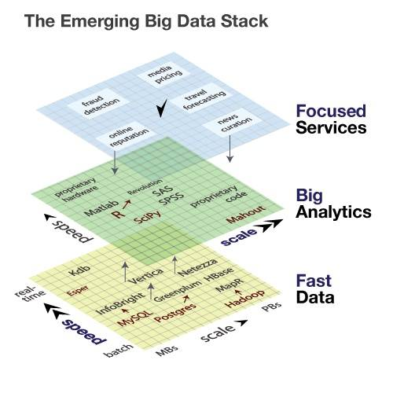
Design for Data
Basic Elements:
Fast Pipelines
Data Wrangling
Data Analytics
Data Visualization
Designed Experiments
Machine Learning
Adaptable Business Systems and Processes (ready and able to use insights and services)
Credit: Ravi Kalakota, Liquid Analytics

Slide 17
Design the System (not just the code)
Design like a Master Mason
Rather than a Stonecutter

Slide 18
Thank You!
More Information: www.poppendieck.com

