Slide 1
Scaling Stack Overflow
David Fullerton, VP Engineering • @df07
QCon NYC • 2015-06-12

Slide 2
**SPOILERS**

Slide 3
Conclusions
Our architecture is boring

Slide 4
Conclusions
Our architecture is boring
How we keep it boring is interesting

Slide 5
What’s Stack Overflow?

Slide 6

Q&A for Programmers
9.4M questions
16M answers
45M uniques / month
8,000 new questions every day
(quantcast.com/stackoverflow.com)

Slide 7

Developer Jobs
Best place on the internet to get a programming job or hire a developer

Slide 8
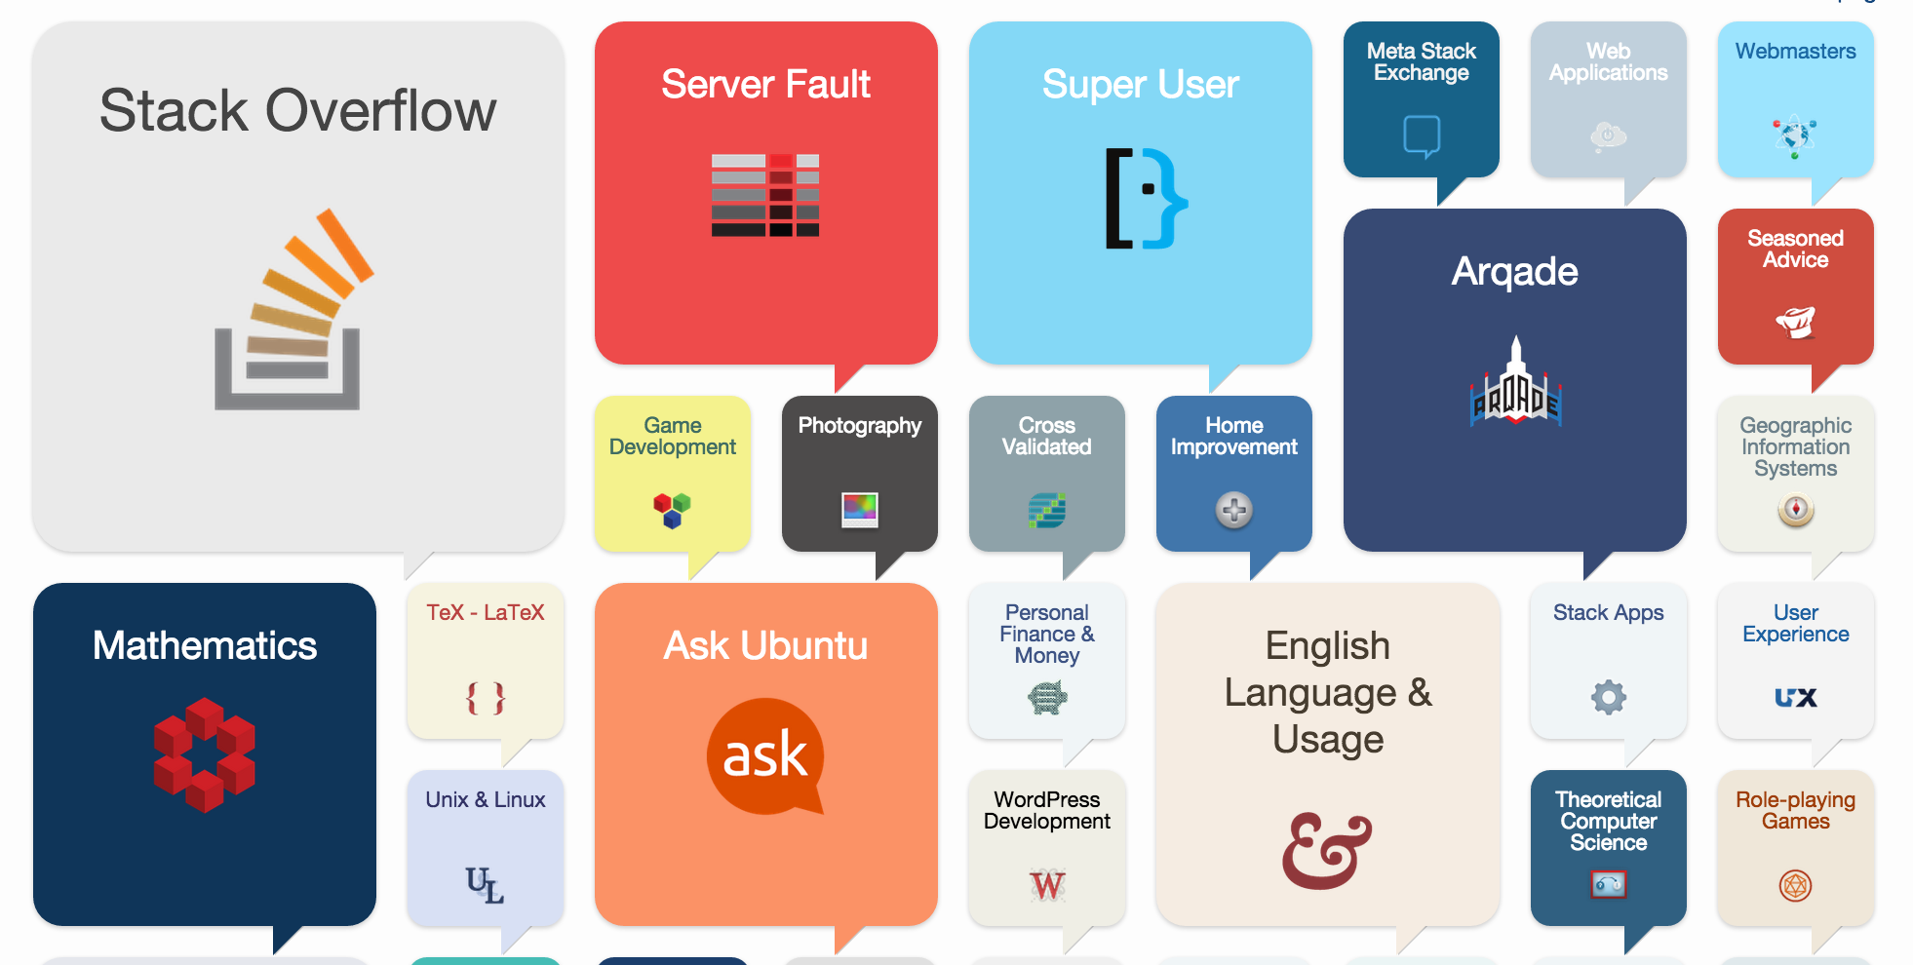

Part of Stack Exchange Network
Stack Overflow-style Q&A in 143 other topics & languages

Slide 9
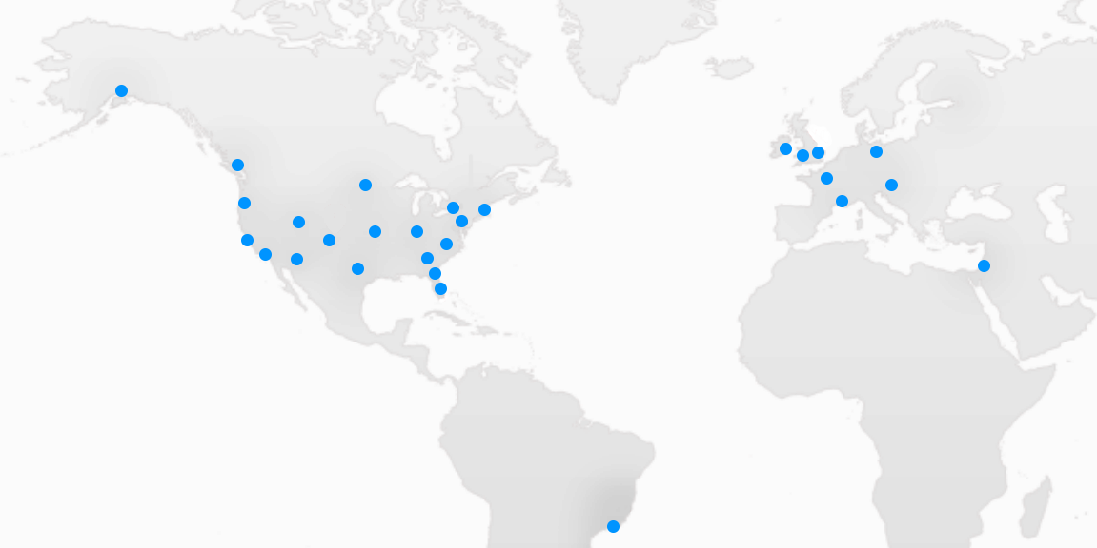
A Distributed Team
34 developers, 6 sysadmins, 6 designers
75% remote

Slide 10

A Distributed Team
34 developers, 6 sysadmins, 6 designers
75% remote

Slide 11
How do we work?
Remote work culture
Hire smart people and get out of their way
Full-stack developers / sysadmins with a specialty

Slide 12
Our Architecture
(I warned you, it’s boring)

Slide 13
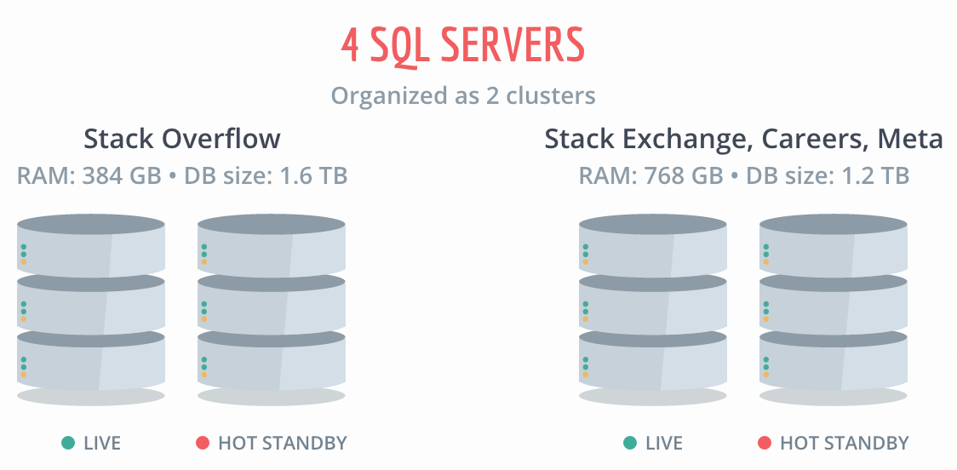
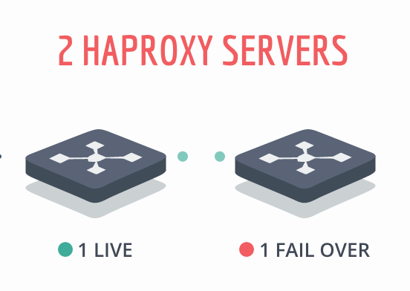
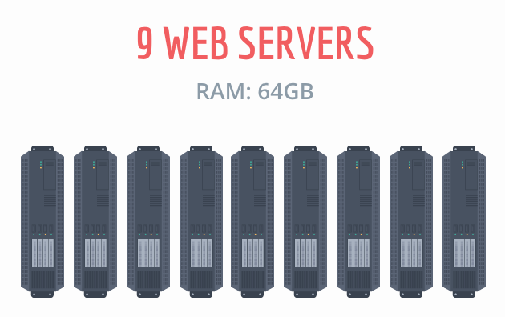
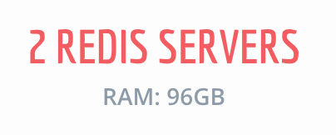
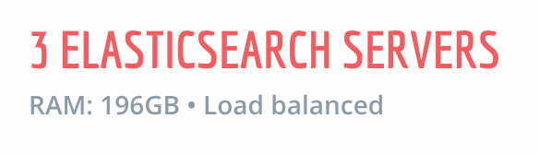
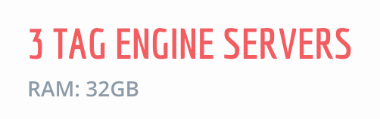
(stackexchange.com/performance)
Notes:
SSDs. 2x12 core processors (48 cores with hyperthreading), 2x 10Gb network on SQL.

Slide 14

“Monolith Plus” architecture
Almost everything happens in the web tier + DB
A few services pulled out and optimized

Slide 15
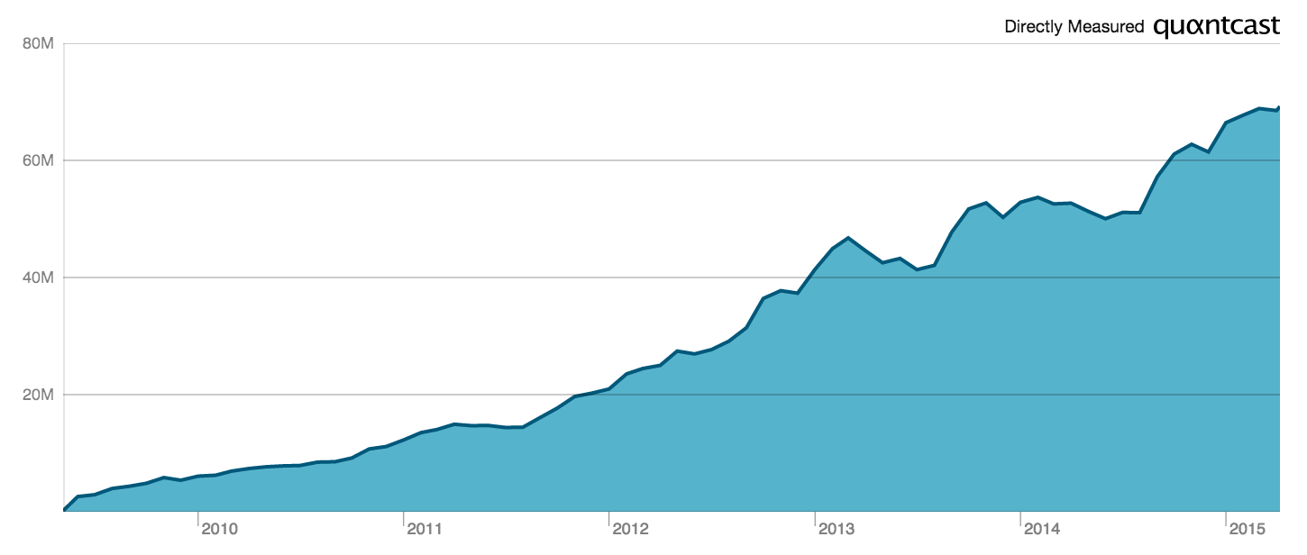
Scales pretty well (for us)
4 billion requests per month, 3000 req/s peak
800M SQL queries per day, 8500/s peak

Slide 16
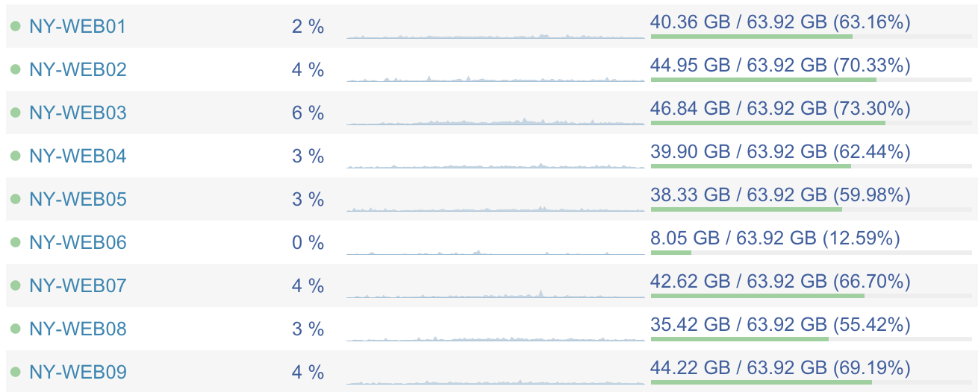
(opserver – https://github.com/opserver/opserver)

Slide 17
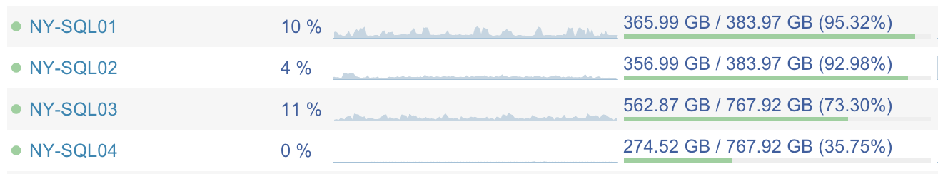
(opserver – https://github.com/opserver/opserver)

Slide 18
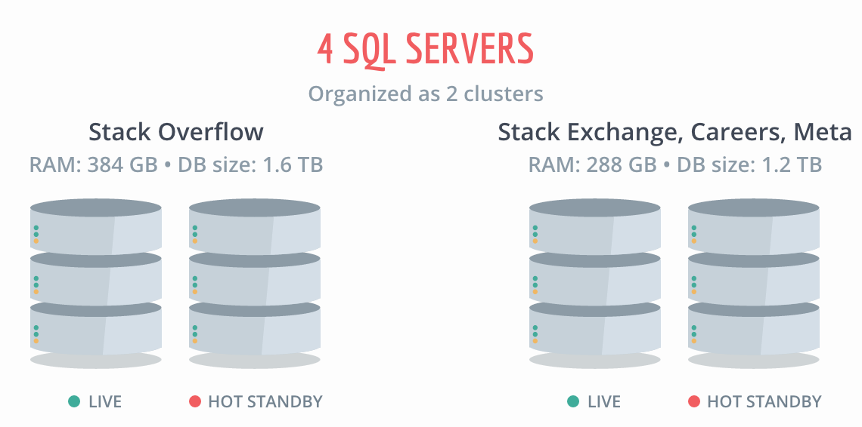
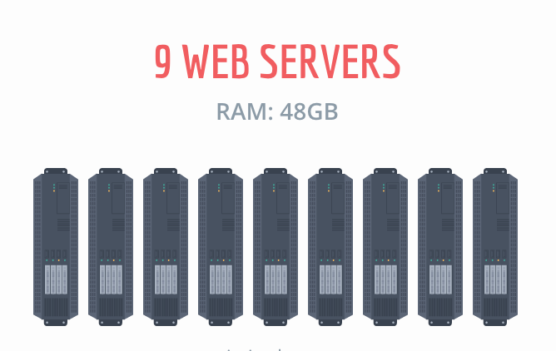
Availability (also boring)
New York
(primary)
Oregon
(secondary)

Slide 19
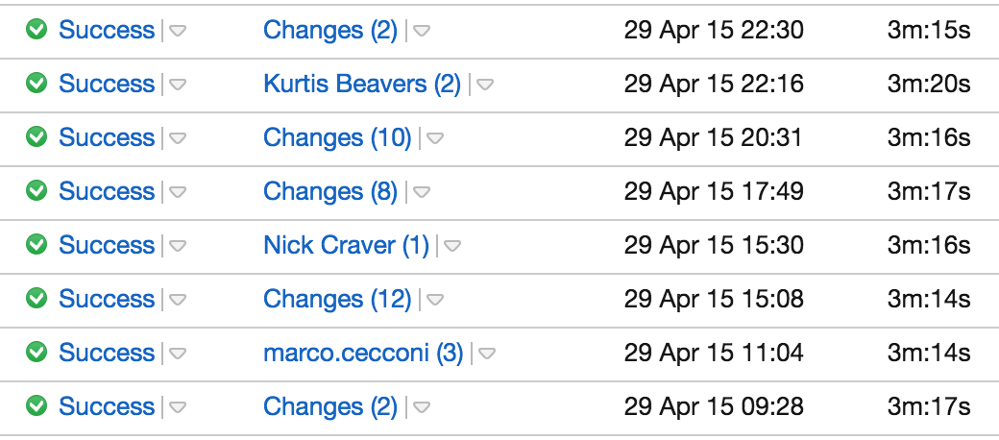
Deploys
All day every day
Rolling deploys through the web tier
Fast!
(TeamCity)

Slide 20
Testing
Test on our users
Feature flag
  Turn it on for a subset of sites to see how it performs

Slide 21
* Works for us!
Read-heavy load centered on one page
Not as much customized content as some sites
A forgiving community

Slide 22
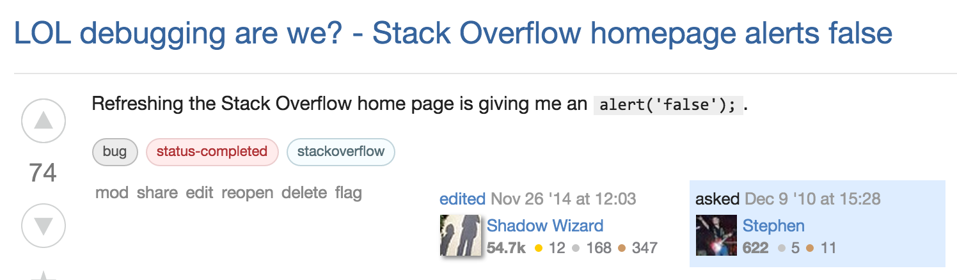

Slide 23
How did we get here?

Slide 24
Our Process
Start with what we know
Measure it live
Fix the slow

Slide 25
Step 1: Start with what we know
Original developers knew C# and MSSQL
Started with a bunch of off-the-shelf tools:
  ASP.NET MVC
  LINQ to SQL
  MSSQL + SQL fulltext search
  Built-in caching (no Redis)

Slide 26
Step 2: Measure it live
Performance is a feature!
Test under real load
Measure, don’t guess

Slide 27
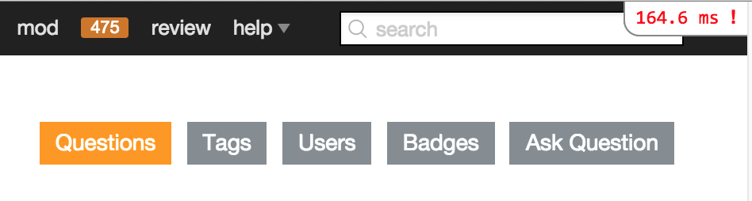
(miniprofiler – https://github.com/MiniProfiler/dotnet)

Slide 28
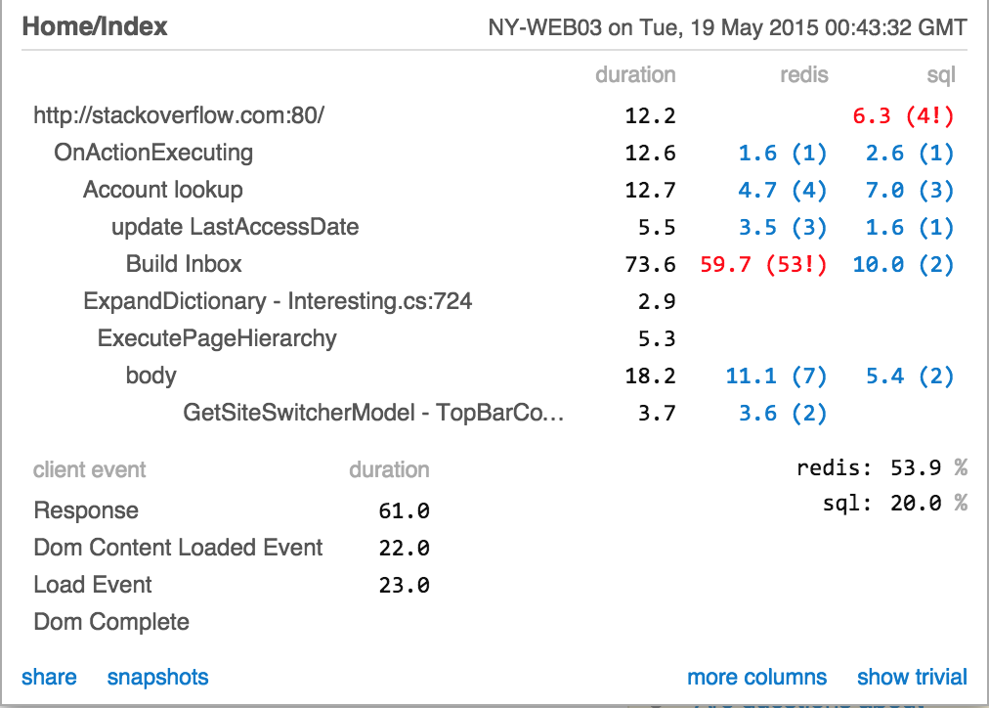
(miniprofiler – https://github.com/MiniProfiler/dotnet)

Slide 29
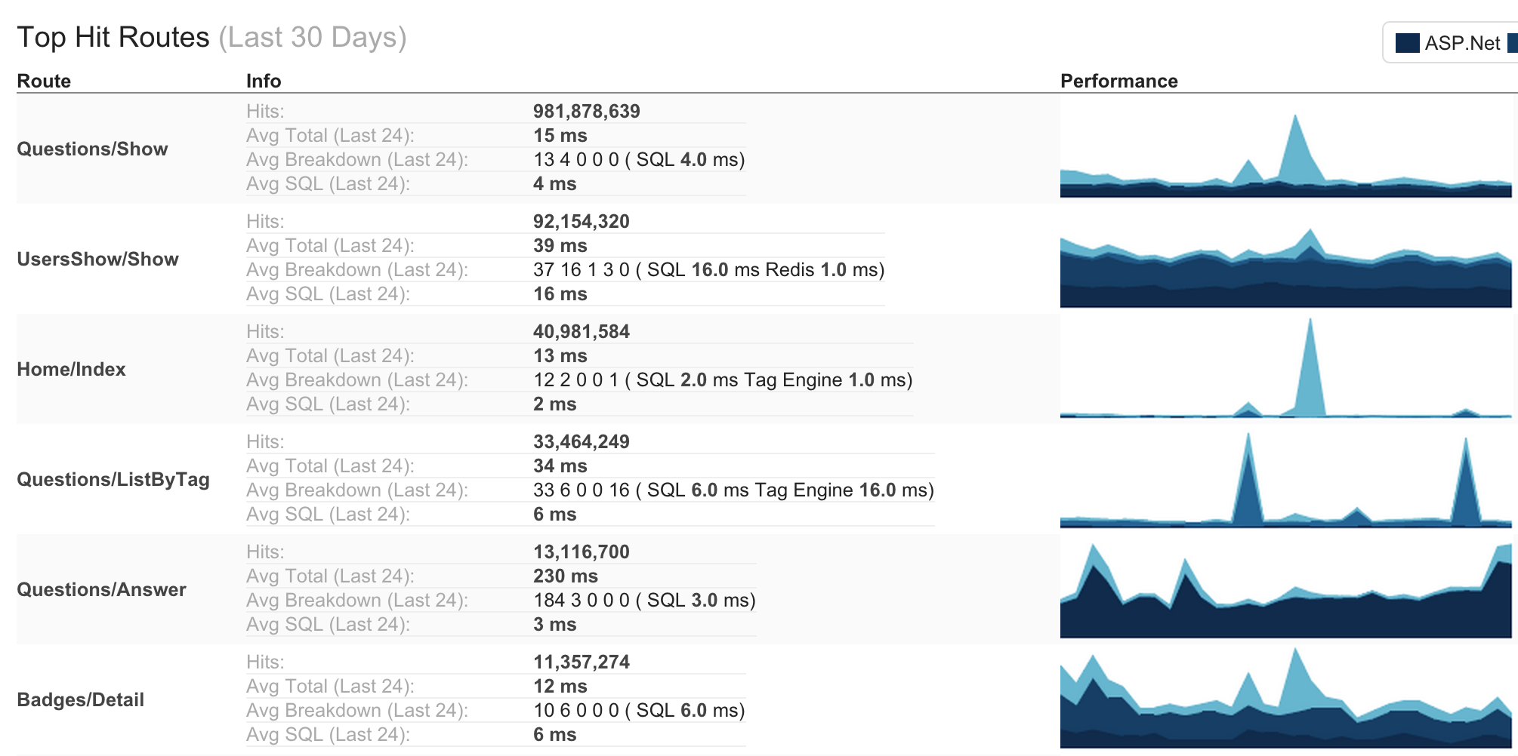
(opserver – https://github.com/opserver/opserver)

Slide 30
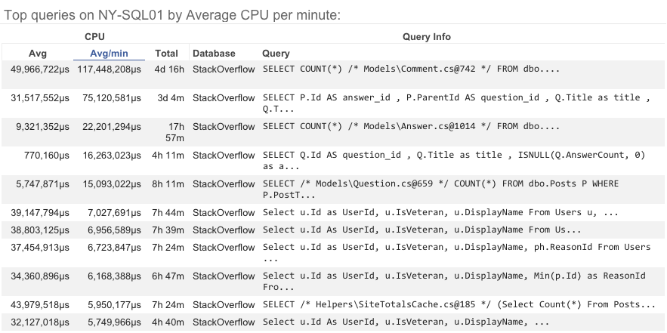
(opserver – https://github.com/opserver/opserver)

Slide 31
Step 3: Fix the slow
Slow performance is a bug, fix it now!
Over time, replace major parts of our stack:
  Caching and Redis
  SQL access
  Tag Engine
  Elasticsearch

Slide 32
Dapper
Already hand-rolling queries for performance
LINQ to SQL provides basic ORM:

Slide 33
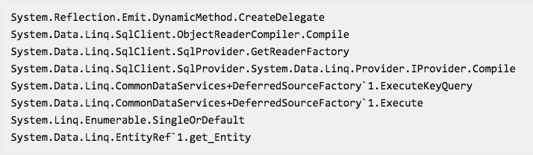
Dapper
Problem:

Slide 34
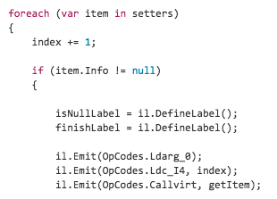
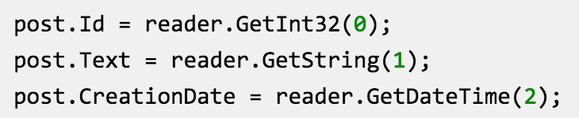
Dapper
Solution: replace the object mapper
Idea: emit raw IL, then cache mapper

Slide 35
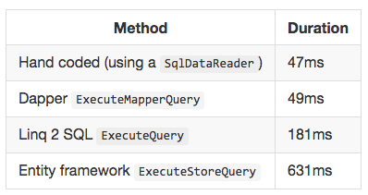
Dapper
Results (500 iterations):
(dapper– https://code.google.com/p/dapper-dot-net/)

Slide 36
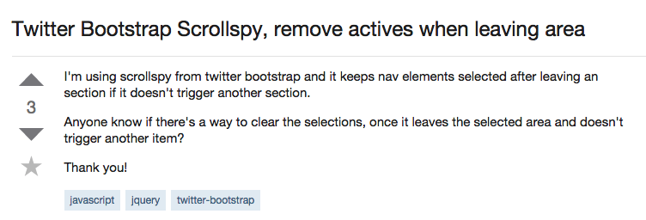
Tag Engine

Slide 37
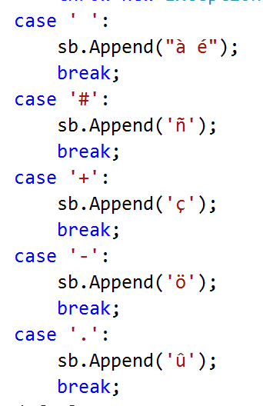
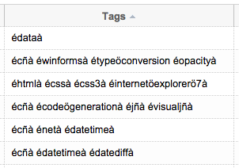
Tag Engine
Early hack: use SQL fulltext search to index tags

Slide 38


Tag Engine
Problem:

Slide 39
Tag Engine
Problem:
Performance!

Slide 40
Tag Engine
Highly custom in-memory tag index cache
Carefully memory-managed to avoid GC stalls
  Learned the hard way: see “Assault by GC” by Marc Gravell
Serialize / deserialize from disk on build

Slide 41
Results

Slide 42
Results
Start with what we know
Measure it live
Fix the slow
Optimize for performance, get scale thrown in

Slide 43
Results
“Monolith Plus” architecture
Extract services that solve real problems, not imagined ones
Avoid SOA “tax”

Slide 44
So my primary guideline would be don’t even consider microservices unless you have a system that’s too complex to manage as a monolith
- Martin Fowler, “MicroservicePremium”

Slide 45
Conclusions

Slide 46
Conclusions
Our architecture is boring
How we keep it boring is interesting:
  Start with what we know
  Measure it live
  Fix the slow

Slide 47
Application
You can optimize for performance and get scale thrown in (almost for free)
Your monolith can scale further than you think
SOA is not the only way
  Know your own problem space
  Fix actual problems

Slide 48
Questions?
(We’re all about questions)
Obligatory:
We’re hiring! stackexchange.com/work-here
Open source! stackexchange.github.io
Follow me! twitter.com/df07

Slide 50
Here Be Dragons
(rejected slides)

Slide 51
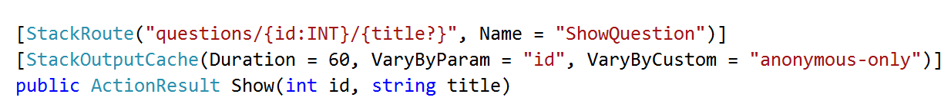
Caching
Started with basic OutputCache (cache rendered HTML for a page)
~4% cache hit rate

Slide 52
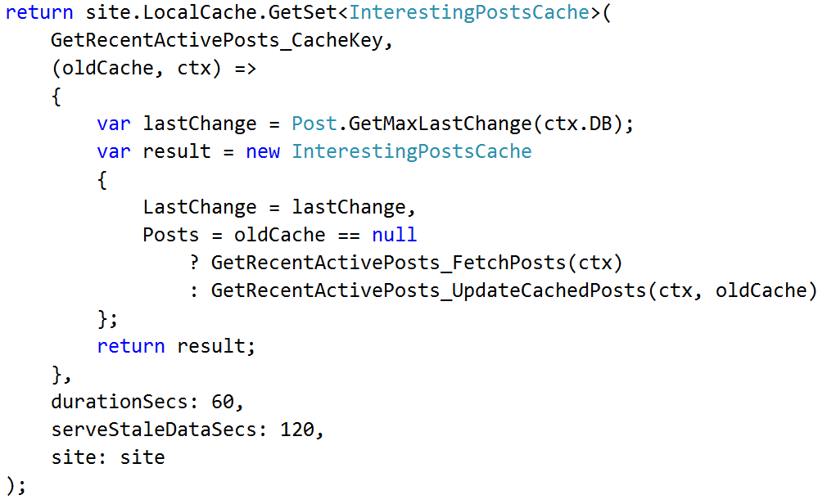
Caching
Add in-memory & Redis caching

Slide 53
StackExchange.Redis
Wrote our own library for talking to Redis
Multiplexing operations over a single connection
Aware of primary / secondary instances
  Can target reads at secondary slave

Slide 54

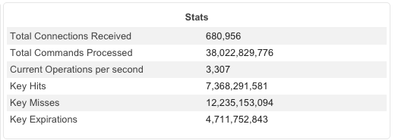
StackExchange.Redis
(opserver – https://github.com/opserver/opserver)

Slide 55
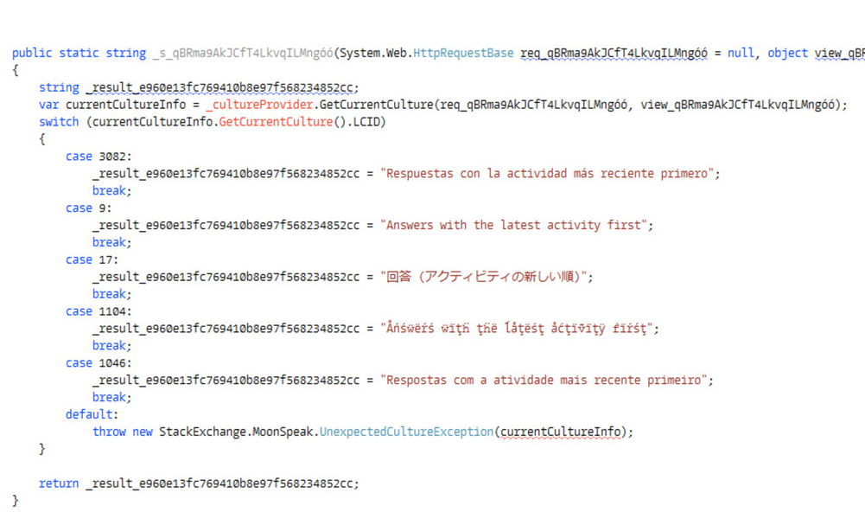
Moonspeak (Localization)

