Slide 1
Here Be Dragons: Security Maps of the Container New World
Josh Bregman
Vice President/Evangelist
@kingoauth

Slide 2
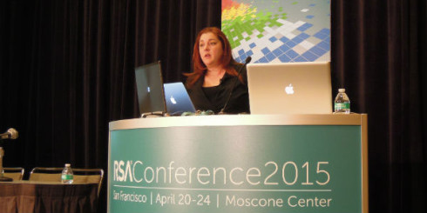
Elizabeth Lawler - CEO/Founder Conjur, Inc.
Elizabeth Lawler is CEO and Co-founder of Conjur, Inc., a security company which focuses on security for next generation infrastructure. Lawler has over 20 years of experience working in highly regulated and sensitive data environments. Prior to founding Conjur, she was Chief Data Officer of Generation Health and held a leadership position in research at the Department of Veterans Affairs. She has been a programmer herself, and is constantly working to make software development and IT systems easier to manage for people working in regulated industries.
Elizabeth’s RSA Presentation “Is DevOps Breaking your Company?” is still available on line

Slide 3
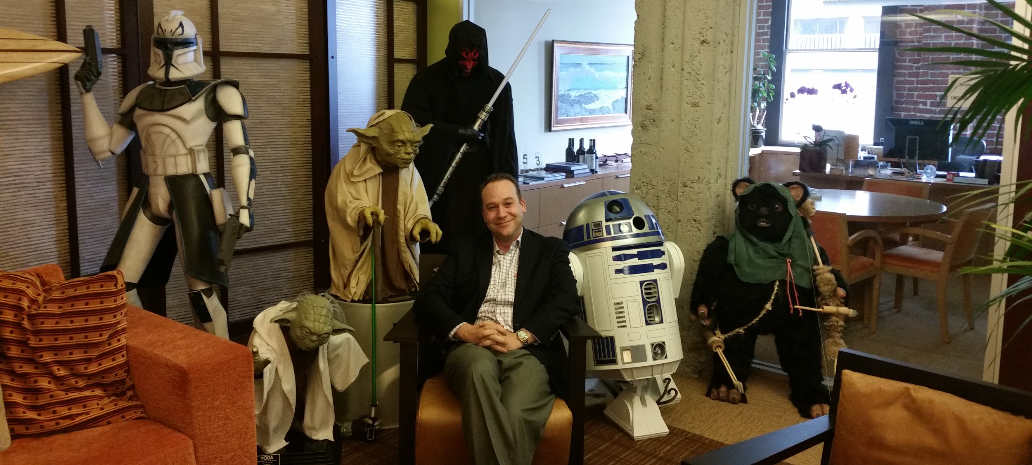
Josh Bregman - Vice President/Evangelist
Josh has 20 years experience successfully architecting, evangelizing, and delivering innovative identity management and security products to customers. Prior to joining Conjur , Josh spent a decade as a solutions and pre-sales leader in the Oracle ecosystem. A developer at heart, early in his career Josh worked as a software engineer at IBM, GTE Labs, and Netegrity. He has 2 U.S. patents and received a B.A. in Math from the University of Rochester in 1995.

Slide 4
Here Be Dragons: Security Maps of the Container New World
kubernetes
mesos
?
ECS
LXC
Rocket
Docker

Slide 5
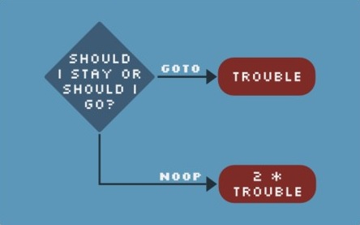
Is the Journey Worth the Risk?
What are some risks?
Escalation of privileges
Image integrity
Un-patched Containers
Tips on operating Docker securely - http://www.slideshare.net/JenAndre/docker-security-talk
Security concerns can always be a barrier to adopting new technology, but containers provide major benefits
Single package for all environments
Well suited for high velocity environments
Cloud Provider independent

Slide 6
Deploying a Container to a PaaS/IaaS
What protections are there in the infrastructure to prevent:
Other “good” containers calling your service accidentally
Other “good” containers calling you service intentionally, but without your permission
A “bad” container calling your service maliciously

Slide 7
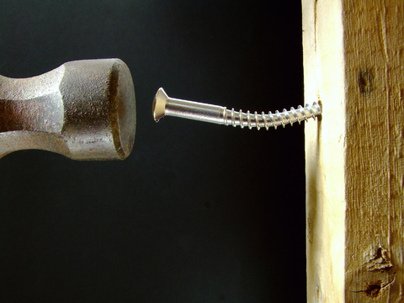
Network Security
Creating private subnets per “app” is cumbersome
Seems easy, but will be hard to maintain velocity and quality
Avoid production only workflows
Networks for dev, qa, stage AND prod all need to be configured
Network segmentation can cause problems with schedulers in orchestration systems
Assumes that all resources are available to all “pods”

Slide 8
Velocity is your Hedgehog, Compliance is your Fox
DevOps is about VELOCITY
How can you go fast if….
Multiple Cloud Providers
Hybrid Cloud
Manual Intervention
Changes in Governance
Security and Risk Management can put on the BRAKES

Slide 9
Embed Security in Service
Embedding security reduces velocity
If the security model changes, then the service needs to be rewritten
Reduces composability
Developer may not fully understand requirements
Externalized is better
Faster to change
Easier to audit
Easier to orchestrate

Slide 10
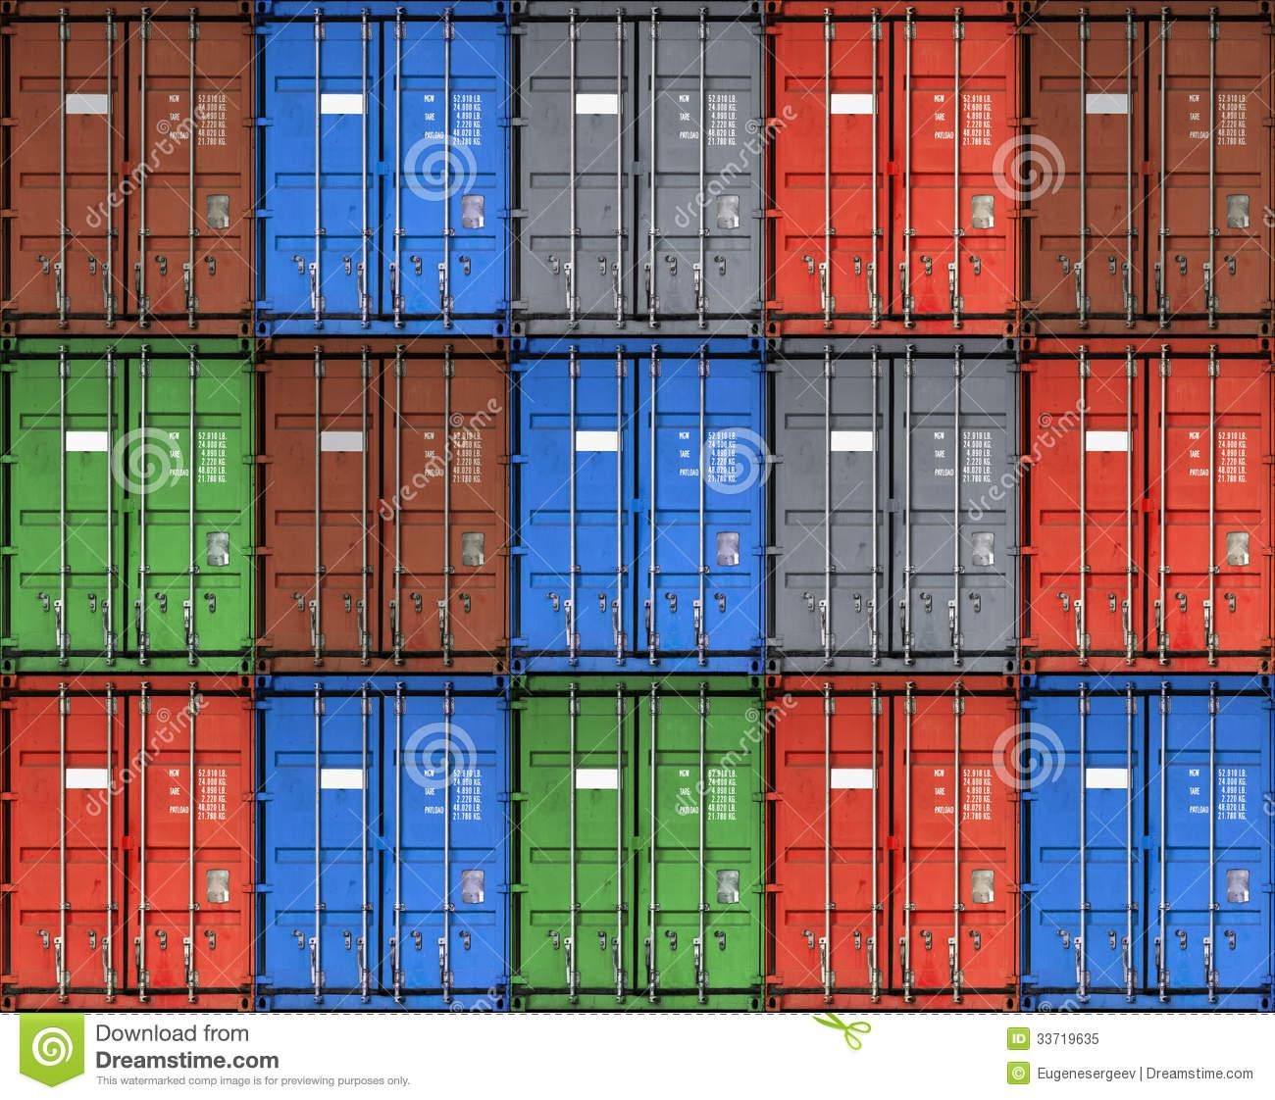
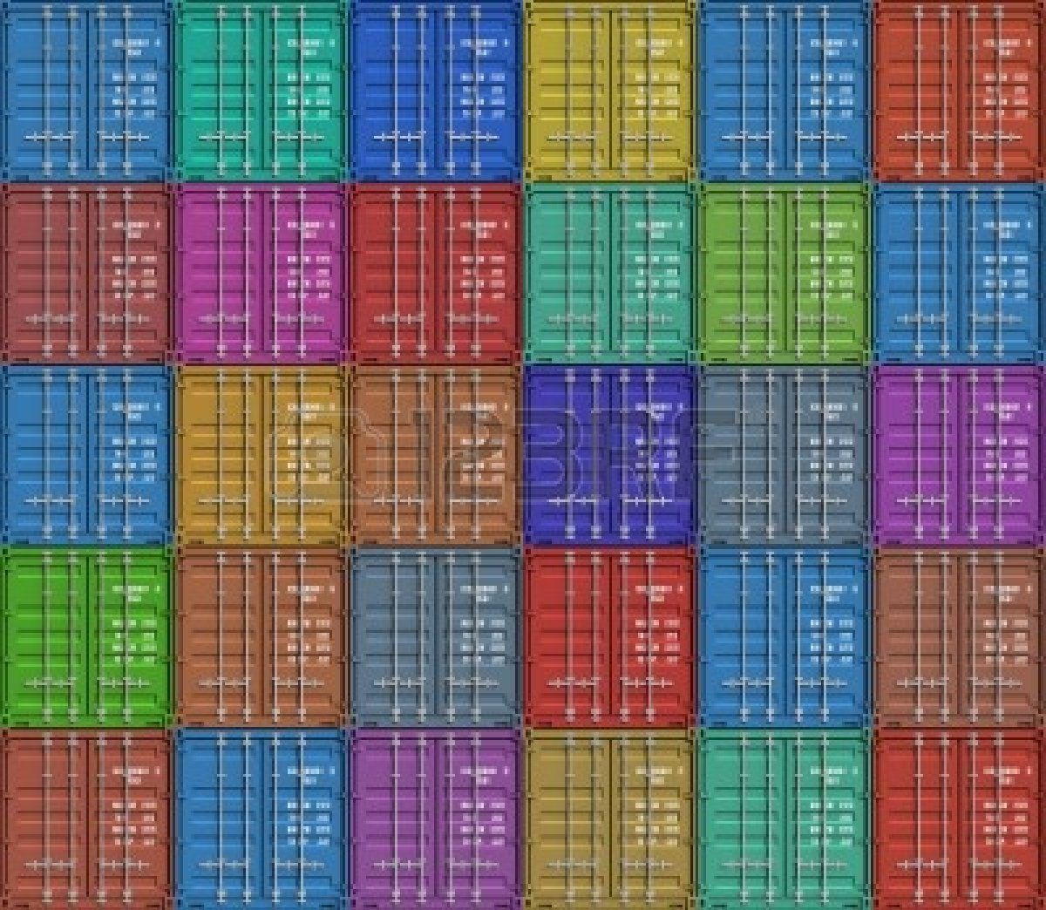
The Challenge
Let’s assume that the shipping containers represent containers (docker, LXC, rocket) or orchestrated groups of containers (kubernetes, mesos)
How could you ensure that:
All of the containers of the same color can call communicate with each other
The blue containers can communicate with the red containers
And the rules and the containers are constantly changing

Slide 11
Introducing Software Defined Firewall (SDF)
Pod supports separation of concerns among Development, Operations, and Security
Route all HTTP traffic to SDF - gatekeeper
Validates if request is authorized
Forwards request to service
Calls to other services outside of the pod are routed to the SDF forwarder
Forwarder attaches identity to the request and sends to the target service
Users
Container “Group” (e.g. pod)
SDF
gatekeeper
service
SDF
forwarder
log-shipper

Slide 12
Introducing SDF - Are you the Keymaster?
Container “Group A” (e.g. pod)
Gatekeeper locates the Keymaster and makes a call to validate the incoming token
The Forwarder makes a call to the Keymaster to issue a token for the outbound call to the linked container
The Gatekeeper in the next group can validate the token by calling the Keymaster again
SDF
Gatekeeper
Service
SDF
Forwarder
log-shipper
validate
Container “Group B” (e.g. pod)
validate
SDF
Gatekeeper
Service
issue
log-shipper
SDF
keymaster

Slide 13
SDF is the Right Approach
Using SDF containers can be organized into layers
Red-Brown - Layer 1
Blue-Green - Layer 2
Grey - Layer 3
All service to service traffic allowed inside of the layer
SDF architecture can support more elaborate models like claims based authorization or federation

Slide 14
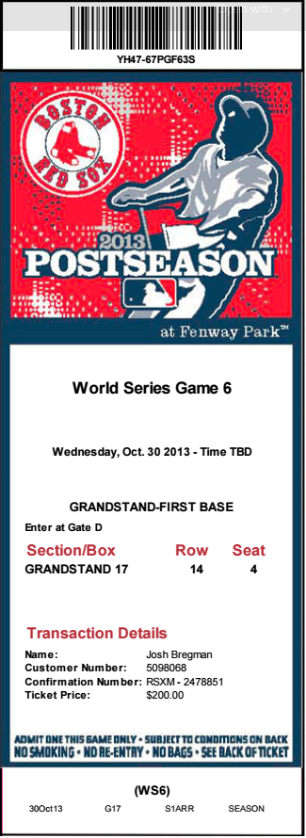
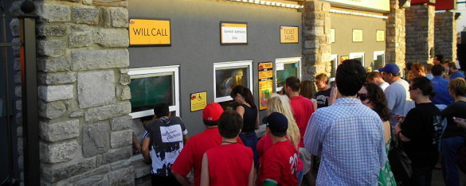
Dynamic Layer Assignment - Host Factory
The assignment of the containers to the layer is based on having credentials for the keymaster protecting the layer
The mapping of services to layers is dynamic
Same service will be deployed in dev, test, stage, prod
Application composition changes and services will be orchestrated differently
The retrieval of the credential that grants access to the layer should be done during deployment/fabrication pipeline via a Host Factory

Slide 15
Two Approaches to Integrating the Host Factory - Approach 1
Toolchain
Processing Environment
Host Factory
Host
Factory
Host
Factory
Keymaster
Keymaster
Keymaster

Slide 16
Two Approaches to Integrating the Host Factory - Approach 2
Toolchain
Processing Environment
Keymaster
Keymaster
Keymaster
Other Source of Identity
(SSL Certificates, Kerberos, OAuth...)
Host Factory
Host
Factory
Host
Factory

Slide 17
Continuous Deployment of Containers
Rugged DevOps

Slide 18
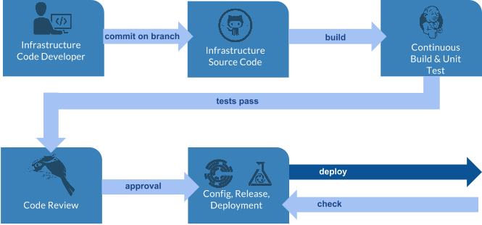
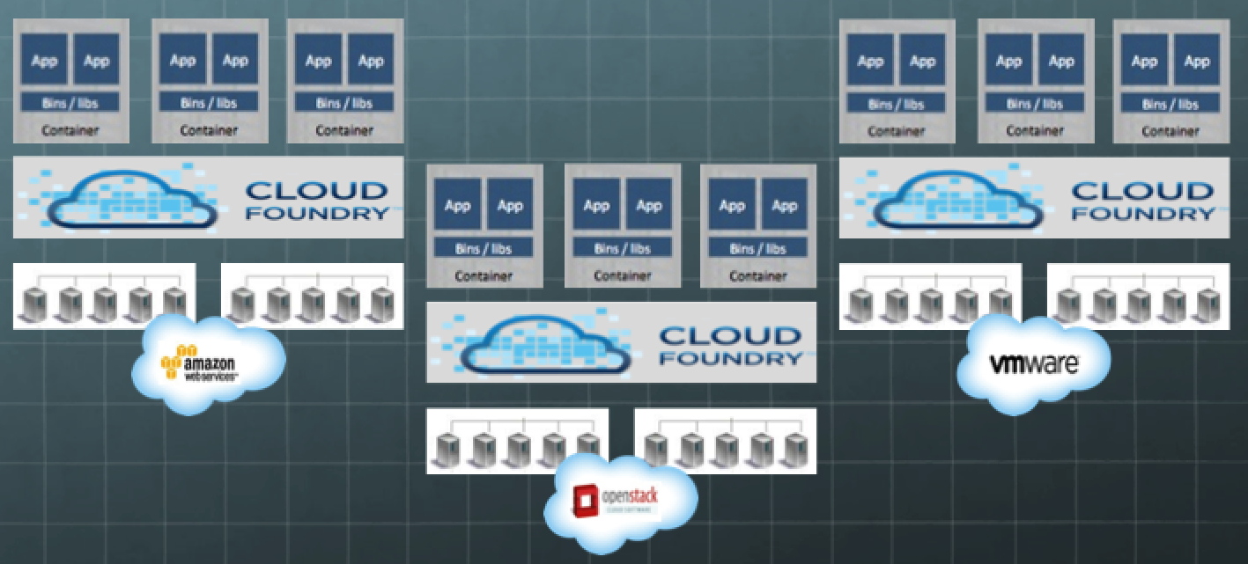
The Goal is Continuous Deployment of Containers
Users
DevOps Enabled Enterprise
Security Orchestration System
RBAC for people, machines and code | Self Auditing |Fully programmable with fine granularity | Highly available across any cloud, hybrid and global architecture |End to end encryption

Slide 19
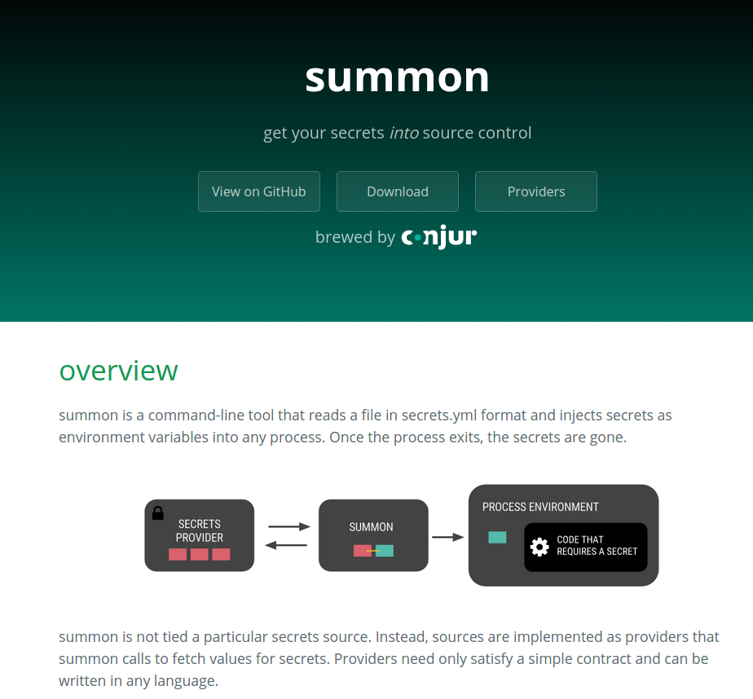
Rugged DevOps - Reference Architecture for Security Orchestration
Automation Toolchain
Process Environment
SCM/CM/CI
SDF
Gatekeeper
SDF
Forwarder
Policy
Summon
.secrets
Summon Driver
Security Orchestration System
Secrets
Storage
Host
Factory
Keymaster

Slide 20
Introducing project gozer
Open Source SDF
Promotes the adoption of SDF pattern for high-velocity environments
sdf-gen
Tool that simplifies the creation of an nginx based SDF by leveraging a simple YAML
keymaster
Implementation of keymaster service that works with sdf-gen to create a layer of trusted services
https://github.com/conjurinc/sdf-gen

Slide 21
sdf-gen YAML
global section
Defines the remote hostname of the keymaster service.
global:
keymaster:
certificate_path: /etc/keymaster.pem
hostname: keymaster

Slide 22
sdf-gen YAML continued
gatekeeper section
Defines the inbound port and local protected service.
gatekeeper: port: 80 service: unix:/tmp/nginx.socket fail_timeout=0
forward section
A list of forwarders. Each one specifies a listen address, and a remote service to which outbound requests will be sent.
forward: - id: eureka listen: 127.0.0.2 service: https://eureka

Slide 23
sdf-gen example

Slide 24
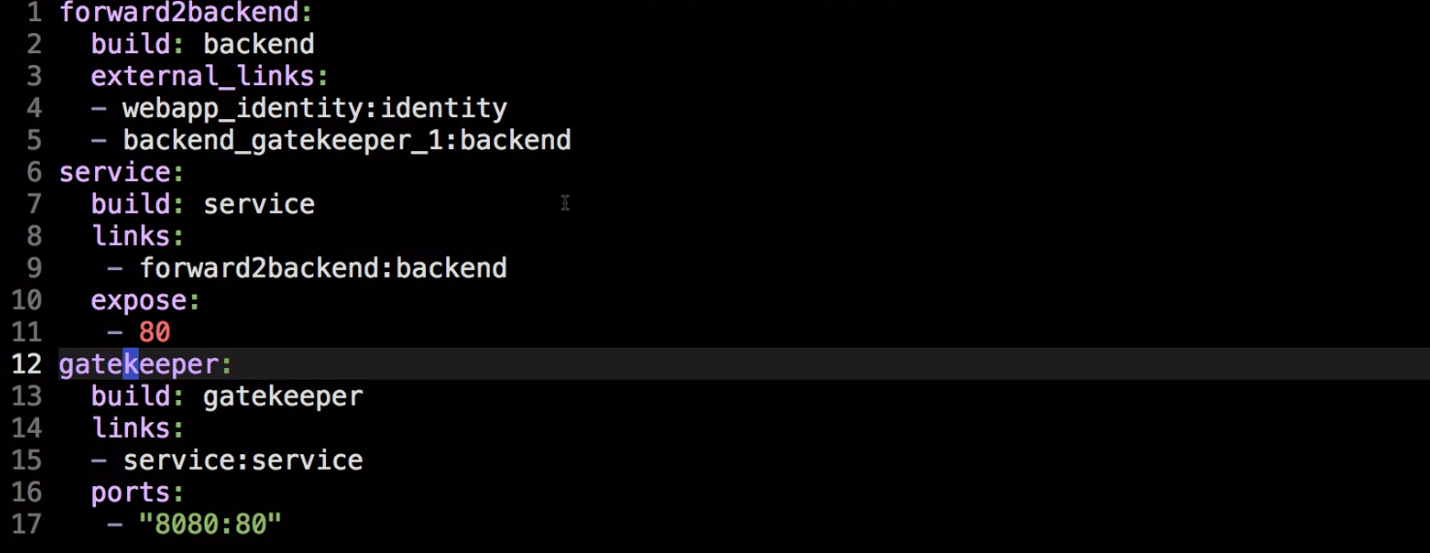
sdf-example - docker compose

Slide 25
Project Summon is Live
secrets.yml
AWS_ACCESS_KEY_ID: !var aws/$environment/iam/user/robot/access_key_id AWS_SECRET_ACCESS_KEY: !var aws/$environment/iam/user/robot/secret_access_key AWS_REGION: us-east-1 SSL_CERT: !var:file ssl/certs/private
Launch docker
summon docker run -e AWS_ACCESS_KEY_ID -e AWS_SECRET_ACCESS_KEY myapp
https://github.com/conjurinc/summon

Slide 26
Project Summon is Open Source - We need Secrets Providers
https://github.com/conjurinc/summon/tree/master/provider
Functions to resolve and call a Summon provider.
func Resolve(providerArg string) (string, error)
Searches for a provider in this order:
providerArg, passed in via CLI
Environment variable SUMMON_PROVIDER
Executable in /usr/libexec/summon/.
func Call(provider, specPath string) (string, error)
Given a provider and secret's namespace, runs the provider to resolve the secret's value.
Secrets Providers supported by summon initally:
AWS S3 Buckets
Mac OSX Keychain
Conjur
We need more
Secrets are stored today in a variety of systems - vault, consul, zookeeper, database, credstash, sneaker, keywhiz, home grown
Writing a secrets provider is SIMPLE and supports best practices of 12 factor application and NOT storing secrets in source control

Slide 27
Rugged DevOps - Continuous Secrets Delivery
Policy
5 step process based on years of delivering secrets management solutions to highly regulated industries
Skipping steps will result in issues down the road and cause disruption and delay
DIY projects that start with tools and then try to work backward are extremely difficult
secrets.yml
Host
Factory
Alignment Required
High
Availability
Tools

Slide 28
Rugged DevOps - Continuous Secrets Delivery
Policy
Policy defines the security structure for the infrastructure in code
For each layer:
Which people, machines are allowed/denied?
Which credentials will they require?
Which services need to talk to eachother?
secrets.yml
Host
Factory
Alignment Required
High
Availability
Tools

Slide 29
Rugged DevOps - Continuous Secrets Delivery
Policy
For the credentials defined - “get them into source control”
secrets.yml
AWS_ACCESS_KEY_ID: !var prod/aws/iam/users/fabric/access-key-id
AWS_SECRET_KEY_ID: !var prod/aws/iam/users/fabric/secret-access-key
MONGODB_PASSWORD: !var prod/mongo/deployments/password
Host
Factory
Alignment Required
High
Availability
Tools

Slide 30
Rugged DevOps - Continuous Secrets Delivery
Policy
A host factory is a mechanism for “lifting” a new host (machine, container, or PaaS application) into a privileged computing role.
Key component to delivering securely at speed
secrets.yml
Host
Factory
Alignment Required
High
Availability
Tools

Slide 31
Rugged DevOps - Continuous Secrets Delivery
Policy
Make the components in the Security Orchestration System HA- secrets source, host factory, and gatekeeper
The goal is to deploy to production on demand, so consider tool chain as well
secrets.yml
Host
Factory
Alignment Required
High
Availability
Tools

Slide 32
Rugged DevOps - Continuous Secrets Delivery
Policy
The final step is to integrate with the other tools in the toolchain
Use gozer sdf-gen to create sdf (nginx)
Use summon to launch
summon docker run \
-d \
-e SSL_PRIVATE_KEY_FILE \
-e SSL_CERT_FILE \
-e DB_PASSWORD \
myapp
secrets.yml
Host
Factory
Alignment Required
High
Availability
Tools

Slide 33
Here Be Dragons: Security Maps of the Container New World
kubernetes
mesos
3
?
ECS
5
1
4
2
LXC
Rocket
Docker

Slide 34
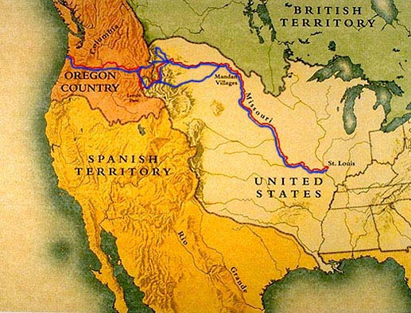
Here Be Dragons: Security Maps of the Container New World
4
3
5
2
1

Slide 35
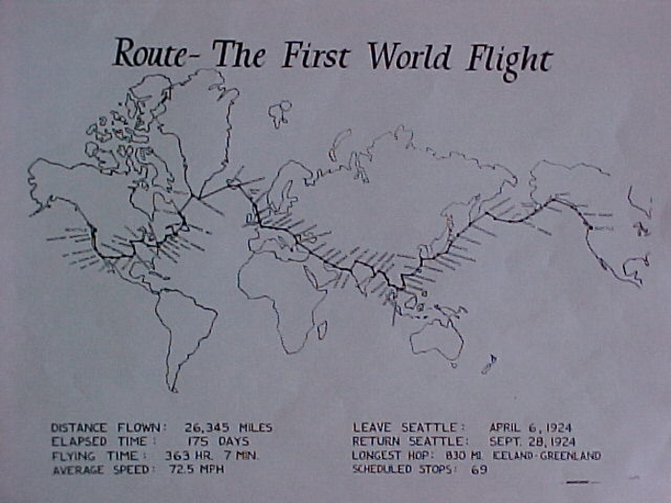
Here Be Dragons: Security Maps of the Container New World
4
1
5
3
2

Slide 36
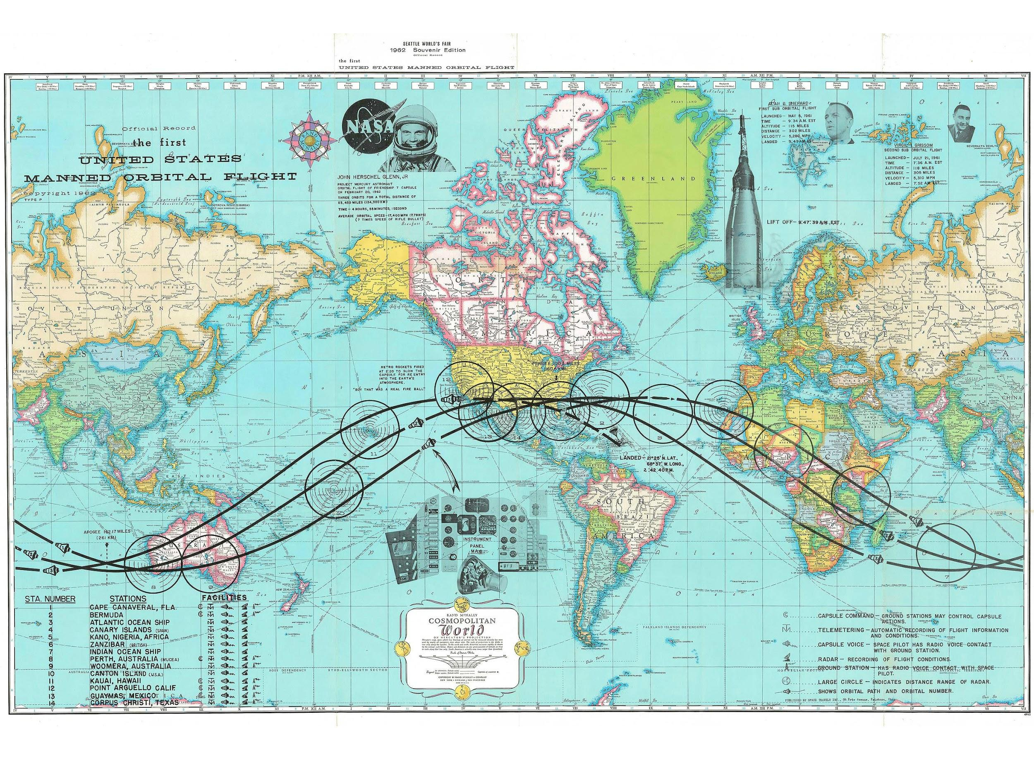
Here Be Dragons: Security Maps of the Container New World
2
1
3
4
5

Slide 37
Here Be Dragons: Security Maps of the Container New World
5
4
2
1
3

Slide 38
Questions?

