Slide 1
Too Big To Fail
QCon NYC, June 2015
Nori Heikkinen
@n0r1
Notes:
Name
“Too Big To Fail”
My observations on outages involving failures broader than you imagined

Slide 2
Google:
Traffic SRE, 2007 -
Tech Surge, Dec. 2013 - Jan. 2014
healthcare.gov:
Notes:
Google for 10 years
SRE for the last 8 years
Traffic SRE: Manages the infrastructure layer that fields all web traffic coming into Google.
Fun team -- imagine the Y-axis
healthcare.gov: 1 month, 1.5 years ago, during the critical period of EOY Open Enrollment for 2013

Slide 3
computers suck.
Notes:
You know machines will fail; you engineer around them.
This is the “Architecting for Failure” track -- we’re not here for Reliability 101

Slide 4
The captain can, by simply moving an electric switch, instantly close the doors throughout, practically making the vessel unsinkable.
Notes:
This is a 1911 quote from Shipbuilder magazine about the Titanic (1 year before it sank)
Illustrates resilience in the face of small, anticipated failures (101 level)
You know to isolate and plan for individual domain failures. (We’ve been doing that since 1912.)

Slide 5
What do you do when the “unsinkable”…
Notes:
So you build the best system you can, engineering around known failure domains.
What do you do when your watertight system…

Slide 6
sinks?
Notes:
Sinks?
At Google/hc.gov, seen a lot of disasters that follow this pattern
After recovering, we’ve reflected on / learned from these outages/incidents

Slide 7
From The Annals
War stories
Lessons learned
Notes:
Here’s how this is going to go:
I’ll tell you the story of some of my favorite outages / near-outages
Use those to illustrate some of the biggest lessons we’ve learned from fielding these outages

Slide 8
Story 1: A City Vanishes
A Tale of Two Router Vendors

Slide 9
Atlanta
Notes:
[background]
Google network: Clustered POPs (metros) + links between them.
Metros guarded by 2 massive routers
(2 for redundancy)
Within metro, datacenters; within datacenters, clusters -- all behind 2 routers
ATL was the biggest example
[network tools]
These massive rotuers also need monitoring & tools
One afternoon, a net-tools SWE was testing out ad-hoc SNMP querying
Routers were new vendor hardware; behaved differently
[event]
Cut over to my desk. Secondary oncall; don’t hear beeping when primary’s pager “lights up like a Christmas tree”
Coworker barges into my office: “I think you better get out there. We just lost Atlanta.”
I dash out; primary oncall mashing buttons (200+ pages)
Yup, ATL has vanished. Not just one logical cluster; not one datacenter -- the entire metro.
[magnitude]
Traffic SRE == traffic coming into all of Google’s network -- no stranger to large-scale failures.
Could tell you stories about the time I accidentally took down New York.
Yet, we’ve never seen anything like this.
If a cluster were to go hard down, or even an entire datacenter, our systems would cleanly and automatically direct traffic elsewhere; it might register as a blip on our pagers, but not a catastrophe -- and certainly not a user-visible one.
But we never thought all of Atlanta could fail.
[root cause]
So simple as to be both beautiful and terrible.
Network tools engineer was sending SNMP queries to a new router?
Asking the routers about their CPUs, indices 0 and 1.
New vendor’s CPU indexing starts at 1; and the failure mode is to crash.
Quietly and efficiently crashed an entire metro’s worth of our production network from her desk in a matter of seconds.
Flip-side: as soon as the SWE stopped, routers stabilized, and Atlanta was well again.
[wrap-up]
Didn’t know this at the time
Spent the rest of the afternoon in a conference room -- senior SREs, network engineers, VPs -- trying to figure out
what had caused Atlanta to briefly implode,
if it could happen again,
how we were going to react if it did.
Because of the quick reactions of the network tools engineer, answering this question turned out to be moot. But in another situation, it might not have been.

Slide 10
Preparation
Notes:
Use this outage to discuss how you can prepare for incidents like this.
Prevention is ideal, but preparation is practical.

Slide 11
Reasoning About Your System
Model ahead of time
Load testing
Capacity planning
Regression analysis
Visualize in real time
Answer “What effect would X have?”
Allows you to react in real time
Notes:
For me, ATL illustrates need for reasoning about your system (or, what happens if you don’t)
2 forms: Static, dynamic. Both critical.
Static: Modeling
Do ahead of time
Understand intended behavior
Room for spikes / unexpected events
(1) load testing, (2) capacity planning, & (3) regression analysis with each binary push
In ATL, both did and did not do this:
Did: Capacity-plan webservers. No problem to drain ATL, webserver-wise.
Did not: Have network plan w/out ATL.
No luxury of overprovisioning, like frontend.
Links not fungible: Transatlantic doesn’t help if you’re short on ATL-ORD.
Dynamic: Visualization system’s behavior in real time [click]
Useful during outage
Must be able to make decisions on the fly
(1) In ATL, needed to answer “can we drain traffic” in O(minutes), not O(hours)
(2) Ability to answer complicated technical questions gives you information to react in real time.
Can now start applying your human judgement, e.g.:
“Should we do X?”
“Is doing X better than not / better than doing Y?”
This is high-level automation -- computers answer technical questions; humans apply judgement.

Slide 12
Story 2: The Edge Snaps
Failure Domains, Writ Large

Slide 13
Satpocalypse
Notes:
Background:
Google’s frontend webservers divided into a few classes:
Machines in “core” clusters
A few types of “satellite” or “edge” clusters (hence the satellite graphic)
These are much smaller -- terminate most connections, for low latency
We’re constantly installing / decommissioning these satellites
Tool that sends satellite machines to “disk erase”
Story
Decommission workflow failed, but *after* disk-erase had succeeded
To debug the failure, restarted the decommission for that satellite
Tool was not idempotent (EYE-dimm-’po-tent) :(
“Empty set” of machines to be erased interpreted as “ALL SATELLITE MACHINES”
Automation sent ALL SATELLITE MACHINES to disk-erase :(
Effect
Disk-erased machines stopped serving
Traffic fell back to core (satellites so flaky that automation mostly saved us)
Good capacity-planning + automation == minimal user-visible effect (just increased latency)
Reinstalling took days

Slide 14
Response
Notes:
A whole class of your frontend serving infrastructure gets wiped == PANIC
500+ pages!
Anyone oncall knows basic flow-chart: “Mitigate first, then understand”
HUGE outages subvert flowchart -- might not be able to mitigate quickly
Could mitigate fast in Satpocalypse
Couldn’t in ATL
In this situation, must be able to fall back on established protocol

Slide 15
How To Panic Effectively
Incident Command System (ICS)
Centralizes response
Allows cross-agency collaboration
Expands or contracts as needed
Incident Management at Google
Lighter-weight
Culture fit
No penalty for invocation
Notes:
ICS
“Falling back on established protocol” -- exactly what firefighters do
“Standard management hierarchy and procedures for managing temporary incident(s) of any size.”
ICS developed by firefighters in 60’s & 70’s to fight massive CA wildfires
Advantages:
(1) Centralizes response to the fire (communication; duplication of effort)
(2) Framework for different agencies to collaborate
(3) Use it for everything (small to large complexity)
IMAG
At Google, never used to have a protocol -- mostly fine; sometimes not
SREs familiar with ICS adapted it for Google
Adaptation:
(1) Stripped down -- less bureaucracy (we’re just 1 company)
(2) Culture fit -- Google not very hierarchy-friendly
(3) Use it for everything -- only works if you err on the side of using it
w.r.t. Satpocalypse:
Recently adopted; fun for me to watch effect @ GOOG,
Part of why Satpocalypse was so minimal an outage was our quick invocation of this protocol

Slide 16
Story 3: The Call is Coming from Inside the House
Tripping Over Anti-Patterns
Notes:
This one comes from my time at healthcare.gov
Was instructive -- got to see what happens when you ignore the gospel I’ve been steeped in at Google

Slide 17
is not a strategy.
Notes:
I call this one, “Hope … [click] Is Not A Strategy” -- SRE motto; healthcare.gov strategy
Story:
My first week; last week of Open Enrollment for 2013
Login system goes down.
Not only prevents people from logging in; spaghetti architecture means that other pieces are calling back into it
So basically everything is hard down.
Again.
Graphs (new!) show it’s the Oracle DB layer
Cody hands laptop + root shell to an Oracle DBA who just walked in
30 minutes: Problem found!
40 minutes: Problem was coming from guy in the corner.
Root cause:
Contractor’s manager wanted a report with data, so guy runs a reporting query
Reporting query runs as the DB superuser
Clobbers all legit traffic
Guy had been sitting in the corner, saying nothing
[Understandable]
Worst part: Understandable why the guy did nothing -- he’d have been fired.

Slide 18
Analysis
Notes:
[Anti-pattern]
This is your anti-pattern.
This is what the “Tech Surge” was there to fix.
We also fixed technical problems --
removing firewalls from the middle of storage layers;
instrumenting the caching layer;
tweaking LB settings
-- but amazing just how much of the problem was cultural.
[Culture]
I want to use this terrible story to talk about the importance of culture in reliability.
Might sound like a digression; instead, critical to both achieving reliability, and scaling it (as this anecdote perfectly captures)

Slide 19
The Fifth 9 is People
Culture of response
Care enough to monitor
Care enough to react
Connect engineers’ work to bottom line
Culture of responsibility
Blameless postmortems
Operational experience informs system design
Notes:
“The Fifth 9 is people”
From GHC talk
9’s as a way of measuring uptime
Captures the personal / cultural element to reliability
(Of course, sometimes you’re fighting for even the first 9.)
Culture of response
You have to care that your system is down
(1) Care enough to monitor it
(2) Then care when your new alerting fires, act on it
(3) Connecting work to company’s bottom line
Half of what Tech Surge did was instill a sense of urgency.
Treating downtime as serious (no “approved downtime”)
Culture of responsibility
You must write postmortems / RCA
(1) They must be blameless (otherwise no responsibility)
If not, they’re strictly punitive
Poor guy who ran superuser query rightly feared for his job
(2) When you do, you unlock the real value-add of SRE / DevOps: Operational experience feeding back into system design.
^^ This is 5th-9 stuff, though; hc.gov still on 1st 9

Slide 20
Prevention
Notes:
[In the interest of time, there’s no story to lead into this topic]

Slide 21
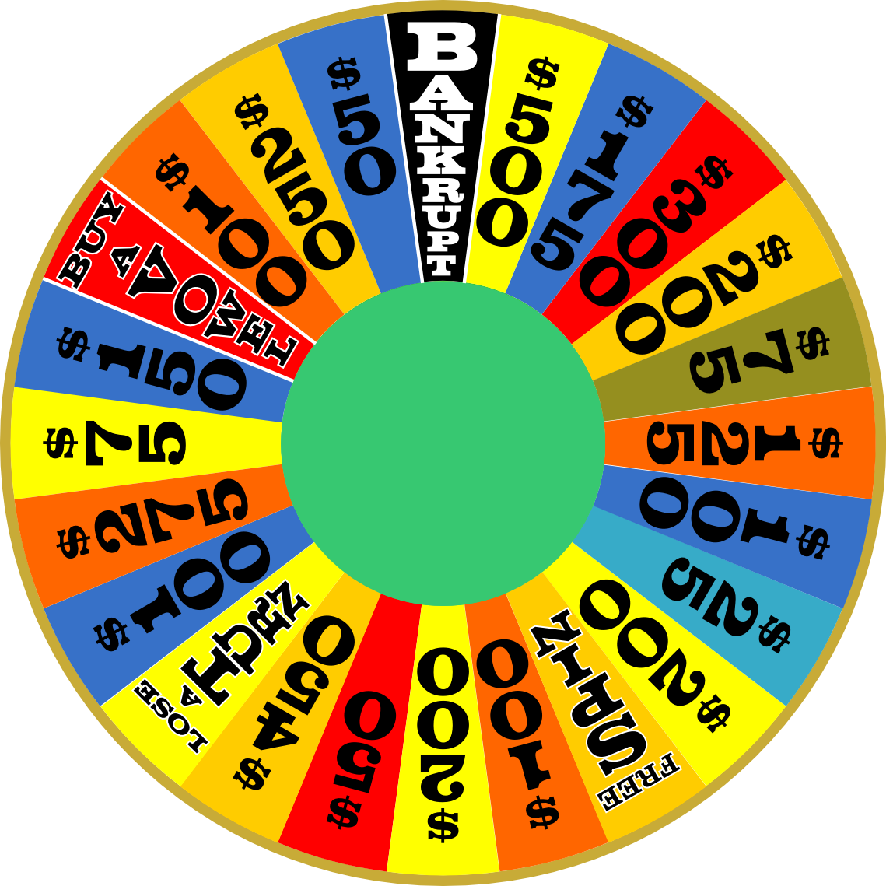
Practice Disaster
Disaster in Recovery Training (“DiRT”)
Wheels Of Misfortune
Notes:
The best way we’ve found to prevent disaster is to actively engage with it.
Remember back to “hope is not a strategy”?
A couple different periods of doing this:
“Disaster Recovery Testing”
Pretend CA has been overtaken by zombie apocalypse
Real things are broken
Test are halted if breakage becomes user-facing
Wheels of Misfortune
Role-playing scenarios with teams
Victim is selected at “random”
Can be past outages, or potential future weirdness
I’ve seen this flush out real bugs.

Slide 22
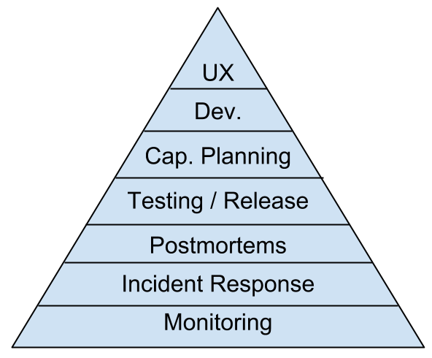
Dickerson’s Hierarchy of Reliability
Notes:
Dickerson's hierarchy of reliability: History
Came from healthcare.gov, by Mikey Dickerson
Name came later (he's too self-effacing to have named it for himself)
We’ve discussed aspects of managing large-scale outages:
Preparation
Response
Analysis
Prevention
Dickerson’s hierarchy fits them into an ordered list:
(1) Response (bottom 2); Analysis (PMs); Preparation (next 2)
Doesn’t address prevention
Partly because 100% uptime is impossible
Partly because you must have bottom 3 to begin.
[wrap-up]
By focusing on these principles, you can be best prepared for fielding large outages
Ideally have fewer of them, but at least they'll be ones your users don't notice.

Slide 23
Q & A

